Slide 1

Impacts of the Ethiopian Health Extension Programme (HEP) on adolescent health and wellbeing
William Rudgard
Silinganisiwe Dzumbunu
Rachel Yates
Contact: william.rudgard@spi.ox.ac.uk

Slide 2
ETHIOPIAN CONTEXT FOR GIRLS
Adolescent girls | 2005 | 2015/16
Undernutrition (BMI <18.5) | 32% | 29%
Contraceptive use (any method) | 18% | 34%
Early pregnancy | 17% | 13%
Child marriage | 60% | 40%
FGM/C | 65% | 47%
Secondary school enrollment | 18% | 34%
CSA Ethiopia, 2005; CSA Ethiopia 2016; UNESCO Institute for Statistics, 2020
Notes:
https://www.unicef.org/ethiopia/sites/unicef.org.ethiopia/files/2018-10/Child%20Marriage%20Ethiopia-%20online%20version_0.pdf
file:///C:/Users/WILLIA~1.RUD/AppData/Local/Temp/A-Profile-of-FGM-in-Ethiopia_2020.pdf
https://ijponline.biomedcentral.com/articles/10.1186/s13052-019-0745-4

Slide 3
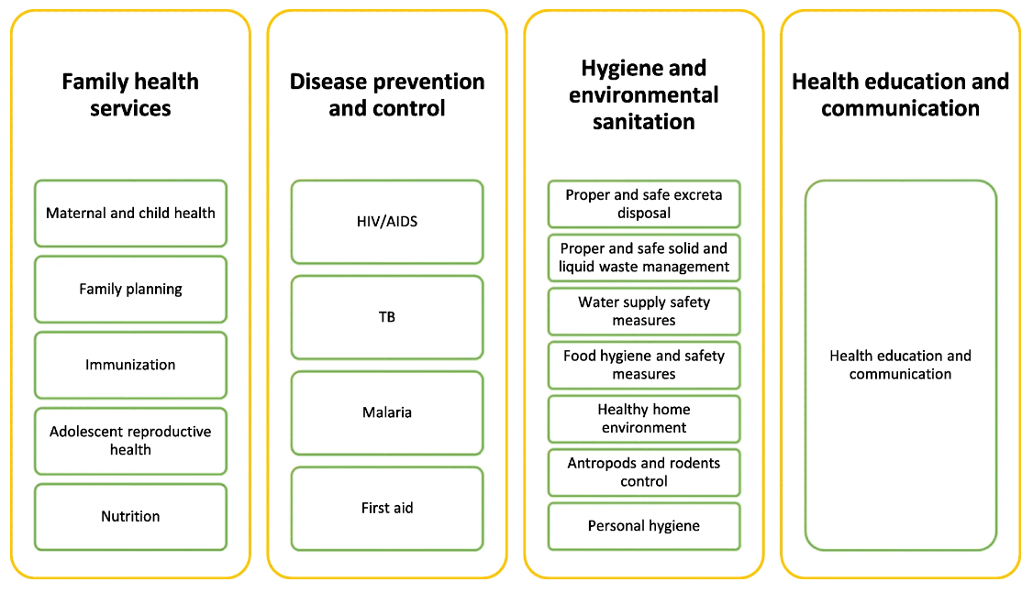
ETHIOPIAN HEALTH EXTENSION PROGRAMME
Assefa, Y., Gelaw, Y.A., Hill, P.S. et al. Community health extension program of Ethiopia, 2003–2018: successes and challenges toward universal coverage for primary healthcare services. Global Health 15, 24 (2019). https://doi.org/10.1186/s12992-019-0470-1
Notes:
Over the period of the millennium development goals Ethiopia experienced remarkable progress in areas of health, education, and child marriage. A series of multi-sectoral policies, linked to the national growth and transformation plan are recognised as driving this.
A key initiative linked to these policies, was the roll out of the national Health Extension Programme (HEP) in 2003 (21). As we’re sure your familiar with, it is made up of 4 key components with 17 packages.

Slide 4
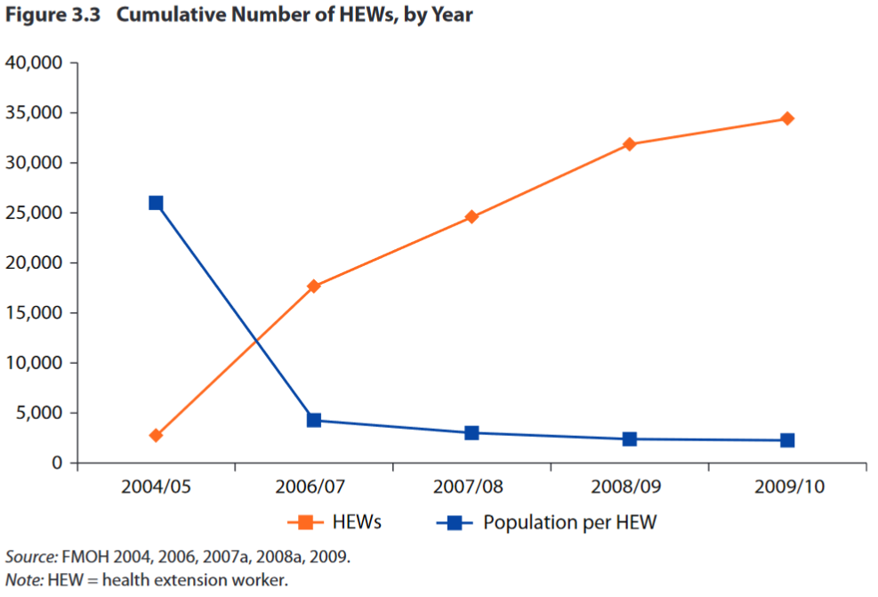
HEP EXPANSION
Wang, H., Roman T., Gandham N. V. R., Chala Tesfaye C. 2016. Ethiopia Health Extension Program: An Institutionalized Community Approach for Universal Health Coverage. World Bank Studies. Washington, DC: World Bank. doi: 10.1596/978-1-4648-0815-9
Notes:
Expansion of HEP was gradual, with the number of HEWs rising to approx. 30,000 in 2009, and their coverage per population achieving a stable rate of around 1 HEW per 2,500 households

Slide 5
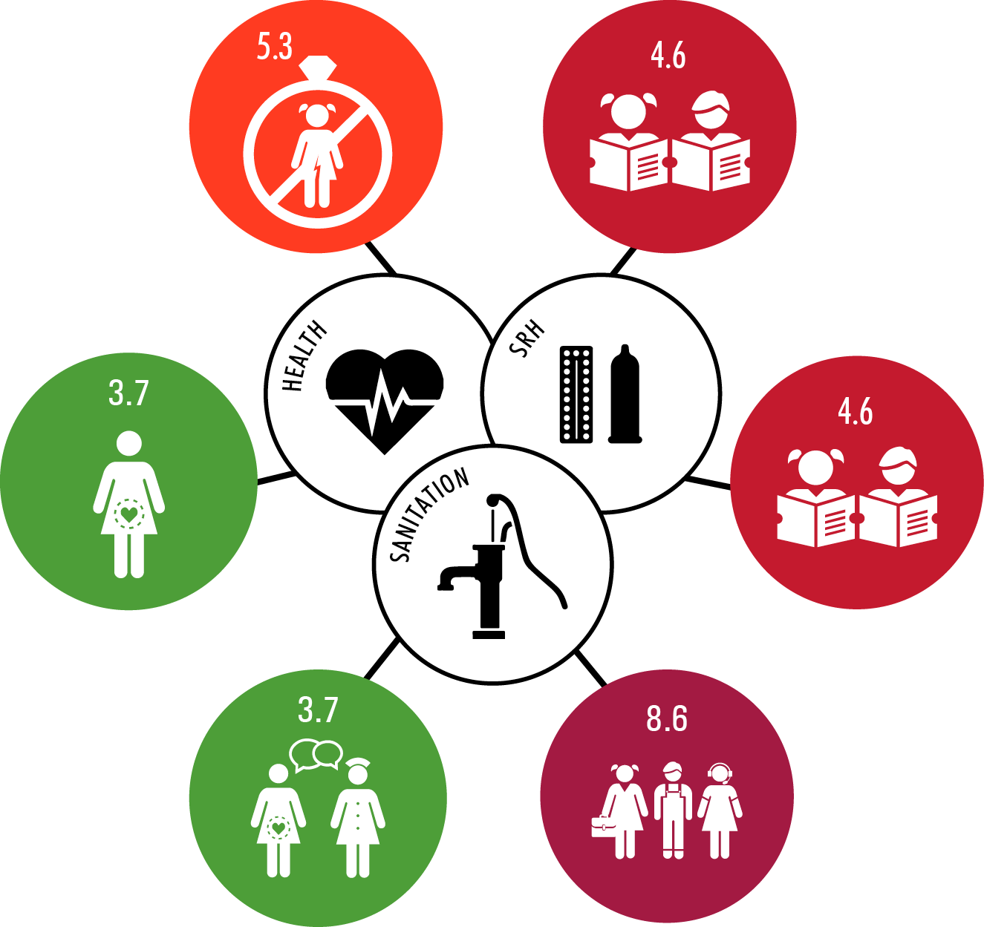
RESEARCH AIM
Evaluate the potential of HEP to impact across eleven domains of adolescent health and wellbeing
Notes:
With this background in mind our research aim was to evaluate the potential of HEP to impact across multiple domains of adolescent health and wellbeing

Slide 6
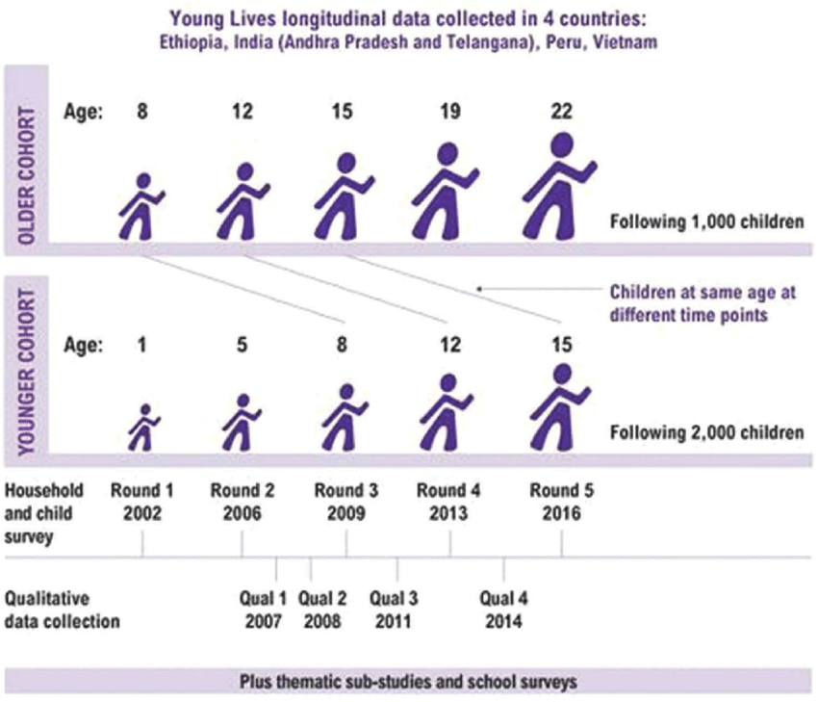
METHODOLOGICAL APPROACH
Round 1
Age = 8
Round 2
Age = 12
Round 3
Age = 15
Round 4
Age = 19
vvvvvv
2001 2002 2003 2004 2005 2006 2007 2008 2009 2010
2013
Household support from HEP
Outcomes
  Treatment: Participant recall of their household being a beneficiary of HEP (No/Yes) during the calendar year they turned 15 years
Abbreviations: HEP, Health Extension Programme
Notes:
Round 1: September 2002 to October 2002
Round 2: October 2006 to August 2007
Round 3: October 2009 to March 2010

Slide 7
HOUSEHOLD SUPPORT FROM HEP
 | Support from HEP N=775
Age = 8 2002 | *
Age = 12 2006/7 | 32%
Age = 15 2009/10 | 64%
Frequency of support from HEP
Annually | 15%
Every 4-6 months | 19%
Every 2-3 months | 21%
Monthly | 45%
HEP, Health Extension Programme
*HEP was not yet introduced
Analysis focuses on Tigray, Amhara, Oromiya, and Southern Nations, Nationalities, and Peoples regions

Slide 8
ELEVEN OUTCOMES
SDG | Outcome at age 19 years | Prevalence
 |  | Girls | Boys
2.1 | Not underweight | 86% | 73%
3.3 | Very good health | 35% | 51%
3.7 | Knowledge about STIs | 40% | 51%
3.7 | Knowledge about fertility | 38% | 50%
3.7 | No early pregnancy | 88% | 100%
4.6 | Literacy | 55% correct | 55% correct
4.6 | Numeracy | 42% correct | 50% correct
5.3 | No child marriage | 87% | 99%
8.6 | Education enrolment | 64% | 57%
8.6 | <3 hours per day on domestic tasks | 27% | 74%
8.6 | >4 hours per day in paid work | 21% | 47%
Notes:
Round 4 in 2013

Slide 9
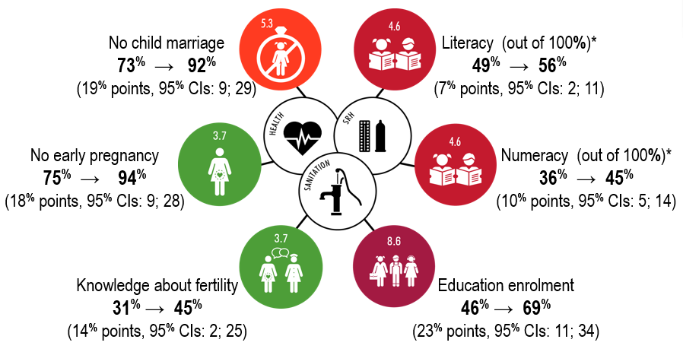
GENDER EQUALITY,
HEALTH, AND EDUCATION
No evidence: Not underweight, very good health, knowledge about STIs, <3hrs per day on domestic tasks, >4hrs per day in paid work
Notes:
HEP is represented by the three dimension of health SRH and sanitation.

Slide 10
MAIN FINDINGS: HEALTH
We find mixed evidence for impacts on health:
Lower risk of early pregnancy and improved knowledge about fertility
No observed link with self-reported health or knowledge about STIs
Existing evidence for HEP:
Higher ante-/ postnatal service uptake in mothers (Admassie et al, 2009)
No observed link with contraceptive use in women 15-49 years (Admassie et al, 2009)
Existing evidence for adolescent health services in Ethiopia:
Low levels of SRH service use in adolescents (Binu et al, 2018)
Common reports of lack of privacy in health centres (Haile et al, 2020)
Regional differences in community acceptance of contraceptive use (Jones, 2016)
Notes:
Change Null Effects

Slide 11
MAIN FINDINGS: CHILD
MARRIAGE AND EARLY PREGNANCY
  We find evidence of lower risk of child marriage and early pregnancy
  Existing evidence for HEP from Nicola Jones / ODI:
  “If I had not participated in the training and discussions about child marriage, childbirth, rape, venereal diseases, HIV/AIDS, I would not have completed my secondary education and I would have married as a child and had my own baby when I was still a child myself.” 19-year-old girl (Jones et al, 2018)
  HEWs even come to school, to “educate the students at the beginning of the academic year to protect them from unwanted pregnancy and early sexual relationships” older adolescent boy (Jones et al, 2018)
Jones N et al,. The Politics of Policy and Programme Implementation to Advance Adolescent Girls’ Well-being in Ethiopia. In: Empowering Adolescent Girls in Developing Countries. Taylor & Francis; 2018. p. 228

Slide 12
MAIN FINDINGS: EDUCATION
  We find evidence of higher probability of girls enrolment in education and higher numeracy and literacy at age 19
  Existing evidence for HEP from Nicola Jones/ ODI:
“Secondary school girls who marry while still at school are vulnerable to dropping out since they are responsible for managing household activities and giving birth and taking care of children.” Key informant (Jones et al, 2016)
Existing evidence from Young Lives Ethiopia:
Close link between parental illness and adolescent education in Ethiopia (Dinku et al, 2018)
Jones N et al,. What works to tackle child marriage in Ethiopia: a review of good practice. Overseas Development Institute. 2016 Available from: https://www.odi.org/publications/10453-what-works-tackle-child-marriage-ethiopia-review-good-practice

Slide 13
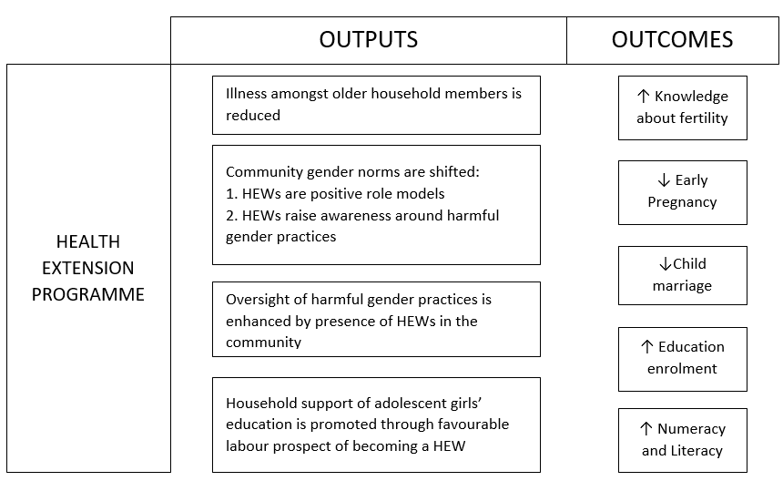
LOGIC MODEL

Slide 14
POLICY IMPLICATIONS
Local salaried female HEWs can be effective for:
Impacting multiple dimensions of adolescent wellbeing
Educating about the sensitive topics: child marriage and early pregnancy
Is this also observed in other countries with community health workers, for example India?
In order to achieve further impacts for adolescent girls.
Review adolescent barriers in accessing health services including attitudes of health workers towards adolescent sexuality
Ensure youth-friendly SRH awareness and services are a key priority within Ethiopia’s new health education strategy
Ensure youth-friendly SRH is a priority package within HEP model family training
Notes:
Services should be confidential, affordable, convenient and discreet

Slide 15
FURTHER RESEARCH
Unpack the causal pathway between HEP and adolescent outcomes for strengthening generalisability of findings to other settings
Investigating the combination effects of receiving both HEP and other social programmes established by the Ethiopian government, for example the Productive Safety Net Programme.
Understanding what the impact of Covid-19 has been on these outcomes using the next round of Young Lives data

Slide 16


Thank you!
dsilinganisiwep@gmail.com
rachel.yates@acceleratehub.org
william.rudgard@spi.ox.ac.uk
Special thanks to Dr. Elona Toska, Dr. Heidi Stöckl, Prof. Mark Orkin, Prof. Lucie Cluver, Dr. Alula Pankhurst, and Dr. Nicola Jones for their intellectual contribution, to the Young Lives team for making their data publicly available, and Girls Not Brides for the opportunity to present in this forum

Slide 17
MULTIVARIABLE ANALYSIS
 | Not underweight n=710 |  | Very good health n=710 |  | Knowledge about fertility n=708 |  | Knowledge about STIs n=708 |  | No child marriage n=328 |  | No early pregnancy n=327
 | AOR (95% CI) | p-value | AOR (95% CI) | p-value | AOR (95% CI) | p-value | AOR (95% CI) | p-value | AOR (95% CI) | p-value | AOR (95% CI) | p-value
Boys | 0.75 (0.42; 1.31) | 0.31 | 1.00 (0.52; 1.92) | 0.99 | 0.88 (0.55; 1.41) | 0.59 | 0.83 (0.52; 1.33) | 0.43
Girls | 1.44 (0.71; 2.92) | 0.31 | 1.43 (0.78; 2.63) | 0.25 | 1.82 (1.08; 3.08) | 0.03* | 1.32 (0.77; 2.27) | 0.31 | 4.50 (2.14; 9.50) | <0.001* | 5.11 (2.36; 11.03) | <0.001*
 | Education enrolment n=710 |  | <3hrs domestic tasks/ day n=710 |  | >4hrs paid work/ day n=710 |  | Literacy n=704 |  | Numeracy n=678
 | AOR (95% CI) | p-value | AOR (95% CI) | p-value | AOR (95% CI) | p-value | ABeta (95% CI) | p-value | ABeta (95% CI) | p-value
Boys | 2.13 (1.32; 3.44) | 0.002* | 0.82 (0.48; 1.40) | 0.47 | 0.53 (0.33; 0.84) | 0.01* | 2.89 (-1.33; 7.12) | 0.18 | 1.18 (-3.47; 5.82) | 0.61
Girls | 2.76 (1.56; 4.89) | <0.001* | 0.66 (0.37; 1.15) | 0.14 | 0.81 (0.43; 1.52) | 0.52 | 6.84 (2.40; 11.28) | 0.003* | 9.78 (5.31; 14.25) | <0.001*
*p-values are significant after applying the Benjamini-Hochberg Procedure specified with a false discovery rate of 10%. Abbreviations: AOR, adjusted odds ratio; Abeta, Adjusted ordinary least squares regression coefficient; CI, confidence interval; STI, sexually transmitted infection.
N=775. Multivariable models are adjusted for age participant started school, receipt of the Productive Safety Net Programme, exposure to climate shock, and exposure to increased food prices, and weighted using individuals inverse probability of treatment.

