Slide 1
Context Matters: Exploring Differential Effects of the More Than Brides Alliance Intervention to Reduce Child Marriage June 2021
Sajeda Amin
A.J. Melnikas
Neelanjana Pandey
Grace Saul

Slide 2
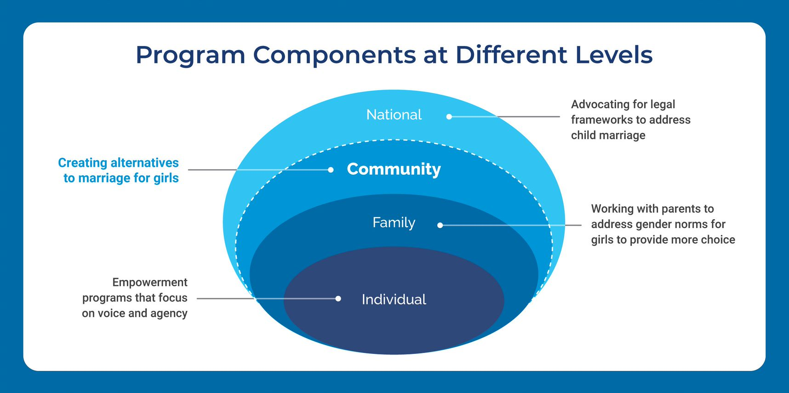
The More Than Brides Alliance (2016-2020)

Slide 3
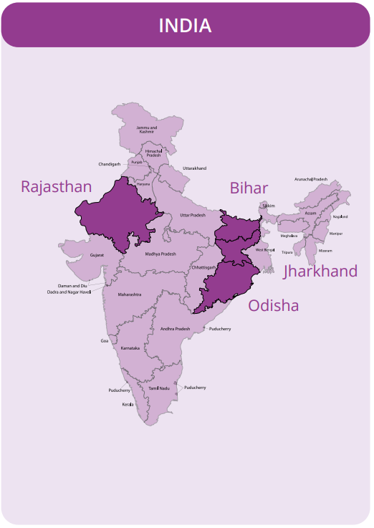
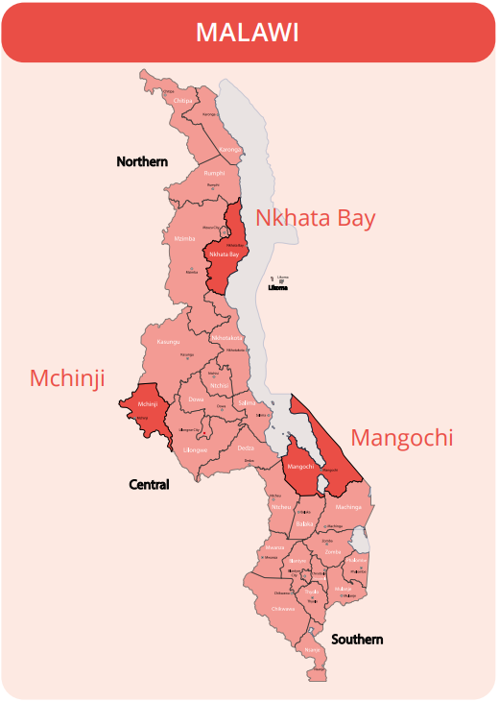
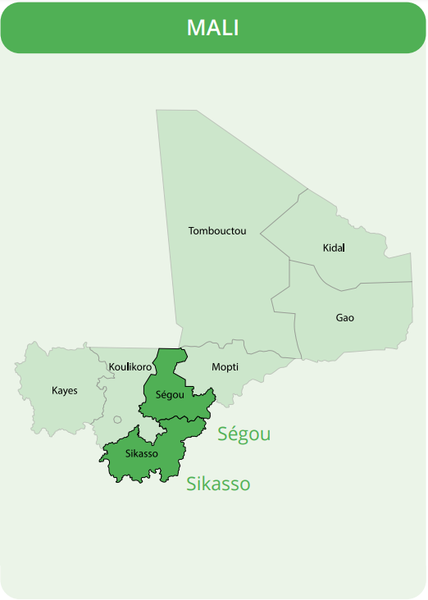
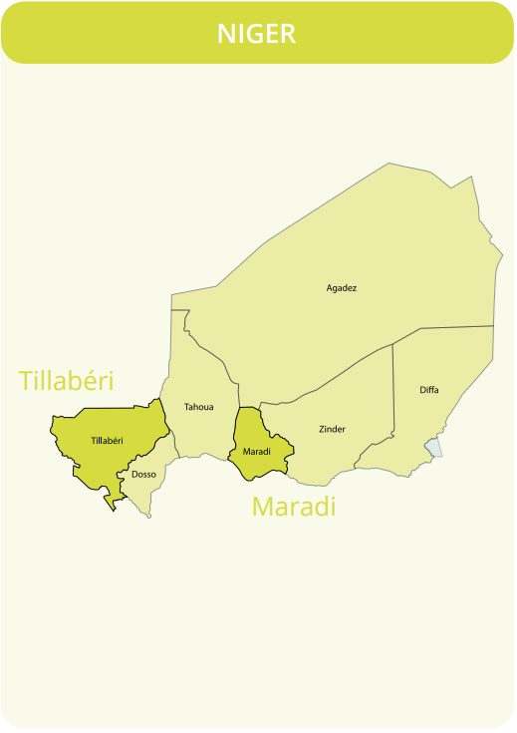
Locations of Intervention & Research Team
Sample size: 2800 (BL/ML); 1500 (EL)
Sample size: 1000 (BL/ML); 730 (EL)
Sample size: 850 (BL/ML); 800 (EL)
Sample size: 600 (BL/ML); 600 (EL)
Randomized
Matched

Slide 4
MTBA Research and Intervention: 2016-2020

Slide 5
Impact Varied Across Contexts
India: Significant impact on % ever married (p<.001)
Niger: Significant impact on % currently working for income
Malawi: Significant impact on educational indicators (ever attended, mean years of education, literacy)
Mali: Increase in mean age at marriage, but no effect on % ever married

Slide 6
Child Marriage Declining Everywhere

Slide 7
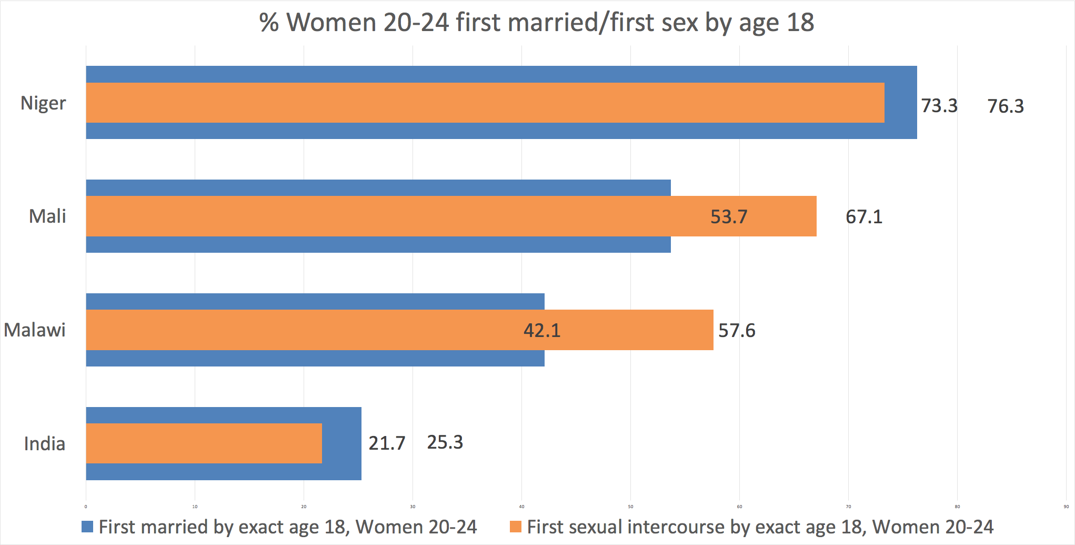
Timing of first sex and marriage across contexts

Slide 8
Pregnancy declining in Mali and Malawi

Slide 9
Pregnancies are declining but proportion of pregnancies that are premarital is growing
22% of all pregnancies in Malawi at baseline were to never married girls → increased to 48% at endline
30% of all pregnancies in Mali at baseline were to never married girls -→ increased to 45% at endline

Slide 10
Enrollment in School Increasing in Most Countries

Slide 11
Why do we see an intervention effect on some education indicators but not on marriage or pregnancy in Malawi?
Drivers of pregnancy are different than drivers of school drop out
Pregnancy is on the pathway to child marriage

Slide 12
Malawi: Role of Pregnancy
These girls are selecting the man that they think when they have become pregnant by him, he will not be able to deny her. Or even his parents will welcome her even if he impregnates her.
FGD with unmarried girls, Mangochi

Slide 13
Malawi: Family Planning Seen as Issue within Marriage
What influences young women to use contraceptives?
R1: They take contraceptives for the sake of child spacing.
R2: They take contraceptives if the husband is not supportive materially and financially… so the woman goes for contraceptives to have few children.
FGD with married girls, Mangochi

Slide 14
Why do we not see an effect on marriage, pregnancy or education outcomes in Mali?
Role of migration and dynamic communities
Long engagement process and “premarital” pregnancy leads to child marriage
Interventions that primarily work in schools miss girls in contexts where enrollment rates are low

Slide 15
Mali: Engagement Process and “Premarital” Sex
They give the girl to a man, even if the marriage is not celebrated, he will ask her to come chat. A 12-year-old engaged girl who goes to chat every time with her fiancé will get pregnant. Some of them can’t even give birth! It’s all caused by early marriage. But if you don’t give a 12-year-old child in marriage, will other men be able to come and get her to go and chat? There is this aspect, and it is not good.
FGD with married girls, Ségou

Slide 16
Program Implications: Malawi
Need to address pregnancy “ambivalence” in Malawi: in MTBA it was not access to services that was the issue, rather pregnancy may not be seen as worth preventing when pregnancy and subsequent marriage are a livelihood strategy
Interventions need to address sustainable livelihood alternatives to marriage

Slide 17
Program Implications: Mali
Marriage process is not adequately addressed when interventions try to intervene in marriage timing
Difficult to change educational outcomes unless working with earlier age groups
Drop out occurs early – only 66% of primary age girls are in school
Adolescent girls are mobile and communities are dynamic – outcomes for girls who left are not known. Programs in Mali need to address girls’ migration

Slide 18
Implications for Sectoral Action
Education and livelihood linkages needed to create alternatives to marriage for girls
Example: after school livelihood clubs that focus on post-schooling options
“Last mile” approaches need to be different
Hard to reach populations miss out in traditional education and health approaches

Slide 19
Thank You
For more information please see
https://morethanbrides.org/mmwwk
or PopCouncil.org

