Slide 1
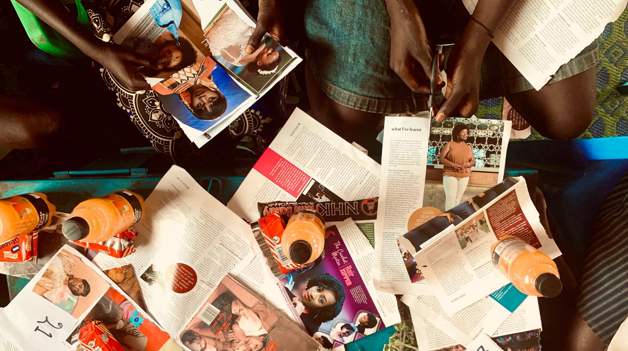




Child Marriage
in Humanitarian Crises
Girls and Parents Speak Out!

Slide 2



The Research Initiative
CHILD MARRIAGE IN HUMANITARIAN CRISES
Phase I:
Evidence Review
Phase II:
Formative Research
Phase III:
Pilot & Evaluation
Global evidence review on child marriage interventions in development & humanitarian contexts
Participatory research in Uganda & Jordan
Community stakeholder workshops
Intervention design workshop
Pilot implementation
Rigorous monitoring and evaluation
Notes:
Julie

Slide 3
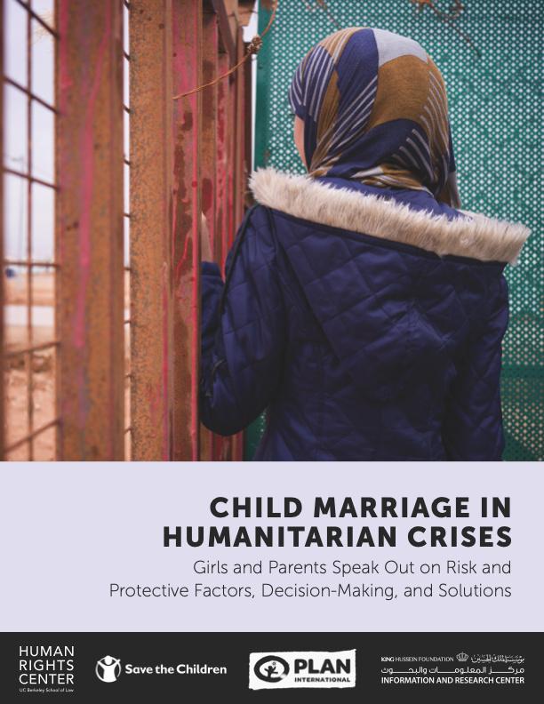
Phase II
HUMAN RIGHTS CENTER, SAVE THE CHILDREN, & PLAN UK TOGETHER WITH IRCKHF AND CLARE BANGIRANA
Aimed to identify and explore:
risk and protective factors
decision-making
service and support needs
community-driven solutions
Notes:
Julie

Slide 4
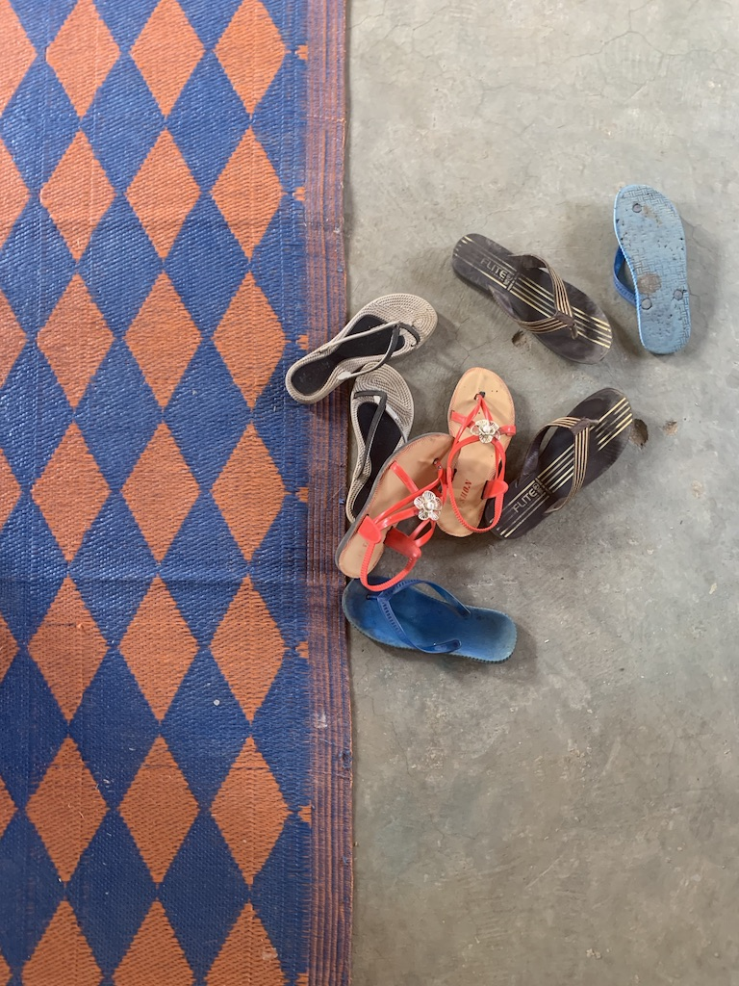
Youth-Centered Methodology
CHILD MARRIAGE RESEARCH, PHASE II
Participatory research activities with girls ages 10-17, including:
flower map activity
drawing and collages
world café
Semi-structured interviews with:
girls ages 14-17
parents and caregivers of adolescent girls
key informants
Notes:
Julie

Slide 5
PHASE II SETTINGS
UGANDA
JORDAN
Notes:
Julie
94% of ALL refugees in country, including Burundian and DRC

Slide 6
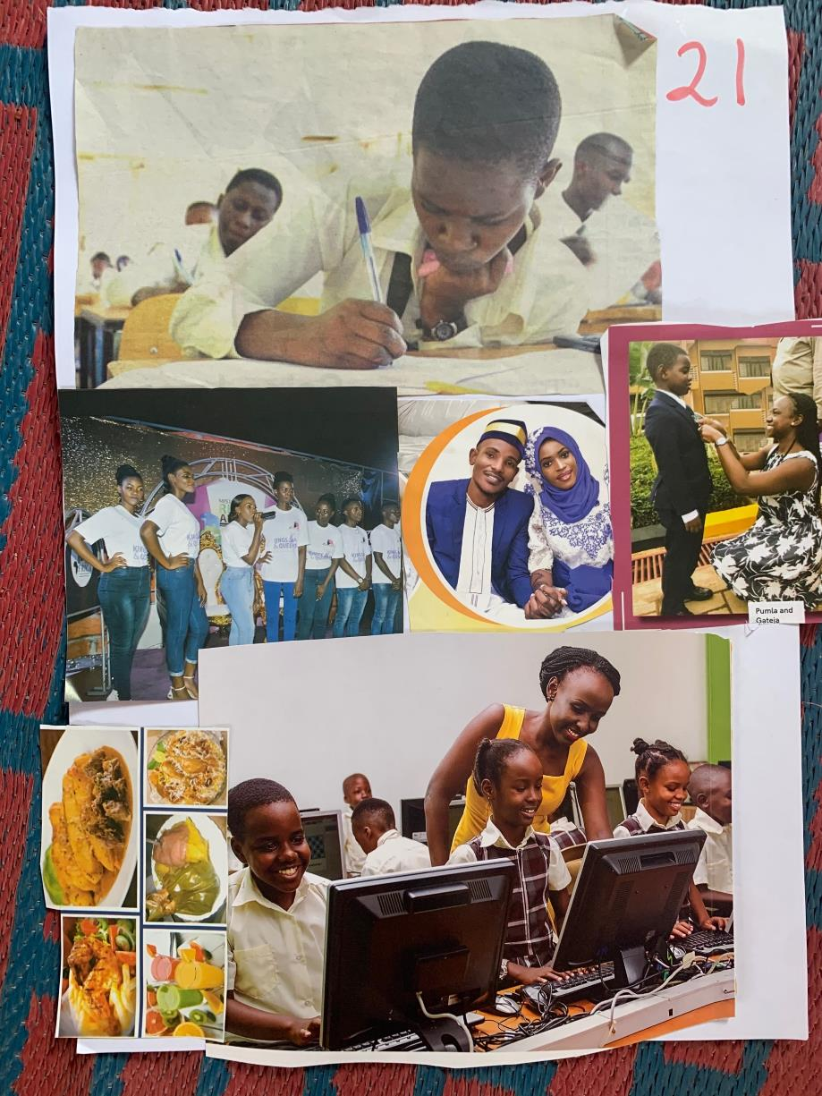
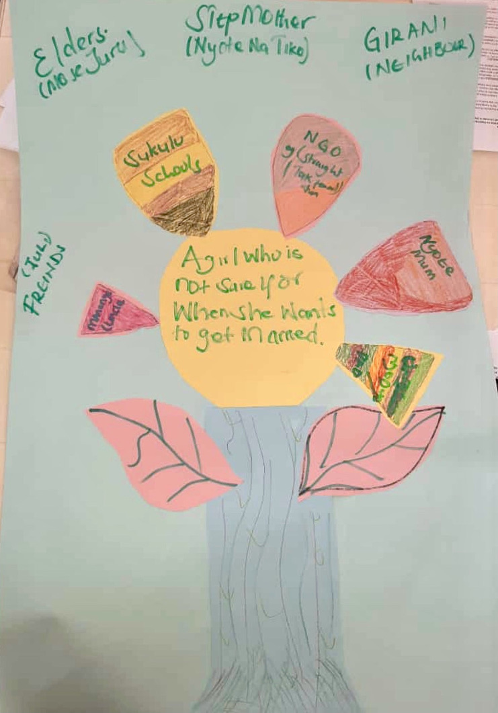
Notes:
Clare

Slide 7
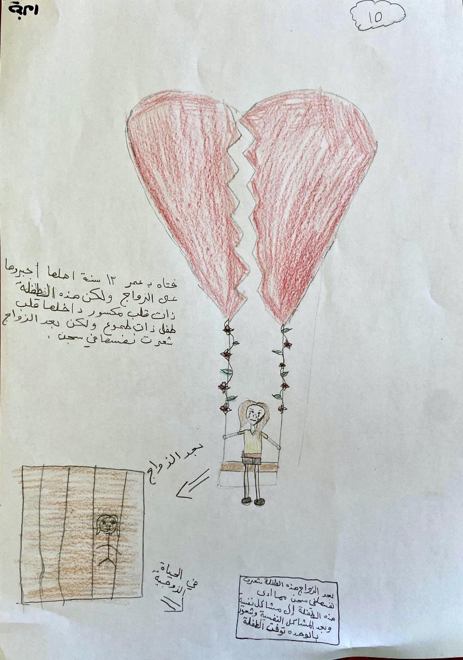
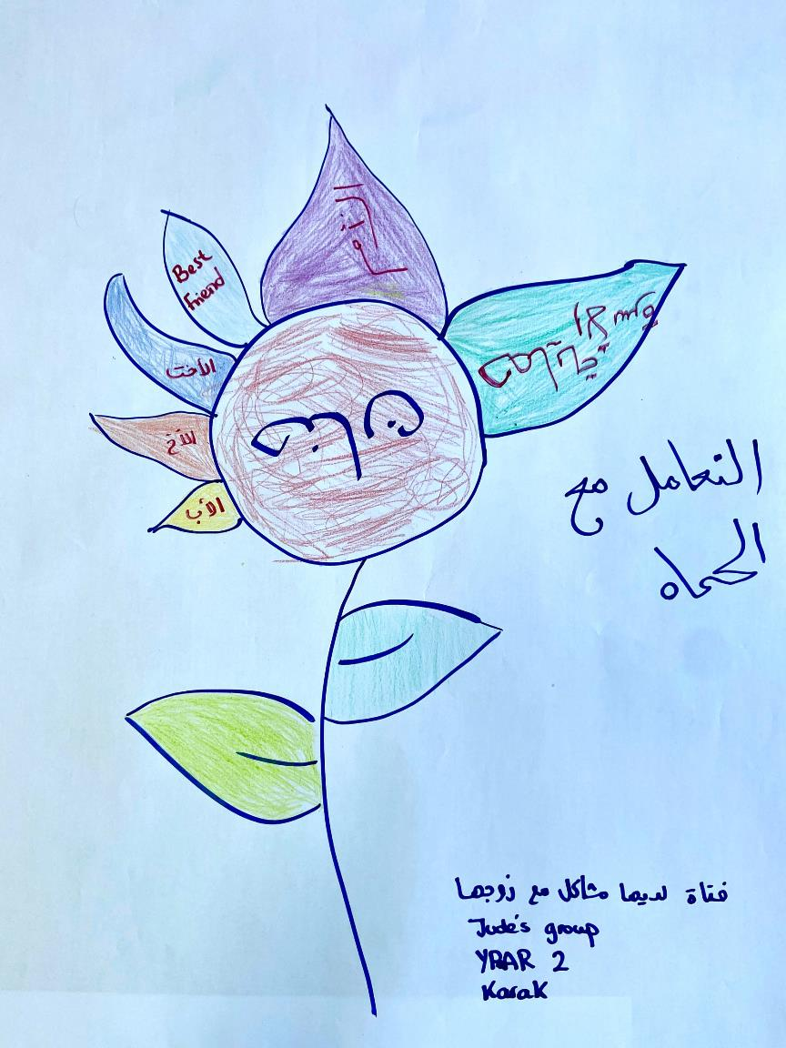
Notes:
Clare

Slide 8
Sample
CHILD MARRIAGE RESEARCH, PHASE II
 | Uganda |  | Jordan
 | Bidi Bidi | Palorinya | Al Karak | E. Amman
Girls 14-17 (Interviews) | 28 | 29 | 25 | 26
Female Caregivers (Interviews) | 11 | 11 | 14 | 10
Male Caregivers (Interviews) | 7 | 7 | 1 | 6
Girls 10-13 (Participatory Workshops) | 28 | 28 | 17 | N/A
Girls 14-17 (Participatory Workshops) | 34 | 34 | 31 | N/A
Totals | 217 (181 girls*) |  | 130 (99 girls**)
*22% married **10% married
Notes:
Clare
Married: 9 in Jordan (9% of girls)
Emancipated: 39 in Uganda (22% of girls)
Fathers: 7 in Jordan (23%), 14 in Uganda (39%)

Slide 9
Community Validation Workshops
CHILD MARRIAGE RESEARCH, PHASE II
Goals:
To share findings back with the community
To validate research findings with community feedback
Workshops held with girls and caregivers in research sites in Uganda (in-person) and in Jordan (via Zoom). Feedback was incorporated into research findings.
Notes:
Julie

Slide 10

Findings: What Girls & Caregivers Want
CHILD MARRIAGE RESEARCH, PHASE II
1. Financial support for girls and their caregivers
Notes:
Julie

Slide 11

Findings: What Girls & Caregivers Want
CHILD MARRIAGE RESEARCH, PHASE II
2. Addressing barriers to education for girls
Notes:
Julie

Slide 12

Findings: What Girls & Caregivers Want
CHILD MARRIAGE RESEARCH, PHASE II
3. Sensitization and awareness-raising on child marriage for girls, caregivers, and community members
Notes:
Clare

Slide 13

Findings: What Girls & Caregivers Want
CHILD MARRIAGE RESEARCH, PHASE II
4. Addressing violence within the home
Notes:
Clare

Slide 14

Findings: What Girls & Caregivers Want
CHILD MARRIAGE RESEARCH, PHASE II
5. Creating opportunities for positive peer influence
Notes:
Clare

Slide 15
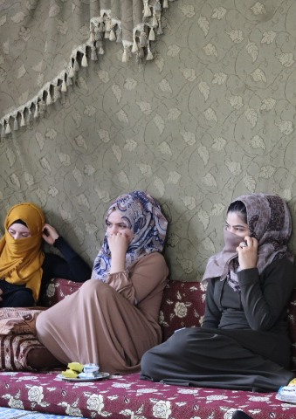
Impact of COVID-19
CHILD MARRIAGE RESEARCH, PHASE II
Study instruments adapted to explore the impact of COVID-19 and restrictions on:
  Girls’ health and well-being, access to education, and access to services
  Marriage perceptions and decision-making
  What girls want during COVID-19
Notes:
Julie

Slide 16
Key Findings: COVID-19 & Child Marriage
Many girls got engaged or married during the lockdown due to:
  Desire to accelerate marriage plans to avoid wedding expenses
  Wanting to escape increased housework and restrictions at home
  Jealousy of sisters/peers who were treated well by husbands in lockdown
  Increased financial strain on the family
  Closed schools and barriers to accessing online education
CHILD MARRIAGE RESEARCH, PHASE II
Notes:
Julie

Slide 17
What Girls Want: COVID-19
CHILD MARRIAGE RESEARCH, PHASE II
Girls and caregivers want:
Counseling and psychosocial support
Educational support to help with distance learning and technology
Financial support for basic needs
More online awareness-raising programs and workshops for girls and parents
Access to maternal health services
Basic hygiene items & education on protection from COVID-19
Notes:
Julie

Slide 18
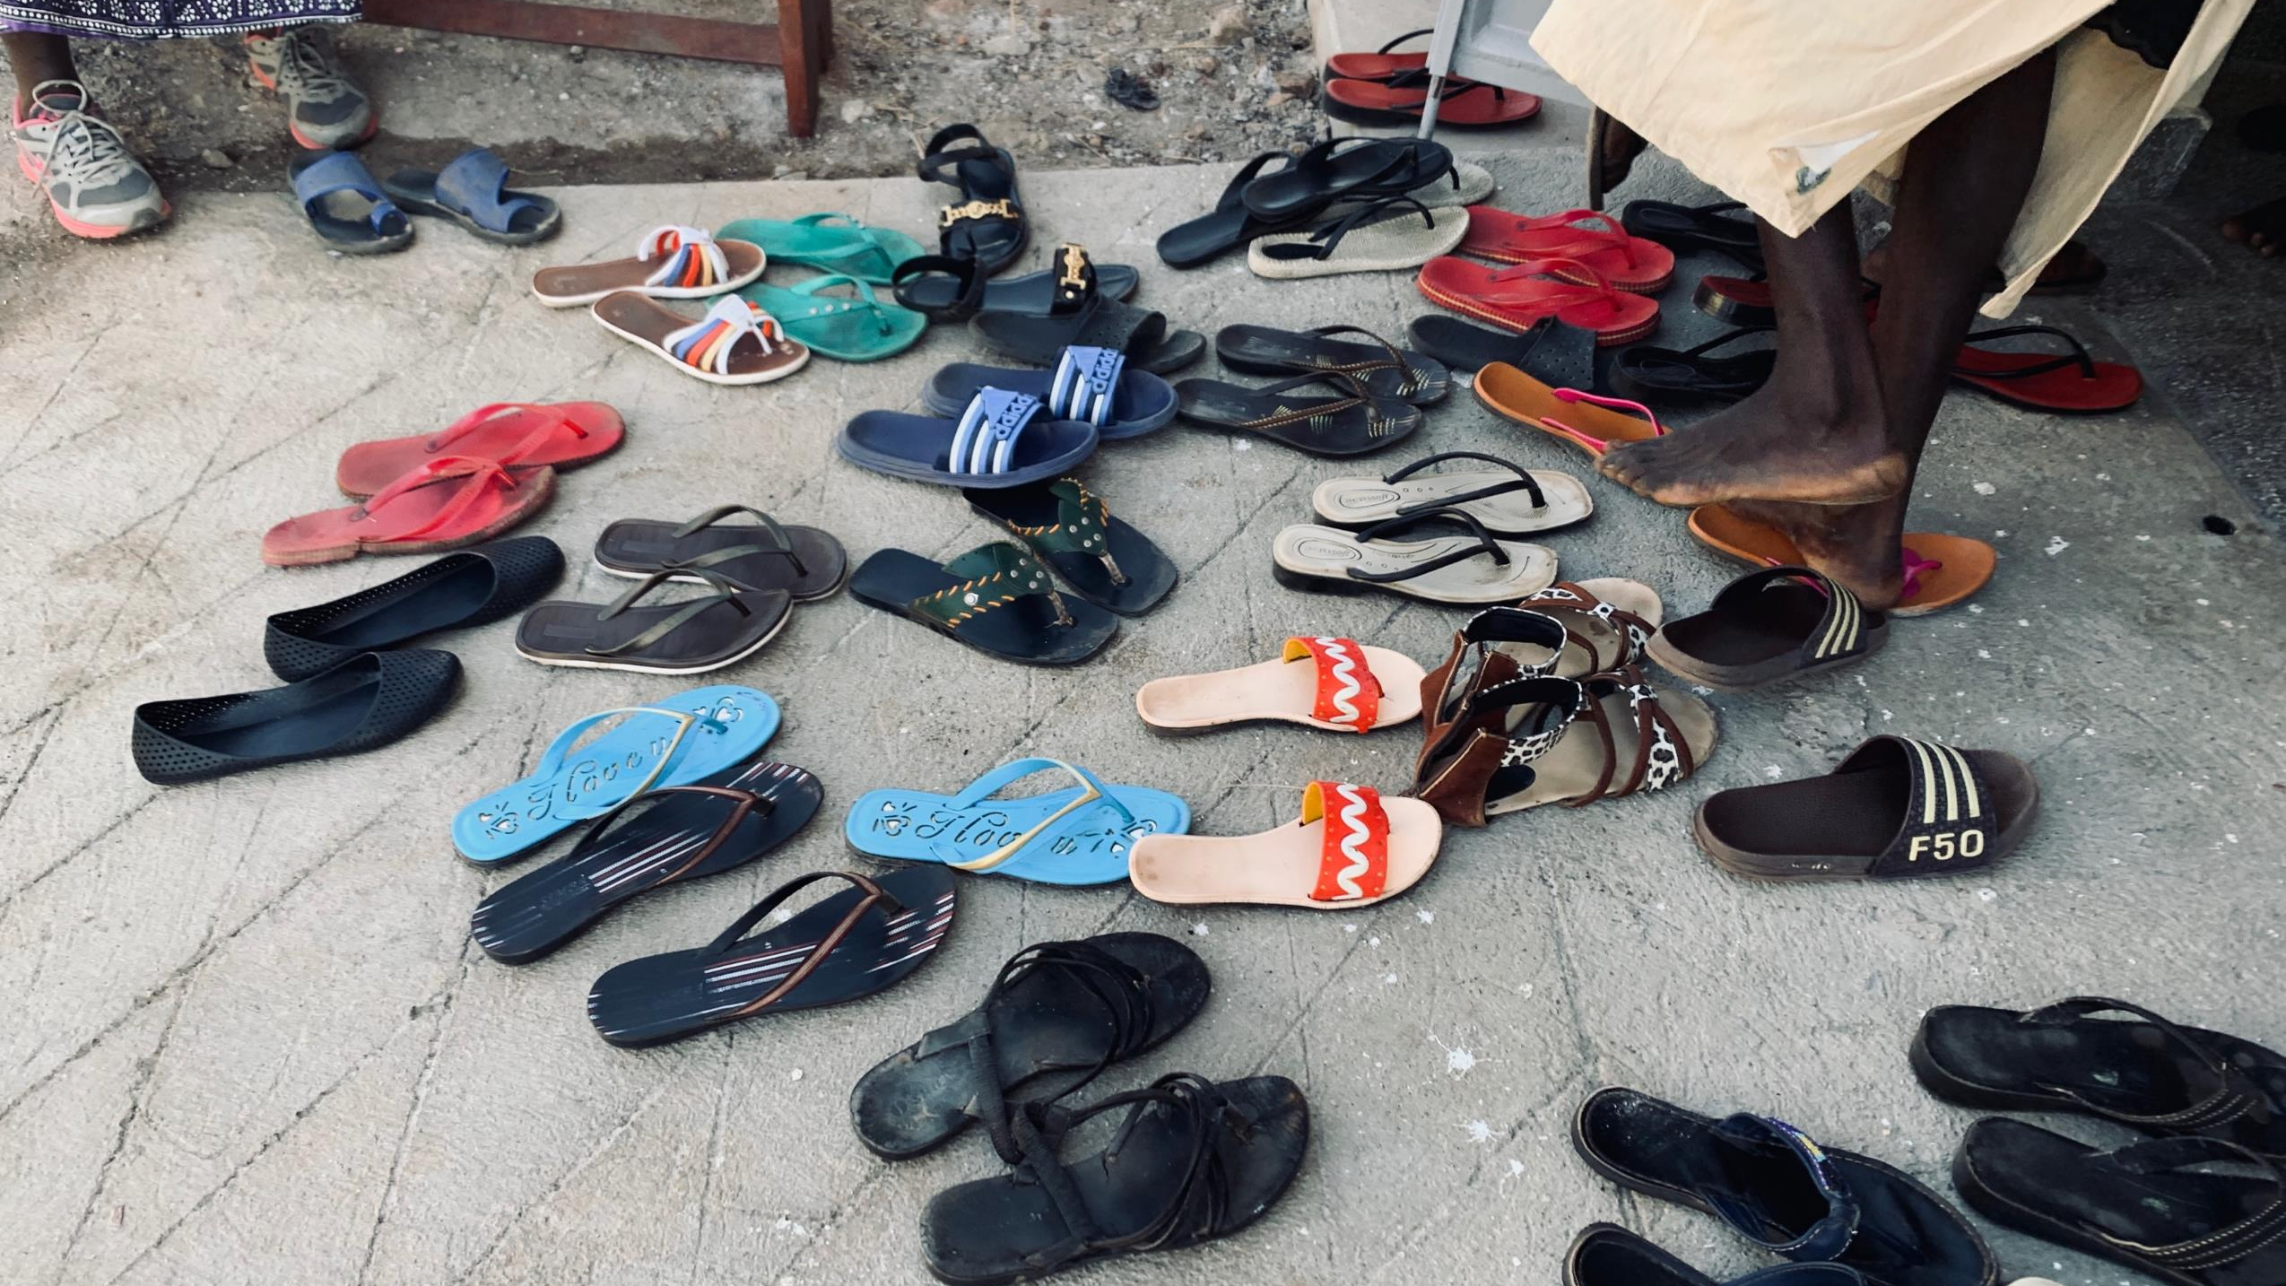
Questions?
juliefrecceroberkeley.edu
ahabwec@yahoo.com
nina.gora@savethechildren.org
grainne.quinn@plan-uk.org

