Slide 1
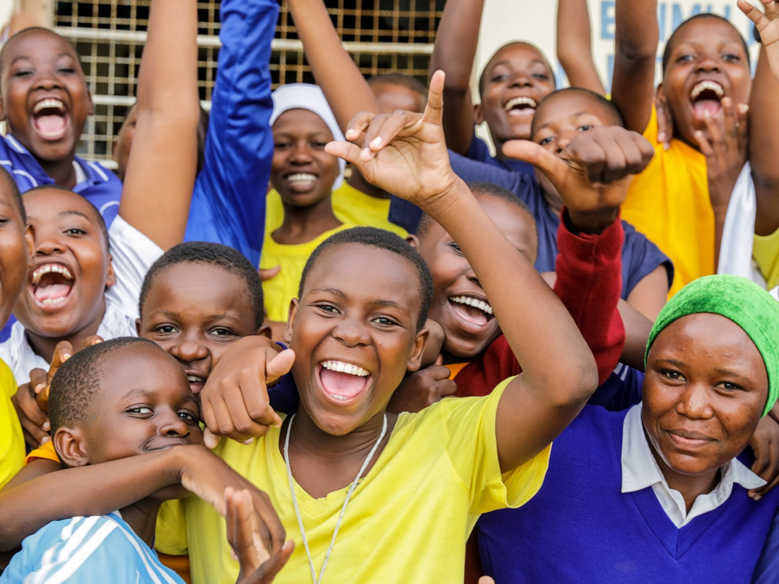
The Power of a Story
Girl-led Child Marriage Action Research in Two Humanitarian Settings
Notes:
·

Slide 2
Child Marriage in Humanitarian Settings Initiative
GOAL: Girls, families and communities drive humanitarian efforts to address and limit the impact of child marriage in humanitarian settings to ensure girls are safer and healthier.
Girl-led action research led by Plan International and the Women’s Refugee Commission in collaboration with: Transforming Fragilities (Philippines-based research partner) Dr. Abel Blessings Matsika (Zimbabwe-based research partner) 2 humanitarian contexts Philippines: Marawi Crisis, internal conflict, natural hazards Zimbabwe: food insecurity, extreme weather

Slide 3
Research objectives
Understand the key drivers of child marriage in diverse humanitarian settings
Understand the needs and priorities of adolescent girls affected by crises
Understand the adaptive capacities within girls, their families and communities to support girls’ healthy development trajectories
Understand how programs and services respond to the needs of adolescent girls, and identify access and utilization barriers
Explore how COVID-19 impacted the decision-making pathways within households to enhance or mitigate risk of child marriage
1
2
3
4
5

Slide 4
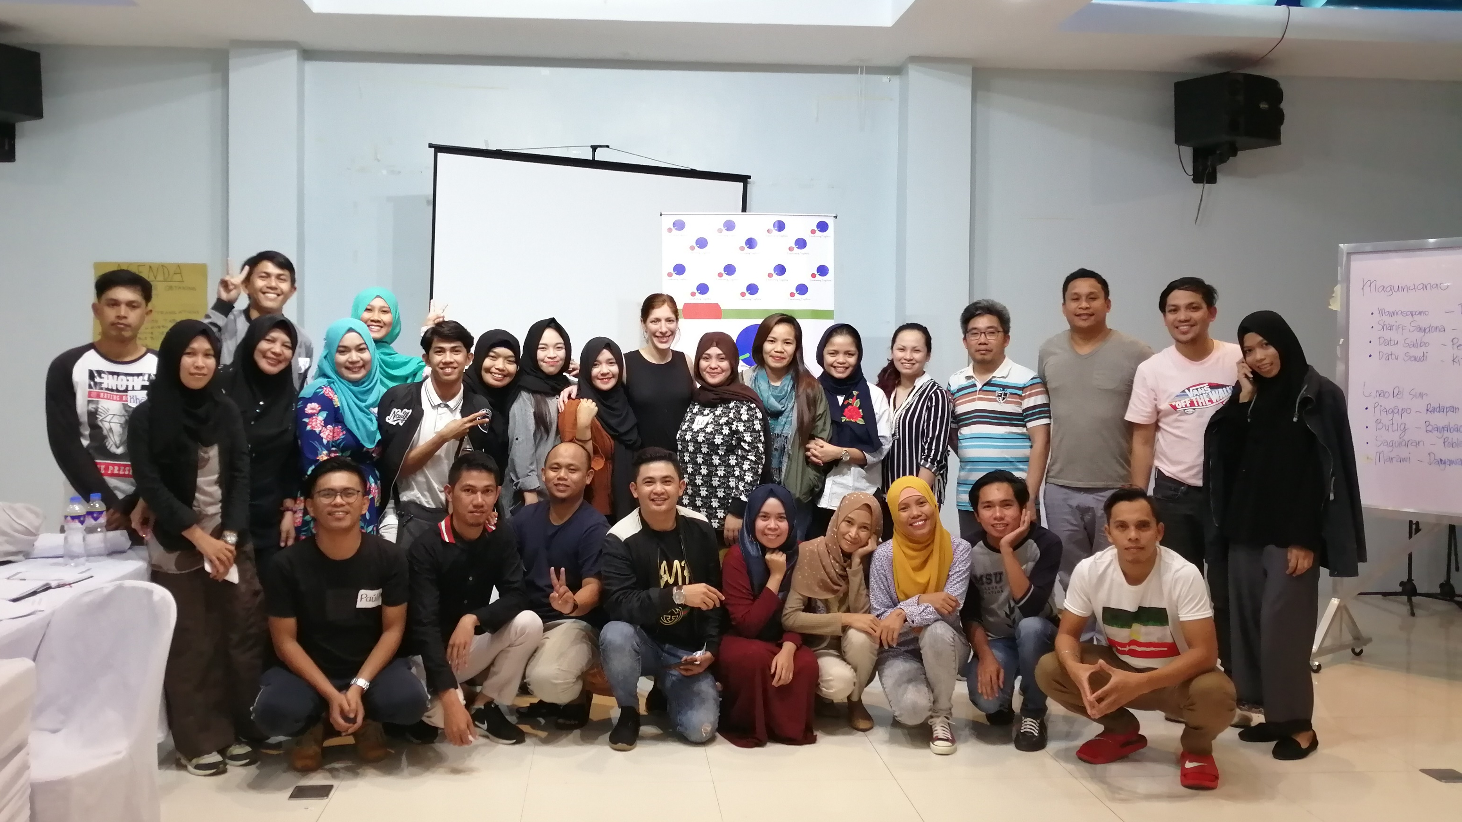
Research methods
Mixed-methods
Literature reviews
KIIs
Participatory group activities
SenseMaker®
Capacity & gaps mapping
Co-design workshop w. communities
Co-analysis workshop w. communities
Institutional stakeholder workshops
Plan Philippines, WRC, and Transforming Fragilities, Enumerator Training, Iligan City, February 2020

Slide 5
A storytelling data capture that permits the narrator to analyse their own story in
real time and give it deeper meaning

Slide 6
Who/what was responsible for what happened in your story?
“I was in my third year in high school when I stopped schooling because my parents wanted me to marry my cousin. Because of that, I had to stop going to school. People told me that I'm already married so I should find livelihood instead. And because we were arranged, we weren't close. We wouldn't talk to each other [at first]. We eventually started selling things.. Of course it was hard. I was very young. I didn't know how to earn a living, I was [supposed to be] studying. I felt like I was too young when I married. I was ashamed. I thought to myself, "Why [is it like this]?" I married early against my will. If I didn't obey, there would probably be conflict between our families.” –Adolescent girl (married),18-19 years, Lanao Del Sur
Individual
People’s mindsets
People w/ power and authority
Notes:
SenseMaker: Set of questions inputted on a tablet application that allows the storyteller to analyze her/his own story, built together with girls and community members
A participant-led mixed-method data collection and analysis approach to storytelling
Open-ended story prompt protected GBV survivors from forced disclosure, while still providing an outlet for stories to be shared and heard in a safe and ethical way
Co-design workshop with community members, caregivers and adolescent girls to design tool
Translated, piloted and adjusted tools
Collected 2,000+ stories from target provinces in Mindanao, Philippines and ~2,000 stories in Chiredzi, Zimbabwe
Co-analysis workshops with community members, including married and unmarried girls

Slide 7
Key Findings Across Settings
Drivers of child marriage
Underlying drivers of child marriage remained consistent e.g., gender inequality
Other drivers differed across settings, reflecting their diverse populations, context, and nature of the crisis
Needs of Married Girls
Education support
Livelihoods/income generation
Mental Health and Psychosocial Support
Childcare
Sexual and reproductive health, including maternal health
Protection services
Social capital
Notes:
Although underlying drivers of CEFM remain consistent (e.g., gender inequality), the drivers differ across settings, reflecting their diverse populations and nature of the crisis (e.g., natural hazard, conflict, displacement). The engagement of adolescent girls and the use of gender-transformative and multi-sectoral approaches to CEFM programming is necessary for durable community-driven solutions to CEFM.
Key DRIVERS
Gender inequity/discrimination
Control of adolescent sexuality
Lack of agency
Poverty
Lack of alternative opportunities
Expectations about marriage
Enabling legal framework
Many drivers were exacerbated by COVID-19

Slide 8
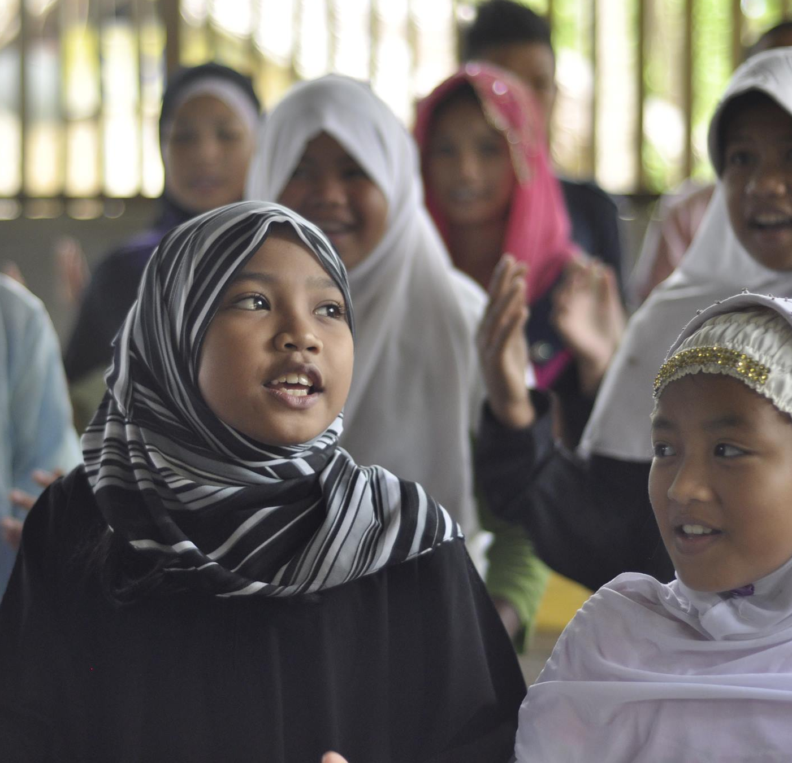
Key Findings: Philippines
Main CEFM drivers
Resolving clan feud/violence
Family honor / controlling adolescent girl sexuality
Cultural norms and interpretations of religious text
Human trafficking, kidnappings and marriage after siege
Lack of alternatives (e.g., quality education; employment opportunities)
Political and resource power
Aid distribution mechanism for displaced families
Enabling legal framework
Technology/social media
CEFM decision-making pathways
“Love" marriages vs arranged marriages
Need to engage not only families (especially mothers), but also religious and community/clan leaders in programming
Sense of duty at individual vs community and societal levels

Slide 9
Key Findings: Philippines
Boys vs Girls
While girls indicated having overwhelming access to information; boys indicated having no access at all
Girls in general showed a higher likelihood to be agents of change, as they were less likely than boys to see their stories as revealing efforts to “keep tradition”
Married participants 12-14 years were more likely to share stories that leaned towards wanting drastic change
Issues facing adolescents
Discrimination based on IDP status, religious status, indigenous status, gender, pregnancy status
Child labor / human trafficking
Violent extremism
Lack of safe spaces
Use of illegal drugs (boys)
Lack of adolescent friendly sexual and reproduction health information and services, child protection services, mental health and psycho-social health services
Notes:
Male vs Female
While girls indicated having access to an overwhelming amount of information; boys indicated having access to no information at all
Females can be potential agents of change as they are less likely than males to see their stories as revealing efforts to “keep tradition”
Married participants 12-14 years were more likely to share stories that leaned towards wanting drastic change
Issues facing adolescents
Discrimination based on IDP status, religious status, indigenous status, gender, pregnancy status
Child labor / human trafficking
Violent extremism
Lack of safe spaces
Use of illegal drugs (boys)
Lack of adolescent sexual and reproduction health information and services, child protection services, mental health and psycho-social health services

Slide 10
Preliminary Findings: Zimbabwe
Key drivers
Controlling adolescent girl sexuality
Adolescent pregnancy
Lack of alterative opportunities-education, livelihoods
Child abuse, neglect, abandonment
Initiation ceremonies
Severe economic hardship
Food insecurity
COVID-19 induced lockdowns amplified some of the pre-existing drivers
Diverse Types of “marital” engagements
Marriage
Informal marriage
Co-habiting

Slide 11
Preliminary Findings: Zimbabwe
“I will share a story of what happened to me when I was doing my form 3 and aged 15. There was a guy that I dated. This guy was older than me, he was 20 years old. He was enrolled at a teacher's college in Masvingo and he would go there. While I was dating this guy, he forced me to sleep with him. He started sleeping with me when I was 15 up until the time I got pregnant. When I told him that I was pregnant, he denied it, saying it wasn't him that had impregnated me. Regardless of this I eloped to his place and when he returned from Masvingo he found me there. That is how I got married. My wish is that young children remain in school because nothing is as painful as getting impregnated and the person responsible for it denying it and then you force him to get married to you. If children take school seriously then things will get better”
-Adolescent girl (married) 15-17, Chiredzi
CEFM decision-making pathways
“Love” marriages vs child/forced marriages
Role of initiation ceremony
Issues facing adolescents
Lack of educational support and employment opportunity
Severe economic hardship/unmet basic needs
Food insecurity and instability
Lack of adolescent friendly services
Child-headed households
Severe child protection and GBV concerns
Notes:
Issues facing adolescents
Lack of educational support
Severe economic hardship/unmet basic needs
Food insecurity
Lack of adolescent sexual and reproduction health information and services, child protection services, mental health and psycho-social health services
Child-headed households

Slide 12
Research to Action: Child Marriage in Humanitarian Settings Programming Guidance
A multisectoral approach to prevent, delay and respond to child marriage.
Practitioner and program capacity and gaps mapping & desk reviews
Girl-led research in two humanitarian settings
Internal development of guidance for implementation research/ testing with communities
External guidance for child marriage programming for adolescents affected by crises
Coordination across sectors and agencies to explore what works

