Slide 1
5 minutes on
Gender Norms and Child Marriage
Beniamino Cislaghi
Ben.Cislaghi@lshtm.ac.uk

Slide 2
Please Watch: https://www.youtube.com/watch?v=9WqSLf7AdQg

Slide 3
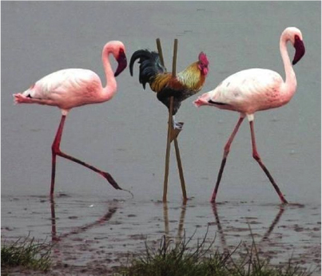
Social norms regulate what behaviour is “normal.”

Slide 4
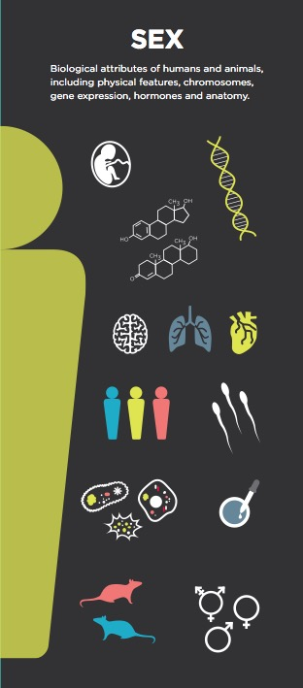
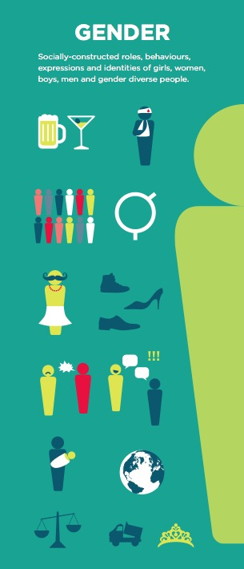
Sex and Gender
Picture source:
https://sparc.ubc.ca/announcement/cihr-workshop-sex-and-gender-considerations-jan-16-30
Notes:
Originally a linguistic term, the word gender was first appropriated in the late 1950s by clinicians to describe the psychological sense of oneself as male or female separate from one’s genital anatomy (first prompted by patients whose psychological identity did not conform to their sex designation at birth). In the 1980s the term gender caught the attention of social scientists, feminists and others who re-framed it from a psychological state to a system of social relations.[ref] In this understanding, gender was no longer a perception, trait or identity, but a social system that defines males and females as different and justifies inequality on the basis of that difference.

Slide 5
Gender Norms
Gender norms are social norms defining acceptable and appropriate actions for women and men in a given group or society. They are embedded in formal and informal institutions, nested in the mind, and produced and reproduced through social interaction. They play a role in shaping women and men’s (often unequal) access to resources and freedoms, thus affecting their voice, power and sense of self.
Cislaghi B, Heise L (2019); Gender norms and social norms: differences, similarities and why they matter for prevention science. Sociology of Health and Illness. https://doi.org/10.1111/1467-9566.13008

Slide 6
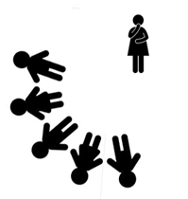
Norm: Respectable women marry early
Subject: Adolescent girls who reached puberty
Sanctions: Less desirable marriage prospects at age 18
Reference Group: Community members (future in-laws and husbands)
Variations by ethnic group:
Maka. Uncommon, Acceptable
“Is marriage a race? Marriage comes at its time, we don’t force it. She will get married one day”
Mafa. Common, Acceptable and Appropriate
“It is easy for her to find a husband [now that she’s 22], but she will not likely find the type of husband she ever dreamed of when she was 17 or 18 years old”
Mbororo. Common, Acceptable, Appropriate, and Obligatory
“To me, it will be very difficult for a girl to get married [when she’s 20]. At that age, all her sisters would be in their marital homes”
Musgum. Common, Acceptable, Appropriate, and Obligatory
“It will be difficult for her to find a husband, because she is stigmatised by the people in the village”
Shakya, Nkwi, Mackie, Pereyra, Cislaghi (2018). Social norms and child marriage in Cameroon: a qualitative study. UNICEF

Slide 7
Cislaghi B, Heise L (2018); Using social norms for health promotion in low and mid-income countries. Health Promotion International.

Slide 8
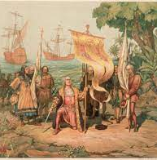
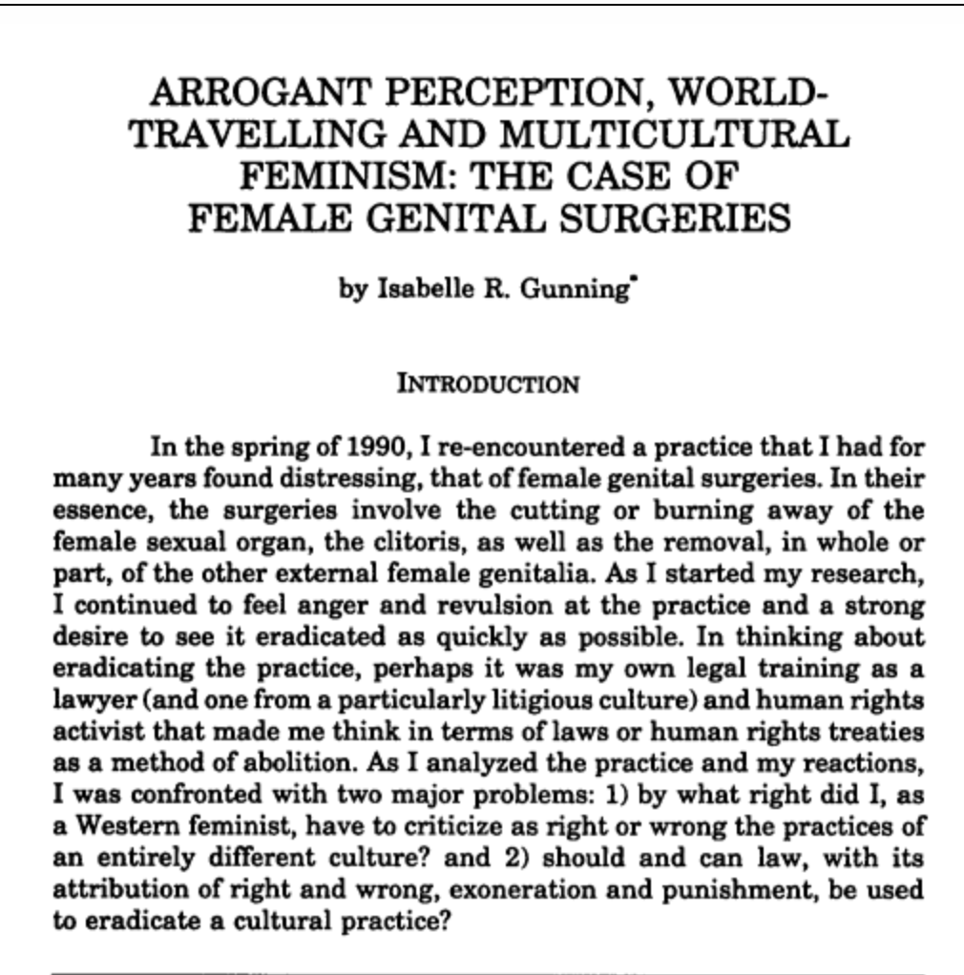
Who controls norms of acceptable intellectual hegemony

Slide 9
5 minutes on
Gender Norms and Child Marriage
Beniamino Cislaghi
Ben.Cislaghi@lshtm.ac.uk

