Slide 1
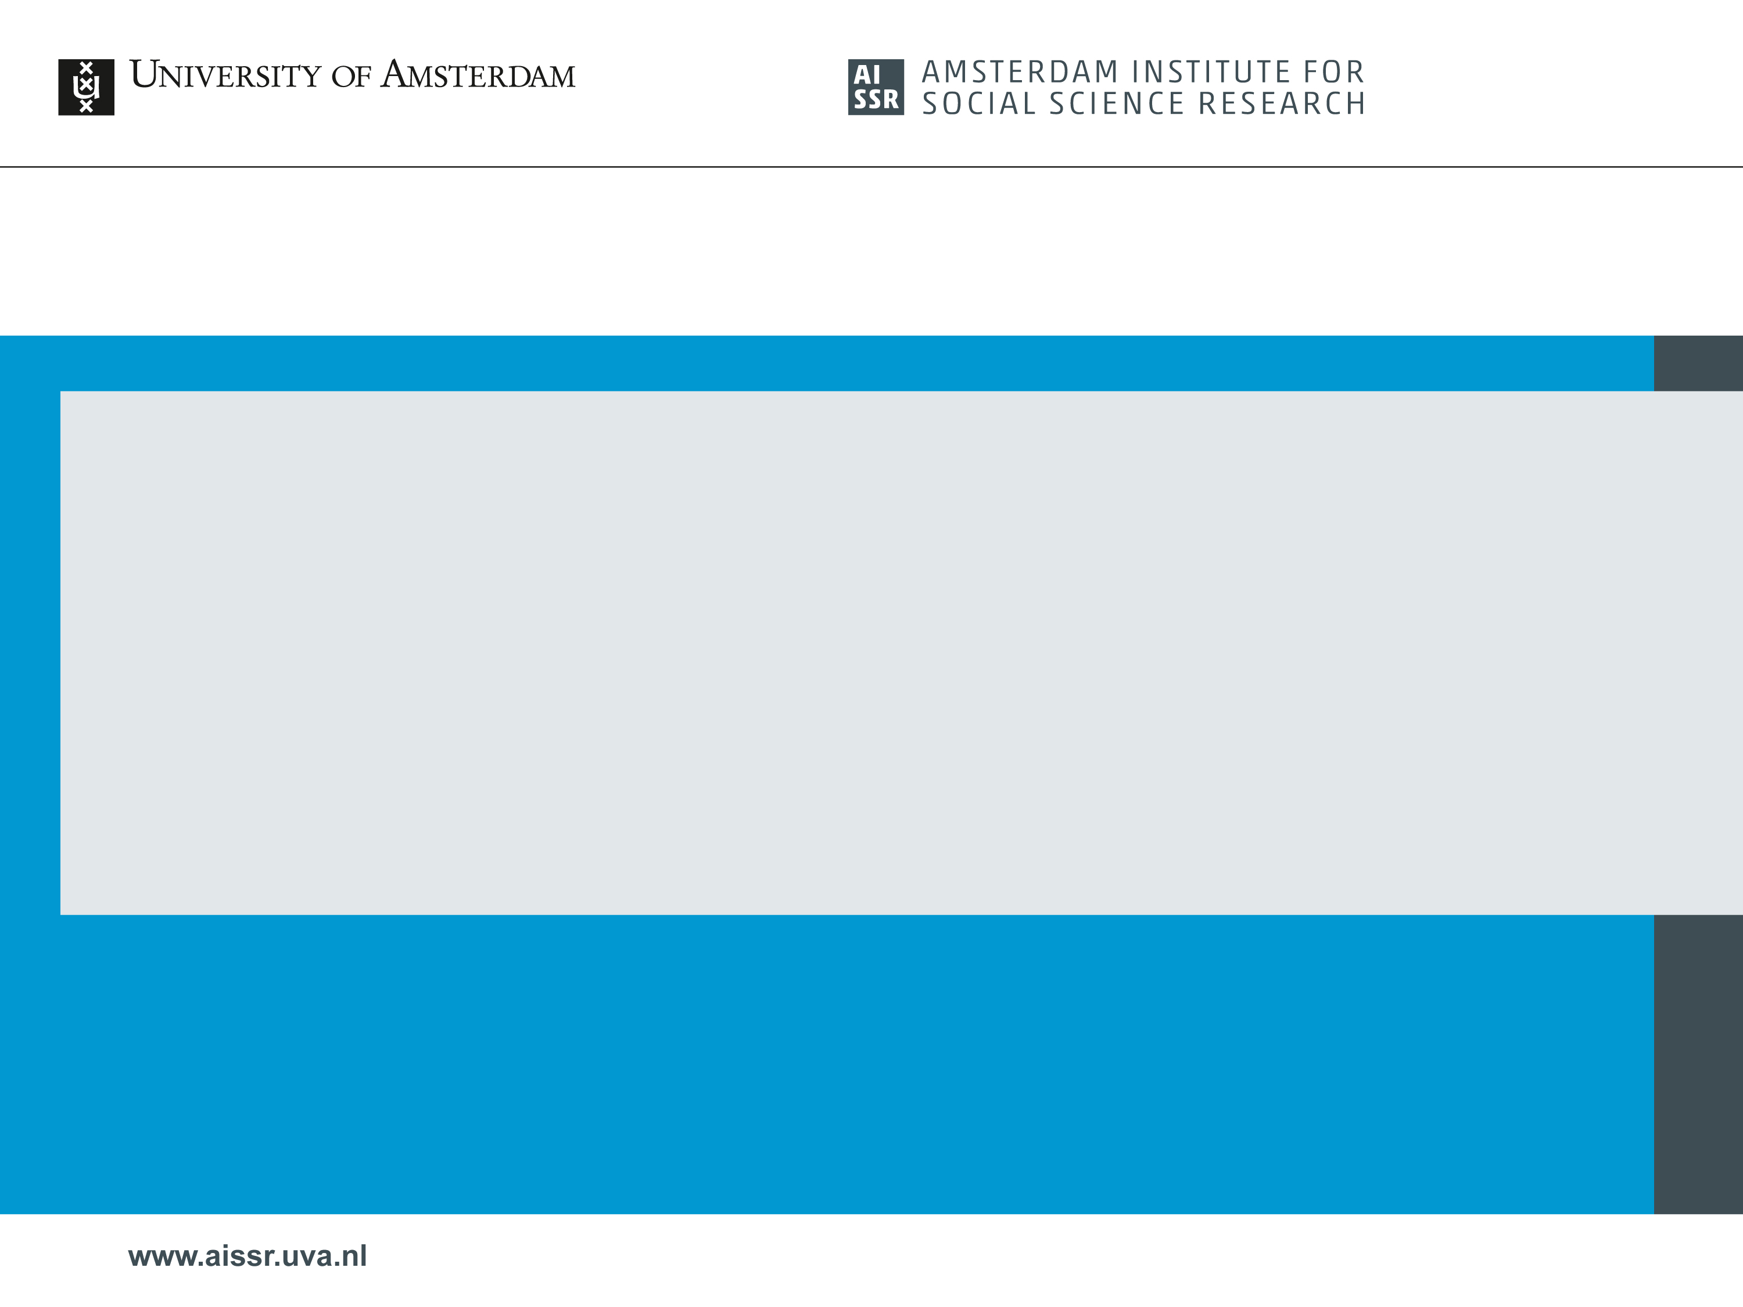
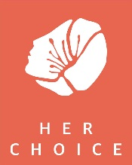
Child marriage, structural drivers and alternatives: Attending to gendered constraints and structures encountered by young women and families Esther Miedema, Winny Koster & Nicky Pouw, GID

Slide 2
Overview
AISSR ‘Her Choice’ research programme: intro and set up
Overview of articles in Special Issue & key arguments
Thinking about implications

Slide 3
HC impact evaluation study - design
Difference in Difference design:
‘’Treatment’’ and ‘’comparison’’ locations
Three phases: Baseline, Midline, Endline
Mixed-methods: Quantitative and qualitive data collection tools
Collect data to:
  Measure 39 programme indicators in all 10 countries
  Support, validate, inform, explain indicators
Generated questions regarding notion of 'choice' in contexts characterised by fewer opportunities & where choice might be (even) less an individual matter

Slide 4
Special issue: background & rationale
Governing choice and child marriage: Young women, marriage and development aid programes, Progress in Development Studies
Guest editors: Esther Miedema, Winny Koster and Nicky Pouw
Growing investment in early marriage issue meriting attention
What drives decisions, and is a focus on women’s individual choice as indicative of feminist gains (always) useful?
Who is served by focus on women’s ‘empowerment’ as typically conceived? Women?
Purpose of SI: to contribute to debates on CM by offering emic understanding of decision-making processes and choices of various sets of actors.

Slide 5
Special Issue: intro & findings
Different affiliations & different research designs, most within larger intervention programmes
Research conducted in settings with high prevalence rates in SSA, South (East) Asia
Reasons for marriage:
Free choice? (Saul et al.): In contexts where emphasis is placed on girls’ obedience, parental and community approval, and there are limited economic opportunities, particularly for women, what does it means to have a ‘choice?’
Complexity (Jones et al.): interplay of social norms, economic factors, and young women’s capacity to exercise choice, and variation that exists depending on individual, family, and community characteristics
Traditional or modern (Hori)?: Marriage as resolving contemporary ‘problem’ of unplanned out-of-wedlock pregnancy and as response to current precarities.
Notes:
unpack each of these for the audience as really aligns with the focus of the session and the interlinkages underlined between gender and social norms, inequitable structures that do not provide (incl. economic) alternatives for girls etc?
For the audience good to frame the interlinkages clearly.

Slide 6
Implications
When we draw on understanding of CM as primarily indicative of lack of education, individual rights, ‘harmful traditions,’ and women (in the Global South) as victims, tendency to fall back on ‘awareness raising’ (Van Raemdonck & De Regt; Miedema et al.)
Need for dialogue and space for women and men’s own perspectives, and parking assumption that CM is always and unvaryingly harmful (Van Raemdonck & De Regt; Miedema et al.)
Given constraints and possibilities of particular socio-economic contexts and existing (gender) orders, what functions does child marriage serve?

Slide 7
In closing
Exclusive focus on negative outcomes of child marriage, and 'empowering' girls and 'combatting' CM as counterproductive. Such a focus may mean that:
more child marriages go underground;
positive outcomes of child marriage are overlooked, such as (short-term) social, physical, and economic security;
complex structural processes and drivers of child marriage are insufficiently addressed in programs; and
too little is done to identify alternative arrangements that could generate the kinds of securities families and girls may seek, while mitigating the negative (longer-term) consequences

Slide 8
Questions to explore
What kinds of alternative arrangements could be identified that could generate the securities families and girls may seek when deciding on an early marriage (while mitigating the negative (longer-term) consequences)?
What role can we play in addressing complex structural processes and drivers of child marriage? What is within our scope, and what can we do (and which alliances are needed) in relation to underlying structures?
How do we tackle the gendered dimensions of structural constraints and barriers?

Slide 9
