Slide 1
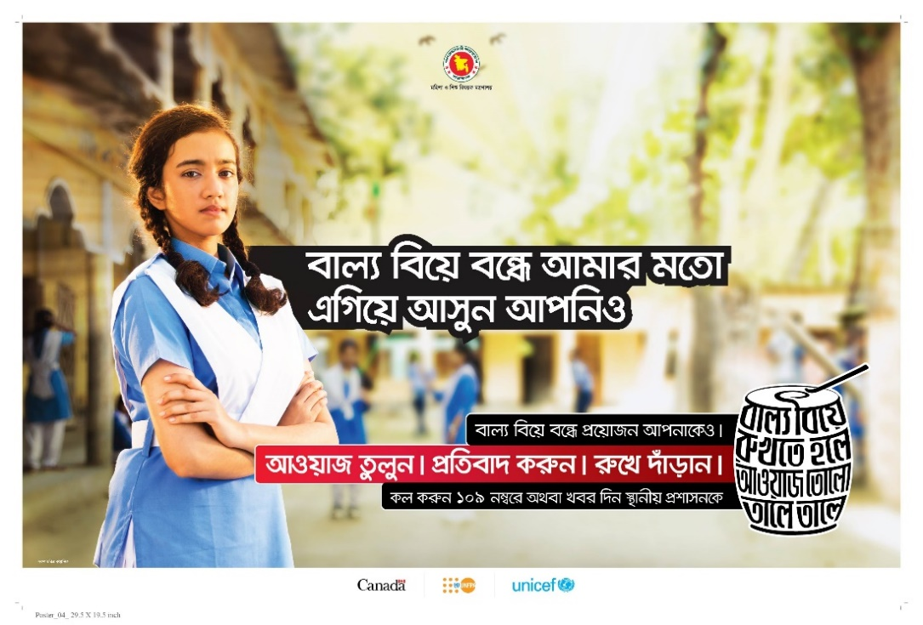
ENABLING GENDER NORM CHANGE THROUGH COMMUNICATION: A
CASE STUDY OF A TRANS-MEDIA ENTERTAINMENT-EDUCATION
INITIATIVE IN BANGLADESH
Ami Sengupta, Suruchi Sood, Neha Kapil and Tania Sultana
December 2021

Slide 2
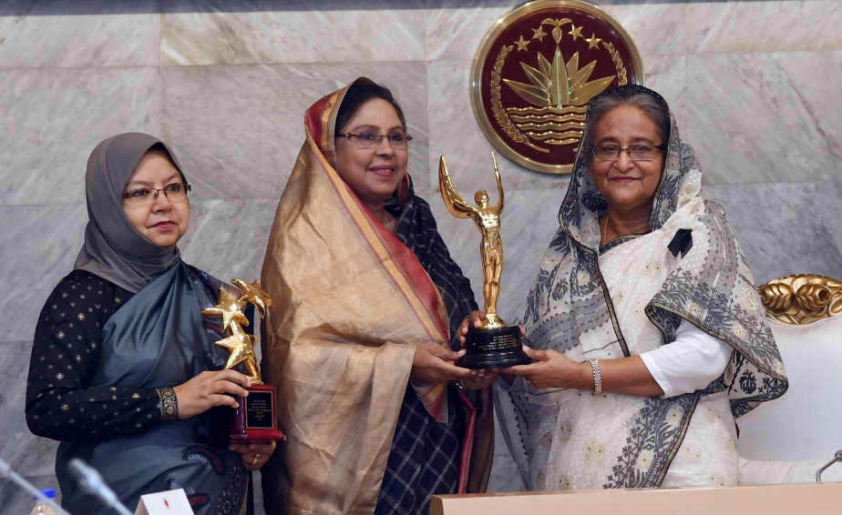
Overview
UNICEF-UNFPA partnered with the Government of Bangladesh, under the leadership of the Ministry of Women and Children Affairs (MOWCA) to spearhead a comprehensive response to end child marriage
Launched a multi-phase trans-media campaign to end child marriage in 2017 which is still ongoing
Part of an evidence-based, multi-layered social and behaviour change communication (SBCC) strategy to empower adolescents to foster norm changes that promote gender equality and prevent child marriage
Drew on social norms, entertainment-education and gender transformative approaches.

Slide 3
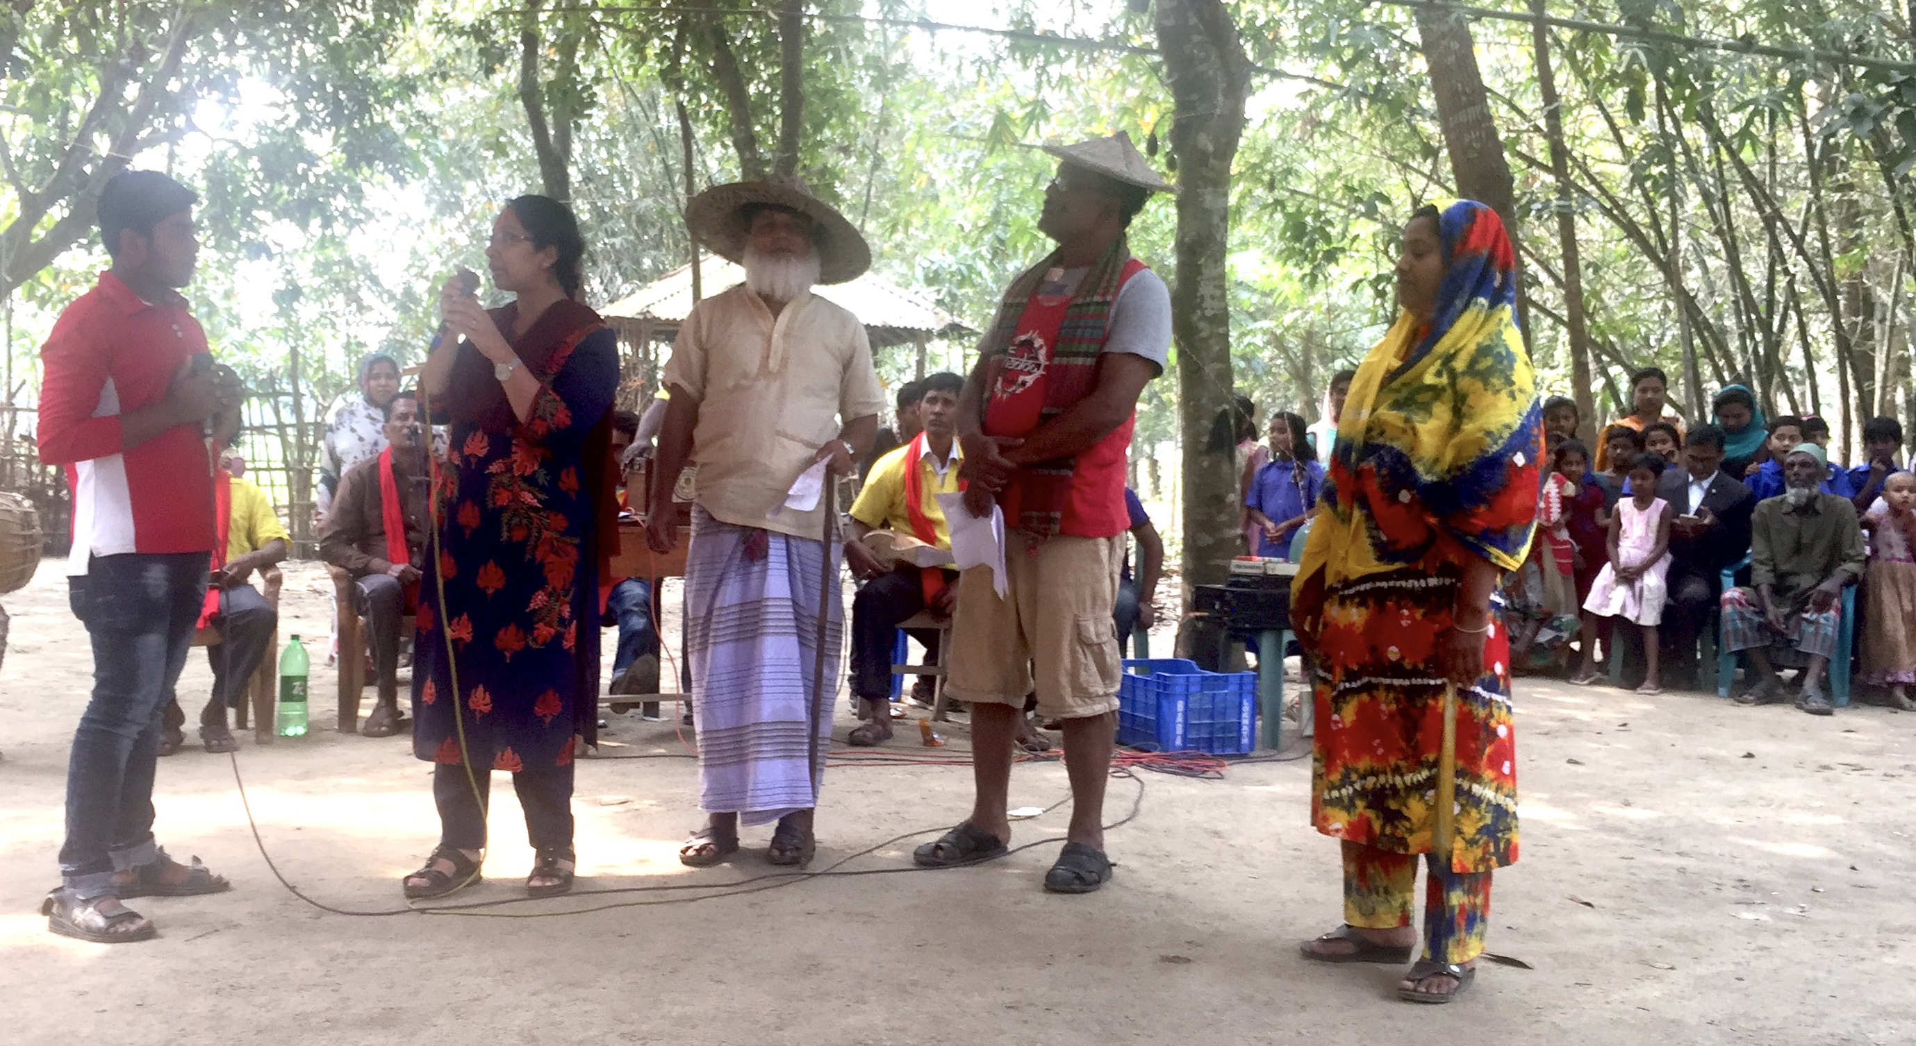
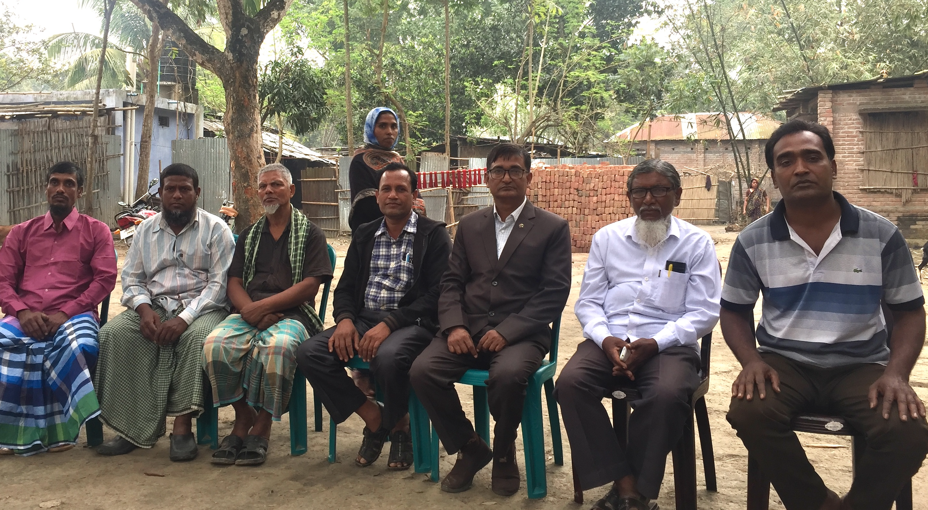
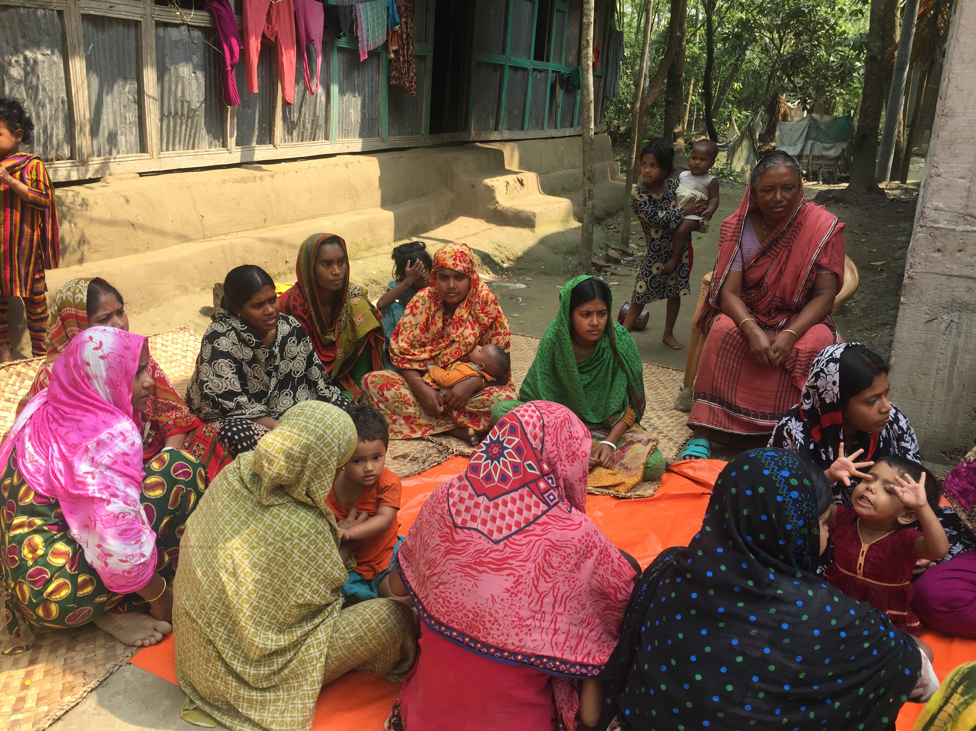
360 Degree Approach
Trans-media
Social media
Folk media
Radio Listeners Group
Community Dialogue
Fathers Group
Courtyard Sessions
Training of local leaders
Faith based leaders
Systems Strengthening

Slide 4

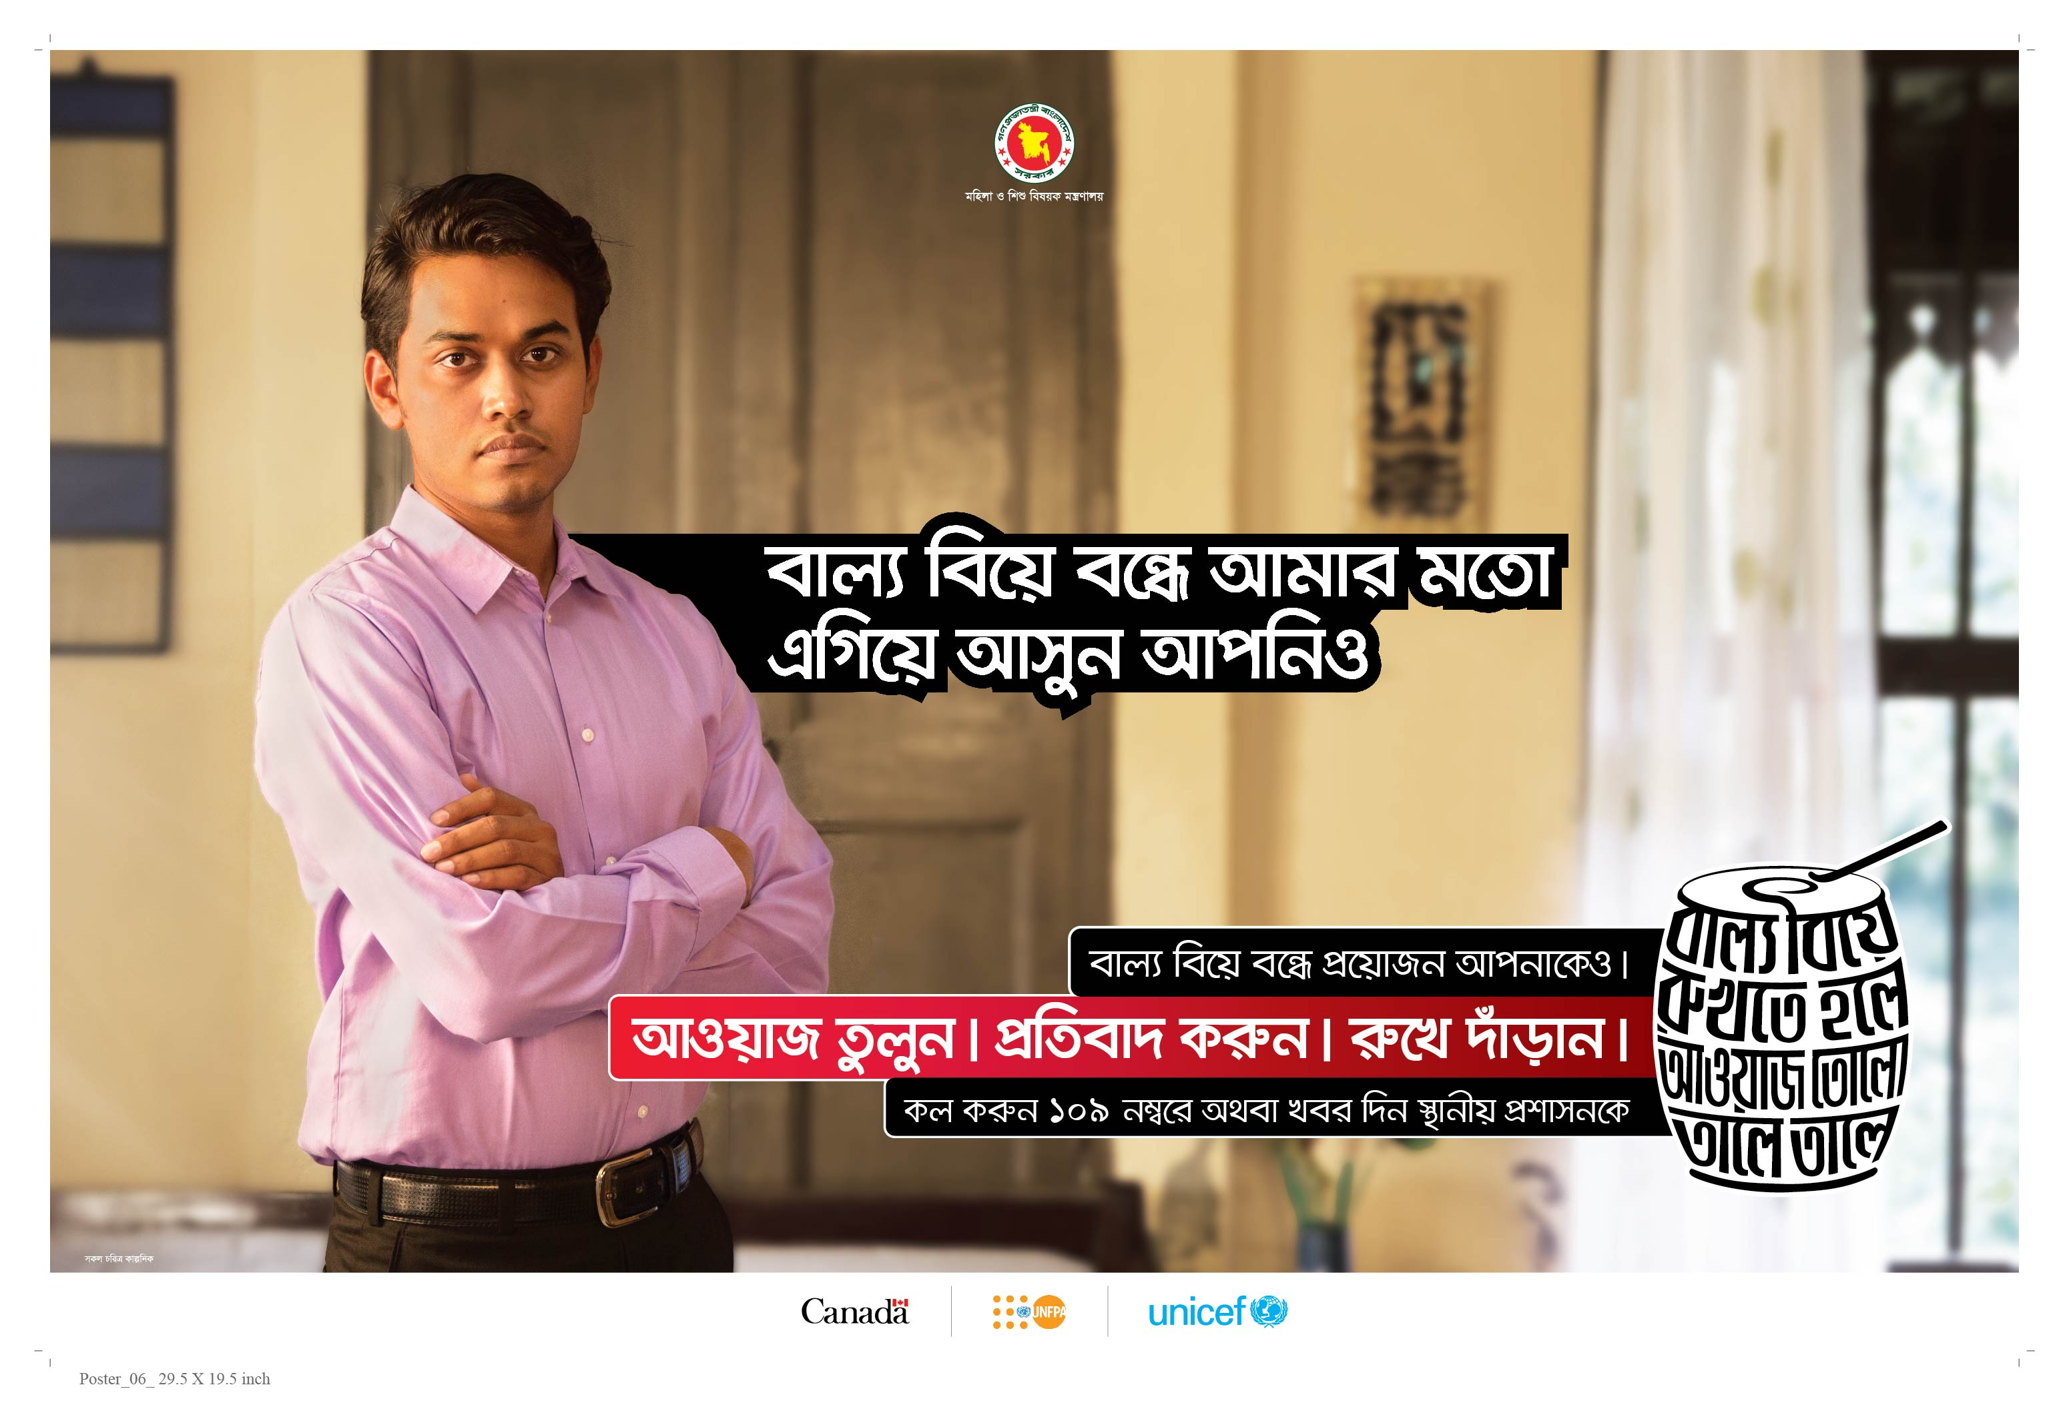
Dhol Campaign
Triggered action to stop child marriages by depicting grooms, bystanders, marriage registrars and created public pressure around non-acceptance of child marriage.
Phase II of the campaign continued with the theme of the Dhol, shifted to presenting real-life actions by ordinary citizens who advocated for change in their communities.
Campaign assets included TV, radio and social media adaptations of the PSAs and outdoor materials
10 PSAs were developed and as of today, have reached 160 million viewers on social media.
Notes:
Real life role models and champions -such as a cyclist, a school principal and a youth activist

Slide 5
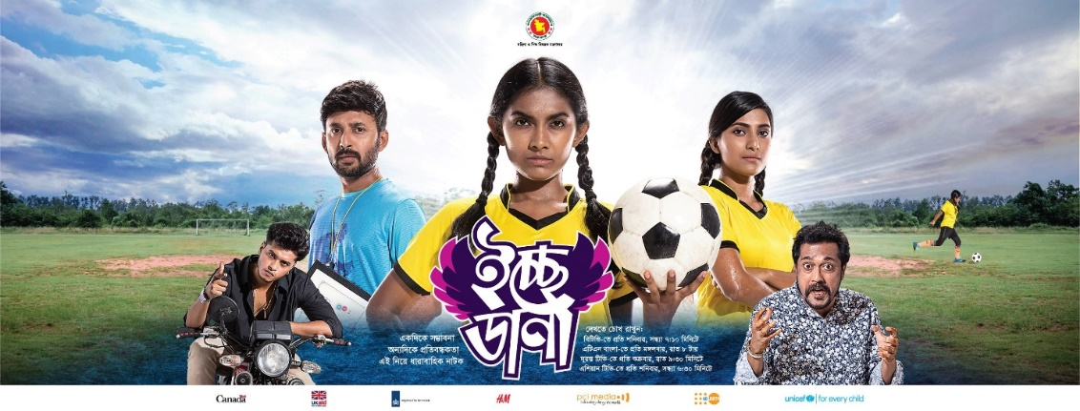
Icchedana
The storyline centres on a girls’ football team and depicts adolescent struggles faced by girls and boys in a small village named Hathmathali and shows how they experience challenges and find solutions.
Individual episodes dealt with issues such as child marriage, sexual harassment, school drop-out, girls’ empowerment, menstrual hygiene, physical and mental health, nutrition and sports.
Till date 52 episodes have been aired.

Slide 6
Summary of Key Findings
Adolescent girls and boys watched the show more than parents
Higher knowledge of age of marriage with higher exposure
Higher exposure showed a positive correlation with knowledge of consequences of child marriage and dowry
Higher levels of IPC/discussion around CM including among boys and men at endline
Increases in actions to prevent CM over time and by exposure
Low levels of exposure and engagement
Personal and family perceptions of disapproval of child marriage increased over time and by level of exposure
Community level perceptions about disapproval of child marriage decreased over time and not affected by exposure.
Notes:
The findings draw on a longitudinal panel study to assess the effectiveness of the trans-media component and qualitative data gathered during field observation visits
Research was embedded in the programme design
District-wise comparison show that Icchedana was significantly more popular in rural households in comparison to their urban counterparts
Viewership data showed low levels of exposure with half the respondents having neither heard of the show nor watched it, or recalling any outreach efforts
Levels of engagement were also low, with few people watching multiple episodes, recommending the series or recalling the content
The role of social norms in upholding the practice of child marriage was evidenced in the fact that while respondents felt that they and their friends and family members approved of preventing child marriage, they felt the community at large were supportive of child marriage.

Slide 7
Findings: Gender Norms
Attitudes around early marriage, girl’s education, gender roles, and sexual harassment showed positive improvements over time and by level of exposure
Increase in positive attitudes towards girls' nutritional requirements, breaking menstrual taboos, girls playing football and education
More respondents (both over time and by exposure) agree that girls are not responsible for sexual harassment or eve teasing
Improvement in negative attitudes towards relying on a daughters’ income during old age, over time and by exposure
Decline in beliefs that sons should continue education over girls if there are financial constraints
Notes:
A key objective of the research was to move beyond measuring individual change and examine the effectiveness of E-E at a broader social level. The assessment included measures for social norms constructs such as descriptive norms (doing what others do), injunctive norms (doing what others think one should do) and outcome expectations (social rewards or punishments).
Positive changes in attitudes around gender were noted over time and by level of exposure, though not all of these changes were statistically significant. When examined by other background variables those with higher education and wealth held significantly more positive perceptions. Adolescent girls scored a significantly higher mean score on positive attitudes towards both boys’ and girls’ education at end line compared to baseline. There was a significant increase in beliefs at end line that girls are not responsible for sexual harassment/eve-teasing (baseline mean score 9.2, end line mean score 11.6). Mobility for mothers of adolescents and adolescent girls improved significantly from baseline (14 per cent, n=589) to end line (21 per cent, n=803). Similarly, significant increases are found by level of exposure. The per cent of “medium exposure” group (23 per cent, n=253) compared to 19 per cent (n=377) among the “no exposure” group were supportive of mobility for girls.
These changes were also reflected in the qualitative data. Listening to a group of fathers and grandfathers share their aspirations for their daughters showcased how men were beginning to envision the future of girls beyond marriage and household roles, seeing them as having equal rights and opportunities as their male siblings. Many men wanted their daughters to become teachers or doctors; but one father stood up and proudly declared that he would support his daughter to become not just a teacher, but a female religious teacher (maulana), a respected role normally restricted to men.

Slide 8
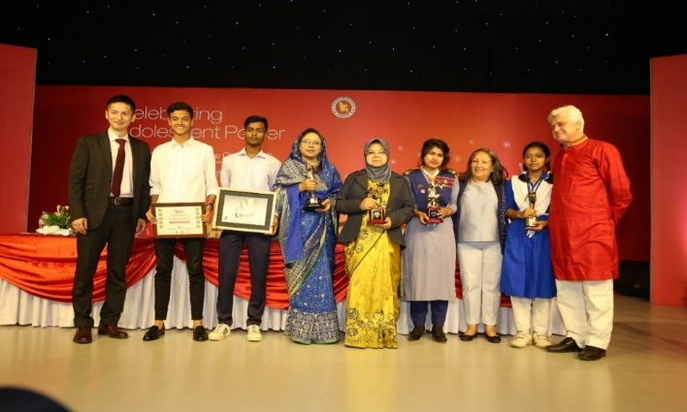
Achievements & Innovations
Evidence Based Theoretically Driven Strategy
Media campaign reach and recognition
Leveraging social media
Norm Based Media Campaign
Partnerships and move away from sectoral silos
Changes in CM and gender related knowledge, attitudes, practices and norms
Notes:
The campaign is innovative and it is the first time an evidence and social norms theory-based effort has been executed in such a strategic manner in Bangladesh. Such large-scale digital and mass media engagement is a meaningful milestone for social change efforts.
Focused on ending child marriage using a transformative approach
Addressed attitudes about how girls are valued

Slide 9
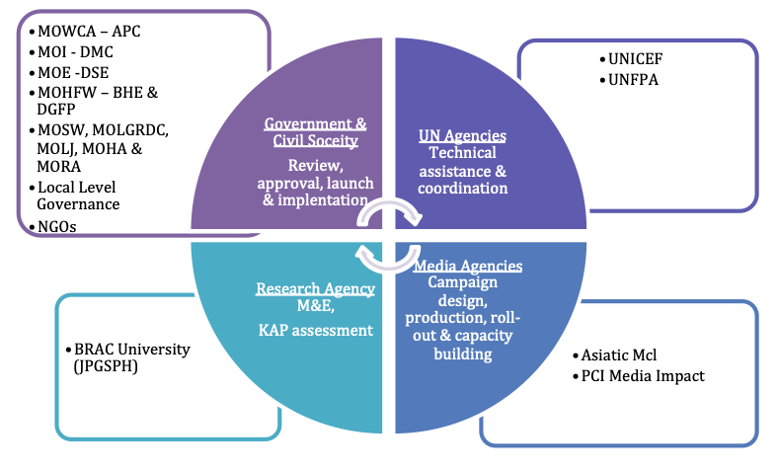
Implementing Partners

Slide 10
Takeaways: Partnership and Capacity Building
Close collaboration and high level support from the Government, fostering inter-ministerial collaboration
Institutionalizing a C4D advisory group within MOWCA
Strong partnership among stakeholders and bringing together national and global partners
  Asiatic MCL, a leading private-sector creative agency, headed the creative strategy and media production. PCI Media provided mentoring support to Asiatic MCL.
  BRAC University (JPGSPH) conducted the research with Drexel University providing technical support.
The Dhol Campaign was instrumental in advancing private sector partnerships and laid the foundation for pro bono airtime for the broadcast of the television series on the government channel and four private channels.
Notes:
Icchedana, built national capacity in designing, implementing and assessing theory-driven and evidence-informed trans-media SBCC programs, and provides a model for other developing contexts.
Ongoing collaboration with partners strengthened ownership and required advocacy, engagement and commitment.

Slide 11
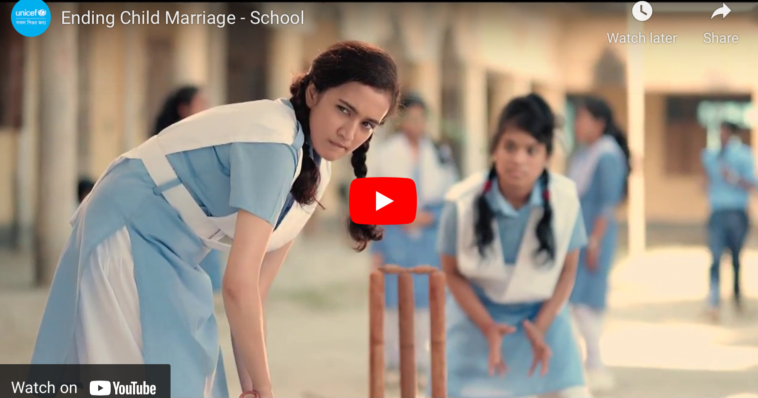
Recommendations
Sustain the momentum
Strengthen the on-air, on-line and on-ground synergy
Generate evidence through robust M&E
Enhance adolescent participation and male engagement
Invest in cross-sectoral convergence
Explore innovative approaches to increase exposure
Notes:
Continue the delivery of a harmonized ECM package of interventions will further the gains achieved in Phase 1 and sustain the momentum. Social change occurs over time and sustained engagement.
Child marriage is a cross sectoral issue and investing in multi-sectoral partnerships is key. The drama should continue to emphasize broad constructs of gender equality and empowerment such as agency, voice, decision-making skills, confidence and consent while addressing specific sectoral issues such as sexual and reproductive health, education, livlihood and lifeskills.
The comprehensive approach and synergy between the media, community engagement and digital component is important.The whole is greater than the sum of its parts. In the next phase it will be worthwhile strengthen the synergy and to explore opportunities such as including an Icchedana viewers’ group within the existing adolescent club structure.
The media environment is rapidly changing and highly saturated. The creative and programme design needs to consider ways to include more interaction and a live component. This will contribute to higher levels of engagement to the series. Explore new media and innovative ways to enhance reach
Continue to generate evidence and learn from doing. Investing in robust M&E so you know what is working well and what needs to be improved. Documenting the experience and sharing lessons learned will be critical to improving and adapting in the next phase and informing child marriage efforts in other contexts.
As an adolescent centered effort, the overall programme must bolster adolescent engagement and participation across initiatives and different stages of programming.
Engaging boys through additional school based efforts and involving a larger number of boys in adolescent clubs will be beneficial in helping them understand that gender transformation and a shift in existing power structures results when men, women, boys and girls work together.

