Slide 1
Kanyashree Prakalpa
Priyanka Deb, WBCS (EXE)
Department of Women & Child Development & Social welfare
Government of West Bengal, India

Slide 2

Theory of Change
1
Prevention of child marriage
Completion of school education
Financial inclusion
Improved educational attainment and voice in family and society
Two – staged Conditional Cash Transfers
Reduced risk of maternal and child ill-health and mortality
Empowering girls families, community and society
Positive changes in perceptions, attitudes and aspirations of girls and their families
2
Cash Plus interventions
Reduced risk of violence, abuse and exploitation
An enabling environment which encourages girls and women participation on equal terms
Socio-economic inclusion and gender equity
Aligned to the
Sustainable Development Goals

Slide 3
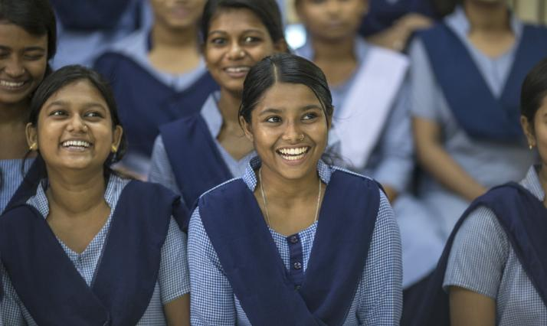
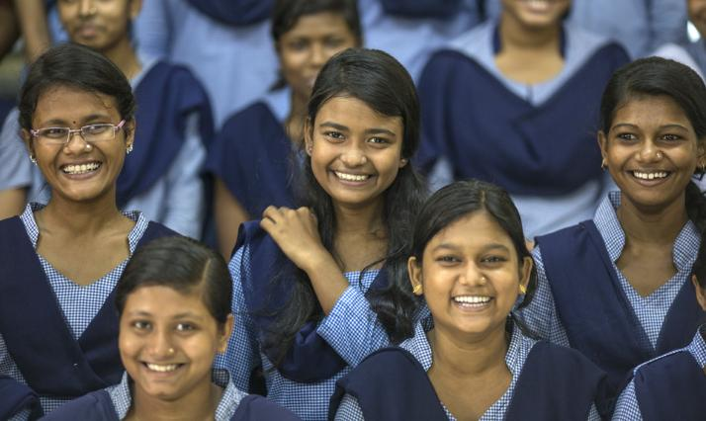
Cash Transfers - Coverage
1
Two – staged Conditional Cash Transfers
78.14 lakh
Kanyashree girls enrolled
18,183
Educational institutions
Budget in Rs. Crore
12598.19

Slide 4
Cash Plus – Activities and Coverage
In Schools
  Kanyashree Clubs
  Awareness generation
  Exposure visits to public institutions (bank, police stations, administrative offices etc.)
  Sports & Games
  Skill Development
In Community (SAG-KP Convergence Programme)
  Kishori Samooh
  Awareness on Nutrition and Health, Adolescent Reproductive & Sexual Health, Life Skills education
  Health Check-up and Referrals
8,000
Educational Institutions
2
Cash Plus interventions
Girls Groups
1,19,481
Community Centres

Slide 5
West Bengal: Location, Size &Diversity
Population | 91 Million (2011)
Density | 1,000/km2 (2,700/sq miles)
Highest Density | Kolkata (24,306)
Urban % | 31.87
Rural % | 68.13
Administrative Units | District Sub-District Municipalities & Corporations Gram Panchayats
Grassroots | Towns & Villages
Adolescent Girls | 44,467,088
Educational Institutions | 18183
Languages
Religions
Regional Diversity
Regional Vulnerabilities
Remote geographic areas
Internet dark areas
High-levels of in and out migration
Borders with three countries

Slide 6

Implementation & Monitoring Mechanisms
Numbers
Project Management
Units
State
District
Subdivisions / Blocks
Educational Institutions
14 State Government Depts.
SPMU
1
State Treasury
DPMU
NIC
UNICEF/NGOs
23
E-Governed through
www.wbkanyashree.gov.in
924
SDO / BDO
18,183
Beneficiary Banks

Slide 7
WAY FORWARD…
District Action Plan which has three major target groups
  KRA 1: Adolescent girls and boys
  KRA 2: Parents, communities, SHGs, PRIs, CPCs
  KRA 3: Service providers
Documentation of Child Marriage Incidents & Follow up

