Slide 1
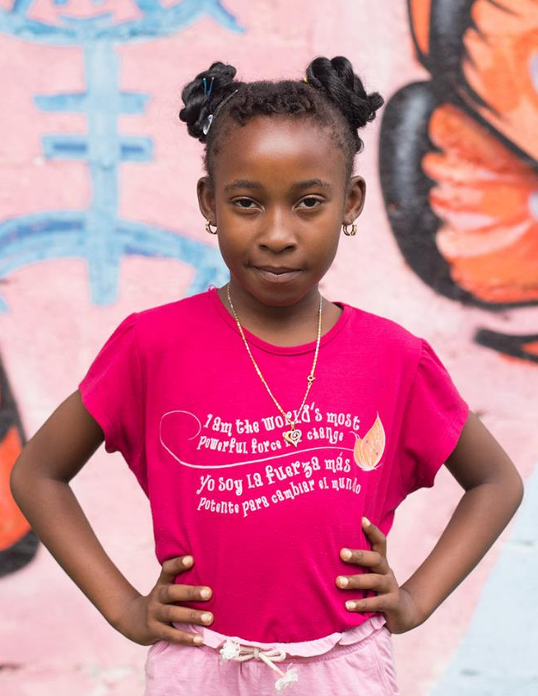

Welcome!
Learning Series Session 3
Supporting Married Girls and Adolescent Mothers

Slide 2

Girls Not Brides Learning Series:
Supporting Married Girls and Adolescent Mothers
This session will have presentations in English and Spanish. To access simultaneous interpretation, please click on the globe icon at the bottom bar of your screen and select your preferred language (English, Spanish, French, or no interpretation).
Esta sesión tendrá presentaciones en inglés y español. Para acceder a los servicios de interpretación simultanea, por favor haga clic en el icono del globo que encontrará en la barra inferior de su pantalla, y seleccione su idioma de preferencia (inglés, español, francés o version original).
Cette session comprendra des présentations en anglais et espagnol. Pour accéder aux services d'interprétation simultanée, veuillez cliquer sur l'icône globe que vous trouverez dans la barre inférieure de votre écran, et sélectionnez votre langue préfrée (anglais, espagnol, français ou version originale).

Slide 3
Supporting married girls and adolescent mothers
22nd September

Slide 4
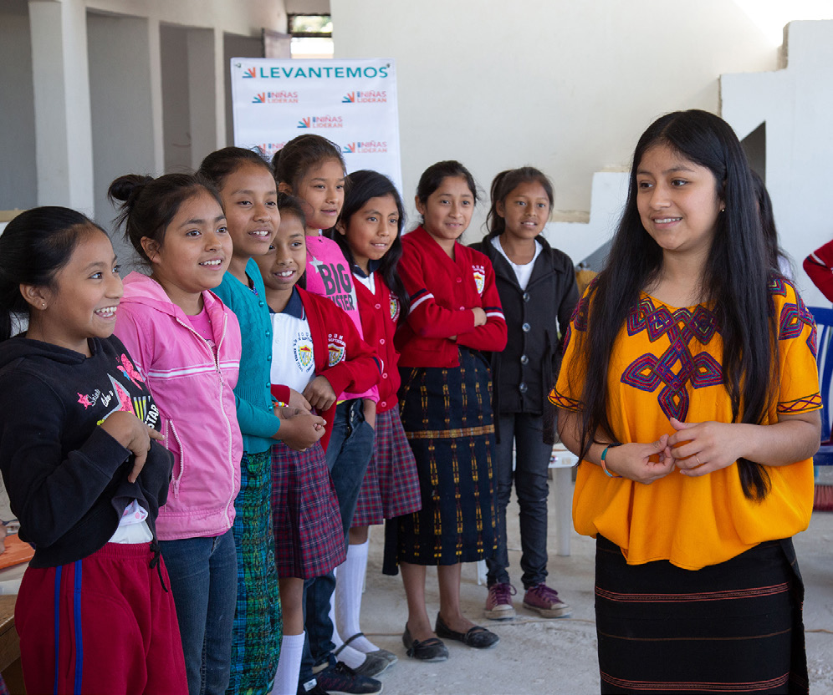
Learning Series
Sharing evidence, learning, new tools and experience to support you work to end child marriage
SIX
SHARED
GOALS
Monthly webinar
June-December

Slide 5
Session overview
Overview of global evidence on the impact of adolescent motherhood on the lives of girls
Key recommendations on supporting married girls and adolescent mothers
Learnings from programmes to support married girls and adolescent mothers from around the world:
    Marla Lino and Ana Gabriela Torres, ProSalud “Reencontrandome” (finding myself again), Mexico
    Usha Choudhary, Vikalp Sansthan, India
4. Q&A

Slide 6
Girls Not Brides’ work to support adolescent mothers and married girls
Arwyn Finnie

Slide 7
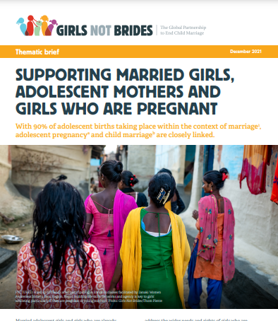


Background
Globally, the vast majority of adolescent mothers are married :
  90% of births to adolescent girls take place within marriage
Responses to both adolescent pregnancy and child marriage to date heavily focused on prevention only:
  the unique needs of married girls and adolescent mothers are often overlooked
To support advocacy in this area, Girls Not Brides decided to undertake desk based research on the needs of married girls and existing initiatives to support them.

Slide 8
Key findings: links between adolescent pregnancy and child marriage
Every year 12 million girls aged 15 to 19 – and 770, 000 girls under 15 – give birth in low- and middle-income countries.
Globally, adolescent birth rates have decreased by about a third since the 1990s.
Adolescent birth rates today are highest in West and Central Africa, Southern Africa, and Latin America and the Caribbean (LAC).
Adolescent pregnancy may occur before or after a girl enters a marriage/ union:
  In South Asia, almost all adolescent mothers are married girls.
  In LAC and sub-Saharan Africa, adolescent pregnancy takes place both within and outside of marriage and unions.
Pregnancy among girls aged 10-14 is much less common than pregnancy among older adolescents, and occurs most frequently in sub-Saharan Africa. Very early pregnancy is often the result of sexual violence, and is strongly associated with child marriage and poverty.

Slide 9

Key findings: the impact of adolescent motherhood on health of girls
Health risks of adolescent pregnancy are well documented:
pregnancy and childbirth related complications consistently among the leading causes of death for adolescent girls globally -> up to 99% of all maternal deaths occur among adolescent girls aged 15 to 19
rapid, repeat pregnancies are common among adolescent mothers, further increasing risks
Children of adolescent mothers more likely to suffer health problems such as low birth weight, stunting, mortality
Increasing recognition however that the focus on maternal and child health has neglected the other needs and rights of married girls and adolescent mothers

Slide 10
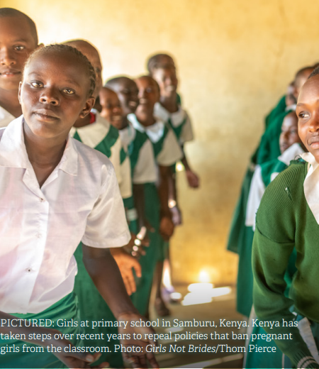
Key findings: the impacts of adolescent motherhood on girls’ education
Disruption to education
Up to 4 million girls drop out of school every year due to pregnancy in sub-Saharan Africa alone.
Girls may choose to discontinue, or be pushed out by policies that ban them from the classroom
Other common obstacles include; lack of awareness of school re-entry policies, lack of school flexibility, financial difficulties, lack of parental support, lack of affordable childcare, and prevailing discriminatory attitudes on the part of teachers, administrators and fellow students

Slide 11

Key findings: the impact of adolescent motherhood on future life prospects of girls
Impact on future life prospects:
Adolescent mothers are more likely to be in employment with limited earning potential throughout their working lives
This can lead to pressure to marry or enter a union with the father
The daughters of adolescent mothers are more likely to become adolescent mothers themselves, creating a cycle of poverty
In LAC and sub-Saharan Africa, adolescent mothers are often abandoned by the fathers of their children, which can lead girls to seek further informal unions or engage in transactional sex
Adolescent pregnancy is often highly stigmatised leading to social exclusion

Slide 12
Key findings: the impact of adolescent motherhood on the lives of girls
Reproductive coercion and the violation of sexual and reproductive rights:
Many adolescent mothers report that the decision to have a child was not made by them, in violation of their reproductive rights
Pregnancy as a result of rape also leads to forced motherhood in contexts where access to safe abortion is restricted
Obstetric violence is more commonly experienced by younger, unmarried and uneducated women. Frequently reported by adolescent mothers in LAC, it ranges from judgemental attitudes during labour to reports of systematically enforced insertion of intrauterine devices (IUDs) after labour in Mexico.
Poor mental health outcomes:
Adolescent pregnancy is associated with increased risk of mental health issues, including depression, anxiety and suicidal thoughts.
In Brazil, a study of suicidality found that 13% of adolescent mothers had exhibited suicidal behaviour and that those who had limited social support were nearly 70% more likely to exhibit suicidal behaviour than those with high levels of social support
In El Salvador and Guatemala there is emerging evidence that forced motherhood is leading pregnant adolescents to take their own lives.

Slide 13
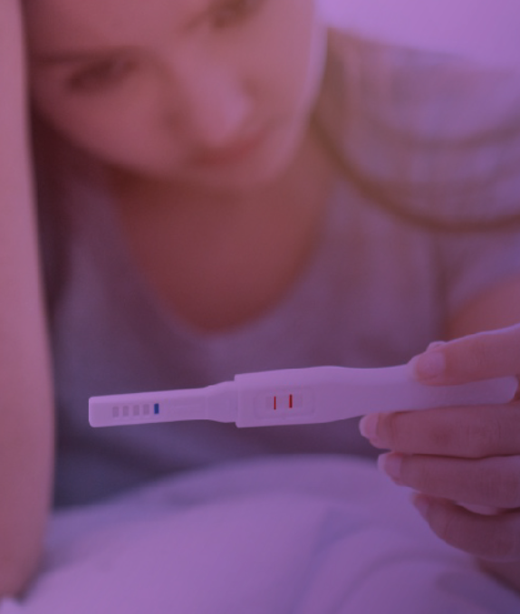
Key findings: the impact of adolescent motherhood on the lives of girls
Gender based violence:
Adolescent pregnancy is often the result of rape or sexual coercion of a minor, especially among younger girls (> 15).
Despite this, girls who have experienced sexual violence are often not provided with adequate psychological support, referrals to social support services or access to justice.
Adolescent mothers are also more likely to experience intimate partner violence than girls who have never been pregnant
HIV:
In East and Southern Africa, HIV infection overlaps strongly with adolescent motherhood.
The double impact of adolescent pregnancy and an HIV diagnosis can be particularly overwhelming for girls

Slide 14
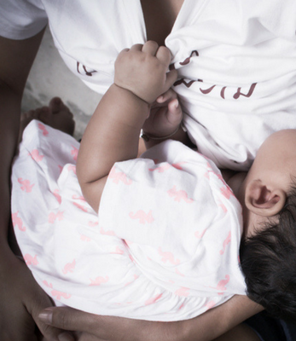
Towards a holistic approach to supporting adolescent mothers
Adolescent mothers and girls who are pregnant have needs that go beyond maternal and neonatal health: they need support to realise their rights, return to school and access economic opportunities, navigate their new role as mothers, and to access justice and support services where their pregnancy is related to sexual violence.
Policies to support them should be integrated into existing national strategies to ensure that adolescent mothers are offered a holistic package of support.

Slide 15
Key findings: the impact of adolescent motherhood on the lives of girls
Reproductive coercion and the violation of sexual and reproductive rights:
Many adolescent mothers report that the decision to have a child was not made by them, in violation of their reproductive rights
Pregnancy as a result of rape also leads to forced motherhood in contexts where access to safe abortion is restricted
Obstetric violence is more commonly experienced by younger, unmarried and uneducated women. Frequently reported by adolescent mothers in LAC, it ranges from judgemental attitudes during labour to reports of systematically enforced insertion of intrauterine devices (IUDs) after labour in Mexico.
Poor mental health outcomes:
Adolescent pregnancy is associated with increased risk of mental health issues, including depression, anxiety and suicidal thoughts.
In Brazil, a study of suicidality found that 13% of adolescent mothers had exhibited suicidal behaviour and that those who had limited social support were nearly 70% more likely to exhibit suicidal behaviour than those with high levels of social support
In El Salvador and Guatemala there is emerging evidence that forced motherhood is leading pregnant adolescents to take their own lives.

Slide 16
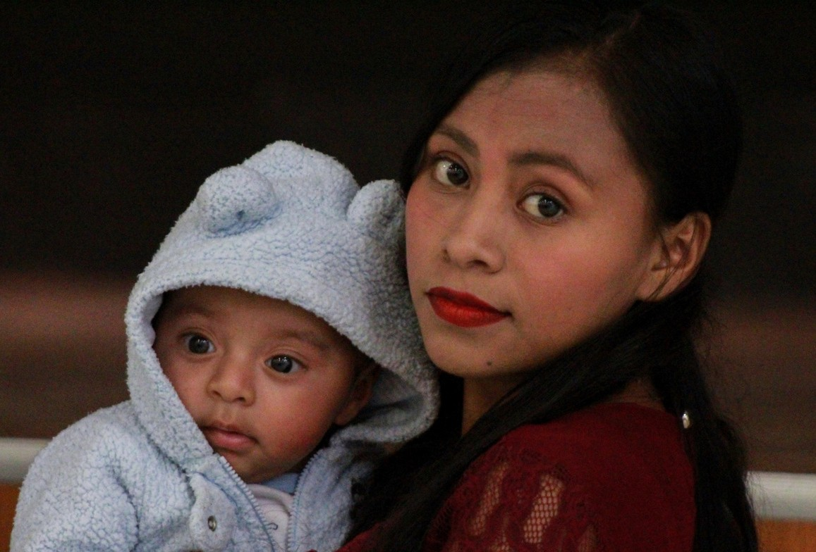


Sesión 3 de la Serie de Aprendizaje de GirlsNot Brides. Apoyo a las niñas casadas y a las madres adolescentes Jueves 22 de septiembre 2022
Marla Lino, Ana Gabriela Torres, Doroteo Mendoza

Slide 17
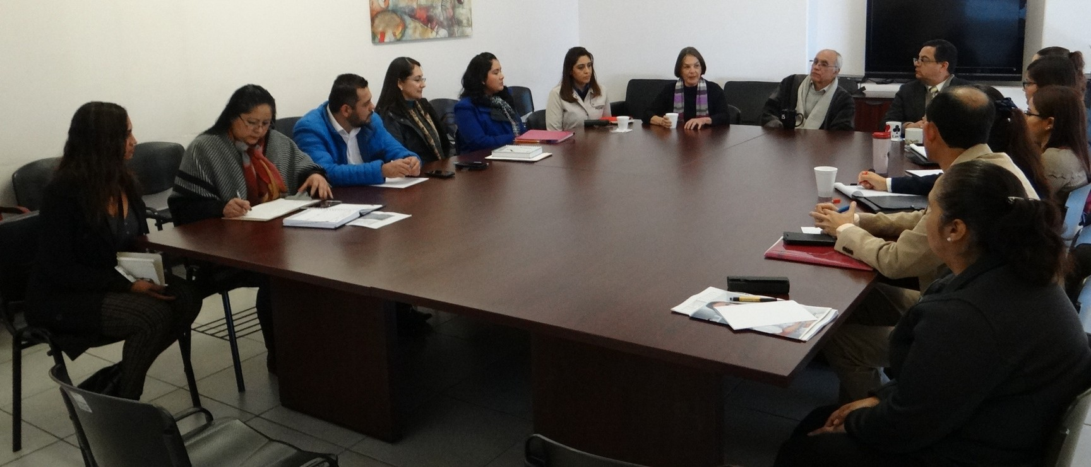
¿CÓMO, CUÁNDO Y PARA QUÉ SURGE REENCONTRÁNDOME?
Reunión con personal de salud

Slide 18
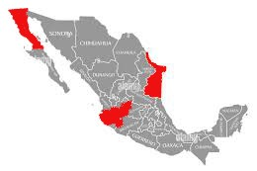
¿DÓNDE SE ORIGINA?
Guadalajara, Jalisco Tamaulipas
Tijuana, Baja California

Slide 19
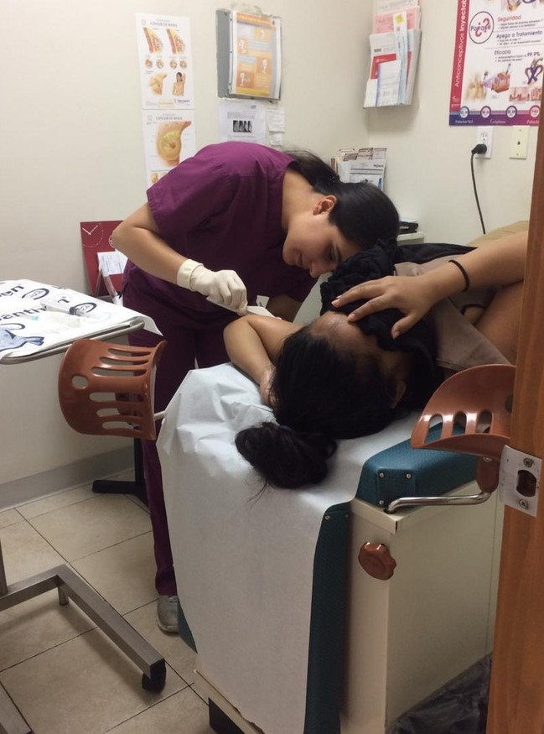
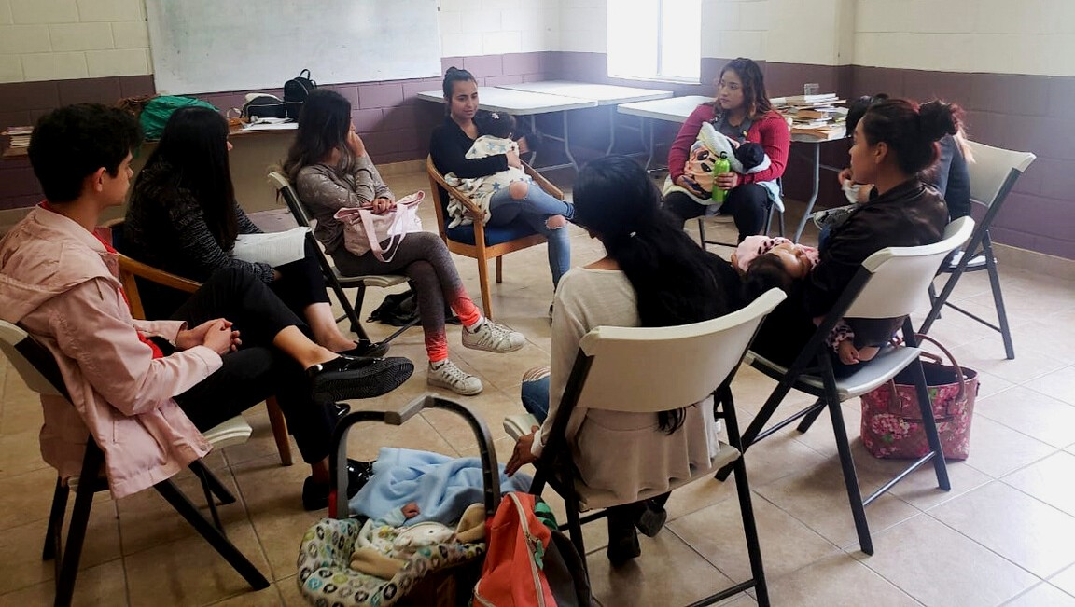
DISEÑO DEL ESQUEMA DE TRABAJO
Intervención educativa
Servicio de salud sexual y reproductiva

Slide 20
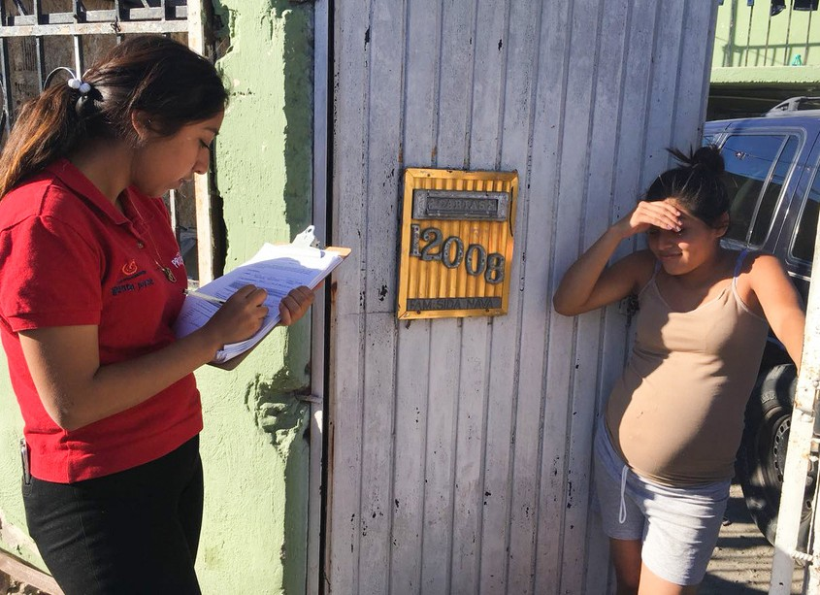
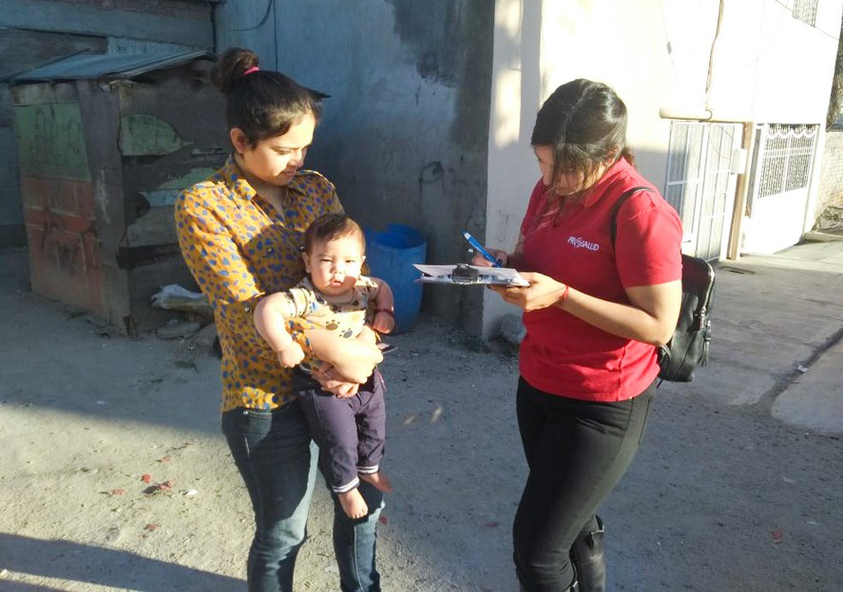
FASE 1
Reclutamiento de adolescentes e inicio del proceso de seguimiento.

Slide 21
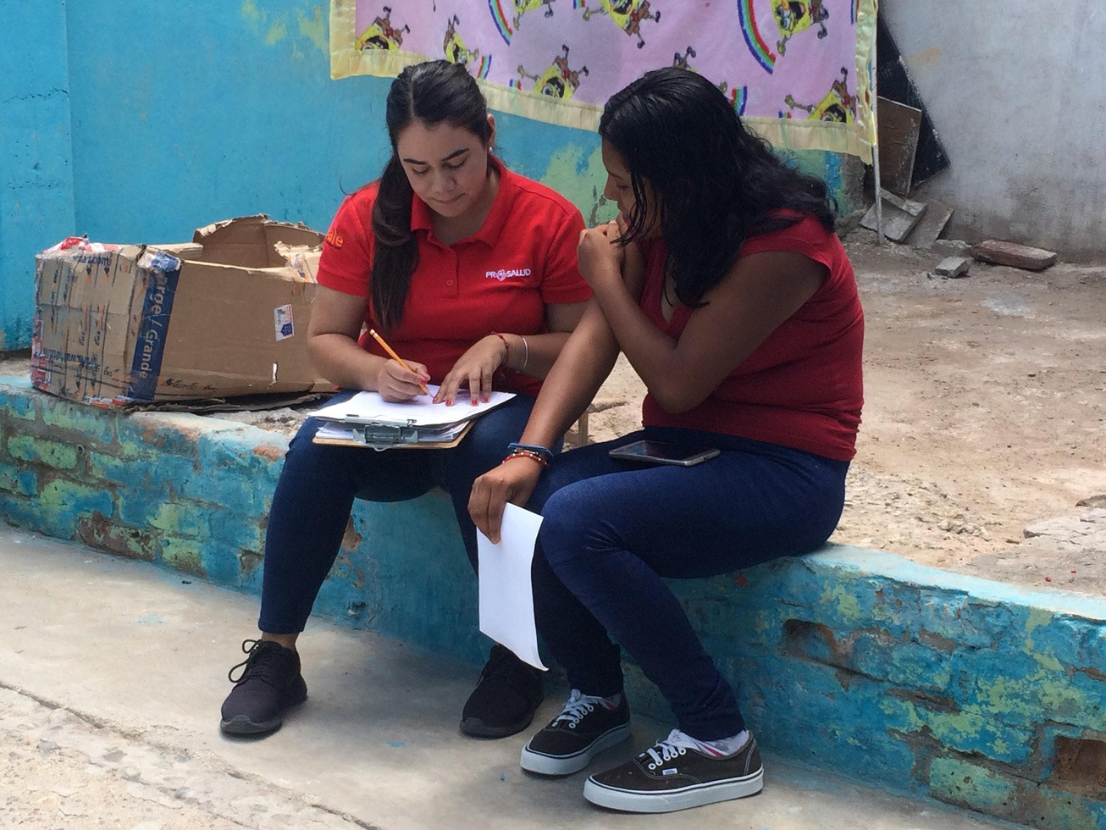
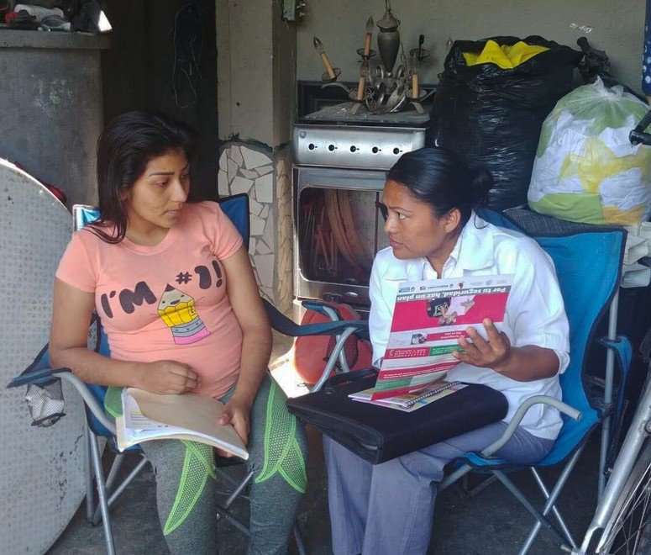

FASE 2
Orientación-acompañamiento, empleabilidad juvenil, redes de apoyo y fortalecimiento de servicios de salud.

Slide 22
FASE 3
Graduación de la adolescente, evaluación, documentación de la experiencia y difusión de resultados.

Slide 23
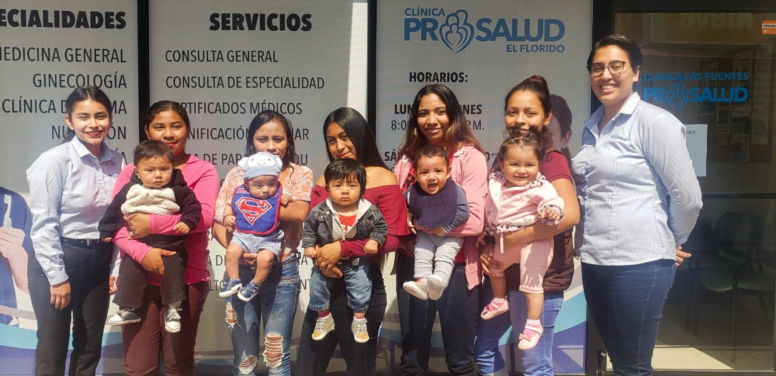
PRIMEROS FRUTOS ¿QUÉ APRENDIMOS?
Grupo de madres adolescentes

Slide 24


¿CÓMO SE VALIDÓ EL MODELO?

Slide 25
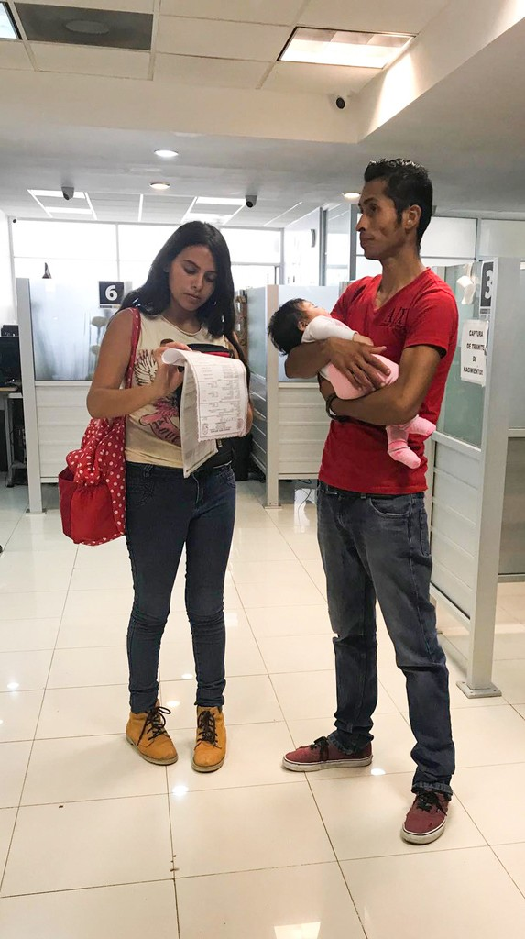
COMPONENTES
Conocimiento de anticonceptivos y uso del método elegido.
Actitudes de corresponsabilidad como madres. Comunicación asertiva con la pareja y redes de apoyo familiar.
Proyecto de vida, incorporación a la escuela o trabajo. Autonomía y empoderamiento en la toma de decisiones.
Promotora por experiencia, agente de cambio.

Slide 26
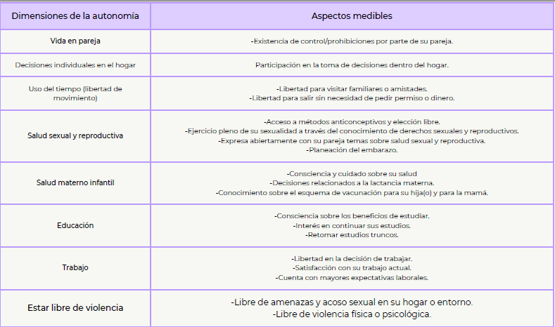
Dimensiones de la autonomía | pectos medibles
Vida en pareja | -Existencia de control/prohibiciones por parte de su pareja.
Decisiones individuales en el hogar | Participación en la toma de decisiones dentro del hogar.
Uso del tiempo (libertad de movimiento) | -Libertad para visitar familiares o amistades. -Libertad para salir sin necesidad de pedir permiso o dinero.
Salud sexual y reproductiva | -Acceso a métodos anticonceptivos y elección libre. -Ejercicio pleno de su sexualidad a través del conocimiento de derechos sexuales y reproductivos. -Expresa abiertamente con su pareja temas sobre salud sexual y reproductiva. -Planeación del embarazo.
Salud materno infantil | -Consciencia y cuidado sobre su salud -Decisiones relacionados a la lactancia materna. -Conocimiento sobre el esquema de vacunación para su hija(o) y para la mamá.
Educación | -Consciencia sobre los beneficios de estudiar. -Interés en continuar sus estudios. -Retomar estudios truncos.
Trabajo | -Libertad en la decisión de trabajar. -Satisfacción con su trabajo actual. -Cuenta con mayores expectativas laborales.
Estar libre de violencia | -Libre de amenazas y acoso sexual en su hogar o entorno. -Libre de violencia física o psicológica.

Slide 27
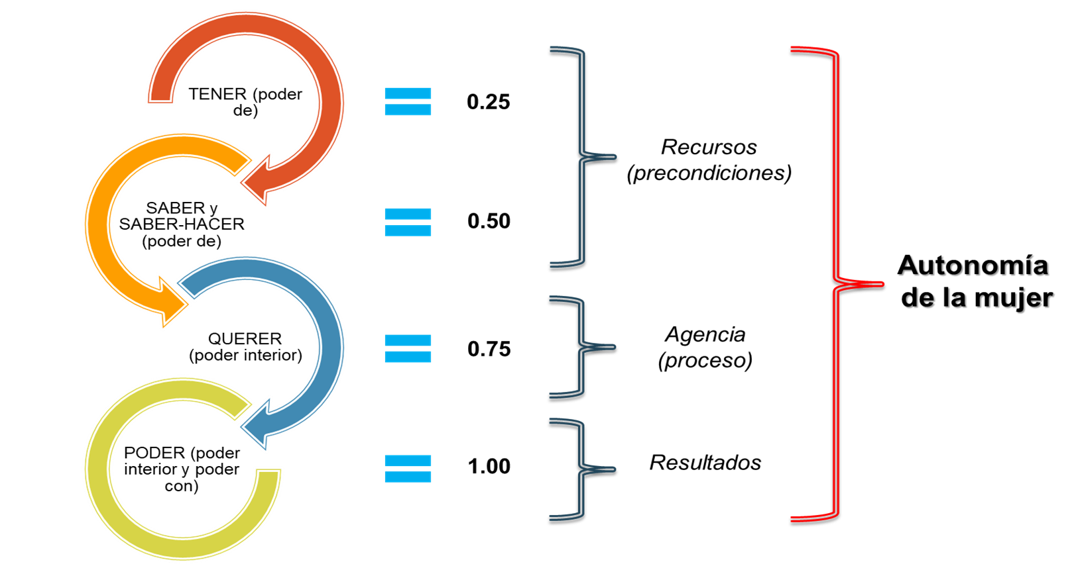

ESCALA DE INTERVALO PARA LA VALORACIÓN DEL PROCESO DE AUTONOMÍA

Slide 28
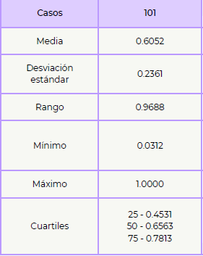
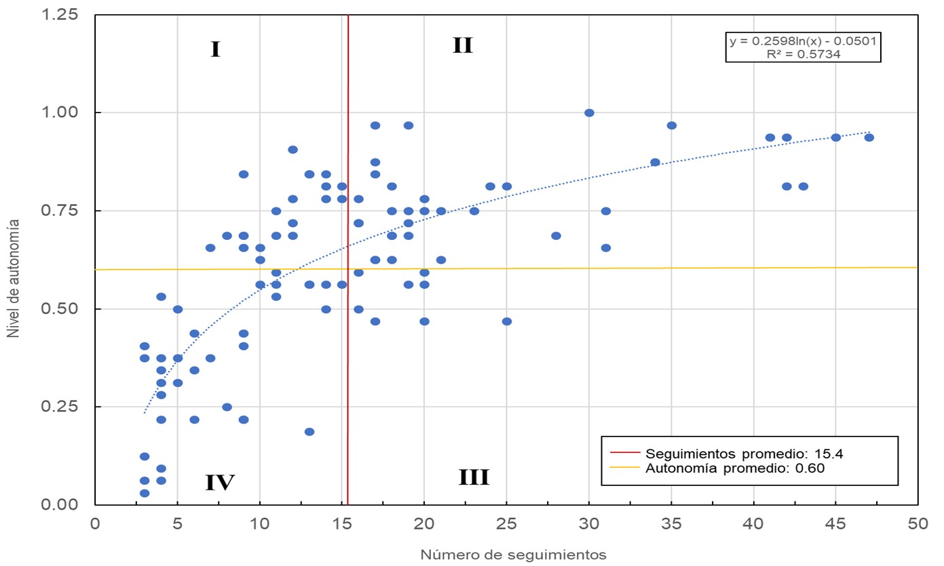
DISTRIBUCIÓN DE CASOS SEGÚN AUTONOMÍA
Casos
Media
Desviación estándar
Rango
Mínimo Máximo
Cuartiles
101
0.6052
0.2361
0.9688
0.0312
1.0000
25 - 0.4531
50 - 0.6563
75 - 0.7813

Slide 29
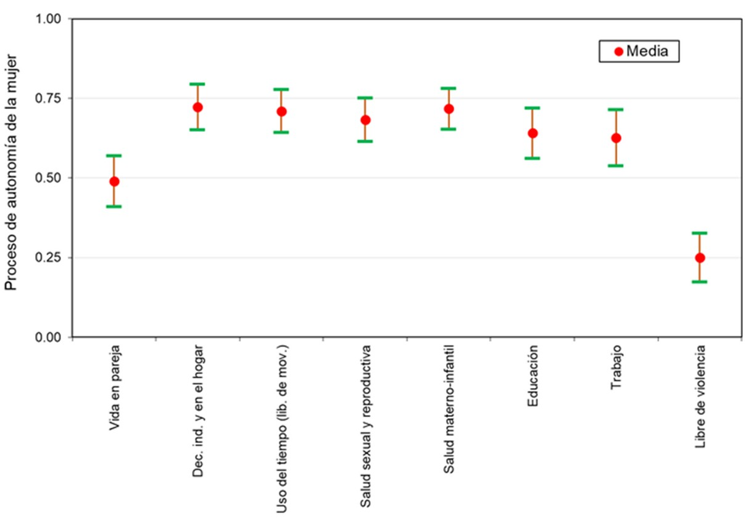
RESULTADOS SEGÚN DIMENSIONES DE LA AUTONOMÍA

Slide 30
ESTIMACIÓN DEL IMPACTO EN LA DISMINUCIÓN DEL EMBARAZO
De las 101 adolescentes del seguimiento, 29 usaban un método al inicio (“no estarían expuestas al embarazo”)
101 – 29 = 72 teóricamente expuestas a un embarazo durante la intervención, potencialmente se hubieran embarazado en algún momento
12 se embarazaron: 9 no planeado y 3 embarazo deseado
Por lo tanto: 72 – 12 = 60 / 101 = 59% evitó la intervención como aproximación al impacto.

Slide 31
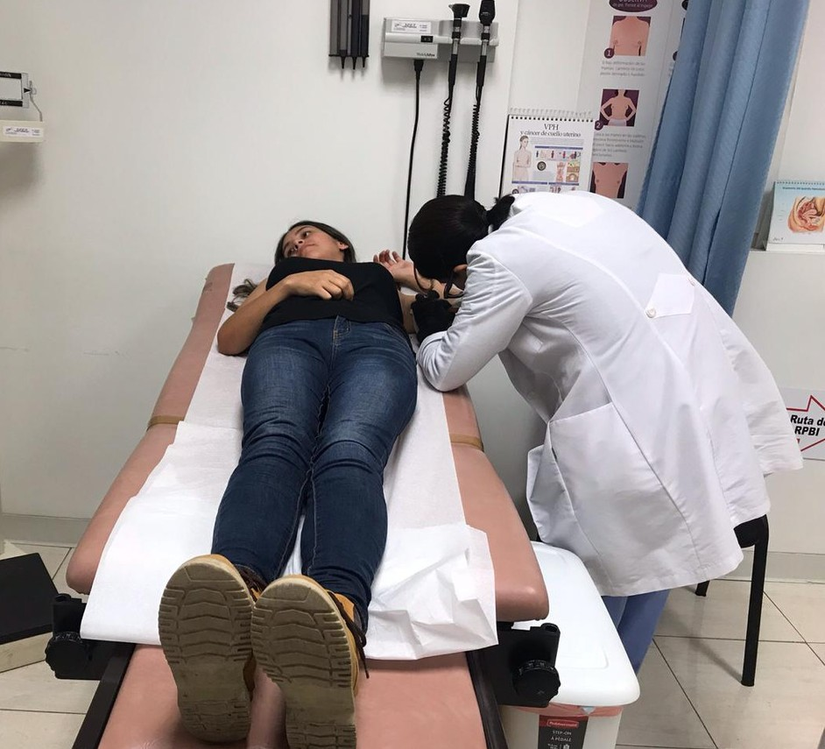
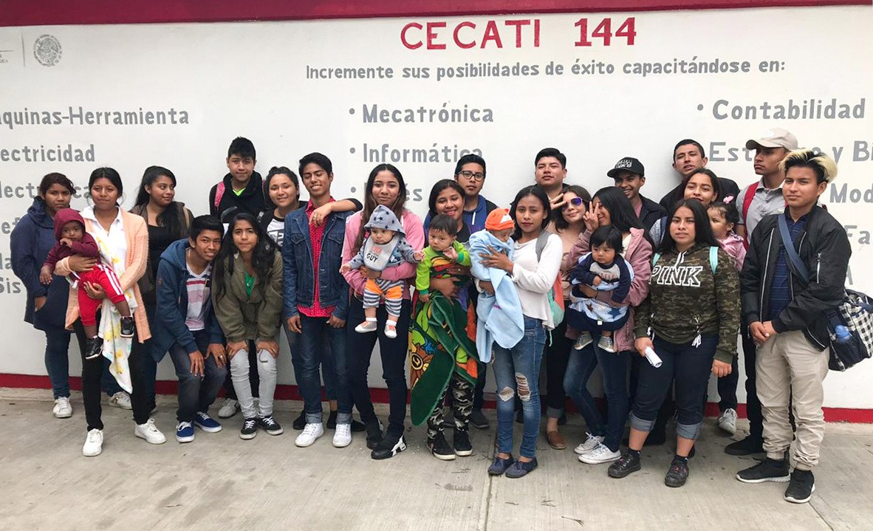
CONCLUSIONES

Slide 32
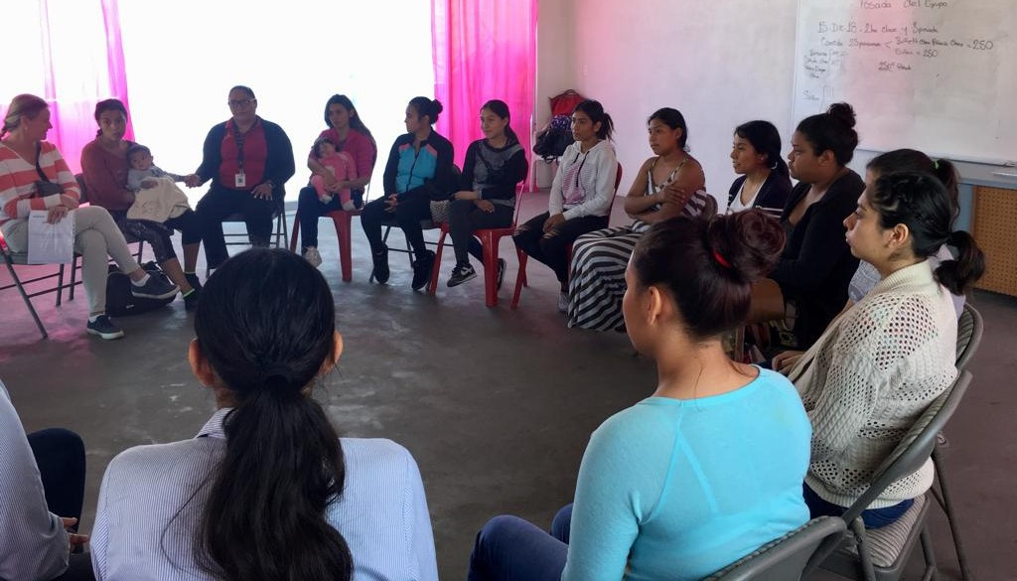
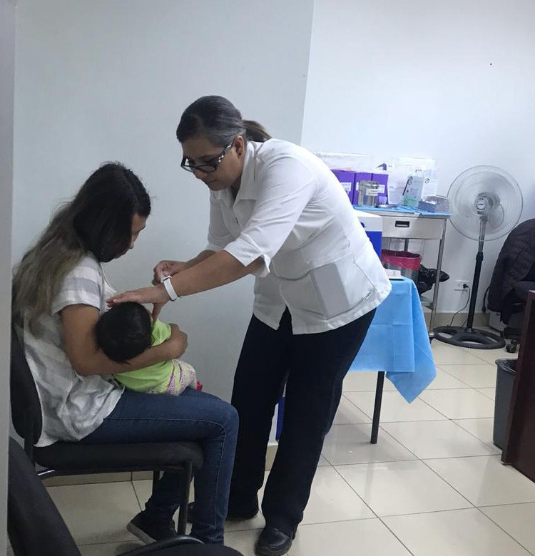
CONCLUSIONES

Slide 33
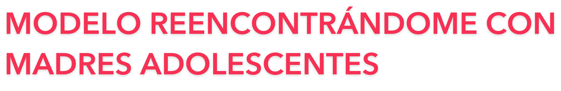
GRACIAS POR SU ATENCIÓN
PUBLICACIÓN DE LA VALIDACIÓN DEL MÓDELO REENCONTRÁNDOME

Slide 34
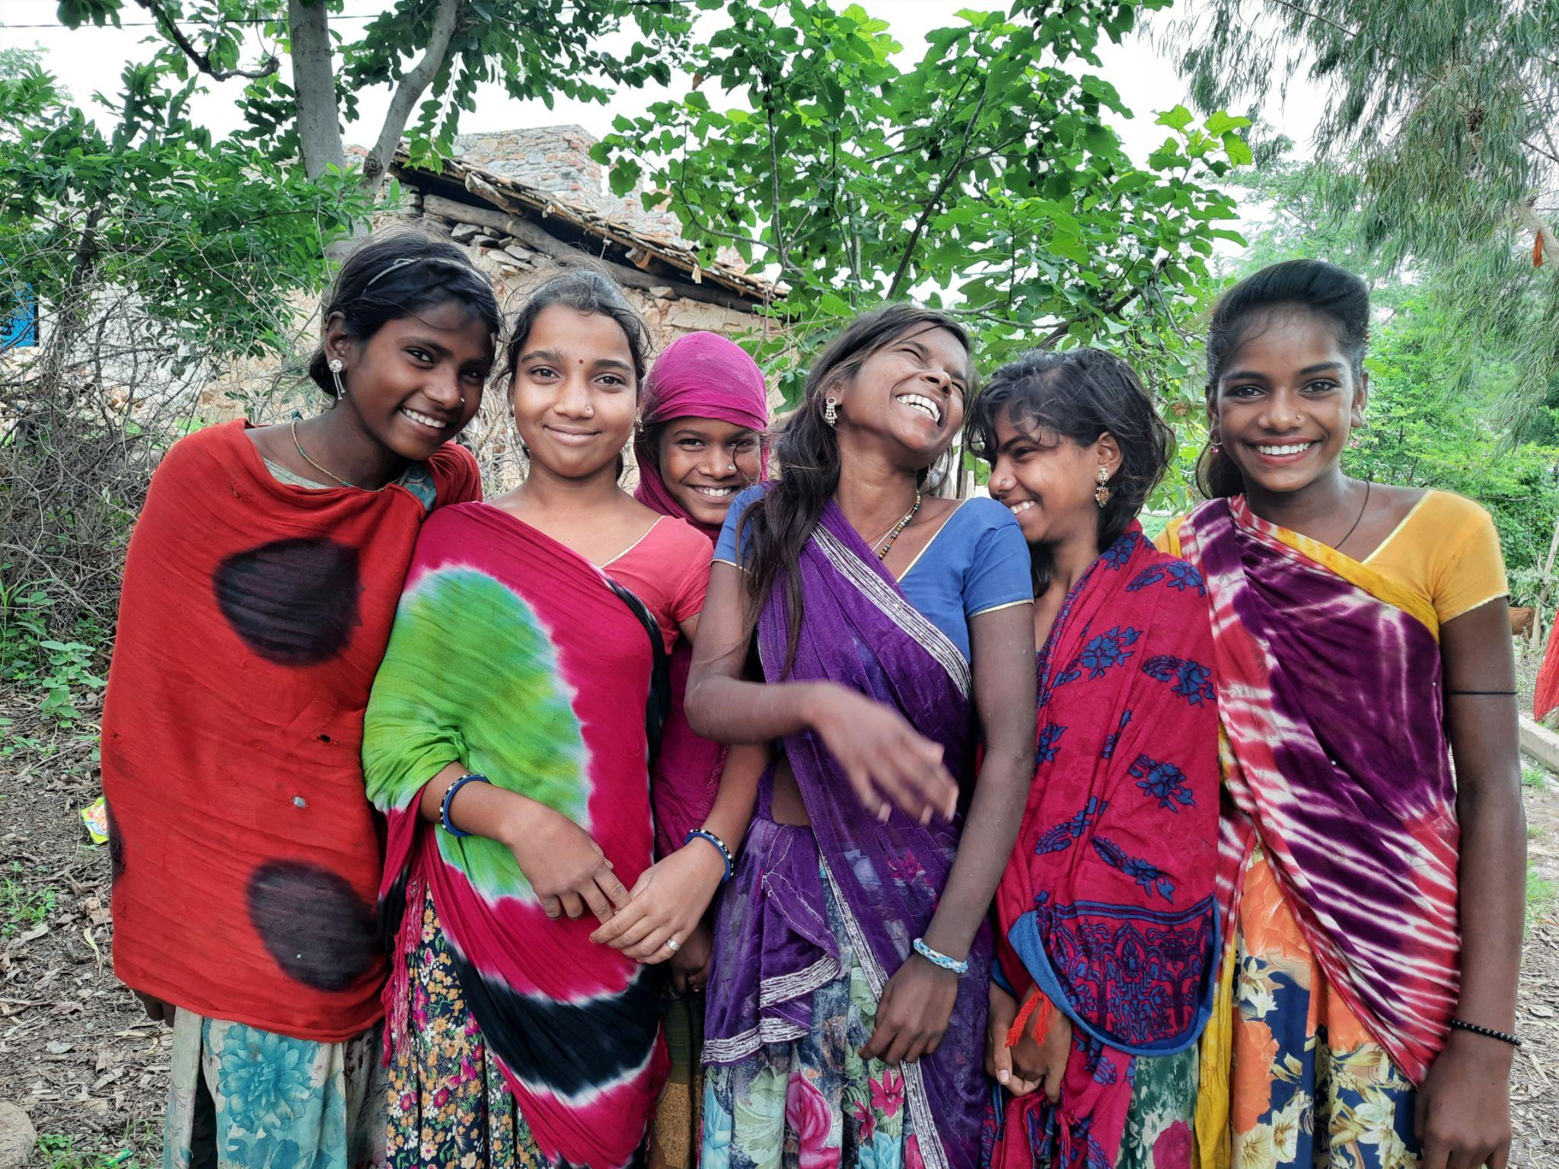

Young Married Girls and their needs

Slide 35
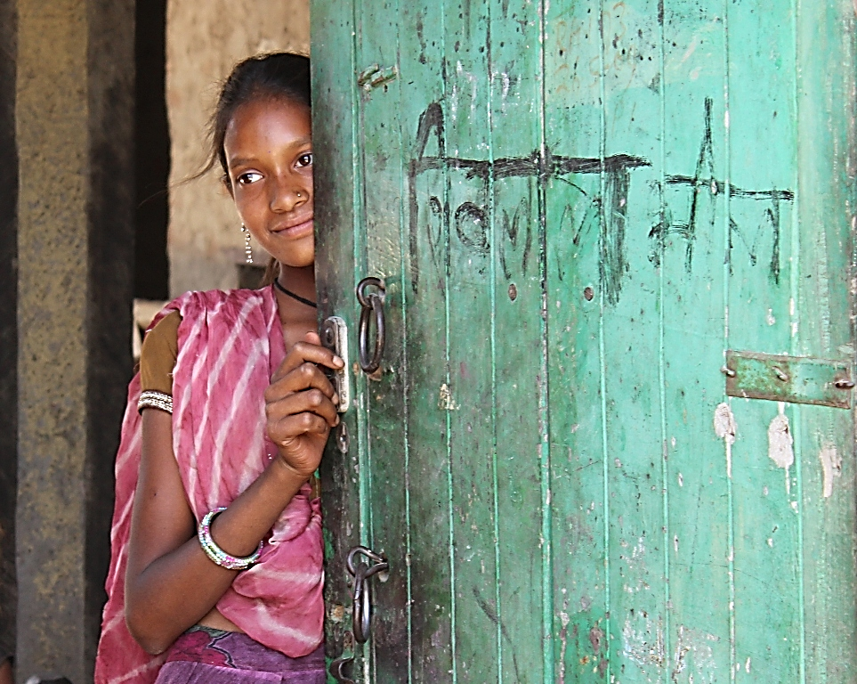
Feudal state
Caste Based Discrimination
Domestic Violence
Patriarchy
Child Marriage
Witch Hunting
Sex Selective Abortion
To End Gender Based Violence
Convert to agency of change

Slide 36
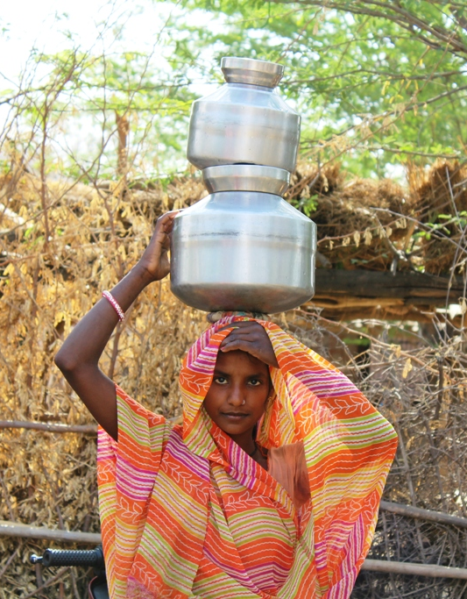
Why Young Married Girls?
“How can we dream now? We are married. Our education, our dreams are not in our hands now. Now we can only do what our marital family allows us to do. So we do not have any dreams.”
Lack of quality education
High rate of drop out from Education
Poverty
Under development
Cast Based Discrimination
Control on sexuality and Mobility
Harmful Social Norms
Early, child and forced marriage is a Deep Rooted and Socially Accepted Norm
THE INVISIBLE POPULATION

Slide 37
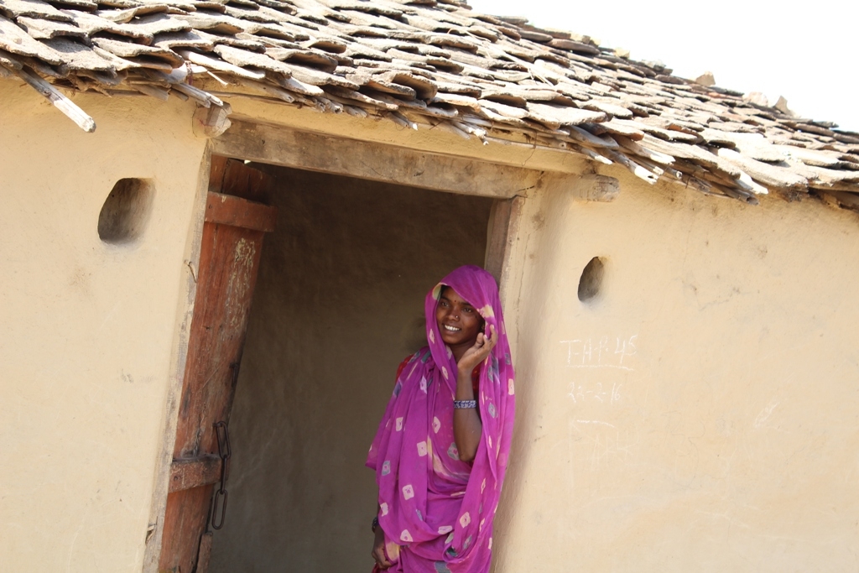
Government, NGOs, donors, all focus on girls who are at risk of marriage but married girls are more vulnerable.

Slide 38
Vulnerability of YMG
She consider as a last person of the house
Under control and vigilance
Her mobility controlled by in-laws
She can’t even go to her mother’s house without permission of mother in-law or husband
She has to do all the house work
She can’t share her feelings with anyone in this new home
She don’t have any network and friends
She face sexual harassment
In-laws expect child in first year of marriage
Lack of knowledge of SRHR
She accept all the discriminations and violence.
She lost her agency, dream, and hope for the life

Slide 39
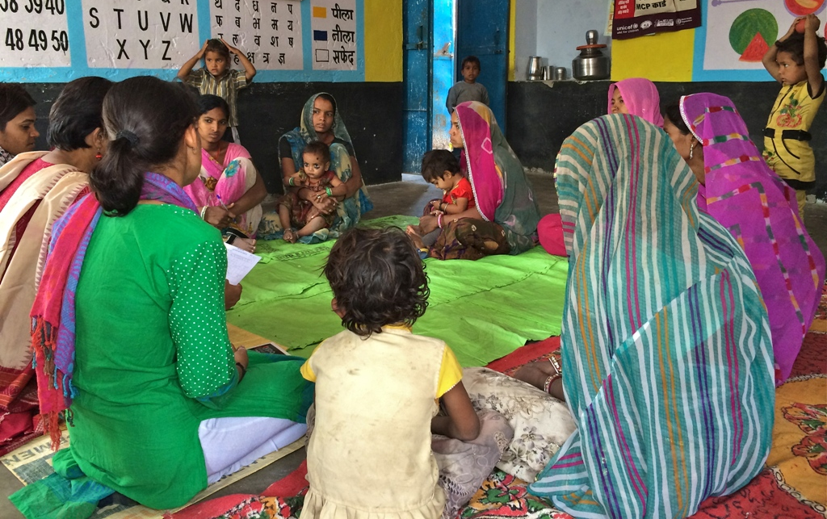
Engaging Young Married Girls
Education
Reproductive Health
Collectivization
Connected with Government schemes
Helpline
Work with Grooms

Slide 40
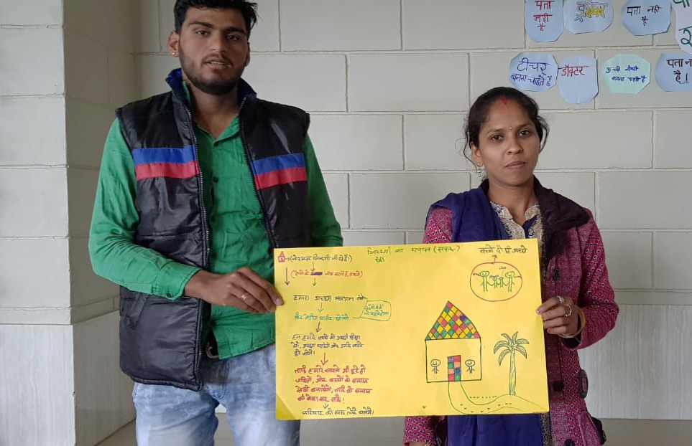
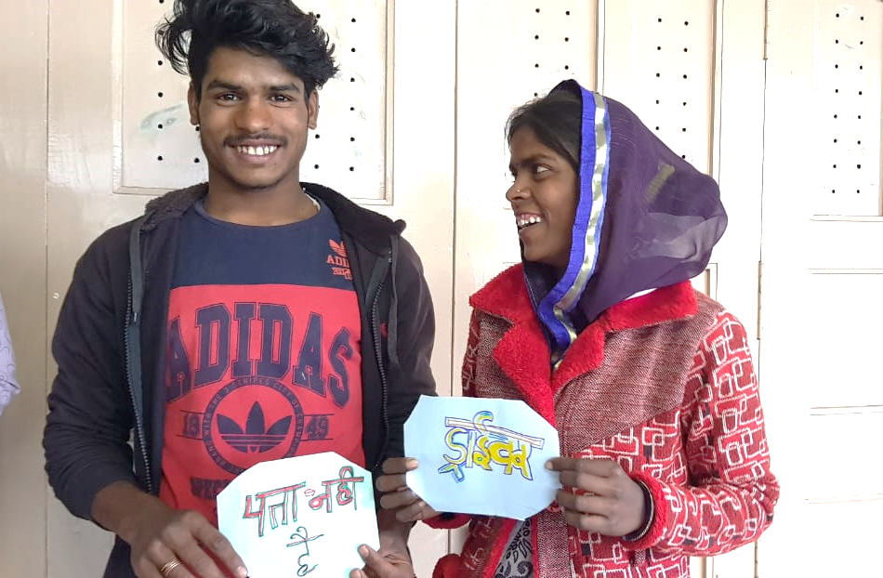
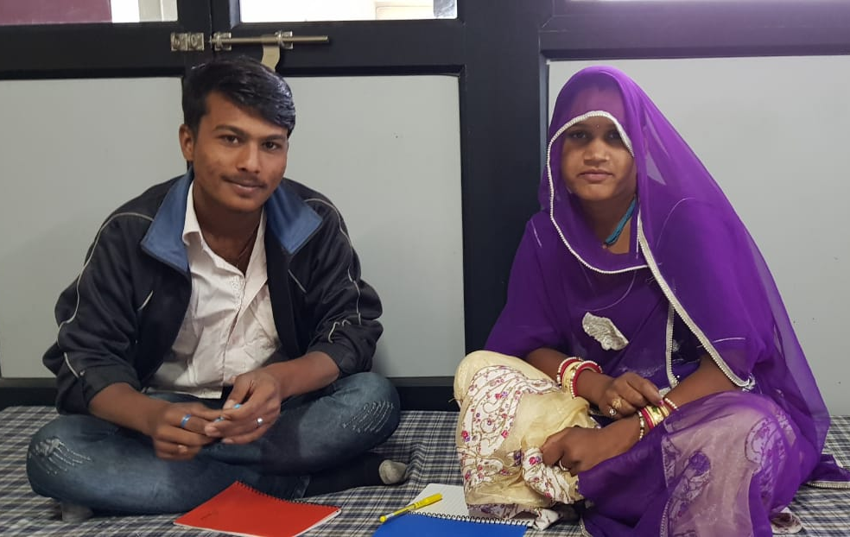
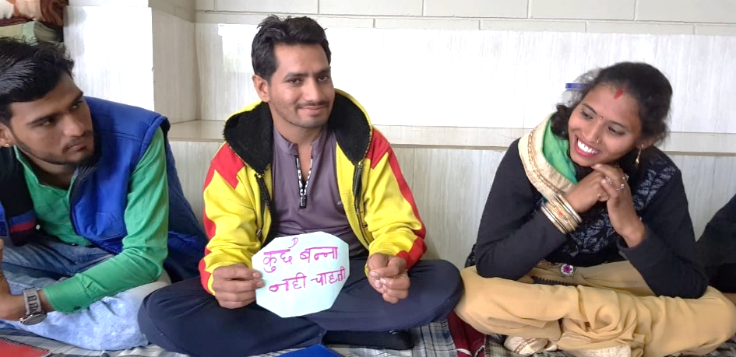
Engaging Young Married Couples

Slide 41
Effective Strategy
Couple workshop
I married form last 15 years but I never thought of the joint dream and planning. I felt that I married today. I talked to my wife on these issues in this workshop only, which I never did it. I thought, my life and family is good. I am earning and getting good food. I thought –”Kha pio aur moj karo.”

Slide 42
Primary Issues of concern
Respect,
Consent,
Joint Decisions,
Awareness about each others Dreams,
Joint Dreams,
Non-violent communication, Resiliency,
Care for each other,
Care Work within the house

Slide 43
Thank you

Slide 44
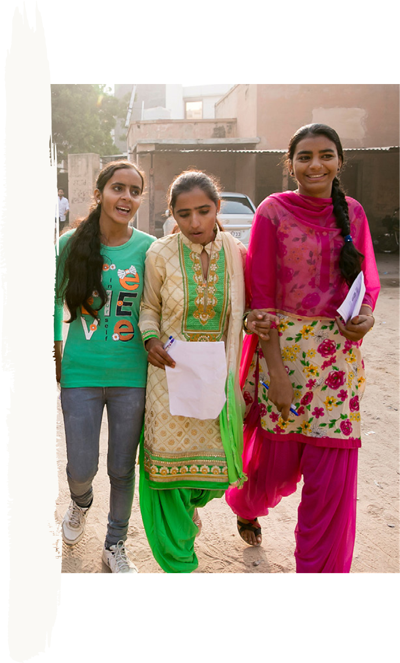
Next Learning Series Session:
Thursday 27th October
Recordings, presentations and notes of this session will be available in the coming days on the Girls Not Brides website.
https://www.girlsnotbrides.org/learning-resources/events/

Slide 45
THANK YOU

