Slide 1
Child Marriage Interventions and Research from 2020 to 2022
Crank global convening, December 2022

Slide 2

Background & Scope
Synthesis of the latest evidence on efforts to prevent child marriage and support married girls 2020 – 2022; inclusive of emerging issues
Focus on detailing promising interventions and practices
Evidence organised across key thematic areas, including cross cutting issues
Each area aims to provide illustration of current evidence landscape – highlighting strengths and weaknesses of different approaches and evidence gaps
Contribute to the knowledge base - efforts to prevent child marriage and support married girls
Evidence review will be finalised and published in English, French and Spanish in early 2023
Notes:
In October / November of this year, we conducted a synthesis of the latest evidence – from 2020 to 2022 - on XXXXX inclusive of emerging issues - so looking at the evidence on climate and crisis
Scope: included interventions ranging from large scale, public systems and services-focused, to medium and smaller scale programming, to community-based programming, and included changes to child marriage legal ecosystems, in both development and humanitarian contexts. Interventions that had an impact on child marriage as a primary, secondary, or unintended outcome, were also included
For this review we focused down on detailing promising interventions and practices; and organised evidence across key thematic areas, including cross cutting issues - inclusion and intersectionality - groups with intersecting vulnerabilities, including girls with disabilities and LGBTQI+ children and adolescents;
Evidence organised across key thematic areas, including cross cutting issues – each section start by briefly outlining what we already know and then goes into the detail of emerging evidence, concluding with key takeaways.
Each area aims to provide illustration of current evidence landscape – primarily those that have been rigorously evaluated
In conducting this learning review we wanted to contribute to the knowledge base on child marriage by synthesising recent evidence, specifically looking at interventions and research that could support our understanding of what works to prevent and respond to cm and what’s less successful
Review conducted by Amy Harrison, in consultation with advisory group from Girls Not Brides, UNFPA UNICEF Global Programme and UNICEF Innocenti STAR incitive

Slide 3
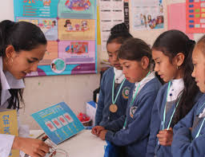
Evidence synthesis: education
What we know
Education is a consistent protective factor against child marriage; girls who drop out of school are significantly more likely to marry early; the pandemic has increased school dropouts, increasing the number of girls at risk of marriage.
Emerging evidence
Increasing evidence that girls’ education plays a key role in the success of multicomponent interventions -> More Than Brides Alliance’s programme reduced child marriage by 69% in India, in part due to its success in increasing girls’ education (Melnikas et al, 2021)
Growing evidence that cash transfers can be effective for keeping girls in school and delaying marriage -> Punjab government’s conditional cash transfer (CCT) assistance programme for girls’ education; however UCTs less successful -> Nepal’s UCT-based Old Age Allowance (OAA) programme used to often used to hasten the marriage of older girls (Mathers 2021)
Girls’ education interventions can also have a positive impact on other pathways for change when part of a multicomponent approach, for example by increasing health seeking behaviour and contraceptive use -> KGIS Bangladesh 2021
Gender-transformative approaches to education programming, including through government leadership, likely to have most effect [Rose, REAL Centre 2020]
Key takeaways
Education may be a non negotiable component of child marriage prevention programming
Cash transfers likely to only be effective in the long-term if implemented in a way that is gender transformative
Supply-side factors including the quality and accessibility of education are critical.
Notes:
Arwyn
Do we want to include the point on GT approaches to education, have added for now so you can review – I think this is an important to linkage to make, but lets see what you think.

Slide 4
Evidence synthesis: livelihoods
What we know
Poverty is a key driver of child marriage & interventions that reduce economic strain on households can delay marriage
Marrying early significantly reduces a woman’s access to paid employment and average earnings over her lifetime.
Emerging evidence
Large scale social protection programmes can be effective in delaying marriage, but may be more effective if they engage with underlying social norms -> Ethiopia’s Productive Safety Net Programme (UNCIEF, 2020)
Adolescent girls who wish to access livelihood and life skills training opportunities may struggle to access or apply these skills without accompanying shifts in gender norms -> UNFPA (2021)
A favourable job market alongside the provision of life skills training can delay child marriage -> Malhotra & El-Nakib, 2020
Key takeaways
Interventions that increase household economic security may reduce rates of child marriage, but are unlikely to shift underlying social norms.
Pairing social protection with efforts to shift restrictive norms around traditional gender roles can have a transformative, longer-term effect
Favourable job markets can have a positive impact on keeping girls in school and delaying marriage
Notes:
Arwyn

Slide 5
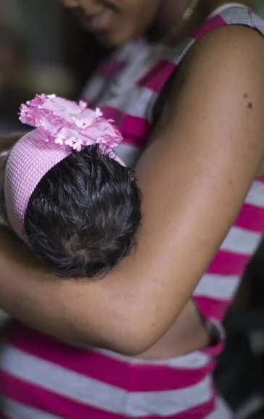
Evidence synthesis: SRHR
What we know
Adolescent pregnancy both a cause and a consequence of child marriage
Married girls, and girls who are pregnant or mothers, have unique needs that health care and social service systems are typically not well set up to meet
Emerging evidence
Health-focused programmes that take a gender transformative approach can reduce rates of child marriage, including via non-health pathways for change -> Ethiopia’s Health Extension Programme (Rudgard et al, 2022)
Programmes focusing on SRHR related norms are unlikely to be successful in contexts where communities are struggling to meet even basic needs -> YIDA evaluation 2021
In multi-component child marriage programmes, norms around SRH appear to be ‘stickier’ or harder to shift than those around child marriage -> HER CHOICE evaluation
Programmes that apply a life-stage and socio-ecological lens to SRH programmes for young first-time mothers can have outcomes that go beyond health, such as improving couple communication, gender equitable attitudes and wellbeing -> E2A programme 2021
Key takeaways:
Efforts to improve adolescents SRHR must combine demand and supply-side interventions, as one without the other is less likely to be effective.
Multi-component programmes that address psychosocial, economic and norms barriers married girls and young mothers face may be most effective.
SRHR interventions should be cognisant of girls’ and families’ broader basic needs, as they may have limited impact where communities are food insecure.
Female health workers can increase trust in and uptake of services
Notes:
Arwyn

Slide 6
Evidence synthesis: laws and policies
What we know
Minimum age of marriage laws are an essential foundation, but not enough to reduce or eliminate child marriage in isolation.
Loopholes, traditional alternatives and dispensations such as marriage with parental consent all continue to allow girls to marry below the legal age, estimated to account for around 7.5 million girls marrying before age 18 each year.
Emerging evidence
Countries that consistently set 18 as the legal minimum age of marriage, for marriage with parental consent, and for age of sexual consent, have rates child marriage rates 40% lower than countries where these laws contradict one another -> UNICEF, 2021
Raising the age of marriage may simply informalise it, especially in settings where non-legal unions are accepted or commonplace -> Bellés-Obrero, C., Lombardi, M. (2020)
Working with civil society to enforce existing laws and bring social norms into alignment with them can be effective strategies for delaying marriage
Civil society led budget analysis and advocacy has lead to more gender responsive budgeting at the state/ subnational level in Nigeria, Pakistan and Kenya (Girls Not Brides 2020)
Key takeaways
Laws are only one part of the holistic response needed
More could be done to build girls’ and their allies’ understanding of how to use the law to prevent and respond to child marriage
Civil society actors can play an influential role in gender-responsive budgeting processes
Notes:
Arwyn

Slide 7
Evidence synthesis: Voice, choice and agency
What we know
Safe spaces can be girls’ only opportunity to feel safe, make choices that affect their lives, and be connected a range of support services and activities
Girls’ empowerment programmes can provide an opportunity to better understand girls’ own decision-making process and rationale in relation to child marriage
Emerging evidence
The effectiveness of empowerment programming may be dependent on context and constraints of girls’ backgrounds. The Adolescent Girls Empowerment Program (AGEP) in Zambia had limited impact in key areas – social & economic barriers & high acceptability of GBV, which an empowerment programme alone could not overcome. (Austrian et al, 2020)
In contrast, combining girls’ empowerment with a focus on building group solidarity and community engagement around norms, can lead to significant and sustained shifts in harmful practices related to child marriage -> TESFA evaluation 2022
Involving girls in the design, running and monitoring of empowerment or safe spaces can ensure they best meet girls’ needs -> UNFPA 2021, Hunersen et al (2020)
Girls may themselves choose to marry early. Effective safe spaces should be based on a realistic assessment of these factors
Key takeaways
Girls’ empowerment programmes have the potential to be both scalable and sustainable.
Grounding activities in local context, recognising the social and economic barriers and supporting girls to access activities is essential.
Failure to recognise that girls’ may self-initiate early marriage may hinder a programme’s success.
Notes:
Jean
What we know
Safe spaces can be girls’ only opportunity to feel safe, able to make choices that affect their lives, and be connected with a range of support services and activities – including access to GBV protection services
Girls’ empowerment programmes can provide a critical opportunity to better understand girls’ own decision-making process and rationale in relation to child marriage
Emerging evidence
The effectiveness of empowerment programming may be dependent on context and the girls’ backgrounds. The Adolescent Girls Empowerment Program (AGEP) in Zambia had limited impact in key areas - low participation, connected to social and economic barriers and high acceptability of GBV, which an empowerment programme alone was not well suited to overcome. (Austrian et al, 2020)
AGEP was a 2-year intervention implemented in Zambia that aimed to build girls’ social, health and economic assets in the short term and improve sexual behaviour, early marriage, pregnancy and education in the longer term.
Activities included weekly mentor-led girls’ group meetings, health vouchers for wellness and reproductive health services, and an adolescent-friendly savings account.
A 2020 longitudinal study of AGEP found the intervention had modest positive impacts on SRH knowledge, savings behaviour, and transactional sex after two and four years.
However, it had no effect on primary education, fertility outcomes, or norms around gender equality, acceptability of IPV, or HIV knowledge.
Suspected reasons for this included overall low participation in programme sessions, due to social and economic barriers and high levels of acceptability and experiences of violence – 60% of girls agreeing IPV is acceptable, two-thirds having experienced sexual violence – which showed that am intervention focused solely on empowerment was unlikely to have an impact without a parallel engagement around attitudes and gender norms.
Austrian, K., Soler-Hampejsek, E. et al (2020) ‘The impact of the Adolescent Girls Empowerment Program (AGEP) on short and long term social, economic, education and fertility outcomes: a cluster randomized controlled trial in Zambia’, BMC Public Health 20:349; p.2
In contrast, combining girls’ empowerment with a focus on building group solidarity and community engagement around norms, can lead to significant and sustained shifts in harmful practices related to child marriage -> TESFA evaluation 2022
Where girls’ empowerment interventions promote group solidary amongst adolescent girls while also being linked into community structures and traditions, there is potential to shift harmful practices around child marriage in a way that is both scalable and sustainable. A 2022 peer-reviewed article on the 2018 study of CARE’s TESFA programme highlights this potential. The TESFA programme in Ethiopia targeted 5,000 married adolescent girls from 2010-2013 via a combination of reproductive health and financial savings-focused interventions. At endline, participants reported improvements across health and empowerment outcomes. Four years post-TESFA, 88% of groups continued to meet without assistance from CARE, with new groups formed including by girls not involved in the original programme. Success factors included the strength of solidarity and safety created within the peer groups – based on peer-facilitated reflective dialogues rather than peer-based learning as is more common; a culturally relevant curriculum, developed in consultation with Ethiopian female health workers;
Chowdhary. P., Mekuria, F. et al (2022) ‘Building sustainable and scalable peer-based programming: promising approaches from TESFA in Ethiopia’; p.2
Involving girls in the design, running and monitoring of empowerment or safe spaces can ensure they best meet girls’ needs ->
Involving girls in the design, running and monitoring of empowerment or safe spaces is recommended as a means of ensuring spaces best meet girls’ needs and do not mirror the restrictive norms they face in everyday life.
Promising practices include establishing safe space committees, conducting regular focus group discussions and formal/informal consultations, and using a range of monitoring and evaluation tools appropriate to girls’ circumstances, including in-person, Facebook and Whatsapp.
A 2020 report on child marriage across the Arab States Region highlights the importance of girl-centred programming in humanitarian settings, and of engaging married girls in all aspects of programme design and implementation UNFPA (2021) ‘Transcending Norms: Gender transformative approaches in women’s and girls’ safe spaces in humanitarian settings’, p.37
Girls may themselves choose to marry early. Effective safe spaces should be based on a realistic assessment of these factors, as well as incorporating support for girls who are already married.
Key Takeaways
Girls’ empowerment programmes have the potential to be both scalable and sustainable, if girls themselves are able to engage and feel individually and collectively empowered by the process. This is particularly important in contexts where girls have limited or reduced agency in everyday life, including humanitarian and highly socially conservative settings. For example, AGEP study suggested future programming incorporate a norms focused workstream and provide HH with a CT to alleviate economic barriers to participation.
Grounding activities in local systems and context, and supporting girls to access programme activities – including through financial support for girls and their caregivers, and through engagement with husbands, male family members, and community members – are likely necessary ingredients for programme success. These needs may be higher in contexts where rates of child marriage are high, or where target households are highly insecure.
Girls themselves may be supportive of child marriage, due to a host of complex social and economic factors; failure to recognise and respond to this may impede a programme’s success. Empowering married girls, and engaging married girls and women in the design of empowerment interventions, may be one entry point into shifting girls’ own perceptions around child marriage and gender roles more broadly.

Slide 8
Evidence synthesis: shifting norms
What we know
Deeply engrained harmful social norms restricts girls’ agency and often hinder girls' access to education, healthcare, earning opportunities.
Meaningful engagement with men and boys, and with community decision-makers and gatekeepers is critical
Efforts to shift norms are likely to be limited if corresponding supply-side interventions do not allow for behaviour change in practice
Emerging evidence
Multi-level approaches to shifting individual and collective attitudes and norms can have a significant impact on child marriage rates and the harmful underlying gender norms-> Sengupta et al (2020)
Safe space programming may be more effective when paired with transformative interventions outside of the space, at the family and community level -> Sibling Support for Adolescents in Emergencies (SSAGE) programme (Koris et al, 2022)
Not engaging men and boys may create risks -> Save the Children FGM/C in Ethiopia (Endale et al, 2022)
Education programmes that encourage critical assessment of gender and sexual norms can be effective in challenging the desire to control female sexuality which is often a root cause of child marriage -> Bayan Association’s Holistic Education for Youth (HEY!) (Kendall, T. 2021)
Key takeaways
Communication-based norm change interventions can have a positive impact, but likely need to engage at multiple levels using a variety of mediums.
Engaging men and boys as a key focus within a whole-household or whole-community approach, is likely important for shifting harmful norms
Girls’ sexuality is often ignored in child marriage programming, and needs further exploration in programming and research
Notes:
For adolescent girls to exercise voice and choice, they not only need economic and political agency but also freedom from the powerful yet invisible norms that erode their potential. As noted throughout this evidence review, deeply entrenched norms around the role of women and girls in society can limit girls’ access to education, healthcare, and livelihood opportunities, and place them at risk when they step outside of these roles.
Meaningful engagement with men and boys, and with community decision-makers and gatekeepers, can be critical in both reducing the risk of backlash against women and girls and in empowering those individuals to act as agents for change. It is important that these efforts do not decentre women and girls’ needs and agency, however.
Efforts to shift harmful and restrictive norms are likely to be limited if corresponding supply-side interventions do not allow for behaviour change in practice – for example, around use of contraception without accompanying availability of contraception, or of acceptability of women working without the availability of secure employment opportunities.
Emerging Evidence:
Programmes that take a multi-level approach to shifting individual and collective attitudes and norms can have a significant impact on both child marriage rates and the harmful underlying gender norms that surround the practice. A 2017 Government of Bangladesh-UNICEF trans-media entertainment-education initiative - 2020 evaluation of the programme found a 3% increase in people reporting having taken action to prevent child marriage, with numbers increasing in line with people’s degree of exposure to the programme.
The evaluation also noted increased awareness amongst fathers regarding the risks of early marriage and pregnancy; overall increases in personal and family disapproval of child marriage; a decrease in the belief that girls themselves are responsible for sexual harassment; and an increase in positive attitudes around investments in girls’ education.
It did not appear to have an impact on community-level attitudes around marriage, suggesting a disconnect between self-reported approval and perceived approval at community level and the potentially greater challenge of shifting collective attitudes as compared to individual ones, and an opportunity to explore how to bridge this gap in future programming.
Sengupta, A., Sood, S. et al (2020) ‘Enabling gender norm change through communication: a case study of a trans-media entertainment-education initiative in Bangladesh’, Journal of Development Communications 31:2; p.41
Safe space programming may be more effective when paired with transformative interventions outside of the space, at the family and community level -> Sibling Support for Adolescents in Emergencies (SSAGE) programme implemented in Maiduguri state, Northeast Nigeria, in 2020 demonstrates the potential of taking a whole-family approach to shifting attitudes around adolescent girls’ agency and the acceptability of violence at the household level.
Through addressing whole family units in synchronised gender transformative curricula, SSAGE reported shifts towards more egalitarian familial relationships, decreased violence perpetration, decreased acceptability of violence and reduced stigmatisation of girls who had experienced violence. Koris, A., Steven, S. et al (2022) ‘Opportunities and challenges in preventing violence against adolescent girls through gender transformative, whole-family support programming in Northeast Nigeria’, Conflict and Health 16:26; p.12
Not engaging men and boys may create risks -> Save the Children FGM/C in Ethiopia
For example: In-depth analysis of Save the Children’s programming on child marriage and FGM/C in Ethiopia published in 2020 led to a number of broad recommendations for how to engage men – as husbands and family members and community stakeholders – in child marriage prevention.
Education programmes that encourage critical assessment of gender and sexual norms can be effective in challenging the desire to control female sexuality which is often a root cause of child marriage -> Bayan Association’s Holistic Education for Youth (HEY!)
Control and regulation of sexuality – particularly adolescent girls’ sexuality – is one of the most powerful drivers of child marriage.
The 2022 ‘Tackling the Taboo’ report identified six common elements for successful gender-transformative programming on child marriage and sexuality, based on five programme case studies in Latin America and the Caribbean: increase critical awareness of gender roles and norms; use girl-centred, participatory approaches; create public platforms for girls’ leadership and voices in communities; offer rights-based, context-specific developmentally and age-appropriate comprehensive sexuality education; work with communities to address child marriage and sexuality; and, advocate for improved availability, accessibility, acceptability and quality of health and SRHR services and education.
One of the case studies showcased Bayan Association’s Holistic Education for Youth (HEY!) programme in Honduras, which piloted a school-based participatory education approach that engaged students, parents, community members and teachers in creating, pilot testing and implementing an education model and materials.
The curriculum was designed to be culturally grounded and feminist in its design and delivery, with an emphasis on critical thinking and reflection. It included teaching by 16- and 17-year-old students to younger students, and the development of two educational guides for students and a ‘parents’ schools’ curriculum, all of which critically addressed gender norms, child marriage and informal unions, biological and psychosocial changes during adolescence, sexual development, romantic relationships, and decision-making around sex.
The programme reported a 38% reduction in cases of child marriage and a 13% reduction in cases of teenage pregnancy from 2017 to 2019, and interest has since been expressed by the local government to have Bayan deliver the HEY! curriculum in urban secondary schools in the Department of Atlántida.
Kendall, T. (2022); p.6
Key takeaways
Communication-based norm change interventions can have a positive impact, but likely need to engage at multiple levels using a variety of mediums.
Girls’ sexuality is often ignored in child marriage programming, and needs further exploration in programming and research
Communication-based norm change interventions can have a positive impact in shifting attitudes and behaviour around child marriage, but likely need to engage at multiple levels using a variety of mediums. Further work is needed to understand how success in influencing individual and household norms can be scaled up to also have influence at community level.
Engaging men and boys as potential allies for change, as a key focus within a whole-household or whole-community approach, is likely important for shifting harmful norms or sustaining behaviour change over the longer term.
Fear, stigma and the desire to control adolescent girls’ sexuality is a key driver of child marriage, yet is often not included in child marriage programming. There are multiple recent examples of promising practice that involve sustained community engagement, comprehensive sexuality education, and critical reflection on harmful gendered norms, to create significant change in attitudes and behaviours. These have generated useful lessons for programming focused on sexuality that may be replicable and scalable in multiple contexts.

Slide 9
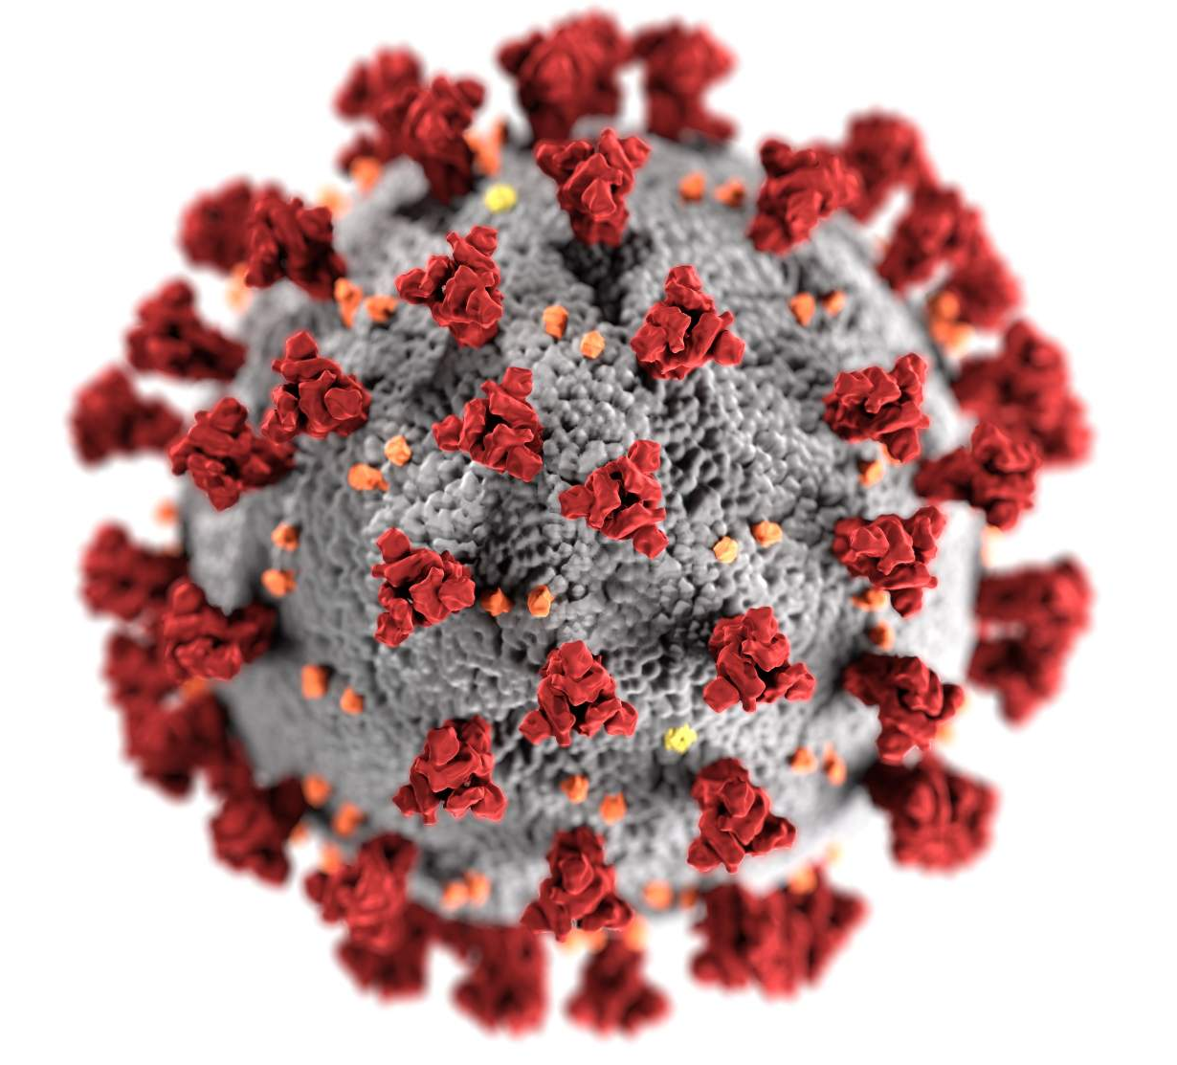
Evidence synthesis: conflict, crises and climate change
What we know
9/10 countries with the highest rates of child marriage are fragile states; child marriage prevalence in fragile contexts is double the global average
Rigorous evaluations of child marriage programming in c&h settings are limited
Evidence on relationship between climate change and child marriage is nascent
Emerging evidence
Growing evidence on promising practice for delivering flexible, context-based SRH services for adolescent girls in humanitarian settings -> MSI Burkina Faso
Safe spaces / empowerment programmes play a critical role in girls’ protection and empowerment --> Arab States region,
Families and wider communities have the potential to serve as a support to adolescent girls, including married girls -> Plan Zimbabwe & Freccero et al. (2021)
Addressing barriers to education for girls in humanitarian settings is a priority for displaced girls and a likely critical protector against the heightened risk of child marriage in these settings- CT conditional on girls’ school attendance -> Freccero et al. (2021)
Climate change may be linked to increases in rates of child marriage -> Carrico, A., Donato, K. et al (2020)
Key takeaways
Humanitarian actors may not be able to shift social norms through immediate response efforts, but can still play a critical role in preventing child marriage
Efforts to support girls to enrol and remain in school are critical - cash transfers condition on girls’ school attendance act as a protector factor for keeping girls’ in school
More evidence is needed on climate change and child marriage
Notes:
What we know
9/10 countries with the highest rates of child marriage are fragile states; child marriage prevalence in humanitarian contexts is double the global average – rigorous evaluations of child marriage programming in C&H settings are limited
The relationship between climate change and child marriage is still in the early days of exploration - Available evidence demonstrates a positive association between extreme weather patterns and early marriage.
Emerging evidence
Growing evidence on flexible, context-based SRH services for adolescent girls in humanitarian settings -> MSI Burkina Faso
There is a growing body of evidence on promising practice for delivering flexible, context-based SRH services for adolescent girls in humanitarian settings. - including the use of mobile SRH clinics and camps, which typically remain in communities for up to four days and so are able to make contact with harder-to-reach adolescents.
Safe spaces play a key role in girls’ protection and empowerment often described as the only place where they feel safe and where they can access the care they need -> Arab States region
Research published in 2021 into the impact of COVID-19 on programming in the region, women and girls unanimously agreed that, second to impacts on case management services, the loss of access to physical safe spaces and related activities was the most negative aspect of the pandemic.
Existing girl-only spaces, established either through other development programming or at schools, community or health centres, may provide existing entry points for introducing CSE and conversations around the risks of and alternatives to child marriage, particularly in humanitarian settings where rapid intervention is both challenging and critical. UNFPA (2021); p13
Global Programme to End Child Marriage (2020) ‘Preventing and responding to child marriage in humanitarian settings: The Global Programme approach’, UNICEF, UNFPA; p.3
Families and wider communities have the potential to serve as a support to adolescent girls, including married girls -> Plan Zimbabwe & Freccero et al. (2021)
Plan study - Participants suggested holding workshops with religious and community leaders, to promote a common understanding of the negative aspects of child marriage.
Engaging with family-level norms around marriage and gender equality more broadly is likely even more critical in humanitarian settings, where stress and insecurity can exacerbate harmful behaviours – as research conducted with displaced communities in Uganda and Jordan in 2021 highlights, violence within the home is as real a threat to increased child marriage as violence caused by conflict and displacement, even though the latter has received more focus in previous research. Freccero, J., Taylor, A. (2021); p.48
Addressing barriers to education for girls in humanitarian settings is a priority for displaced girls and a likely critical protector against the heightened risk of child marriage in these settings -> Freccero, J., Taylor, A. (2021
Research conducted in refugee settlements in Uganda and Jordan in 2021 highlights how addressing barriers to education for girls in humanitarian settings is both a priority for displaced girls and a likely critical protector against the heightened risk of child marriage in these settings. Across the 280 married and unmarried girls aged 10-17 and 67 caregivers who were involved in the study, education was cited as the highest priority solution to prevent and respond to child marriage in their communities. Practical barriers to enrolling and keeping girls in school included the cost of school fees, uniforms and material; distance to schools; and protection concerns. Providing girls and their caregivers with cash assistance to overcome some of these barriers was cited as a possible solution for promoting girls’ continued education in these settings.
Freccero, J., Taylor, A. (2021); p.50
Economic empowerment education components high success rate (Hutchinson et al forthcoming.
Economic / Basic Needs: Provide girls and their caregivers with financial assistance and support for basic needs. Provide cash directly to adolescent girls or their caregivers to dissuade girls from turning to marriage for support.
In camp settings, consider making cash payments to parents conditional upon girls’ school attendance, and Child Marriage in Humanitarian Crises | 5 provide girls with basic items such as underwear, soap, and school uniforms. Provide girls with more vocational training and income-generating opportunities close to their communities, cash-for-work programs, and loans to start small businesses
Provide vocational training, economic empowerment education, and age-appropriate income generating opportunities which are safe and legal for married and unmarried girls; include alternatives for girls who have not completed school.
Climate change may be linked to increases in rates of child marriage -> Carrico, A., Donato, K. et al (2020) - Available evidence demonstrates a positive association between extreme weather patterns and early marriage.
Key takeaways
Humanitarian actors may not be able to shift social norms through immediate response efforts, but can still play a critical role in preventing child marriage; efforts to support girls to enrol and remain in school are critical
Humanitarian actors may not be able to shift deeply held social norms through immediate response efforts, however they can still play a critical role in preventing child marriage. Supporting humanitarian teams across different response areas to understand, identify, and respond to the risks around child marriage (including both prevention and the risks facing married girls) is critical to ensuring a Do No Harm approach is followed.
Specific focus should be paid to efforts to support girls to enrol and remain in school, recognising that providing cash support to girls and their caregivers to overcome financial barriers to accessing education may be important protections against the risk of child marriage.
More evidence is needed on climate change and child marriage
More evidence is needed on the relationship between climate change and child marriage, prioritising countries that face the greatest threats from or are the most vulnerable to climate change. This includes the need to understand if and how different forms and durations of extreme weather differ in their impact and required response. There may also be benefit in investigating what lessons we can learn from other humanitarian settings for tackling gender unequal norms and practices and supporting adolescent girls, and into how climate-driven crises differ from conflict-related crises.

Slide 10
Evidence synthesis: inclusion and intersectionality
What we know
Clear commitments to LNOB 2030 Agenda for Sustainable Development & SDGs
Child marriage most prevalent among girls from the poorest backgrounds, rural areas, with limited access to education, (in some contexts) from minority groups.
Unclear whether interventions are reaching the most vulnerable girls
Understanding of the risk factors facing LGBTQI+ children and children
with disabilities with regard to child marriage is extremely limited
Emerging evidence
A 2020 evidence review of child marriage and disability found limited mention of disability in programme evaluations - a positive example of inclusion was found on the Rwandan Indashykirwa programme
Limited evidence on the relationship between LGBTQI+ adolescents and child marriage suggests marriage may be used as a means of escaping violence and exclusion at home in some contexts -> COLESDOM, 2022
Key takeaways
More evidence is needed on the risk factors facing LGBTQI+ children and children with disabilities in regards to child marriage
Given limited evidence, lessons that can be learnt from other relevant sectors programming for children with disabilities or belonging to LGBTQI+ groups
Working alongside and learning from disabled people’s organisations and other by-and-for organisations is critical
Notes:
What we know
Clear commitments to leaving no one behind in the 2030 Agenda for Sustainable Development and SDGs
However, child marriage remains most prevalent among girls from the poorest backgrounds, from rural areas, with limited access to education and (in some contexts) from minority groups.
It is unclear whether interventions are reaching the most vulnerable girls
Our understanding of the risk factors facing LGBTQI+ children and children with disabilities with regard to child marriage is extremely limited
Emerging evidence
A 2020 evidence review of child marriage and disability found only cursory mentions of disability in programme evaluations
Available datasets on child marriage do not disaggregate data by disability, and data on forced marriage of people with disabilities does not always differentiate data by age. What data we do have is typically a number of years old. While we lack information on the experiences of married girls with disabilities, they are almost certainly at particular risk of violence and coercion once married. Meaney-Davis, J., Lee, H., Andrae, K. (2020); p.4
A positive example of inclusion was found on the Rwandan Indashykirwa programme, however, where the team partnered with the National Council of Persons with Disabilities to train all programme staff on disability inclusion; an adapted version of this training was then delivered by the Rwanda Women’s Network to all programme community activists, women’s safe space facilitators, and 280 community members with disabilities
A 2020 analysis of four intimate partner violence (IPV) prevention programmes in Ghana, Rwanda, Tajikistan and South Africa – all implemented and evaluated as part of the What Works to Prevent Violence against Women and Girls Global Programme – explored the perspectives of men and women with disabilities who were involved in these programmes.
Limited evidence on the relationship between LGBTQI+ adolescents and child marriage suggests marriage may be used as a means of escaping violence and exclusion at home in some contexts -> COLESDOM, 2022
What very limited evidence we have around the relationship between LGBTQI+ adolescents and child marriage suggests marriage may be used as a means of escaping violence and exclusion at home in some contexts. A 2022 small-scale study by the Colesdom-Comunidad de Lesbianas Inclusivas Dominicanas, in the Dominican Republic, looked at the motivating factors behind gender non-conforming individuals marrying under the age of 18. The study revealed a link between these individuals’ experiences of violence and exclusion, and the desire to gain economic independence and escape violence and abuse in their natal home – including violence to ‘correct’ their sexual orientation. The study recommended investment in promoting, supporting and accompanying LGBTQI+ adolescents to continue their education, alongside the provision of culturally appropriate education sessions to address and shift conscious and unconscious stigma around LGBTQI+ individuals. Tools for addressing deeply held stigma around gender- and sexuality-non-conformity include the Looking In, Looking Out, approach, which can be used with programme teams, community members and national decision-makers. As with disability inclusion, working with and supporting the work of by-and-for LGBTQI+ organisations may be an effective means of building meaningful inclusion.
Colesdom-Comunidad de Lesbianas Inclusivas Dominicanas (2022) ‘I am all of those girls who got kicked out of their house: relation among early departures of children and adolescents and the disrespect of their caregivers in the face of transgressions of traditional gender roles in the Dominican Republic’ ; accessed via: https://www.girlsnotbrides.org/learning-resources/child-marriage-research-action-network/crank-quarterly-research-meetings/crank-research-meeting-supporting-marginalised-girls/.
https://positivevibes.org/what-we-do/lilo/
Key takeaways
While more evidence is needed to understand how certain margainlised and minoritized groups experience (the risk of) child marriage, there are also lessons that can be learnt from other relevant programming in terms of how to ensure their safe and meaningful inclusion in programming.
Working alongside and learning from disabled people’s organisations and other by-and-for organisations is an important and effective way of ensuring activities are designed and implemented in a genuinely inclusive manner.
Stigma, discrimination and bias can exist within implementing teams, as well as communities, and this needs to be addressed to ensure marginalised groups are not faced with the same stigma they experience in everyday life.
More evidence is needed on the risk factors facing LGBTQI+ children and children with disabilities in regards to child marriage
Given limited evidence, lessons that can be learnt from other relevant sectors programming for children with disabilities belonging to LGBTQI+ GROUPS

Slide 11
Recommendations
Our main call to action is relevant to funders, programmers and researchers:
-> We need investment in programming to prevent child marriage and support married girls, delivered over the longer term (4-5 years minimum), and with evaluation built into the design from the outset.
For researchers:
Future research should explore areas that where the evidence base is most limited, not continue to focus on areas that are already well documented.
More research is needed on the how the humanitarian and development nexus can best be leveraged to effectively address child marriage.
For programmers:
Include both demand and supply-side components as core elements of programming, recognising the limitations of one without the other.
For funders:
Support pilots that test promising interventions, allowing room for a degree of failure.
For advocates:
Advocate for the inclusion of child marriage into all humanitarian assessments and strategies
Advocate for national governments to integrate child marriage components within large-scale interventions
Notes:
Arwyn last slide?

