Slide 1
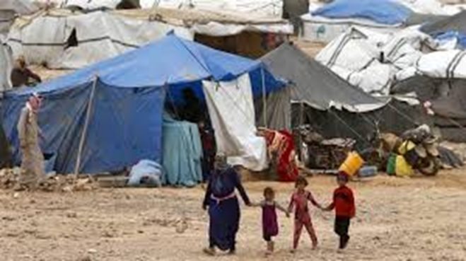
CRANK online global convening Day 1: Learning from latest evidence on efforts to address child marriage and support married girls to strengthen more targeted policy interventions and improved child marriage programme outcomes
Learning from the latest evidence on efforts to address child marriage and support married girls in conflict and crisis
Dr Aisha Hutchinson (King’s College London) aisha.Hutchinson@kcl.ac.uk
Key takeaways from current evidence
Intervention evidence is lacking for crisis affected contexts
Increase in blurring of humanitarian-development-peacebuilding contexts
Need for methodological innovation, flexibility and collaboration
Notes:
Notes
Thank you for the invite to highlight learning from the latest evidence on efforts to address child marriage and support married girls in conflict and crisis
As I only have 5 minutes …
My three main talking points today
Intervention evidence is lacking for humanitarian contexts
Increase in blurring of humanitarian-development-peacebuilding contexts
Need for methodological innovation, flexibility and collaboration

Slide 2
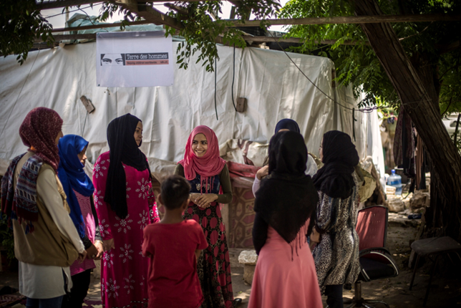
Intervention evidence is lacking for humanitarian contexts
Lack of robust evaluation studies
Unequal attention to different crises
Methodological challenges
Lag between research and practice
Increase in blurring of humanitarian-development-peacebuilding contexts
Impact of climate change
Impact of prolonged displacement
Changes to the humanitarian system
Notes:
Notes
Intervention evidence is lacking for humanitarian contexts
Lack of robust evaluation studies – recent systematic reviews show continued gap in robust evidence for interventions to prevent child marriage in conflict and crisis affected populations, including host communities, and we know there is a lack of evidence for interventions with married girls in all contexts
Unequal attention to different crises – research from Green and colleagues show that many of the countries where there are high rates of child marriage are crisis affected but limited research in these countries (give examples)
Methodological challenges – doing high quality robust evaluations is difficult anyway but especially so in contexts of crisis,
Lag between research and practice – humanitarian contexts characterised by pace of response
2) Increase in blurring of humanitarian-development-peacebuilding contexts
Impact of climate change
Impact of prolonged displacement
Changes to the humanitarian system
How useful is research done in development contexts for crisis affected populations?

Slide 3
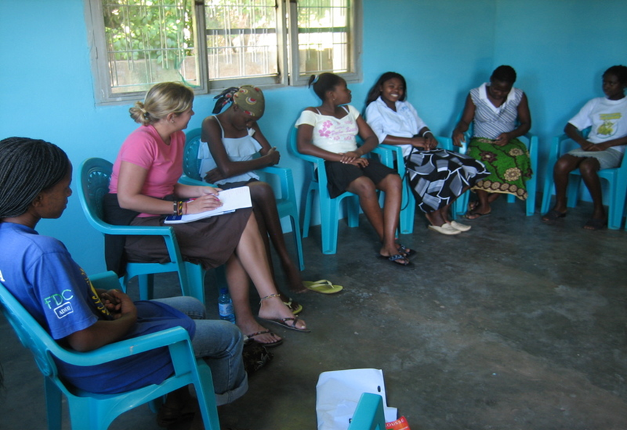
Need for methodological innovation, flexibility and collaboration
Recognition of less robust forms of evidence
Forming local partnerships
Building research capacity
More attention to humanitarian cycle/response
More attention to the process of using research to inform practice
Notes:
Notes
3) Need for methodological innovation, flexibility and collaboration
- Recognition of less robust forms of evidence
Forming local partnerships
Building research capacity
More attention to humanitarian cycle/response
More attention to the process of using research to inform practice

