Slide 1
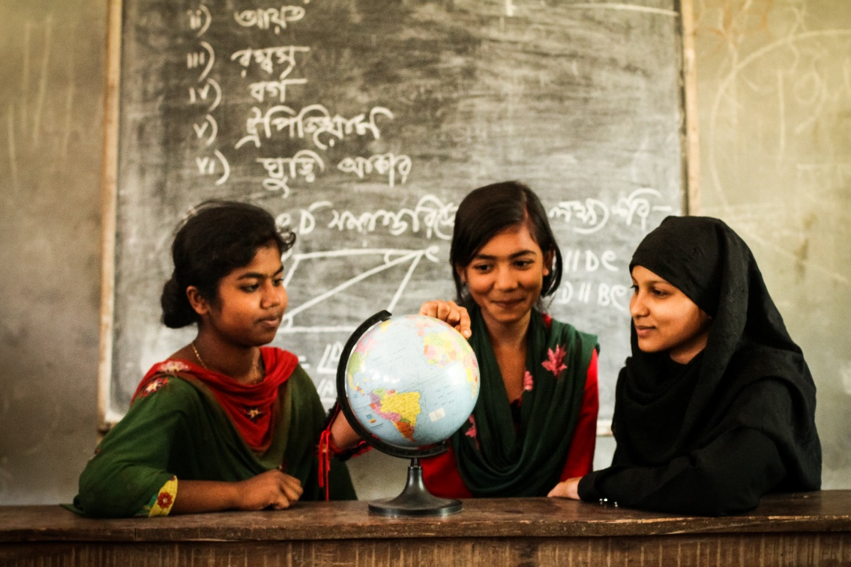
Multilevel Interventions with girls, families and communities to address child marriage
Sajeda Amin
Population Council
CRANK
December 6, 2022
The Daily Star

Slide 2
Synthesis of Evidence
PROGRAM
IMPACT
PROCESS OUTCOME
IMMEDIATE OUTCOME
Empower Girls Treat the community: Engage gatekeepers Two adult mentors A safe space for girls to meet Weekly sessions Expand Opportunities for girls Opportunities meet in a space of their own A dedicated time Exposure to new activities (music, dance, sports, community activities) | opportunities to learn Spend more time learning Have more friends More time spent socializing Learn about planning and budgeting Acquire specific skills for income earning Acquire knowledge about sexual and reproductive health and rights Improved math and reading skills New ways of learning | Improved school performance Livelihood skills developed Aspirations raised Better negotiation skills Ability to negotiate Status in family improves Improved awareness about marriage and related rights Improved critical thinking abilities | Increased retention in school Girls’ income earning power increased Reduced marriage of girls before 18 years
…
…

Slide 3
Moving forward
Empowerment approaches that expand opportunities
Beware of constraining choices
Important to focus on girls while engaging community (beware of the equation of balance of power)
New strategic ideas
Recognize what motivates child marriage and address those
Address insecurity as a driver
Cultivate a supportive community (trusted adults, mentors, safe spaces)
Strategically utilize the expressive impact of legal changes

