Slide 1


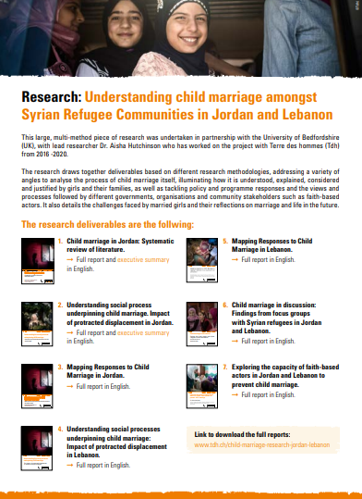
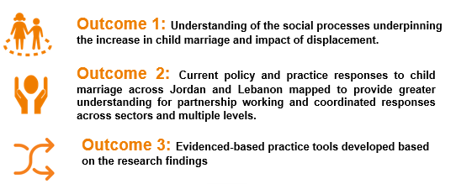
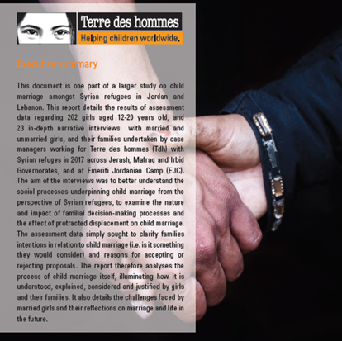
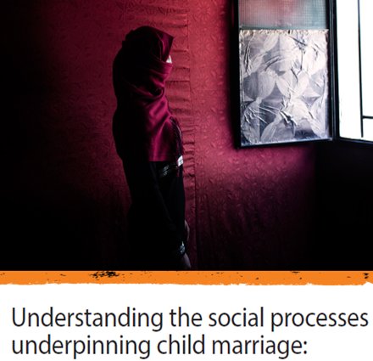
‘Grounded in their lives’
Research undertaken 2017-2020
Six month project to ensure the research
doesn’t ‘sit on the shelf’ and actually makes
a difference in the lives of adolescent girls
through changes to policy, advocacy and programmes
Hand-by-hand partnership: co-creation, co-decision,
Openness to try to do something else, something
ultimately useful, transformative
https://www.tdh.ch/en/media-library/documents/research-child-marriage

Slide 2
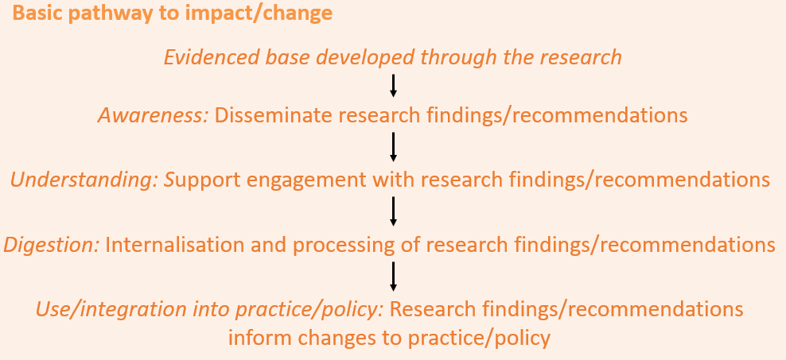
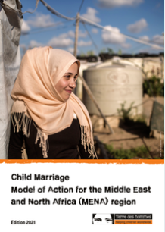
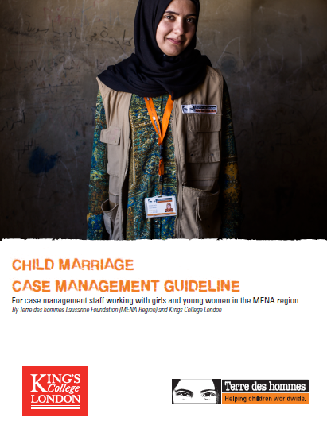
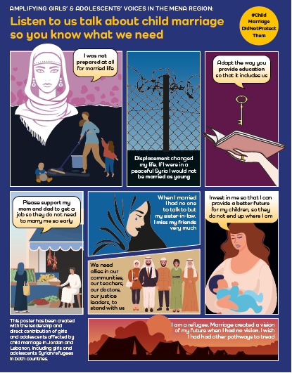
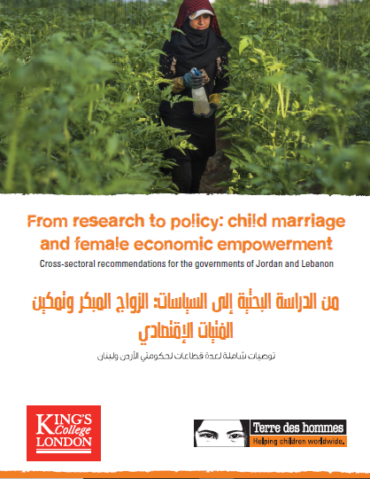
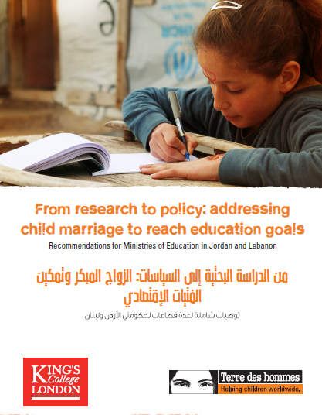
Grounded in their lives
PROGRAMME
POLICY
THEM: GIRLS AND YOUNG FEMALE

