Slide 1
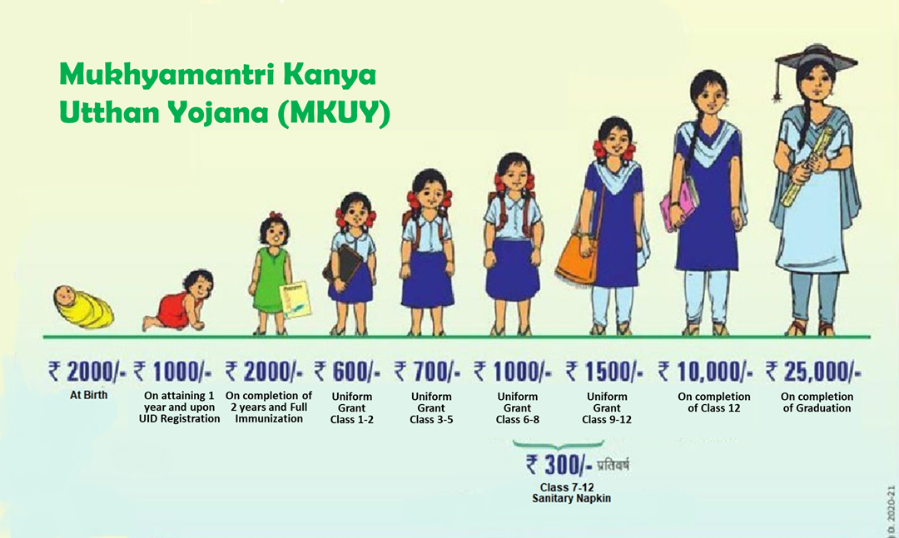
Mukhyamantri Kanya Utthan Yojana (MKUY) A Government - UNICEF partnership for strengthening generation and use of evidence to improve policy and programme outcomes
Mr. Prasanna Ash,
PME Specialist and OiC SPSP,
UNICEF Bihar Field Office

Slide 2
MKUY – The Evolution
42.5% girls are married before the legal age of marriage - highest in the country.
Only half of the women are literate compared to three-fourths of the men
Sex ratio at birth stands at 892 girls against 1000 boys;
Under-five mortality for girls stands at 51 against 35 for boys
Two in every five girls drop out of school before completing elementary education, with a result that only 22.5 percent of women have ten or more years of schooling.
One of the poorest states in India with 41 percent of its population living below the poverty line - accounting for 12 percent of the country’s poor.
Notes:
Good afternoon!
Just to give a brief context
Bihar is one of the poorest states in India with 41 percent of its population living below the poverty line, accounting for 12 percent of the country’s poor.
Only half of the women are literate compared to three-fourths of the men;
sex ratio at birth stands at 892 girls against 1000 boys;
Under-five mortality for girls stands at 51 against 35 for boys with worsening gaps between boy and girl child mortality.
Two in every five girls drop out of school before completing elementary education, with a result that only 22.5 percent of women have ten or more years of schooling.
Child marriage rate is 42.5 percent which is the highest in the country.
•The Mukhyamantri Kanya Utthan Yojana (MKUY) is an effort by the Government of Bihar towards coordinated and integrated social protection•The programme consolidates 19 existing grants and 4 new grants to ensure that vulnerabilities along the life course of a girl child are addressed in a coherent manner from birth to age 21•The implementing departments are Department of Social Welfare, Department of Health, and the Department of Education•The Women Development Corporation (WDC) at the Department of Social Welfare is the nodal agency for the programme
Understandably, the objective of the scheme is to
To improve child sex ratio in the state by curbing female foeticide and promoting the birth of girl child;
To prevent child marriages and incidence of dowry;
To support a girl’s transition from primary grades of education to secondary level and facilitate completion of secondary education;
To improve access of girls to opportunities for skill building and access to labour markets, to enable their transition to a productive adulthood.11

Slide 3
Evidence Generation to strengthen child marriage outcomes
Periodic concurrent monitoring to identify implementation bottlenecks and potential solutions for strengthened outcomes.
Synthesis of global evidence on what works in terms of reducing child marriage in similar socio-economic settings.
Upstream policy advocacy for creating a conducive environment for effectively utilizing the CASH for intended use – a move towards holistic adolescent empowerment (UDAAN)
Increasing the value of girl child through strategic engagement of men and boys

Slide 4
Lessons learnt and Way forward
Evidence based adaptive and agile programming – more nuanced research on what works and what does not and why?
Impact assessment trough RCT – helping programme implementers to assess the contribution and attribution.

