Slide 1
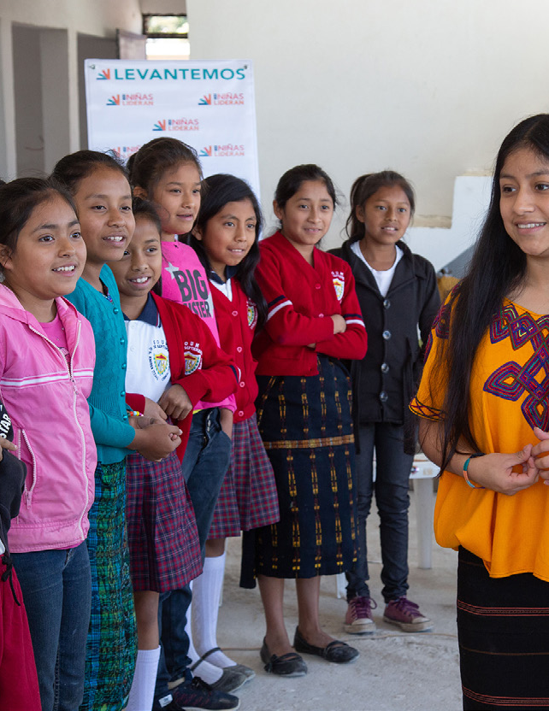
Learning Series
Sharing evidence, learning, new tools and experience to support your work to end child marriage
SIX
SHARED
GOALS
Monthly webinar
June-December

Slide 2
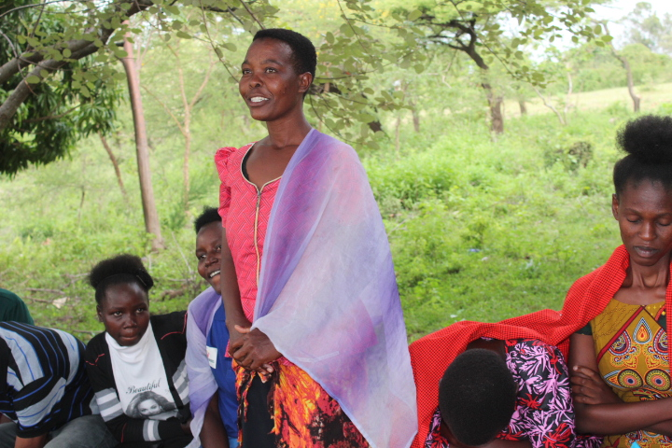
Community members participate in activities as part of a cross-border programme to end child marriage in Kenya and Tanzania
Girls Not Brides/David Owino
Session 5: Gender-transformative collective action to address child marriage – Lessons learned from Africa
Notes:
Lara
This webinar will be a space to:
Learn – with evidence – why gender-transformative collective action is needed to accelerate progress to end child marriage with a particular focus on Africa.
Build shared understanding of what ‘gender-transformative’ means, and the core elements needed for gender-transformative programmes and advocacy
Hear about a gender-transformative journey we’ve taken this year with the National Partnership in Mozambique and the National Coalition in Nigeria together with UNICEF to build gender-transformative skills and practice
Invite you to share your questions and your learning and experience and finally
If you’re a member of a GNB National Partnership or Coalition we invite you to consider whether you’re ready for a gender-transformative journey to catalyse transformative change at scale as leaders in the national movements in your country or region
Run through agenda and hand over to Jacky
Summary of Agenda:
A snapshot of progress on CM and girls’ and women’s rights
Making the case for gender-transformative collective action, what this means and what it takes
The Call to Action for accelerated progress on CM in Africa and an example of the impact of collective gender-transformative action
Introduction to a gender-transformative journey to strengthen GTA skills, knowledge and leadership with an opportunity to hear from 3 GTA travellers on that journey
Time for Q&A

Slide 3
Interpretation
ENGLISH - This session will have presentations in English and Portuguese. To access simultaneous interpretation, please click on the globe icon at the bottom bar of your screen and select your preferred language (English, Spanish, French, Portuguese, or no interpretation).
português - Esta sessão será apresentada em inglês e português. Para aceder aos serviços de interpretação simultânea, clique no ícone do globo na barra inferior do seu ecrã, e seleccione a sua língua preferida (inglês, espanhol, francês, português, ou versão original).
Español - Esta sesión tendrá presentaciones en inglés y portugués. Para acceder a los servicios de interpretación simultanea, por favor haga clic en el icono del globo que encontrará en la barra inferior de su pantalla, y seleccione su idioma de preferencia (inglés, español, francés, portugués, o version original).
français - Cette session comprendra des présentations en anglais et en portugais. Pour accéder aux services d'interprétation simultanée, veuillez cliquer sur l'icône globe que vous trouverez dans la barre inférieure de votre écran, et sélectionnez la langue de préférence (anglais, espagnol, français, portugais ou version originale).
Notes:
Lara or Laia?
Please write in the chat box (preferably in Port, Fr, Sp or English!) if you are having any technical difficulties and a member of our team will be happy to support
Please also use the chat box to post Questions or experience you would like to share. And if you have a question for one of our panellists please do put their name.

Slide 4
What does
“gender-transformative collective action” mean?
Why is it mission critical?
Notes:
Jacky
What does gender-transformative collective action mean? Why is it mission critical?
So, why is gender-transformative collective action needed to accelerate progress to end child marriage?
What do we mean by ‘GTA’?
What does evidence show is needed, what are the core elements for child marriage programming to transform unequal relationships of power, shift power and resources so that girls in all their diversity can choose if, when and whom to marry?
Sometimes it’s easier to understand why something is important by describing what happens if you don’t do it, so what are some examples of ways of working, programmes or advocacy that are not taking a GTA?

Slide 5
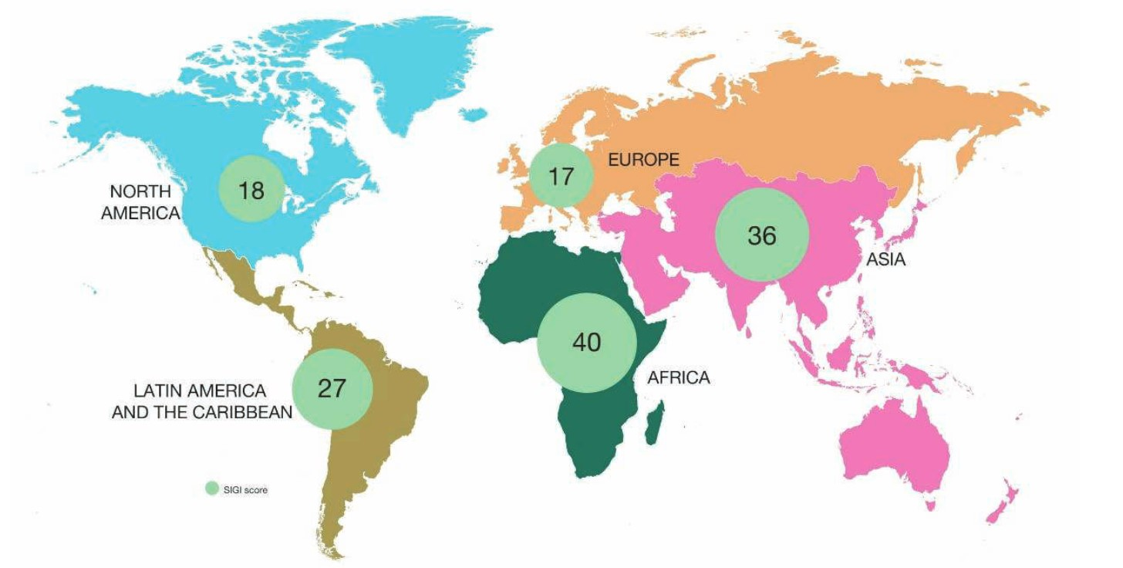
African women face the highest levels of discrimination in the world
Notes:
Jacky

Slide 6
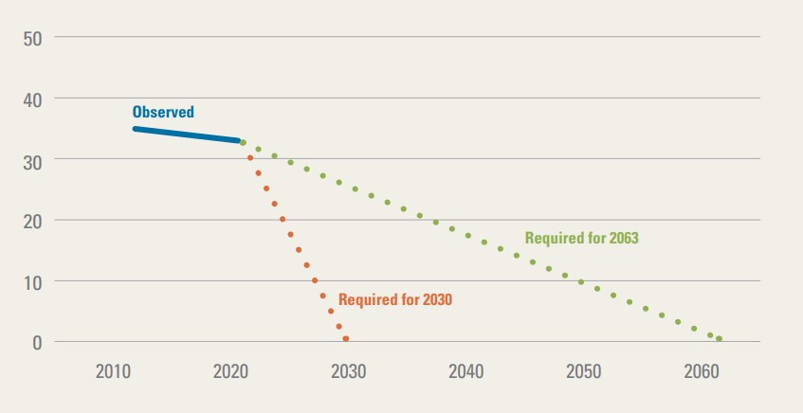
To end child marriage by 2030 Africa needs to accelerate efforts
Child marriage prevalence
SDG 5.3
Africa Union Agenda 2063
Notes:
Jacky
To end child marriage acceleration is required
Graph is from Towards Ending Harmful Practices in Africa: A statistical overview of child marriage and female genital mutilation, UNICEF, New York, 2022.
https://data.unicef.org/resources/harmful-practices-in-africa/

Slide 7

What is a gender-transformative approach?
A transformative approach promotes gender equality by | Fostering critical examination of inequalities and gender roles, norms and dynamics
 | Recognising and strengthening positive norms that support equality and an enabling environment
 | Promoting the relative position of women, girls and marginalised groups
 | Transforming the underlying social structures, policies and broadly held social norms that perpetuate and legitimise gender inequalities
One African member’s definition of a gender- transformative approach:
When you cut a tree from the roots then it will not grow again. When you cut a branch, it will continue.
Notes:
Jacky
What is a gender-transformative approach?

Slide 8
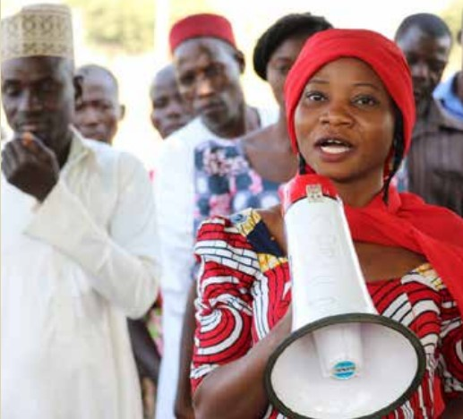
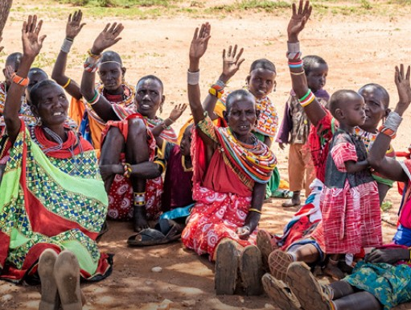

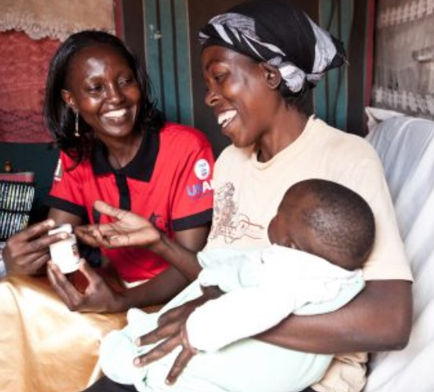
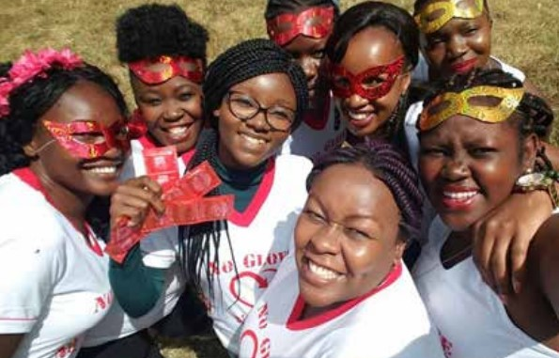
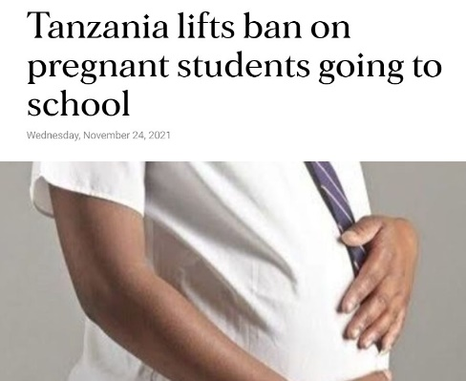
Core elements of a gender-transformative approach
1. Adolescent girls’ skills, agency, and leadership
2. Enabling environment, family and community mobilization
3. Addressing masculinities and engaging men and boys
6. It’s cross-cutting and needs to be integrated across all gender-transformative work - gender norms and inequalities
5. Policy & structural change, and institutional partnerships (incl. laws & policies)
4. Services and multi-sectoral collaboration
Source: Technical Note on GTA in the Global Programme to End Child Marriage, UNFPA, UNICEF and UN Women
Notes:
Jacky
Core elements of a gender-transformative approach?
The Global Programme to End Child Marriage Technical Note on Gender-transformative approaches describes 6 core elements of a gender-transformative approach –or if you prefer jargon-free, ways to uproot a tree
These are from left to right and top to bottom
Core element 1: Adolescent Girls’ Skills, Agency and Leadership
Core element 2: Enabling Environment, Family and Community Mobilization
Core element 3: Addressing Masculinities and Engaging Men and Boys
Core element 4: Services and multi-sectoral collaboration
Core element 5: Policy and Structural Change and Institutional Partnerships , including laws and policies
Core Element 6 is cross cutting and needs to be integrated cross all gender-transformative work, namely Gender Norms and Inequalities

Slide 9
The consequence of not taking a gender-transformative approach
Some members have been able to rescue girls from forced marriages and these girls are now dependent on us. This is a major problem for us and for our respective institutions. What is the point of rescuing girls from marriage if we are not able to support them afterwards – to return to school or learn a skill?
Girls are unable to fulfil their potential
Gains made are concessions rather than entitlements
Alternatives are not created
Educated girls are higher value brides
Increased risk of backlash
Drive the practice underground increasing girls’ vulnerability
Notes:
Jacky
The consequences of not taking a gender-transformative approach

Slide 10
Child marriage in Africa: the scale and the Call to Action
Notes:
PEACE – please make a max of 5 slides
There are a few slides from the Nigeria evidence review that follow.
I don’t recommend using the slides, but you might want to pick out data. Up to you!

Slide 11
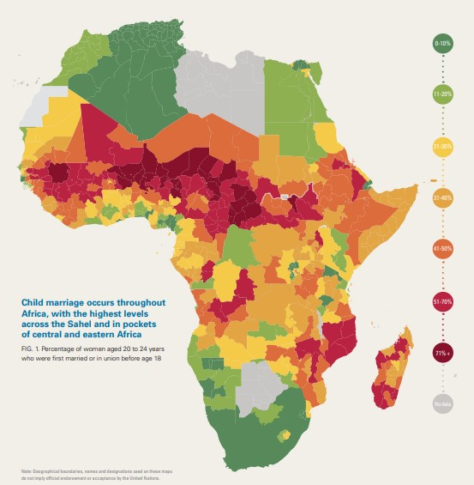
CM prevalence: Africa
Globally 19% of girls marry before the age of 18.
 | 2021 | 2018
Sub Saharan Africa | 35% | 38%
East and Southern Africa | 32% | 35%
West and Central Africa | 37% | 41%
All countries that are not shaded green have CM prevalence above the global average.
Notes:
Peace
The map is from the 2022 UNICEF report Towards Ending Harmful Practices in Africa: A statistical overview of child marriage and female genital mutilation
The countries shaded darker green have CM prevalence below 10% and the deepest red above 71%
Lighter green 11-20%, lighter yellow 21-30%, lighter orange 31-40%, orange 41-50%, red 51-70% and the deepest red over 71%.
All countries that are not shaded green have CM prevalence above the global average of 19%.
Africa is home to some 130 million child brides with huge variations in prevalence across the continent by region, country or even the community a girl is a member of
There has been progress. i.e looking at the Table we see 35% in sub-Saharan Africa down 3 percentage points from 38% in 2018.

Slide 12
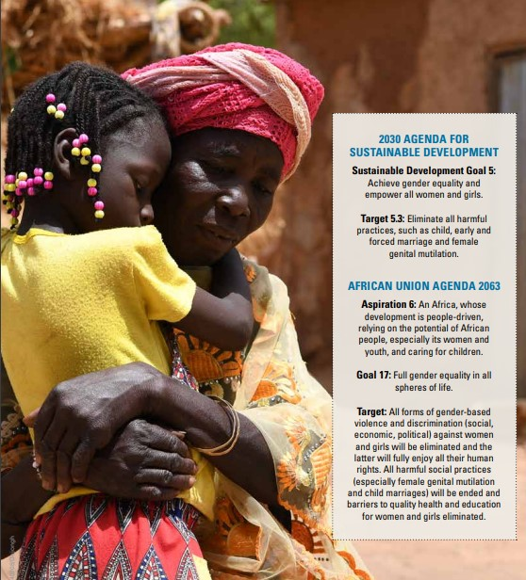

What is needed to accelerate progress
Focus on the root causes of the practice, including social norms, patriarchal structures and age-based discrimination
Government investment in gender-responsive or gender-transformative laws, policies and systems
A comprehensive, rights-based approach
Notes:
Peace
Image: Towards Ending Harmful Practices in Africa: A statistical overview of child marriage and female genital mutilation, UNICEF, New York, 2022.
https://data.unicef.org/resources/harmful-practices-in-africa/
Africa Union Agenda 2063 Aspiration 6: An Africa, whose development is people-driven, relying on the potential of African people, especially its women and youth, and caring for children.
In 2014, the African Union (AU) launched a campaign to end child marriage in Africa “to accelerate the end of child marriage in Africa
More than 40 countries worldwide have or are developing costed national action plans to end child marriage.
Accelerating progress towards ECM in Africa involves; Focusing on the root causes of the practice, including social norms, patriarchal structures and age-based discrimination
Gender-responsive or gender-transformative laws, policies and systems: we need multi-sectoral interventions at all levels; adequate resources; investment in gender-responsive social protection with improved access to quality education, provision of adolescent-friendly sexual and reproductive health services, and protection measures that prevent and respond to violence against children, especially girls.
Focus on girls’ agency and autonomy: investment in 12 years’ quality education; CSE; life skills including legal literacy and information and services related to SRHR services
Promotion of positive social norms and behaviours that respect and support the equal rights, voice and choice of girls: engagement with men and boys, traditional and religious leaders, progressive media and evidence and learning that shows that community-led interventions require a systematic approach focused on norms change rather beyond awareness-raising
Adolescent-friendly services including in crisis settings
Create economic alternatives to child marriage: Poverty is a key driver of CM.
A system-wide approach that is rights-based

Slide 13
Accelerated progress through gender-transformative practice in Tanzania, Uganda and Kenya
Putting Gender Transformative principles into practice
Ecosystem approach
Rights Based Approach
Girl Centred Approach
Engagement with religious and cultural leaders
Collective advocacy for policy change
Youth Engagement
Media engagement
The Six Core Elements of a Gender-Transformative Approach
Notes:
Peace
The Accelerator Approach in ECM
The Accelerator Approach aims to unlock the potential of a wide range of partners, encouraging them to increase efforts and collaboration to ECM. Commenced to test the hypothesis that Ending child marriage is possible at scale that is currently unimaginable when All relevant actors addressing child marriage in Uganda align with each other; and each actor individually intensifies and accelerates their efforts.
The flagship approach witnessed impact and catalyzed GTA programing through;
It's a Multisectoral approach to Centre girl's agency and voice in programing to ECM.
Giving an over-view of the eco-systems wide approach for accelerated change in Gender Transformative programing.
Some of the themes utilized for impact in GTA included;
Champions Approach: Traditional and religious leaders identified(gate keepers of social Norms), and trained to speak against the retrogressive norms and practices that place girls and young women at the periphery of leadership and decision making. Traditional leaders have a better understanding of the causes and consequences of CM, and are able to inform their structures. (Kuria community in Kenya and Western Uganda).
Government: GNB members collectively lobbied for the renewal of the second national strategy on ECM. The strategy sets precedence on some of the GTA interventions that protect girls and young women from adolescent pregnancies and child marriage.
Youth Activist: Young women trained on rolling out the GNB Speak out Speak up youth engagement tool kit on ECM. Cascading the training to their home areas. Building a cadre of young transformative activists against CM in their communities.
To enhance the approach the media is also involved to pick child marriage cases and amplify evidence about the challenge of CM, which is being used as evidence to induce government action. Basing on facts and figures presented, the accelerator approach has generated policy briefs for evidence-based lobbying for relevant stakeholders, on account as policy making and budget appropriation mandates.
Key Messages to accelerate progress- wrapping up
Progress:
Africa is home to some 130 million child brides with huge variations in prevalence across the continent by region, country or even the community.
There has been progress in ECM across regions of Africa, however variation across and within countries.
Sub-Saharan Africa CM stands at 35%(2022), compared to 38% in 2018 (a 3% decline).
Eastern and Southern Africa (32 and 35% 2022 and 2018 respectively) , West and Southern Africa (37% and 41%)
Significant Progress countries:
1.Uganda(34% in 2016, 40% in 2011, 54% in 1995)
2. Ethiopia(40% in 2016, 49% in 2005)
3. Sierra Leone(30% in 2017, 39% in 2013,48% in 2008)
Countries with little progress;
1. Niger(76% in 2012, 75% in 2006),
2. Chad (72% in 2004,72% in 1997)
To accelerate progress to end child marriage in Africa, there is need for approaches to be context sensitive and informed by an understanding of intersectionality which recognizes the diversity of lived experience, that some girls are at greater risk of CEFMU than others.

Slide 14
Taking a gender-transformative journey
Strengthening gender-transformative skills, knowledge and leadership
Notes:
Mercy
Taking a gender-transformative journey: Strengthening gender-transformative skills, knowledge and leadership
Before handing over to our three panellists, a short background to what we’re calling a ‘gender-transformative journey’
Hopefully before Christmas we will publish a step-by-step Facilitation Guide for any group of civil society organisations working to end child marriage and advance girls’ rights
The starting part for this journey was alignment between the mission and vision of the UNFPA-UNICEF Global Programme to End Child Marriage, the UN/EU Spotlight Initiative to eliminate all forms of VAWG and the Girls Not Brides global partnership commitment to build civil society action to end child marriage.
Travellers on this gender-transformative journey include members of GNB’s National Partnership in Mozambique – CECAP – with a key role played by NP member AMODEFA - members of the National Coalition of CSOs in Nigeria – with a key role played by CYPF as the nominated lead CSO on this collaboration.
UNICEF HQ, WACA and ESA Regional and Country offices, plus government representatives
And a special mention to the role played by the 6 Gender Advocates who facilitated or supported many of the workshops, and continue to support application or promotion of the learning supporting CSO members though outreach
The GNB gender-transformative journey is an adaptation and extension of UNICEF’s Gender-Transformative Accelerator Tool which they piloted in African and Asian global programme countries with GP staff from UNFPA and UNICEF.
The change desired through investment in this and future stages of the gender-transformative journey is to recognise the power of collective action and the unique role civil society can play in building the critical mass and consciousness needed from individual to institutional level to enable girls to fulfil their potential and exercise voice and choice.

Slide 15
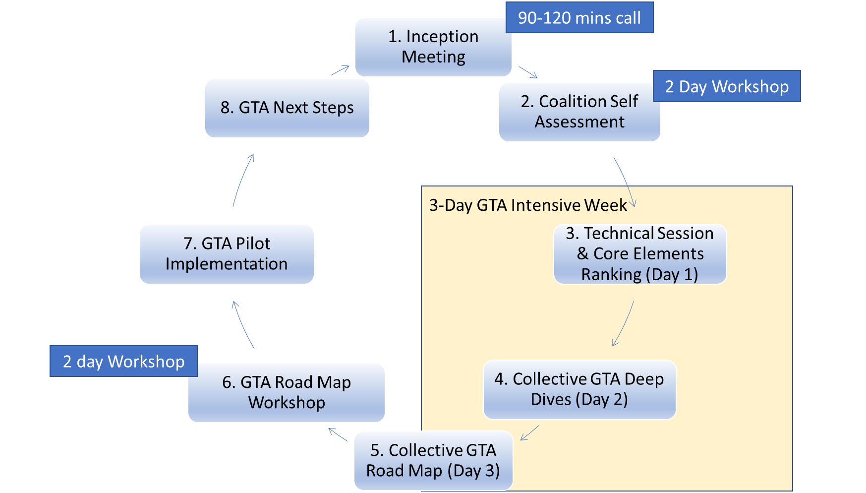
Stepping-stones in a gender-transformative journey
Notes:
Mercy
Stepping stones in a gender-transformative journey
Just to say again the tools, slides, resources, agendas, examples and steps will be made available in the CSO Facilitation Guide to be published and promoted on the GNB website, in English, Portuguese and French.
The Facilitation Guide supports workshop-based critical reflection and action planning to end child marriage as a CSO collective that is informed by external evidence and the experience and perspectives of CSO members and those most affected by child marriage
In the slide we see the 7 stepping stones that mark the gender-transformative journey over a period of 12-14 months
In brief:
Step 1: Inception Meeting, setting the compass, agreeing who does what
Step 2: Organisational self-assessment, a 1 or 2 day workshop
Steps 3,4 and 5 – The 3 days of the GTA Intensive Week of workshops with all members
Steps 6 – Finalising the GTA Road Map and GTA pilots, can be a 2 day workshop.
Step 7 – Implementation of actions and activities set out in the GTA Road Map.
Step 8 - Planning next steps in the GTA Journey, as capacity assessment/learning needs will have emerged along the way and building gender-transformative skills and leadership is a long-term process that requires long-term investment.

Slide 16
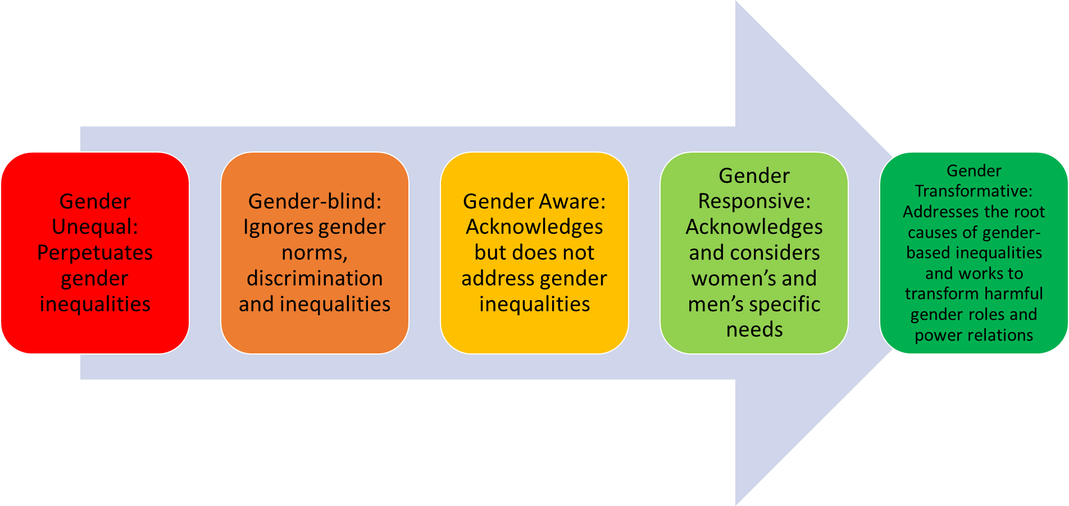
Moving across the Gender Integration Continuum to accelerate progress to end child marriage
Accelerated progress on child marriage
Notes:
Mercy
Moving across the Gender Integration Continuum to accelerate progress to end child marriage
Underpinning the gender-transformative journey is the Gender Integration – sometimes called Equity – Continuum.
This is familiar I’m sure to many of you
The process of gender integration means critically reflecting on the impact of gender norms, roles and dynamics, including unequal relationships of power, and identifying how to transform and overcome them for women, girls and gender minorities to exercise their equal rights and power, including if, when and whom to marry.
At one end (left) of the Continuum gender is not addressed, or gender norms and roles are exploited, which perpetuates gender inequality and worse can be harmful. Moving along the Continuum to the right passing through Gender-aware and Gender-responsive toward Gender-transformative shows active commitment to addressing the root causes of gender inequality which will in turn it is believed lead to change in the lives of girls.
Progress – sometimes called moving the needle – along the gender integration continuum is the only pathway to accelerate progress to end child marriage at scale, safely and sustainably

Slide 17
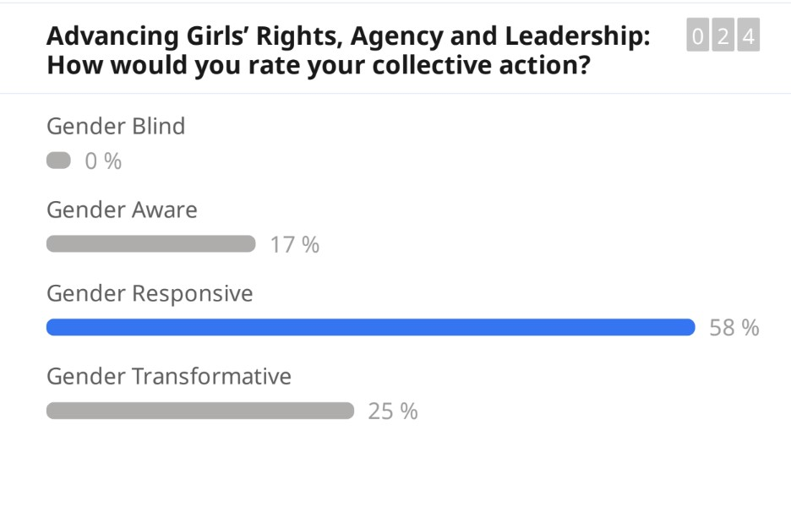
Ranking of GTA core element 1
Notes:
Mercy
Ranking of GTA core element 1 (Day 1 of GTA intensive week)
The approach and work of the collective with regard to advancing girls’ rights, agency and leadership on Day 1 of this GTA Intensive Week were ranked predominantly Gender Responsive at 58%
Interesting to note the range of scores – from gender aware to gender transformative and to use the space to explore possible reasons for this
Back to the previous slide please to take a quick look at Day 2 of the GTA Intensive Week

Slide 18
Key Takeaways
There are different ways that child marriage manifests, some are more visible than others, as well as different drivers across regions.
Making use of expertise within the coalition such as expertise on work on masculinities and working with men and boys, youth engagement and budget advocacy.
Stronger focus on quality and relevance of education, turning attention to the quality of education (not just increased access), its potential to transform discriminatory norms, provide CSE, prepare for employment .
Notes:
Mercy
Observed changes
As well as data available from participant surveys done on Day 1 and Day 3 of the GTA intensive week, included here are some of the observed or self-reported changes emerging that are suggestive of that desired progress across the gender integration continuum
(1) There are different ways that child marriage manifests, some are more visible than others.” Suggests increasing openness to address some of the most powerful and invisible drivers of child marriage, such as the link between family honour and girls’ sexuality. Engaging with complexity and with taboos is essential for gender-transformative approaches
(2) It would be good to document the different drivers across the regions: even stronger recognition of the importance of evidence-informed approaches that are context sensitive
(3) Making more of expertise within the coalition: great to see an appetite for making better use of the expertise within its own membership (this was true for work on masculinities and working with men and boys, youth engagement and also budget advocacy.)
(4) Stronger focus on quality and relevance of education. Already doing a lot to increase demand for education and support by parents and community and religious leaders for girls’ education. Turning attention to the quality of education, its potential to transform discriminatory norms, provide CSE, prepare for employment
(5) Beyond ‘engagement with’ religious and traditional leaders: echoes learning from the Global programme, of the need to do more than engage, to look at messaging, how to engage. Girls’ voice, choice and agency

Slide 19
GNB members on today’s panel
Notes:
Mercy
Introducing our CSO Panellists from Nigeria and Mozambique
It is my pleasure in a moment to hand over to our panel who have been travellers on this gender-transformative journey for most of 2022
They come from Nigeria and Mozambique
So a quick recap of the child marriage situation in their countries

Slide 20

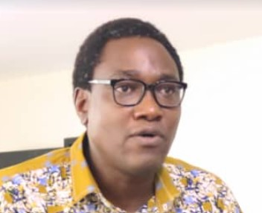

Gender Advocate Nigeria and first responder for sexual and gender-based violence with Equitable Health Access Initiative
Mwema Uaciquete
Kola Olatosimi
Dorinda Odonghanro
Gender Advocate Mozambique and Behaviour Change Advisor with Pathfinder Int’l.
Co-chair of the National Coalition of CSOs on ending child marriage in Nigeria and the National Coordinator and senior program officer at the Child and Youth Protection Foundation
Notes:
Mercy
Need to review the bios I wrote
child marriage prevalence 43% (Nigeria)
Child marriage prevalence 53% Mozambique
One characteristic to highlight is that 39% of girls are in informal unions in Moz comparened to only 2% in Nigeria
Of girls married or in union before the age of 18 91% are out of school in Mozambique and a monumental 97% in Nigeria which has the largest number of out of school children in the world
.
Thank you for joining us today and taking the time to share with fellow members and child marriage advocates and practitioners what ‘gender-transformative collective action’ means for you, and with 5 minutes each (!) a couple highlights from your role and perspective during this gender-transformative journey.
First, Mwema (MWEMA HAS NOT YET SHARED DRAFT SPEAKING NOTES SO THE Qs WILL NEED TO BE REVISED)
Mwema for years you have been active in feminist spaces and civil society networks, speaking up and out for the rights of girls to have choice about marriage, about their bodies and reproductive choices and to have equal opportunities in school and beyond.
As a Gender Advocate for this gender-transformative journey and member of the Facilitation Team
Could you share one or two examples of the activities, discussions, tools of the GTA Intensive Week of workshops in August to support critical reflection and action planning to accelerate progress on premature unions and child marriage and other gender equality outcomes
Or, Choose (2 or 3) of the IW activities to highlight how they built the skills, perspective and commitment needed for participants to strengthen their gender-transformative practice.
CECAP as the primary civil society partner working to end premature unions and marriage in Mozambique historically and currently has a significant focus on raising awareness to support the implementation of the 2019 law that aims to prohibit, prevent, mitigate and penalise premature unions or marriages (child marriage), as well as establish mechanisms to protect children in those unions.
Would you say that this gender-transformative journey has offered food for thought for CECAP in terms of where to focus its collective advocacy and social mobilisation? And if so, in what ways?
Or, In (two) sentences how would you summarise the contribution this gender-transformative journey has started to make to CECAP In your own words to communicate what the key ingredients of gender-transformative collective action are
Kola
Kola, as Co-chair of the Steering Committee for the National Coalition and the designated CSO lead for this collaboration, you’ve been part of the gender-transformative journey from day 1! Supporting the planning, adaptation and facilitation of the workshop sessions, and supporting the development of the GTA Road Maps and pilots which are nearly at implementation stage.
Q1 Please share with us what the national Coalition learnt about its gender-transformative practice and behaviours.
Q2 In what ways is the gender-transformative journey enabling the Coalition to optimise its collective advocacy and action to create the enabling environment for girls in all their diversity to exercise voice and choice, including if, when and with whom to marry?
Anything you’d like to add that would be useful to your global partnership peers?
Dorinda
Dorinda like Mwema you put yourself forward to be a Gender Advocate for this journey.
Q1 What attracted you to the position of Gender Advocate? And maybe following up with what have been your key take aways about what gender-transformative means, why it’s important and what it means for the work you do?
Q2 And looking ahead to that bright future you often describe, what for you are the priorities for the national coalition? And what has shifted for you?

Slide 21
Q & A
Notes:
Lara

Slide 22
Links to key resources
Technical Note on Gender-Transformative Approaches (2020) UNFPA/UNICEF and UN Women
Here
Gender-Transformative Accelerator (2021) UNFPA/UNICEF
Here
Gender-transformative education. Reimagining education for a more just and inclusive world (2021) Plan International
Here
Ending child, early and forced marriage is crucial to gender equality (2020) Girls Not Brides
Here
Tackling the Taboo: sexuality and gender-transformative programmes to end child, early and forced marriage and unions (2019) The Child, Early & Forced Marriage & Unions and Sexuality Working Group
Here
Transcending Norms: Gender-Transformative Approaches in Women and Girls’ Safe Spaces in Humanitarian Settings (2021) UNFPA
Here
Enhancing Social Norms Programs: An Invitation to Rethink “Scaling Up” From a Feminist Perspective (2021) CUSP
Here
Gender-Transformative Budgeting: A Guide for Pan-African Parliamentarians (2019) FEMNET
Here
Notes:
Lara

Slide 23
THANK YOU!

