Slide 1
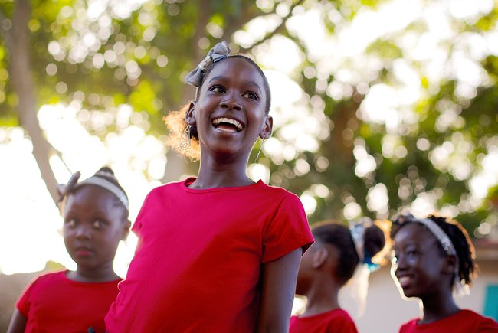
SIX
SHARED
GOALS
Regional GTA Webinars – WCA
Sharing GTA promising practices and strategies that have worked in Nigeria
February 2023

Slide 2
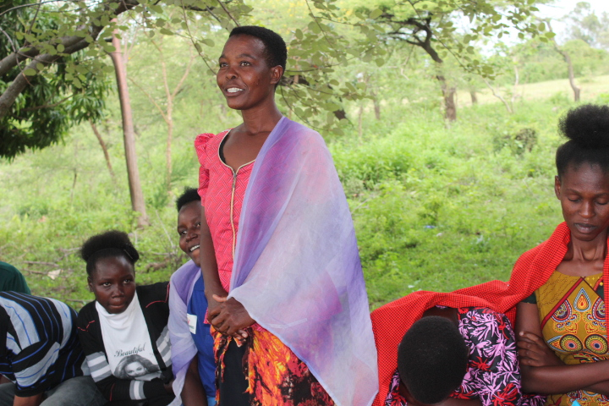
Community members participate in activities as part of a cross-border programme to end child marriage in Kenya and Tanzania
Girls Not Brides/David Owino
West and Central Africa Gender-transformative collective action to address child marriage – Lessons learned from Nigeria
Notes:
Kola
After welcoming everyone (welcome everyone from all over West Africa and mention that translation to French is available)
Ask everyone to introduce themselves in the chat (name, name of organisation and country joining from)
Mention the objectives of the webinar.
This webinar will be a space to:
to learn about:
Promotion of Key GNB for GTA
Next steps: reflections from the National Coalition and GNB
Learn – what gender transformative approaches are with examples of best practices.
Learn – with evidence – why gender-transformative collective action is needed to accelerate progress to end child marriage with a particular focus on Nigeria.
Build shared understanding of what ‘gender-transformative’ means, and the core elements needed for gender-transformative programmes and advocacy.
Hear about a gender-transformative journey we’ve taken this year with the National Coalition in Nigeria together with UNICEF to build gender-transformative skills and practice.
Share with you our learning materials developed during the GTA journey.
Invite you to share your questions and your learning and experience and finally
If you’re a member of a GNB National Partnership or Coalition, we invite you to consider whether you’re ready for a gender-transformative journey to catalyse transformative change at scale as leaders in the national movements in your country.
Welcome Nerida to for welcome remarks.
Call on the government rep for his remarks.
Take over after remarks and mention that after the webinar a recording of the session, key take-aways and resources will be shared by email
Run through agenda and hand over to Husseina.
Summary of Agenda:
A snapshot of progress on CM and girls’ and women’s rights
Making the case for gender-transformative collective action, what this means and what it takes.
The Call to Action for accelerated progress on CM in Africa and an example of the impact of collective gender-transformative action.
Introduction to a gender-transformative journey to strengthen GTA skills, knowledge, and leadership with an opportunity to hear from 3 GTA travellers on that journey.
Time for Q&A (at the end. We will unmute those who indicate that they want to speak, to ask questions using the Q&A button at the bottom of your screen)
Hand over to Husseina
During the presentations, please monitor the chat for questions and note them down so they can be responded to.
After All the panellists finish their session, take over and lead the question and answer session, by asking people to raise their hands and my colleague Noleen can unmute them to ask their questions.
After about 2 or three people ask their questions, next read the questions you have taken from the chat and assign people to respond (me or the Head of Africa for Girls Not Brides), you or Comfort for the Coalition and any of the panellists if the question is addressed to them.
At the end of the Q&A session
Say the following:
Kindly respond to the feedback Poll that has been shared.
Following the webinar, a recording of the session, key take-aways and resources will be shared by email.
The published Facilitation Guide is linked in the chat.
The published Nigeria GTA Report has been published on Girls Not Brides site.
Thank everyone for coming and bring the webinar to a close.

Slide 3
Interpretation
ENGLISH - This session will have presentations in English and French. To access simultaneous interpretation, please click on the globe icon at the bottom bar of your screen and select your preferred language (English, French, or no interpretation).
français - Cette session comprendra des présentations en anglais et en portugais. Pour accéder aux services d'interprétation simultanée, veuillez cliquer sur l'icône globe que vous trouverez dans la barre inférieure de votre écran, et sélectionnez la langue de préférence (anglais, espagnol, français, portugais ou version originale).
Notes:
Kola
Please write in the chat box (preferably in France or English!) if you are having any technical difficulties and a member of our team will be happy to support
Please also use the chat box to post Questions or experience you would like to share. And if you have a question for one of our panellists please do put their name.

Slide 4
What does
“gender-transformative collective action” mean?
Why is it mission critical?
Notes:
Husseina
What does gender-transformative collective action mean? Why is it mission critical?
So, why is gender-transformative collective action needed to accelerate progress to end child marriage?
What do we mean by ‘GTA’?
What does evidence show is needed, what are the core elements for child marriage programming to transform unequal relationships of power, shift power and resources so that girls in all their diversity can choose if, when and whom to marry?
Sometimes it’s easier to understand why something is important by describing what happens if you don’t do it, so what are some examples of ways of working, programmes or advocacy that are not taking a GTA?

Slide 5
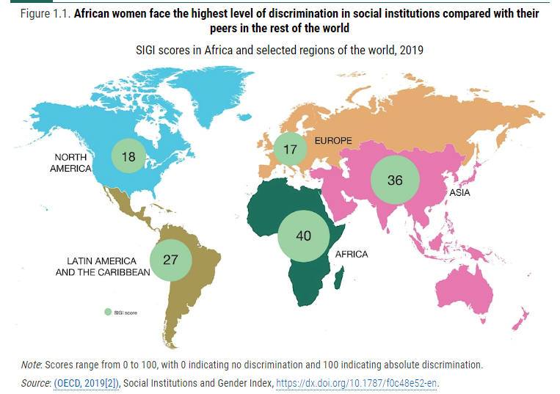
African women face the highest levels of discrimination in the world
Notes:
Husseina
https://www.oecd-ilibrary.org/sites/bd00bc44-en/index.html?itemId=/content/component/bd00bc44-en
Speaking Notes
The map is a snapshot of SIGI scores for different regions in the world
SIGI is Social Institutions and Gender Index, and measures deeply rooted discrimination and obstacles faced by women and girls in different regions of the world.
The scores aggregate country level data from the Social Institutions and Gender Index which looks at laws, social norms and practices – including child marriage - to measure gender discrimination.
The higher the score the higher the level of discrimination
The highest score of 40 suggests African women experience some of the highest levels of discrimination in the world, including low levels of decision-making power in the family.
Low decision-making power, particularly when compounded by poverty and crisis means few girls can choose if, when and whom to marry.

Slide 6
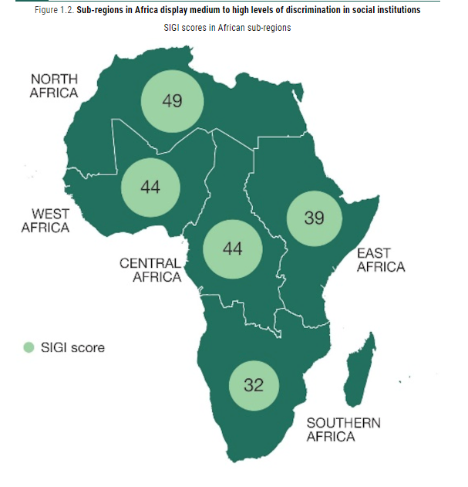
Regional SIGI for Africa
Notes:
Husseina
Speaking Notes
Southern Africa fares the best, with a medium level of discrimination and an overall score of 32 compared to the other African sub-regions, and Northern Africa with the worse score. However, this figure is almost double the global average.
West and Central Africa is above the Africa SIGI Score

Slide 7
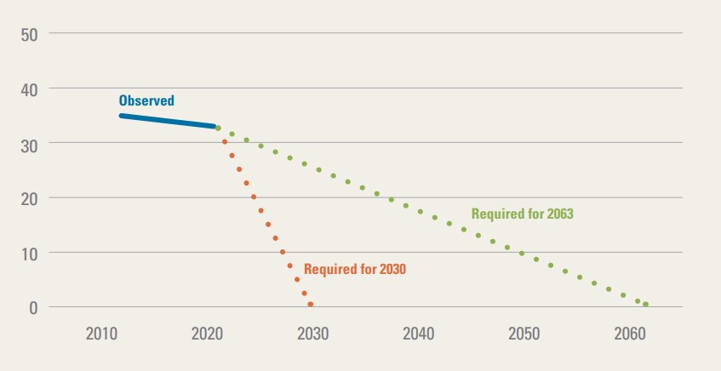
To end child marriage by 2030 Africa needs to accelerate efforts
Child marriage prevalence
SDG 5.3
Africa Union Agenda 2063
Notes:
Husseina
To end child marriage acceleration is required
Graph is from Towards Ending Harmful Practices in Africa: A statistical overview of child marriage and female genital mutilation, UNICEF, New York, 2022.
https://data.unicef.org/resources/harmful-practices-in-africa/
Unless progress is accelerated, it will take over 100 years to end child marriage in West and Central Africa. This would not only negatively impact the well-being of girls, it also has crippling effects on the prosperity of the region.
Speaking notes
The blue line shows child marriage prevalence in Africa.
The dotted red and green lines show the rapid acceleration needed to achieve zero child marriage by 2030 and 2063.
The global prevalence of child marriage is 19%. As an aggregated average child marriage prevalence is 37% for the WACA region.
Unless progress is accelerated, it will take over 100 years to end child marriage in West and Central Africa. This would not only negatively impact the well-being of girls, it also has crippling effects on the prosperity of the region.
Unless progress is accelerated, it will take over 100 years to end child marriage in West and Central Africa. This would not only negatively impact the well-being of girls, it also has crippling effects on the prosperity of the region.

Slide 8

What is a gender-transformative approach?
A transformative approach promotes gender equality by | Fostering critical examination of inequalities and gender roles, norms and dynamics
 | Recognising and strengthening positive norms that support equality and an enabling environment
 | Promoting the relative position of women, girls and marginalised groups
 | Transforming the underlying social structures, policies and broadly held social norms that perpetuate and legitimise gender inequalities
One African member’s definition of a gender- transformative approach:
When you cut a tree from the roots then it will not grow again. When you cut a branch, it will continue.
Notes:
Huseina
What is a gender-transformative approach?
Speaking notes
A gender-transformative approach is one that promotes gender equality by
Fostering critical examination of inequalities, gender roles, norms and power dynamics
Recognising and strengthening norms that support equality and an enabling environment.
Promoting the relative position of women, girls, and marginalised groups
Transforming the underlying social structures, policies and behaviours that perpetuate and legitimise gender inequalities.
One member shared an interesting definition of gender transformative approaches:
“When you cut a tree from the roots then it will not grow again. When you cut a branch, it will continue.”
We can only end child marriage if we address the root causes of gender inequality.
We will not achieve gender equality unless we address child marriage.
We’re committed to both: our vision statement goes beyond a world without child marriage to one where girls and women enjoy equal status with boys and men and can achieve their full potential.

Slide 9
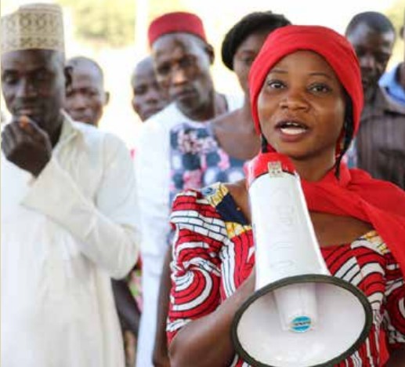
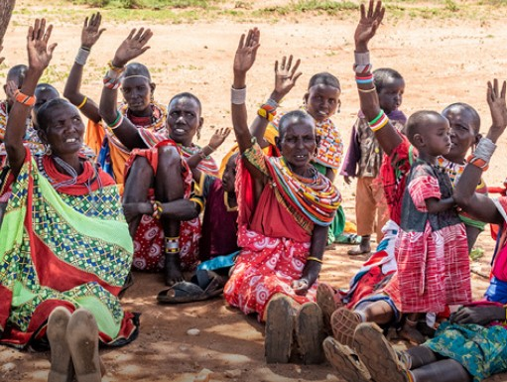

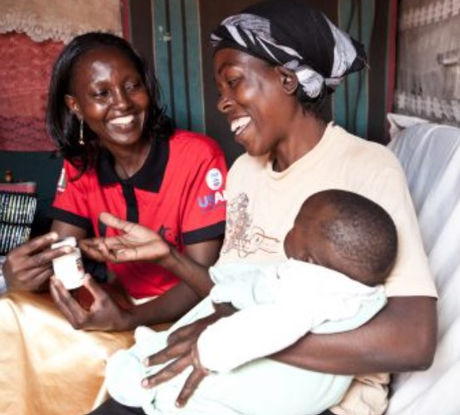

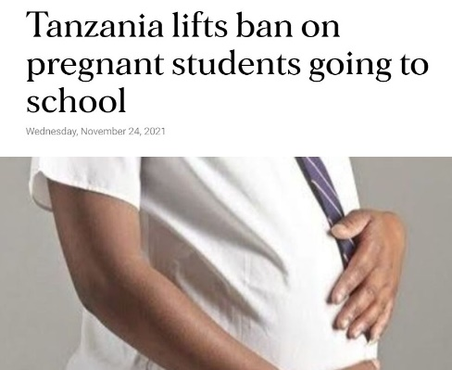
Core elements of a gender-transformative approach
1. Adolescent girls’ skills, agency, and leadership
2. Enabling environment, family and community mobilization
3. Addressing masculinities and engaging men and boys
6. It’s cross-cutting and needs to be integrated across all gender-transformative work - gender norms and inequalities
5. Policy & structural change, and institutional partnerships (incl. laws & policies)
4. Services and multi-sectoral collaboration
Source: Technical Note on GTA in the Global Programme to End Child Marriage, UNFPA, UNICEF and UN Women
Notes:
Huseina
Core elements of a gender-transformative approach?
Speaking Notes
The Global Programme to End Child Marriage Technical Note on Gender-transformative approaches describes 6 core elements of a gender-transformative approach –or if you prefer jargon-free, ways to uproot a tree
These are from left to right and top to bottom
Core element 1: Adolescent Girls’ Skills, Agency and Leadership
Core element 2: Enabling Environment, Family and Community Mobilization
Core element 3: Addressing Masculinities and Engaging Men and Boys
Core element 4: Services and multi-sectoral collaboration
Core element 5: Policy and Structural Change and Institutional Partnerships , including laws and policies
Core Element 6 is cross cutting and needs to be integrated cross all gender-transformative work, namely Gender Norms and Inequalities
Child marriage is a complex issue which needs a complex solution – this means collaborating with a constellation of actors to catalyse change in individuals, institutions and multiple sectors.
Six words beginning with the letter ‘p’ help me to cut through the complexity. They are:
Power and Privilege – in our engagement, how are we catalysing progressive norms to rebalance power and privilege?
Political and Personal – how does our collective action advance accountability for quality gender- equitable services, policies, laws, markets, and budgets to create alternatives to child marriage? And how am I working on my own privilege and prejudice to be the best I can for girls’ and women’s rights.
Potential and People – how do we centre the voice and priorities of girls and young people, respect and value their diversity, and promote their decision-making power.

Slide 10
The consequence of not taking a gender-transformative approach
Some members have been able to rescue girls from forced marriages and these girls are now dependent on us. This is a major problem for us and for our respective institutions. What is the point of rescuing girls from marriage if we are not able to support them afterwards – to return to school or learn a skill?
Girls are unable to fulfil their potential
Gains made are concessions rather than entitlements
Alternatives are not created
Educated girls are higher value brides
Increased risk of backlash
Drive the practice underground increasing girls’ vulnerability
Notes:
Huseina
The consequences of not taking a gender-transformative approach
Speaking notes
To strengthen the case for gender-transformative action here are some consequences of NOT using gender transformative approaches.
The quote on the left is from a Girls Not Brides member, to summarise:
Some members have been able to rescue girls from forced marriages but what is the point if we can’t support them afterwards?
Without systems and services in place what is the future for girls who courageously go against the wishes of family and social norms? And what are the alternatives to child marriage?
This was the same for a girl who I heard said, given her time again she would choose the cut – FGM, in preference to the isolation, poverty and indignity of her daily life since being forced to leave family and home following her refusal to have her genitals mutilated in line with the norm.
Raising the legal minimum age of marriage in isolation can drive the practice underground, replace formal marriage with informal unions (where girls might have fewer rights), delay the age of marriage, possibly, but with little change to the empowerment (economic and life skills such as decision-making power), status and safety of girls and adolescents.
And we know that those challenging the status quo are put at risk without the enabling environment and support needed for activism and advocacy.

Slide 11
Child marriage in West Africa/Nigeria: the scale and the Call to Action
Notes:
Mercy
Speaking Notes
There are a few slides from the Nigeria evidence review that follow.

Slide 12
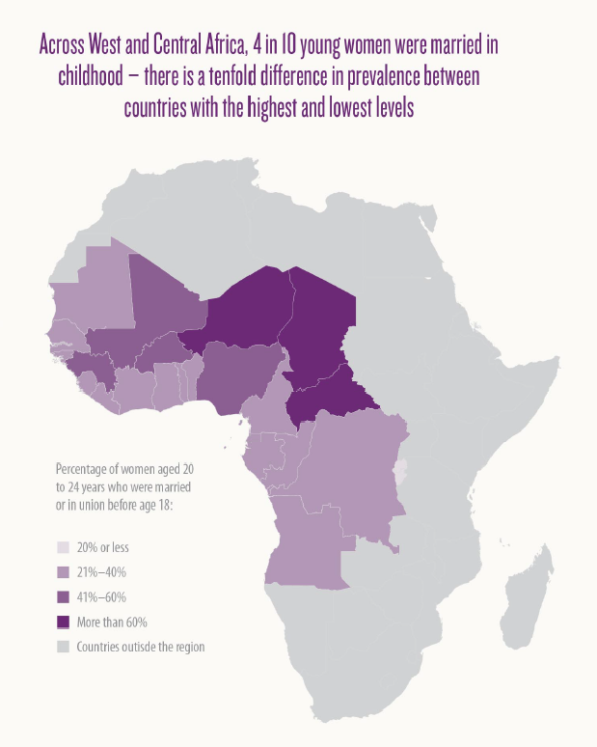
CM prevalence: West Africa
Notes:
Mercy
Speaking Notes
The map is from the UNICEF publication ‘Achieving a Future without Child Marriage: Focus on West and Central Africa’. https://www.unicef.org/wca/media/1021/file/Achieving%20a%20future%20without%20child%20marriage.pdf
Africa is home to some 130 million child brides with huge variations in prevalence across the continent by region, country or even the community.
Nearly 60 million live in West and Central Africa, with the largest number in Nigeria and the highest prevalence in Niger.
Child Marriage prevalence in Africa was recorded to have declined in 2015 (when recorded for a 25-year period, 1990-2015) but by just 1/5th. However, like we have seen varied prevalence across countries continues to contribute to this slow reduction and high prevalence.
Overall prevalence is decreasing, but not fast enough; slow declines + steep population growth means the number of child brides in Africa is increasing; and by 2050, there might be more than 1 in 4 child brides.

Slide 13
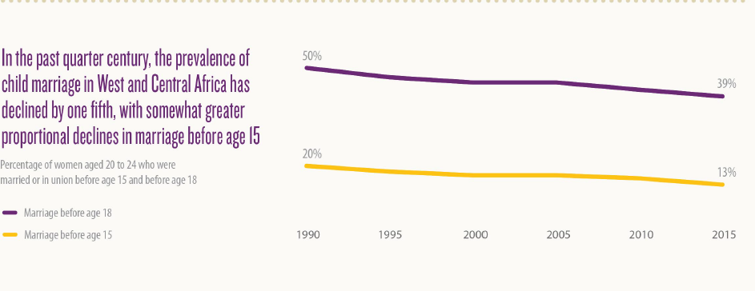
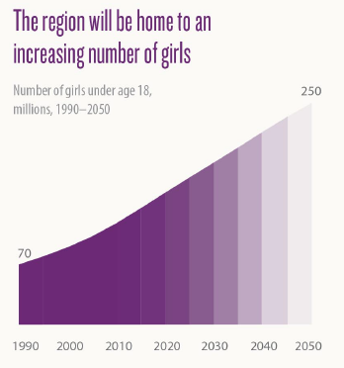
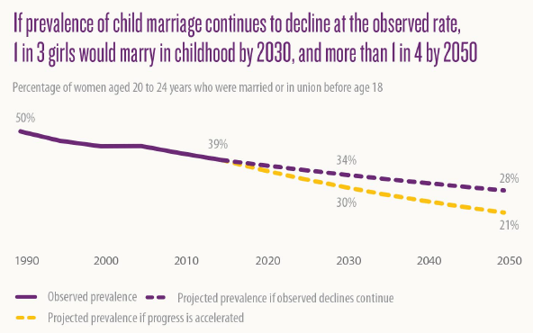
How child Marriage is changing in Africa cf West Africa
Notes:
Mercy
Image from United Nations Children’s Fund, Achieving a Future without Child Marriage: Focus on West and Central Africa, UNICEF, NewYork, 2017.
https://www.unicef.org/wca/media/1021/file/Achieving%20a%20future%20without%20child%20marriage.pdf
This progress, though, has not been equitable; high levels of child marriage among the poorest have persisted, while declines in the practice have been limited to the richest.
36% of girls in the world’s lowest-income countries and 35% in the world’s most fragile contexts marry before 18, almost double the global average
West and Central Africa faces a unique set of challenges in its bid to end reduce child marriage.
A high prevalence and slow rate of decline in child marriage
A growing population of girls

Slide 14
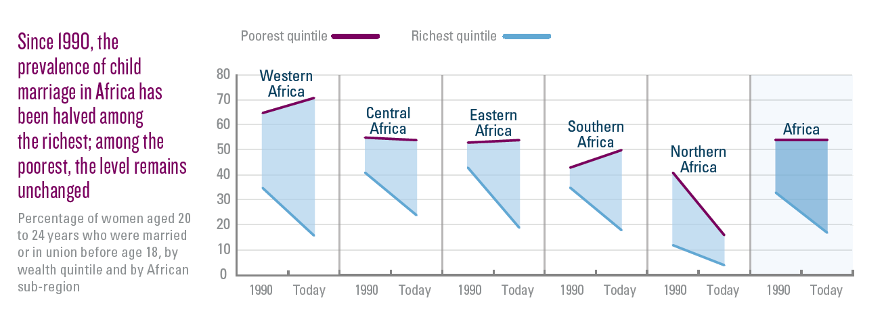
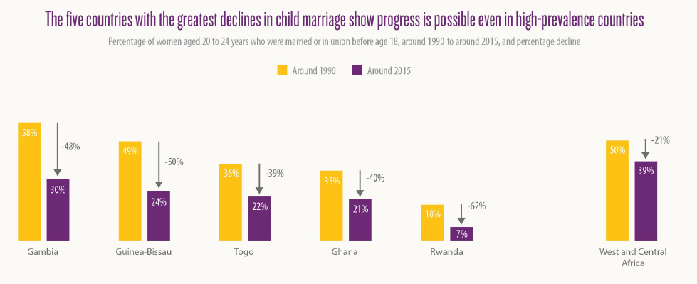
How child Marriage is changing in Africa cf West Africa
Notes:
Mercy
United Nations Children’s Fund, A Profile of Child Marriage in Africa, UNICEF, New York, 2015.
https://www.unicef.org/wca/reports/profile-child-marriage-Africa
This progress, though, has not been equitable; high levels of child marriage among the poorest have persisted, while declines in the practice have been limited to the richest.

Slide 15
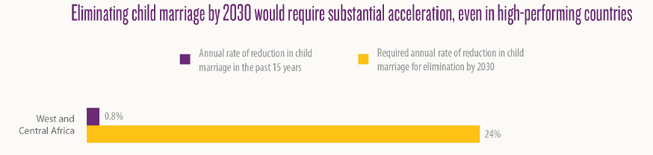
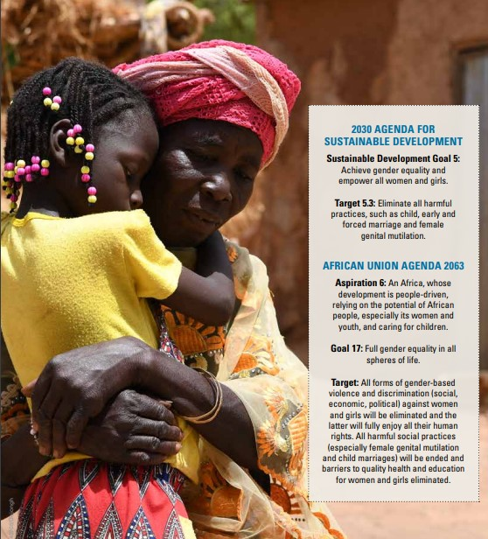
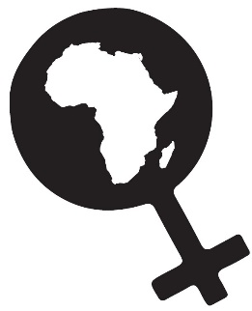
What is needed to accelerate progress
Focus on the root causes of the practice, including social norms, patriarchal structures and age-based discrimination
Government investment in gender-responsive or gender-transformative laws, policies and systems
A comprehensive, rights-based approach
Notes:
Mercy
Image: Towards Ending Harmful Practices in Africa: A statistical overview of child marriage and female genital mutilation, UNICEF, New York, 2022.
https://data.unicef.org/resources/harmful-practices-in-africa/
Africa Union Agenda 2063 Aspiration 6: An Africa, whose development is people-driven, relying on the potential of African people, especially its women and youth, and caring for children.
In 2014, the African Union (AU) launched a campaign to end child marriage in Africa “to accelerate the end of child marriage in Africa
Accelerating progress towards ECM in Africa involves; Focusing on the root causes of the practice, including social norms, patriarchal structures and age-based discrimination
Gender-responsive or gender-transformative laws, policies and systems: we need multi-sectoral interventions at all levels; adequate resources; investment in gender-responsive social protection with improved access to quality education, provision of adolescent-friendly sexual and reproductive health services, and protection measures that prevent and respond (including justice) to violence against children, especially girls.
Focus on girls’ agency and autonomy: investment in 12 years’ quality education; CSE; life skills including legal literacy and information and services related to SRHR services
Promotion of positive social norms and behaviours that respect and support the equal rights, voice and choice of girls: engagement with men and boys, traditional and religious leaders, progressive media and evidence and learning that shows that community-led interventions require a systematic approach focused on norms change rather beyond awareness-raising
Adolescent-friendly services including in crisis settings
Create economic alternatives to child marriage: Poverty is a key driver of CM.
A system-wide approach that is rights-based
Evidence based actions to end child marriage

Slide 16
Accelerated progress through gender-transformative practice in Uganda
Putting Gender Transformative principles into practice
Ecosystem approach
Rights Based Approach
Girl Centred Approach
Engagement with religious and cultural leaders
Collective advocacy for policy change
Youth Engagement
Media engagement
The Six Core Elements of a Gender-Transformative Approach
Notes:
Mercy
The Accelerator Approach in ECM
The Accelerator Approach aims to unlock the potential of a wide range of partners, encouraging them to increase efforts and collaboration to ECM. Commenced to test the hypothesis that Ending child marriage is possible at scale that is currently unimaginable when All relevant actors addressing child marriage in Uganda align with each other; and each actor individually intensifies and accelerates their efforts.
The flagship approach witnessed impact and catalyzed GTA programing through;
It's a Multisectoral approach to Centre girl's agency and voice in programing to ECM.
Giving an over-view of the eco-systems wide approach for accelerated change in Gender Transformative programing.
Some of the themes utilized for impact in GTA included;
Champions Approach: Traditional and religious leaders identified(gate keepers of social Norms), and trained to speak against the retrogressive norms and practices that place girls and young women at the periphery of leadership and decision making. Traditional leaders have a better understanding of the causes and consequences of CM, and are able to inform their structures. (Kuria community in Kenya and Western Uganda).
Government GNB members collectively lobbied for the renewal of the second national strategy on ECM. The strategy sets precedence on some of the GTA interventions that protect girls and young women from adolescent pregnancies and child marriage.
Youth Activist: Young women trained on rolling out the GNB Speak out Speak up youth engagement tool kit on ECM. Cascading the training to their home areas. Building a cadre of young transformative activists against CM in their communities.
To enhance the approach the media is also involved to pick child marriage cases and amplify evidence about the challenge of CM, which is being used as evidence to induce government action. Basing on facts and figures presented, the accelerator approach has generated policy briefs for evidence-based lobbying for relevant stakeholders, on account as policy making and budget appropriation mandates.
Key Messages to accelerate progress- wrapping up
Progress:
Africa is home to some 130 million child brides with huge variations in prevalence across the continent by region, country or even the community.
There has been progress in ECM across regions of Africa, however variation across and within countries.
Sub-Saharan Africa CM stands at 35%(2022), compared to 38% in 2018 (a 3% decline).
Eastern and Southern Africa (32 and 35% 2022 and 2018 respectively) , West and Southern Africa (37% and 41%)
Significant Progress countries:
1.Uganda(34% in 2016, 40% in 2011, 54% in 1995)
2. Ethiopia(40% in 2016, 49% in 2005)
3. Sierra Leone(30% in 2017, 39% in 2013,48% in 2008)
Countries with little progress;
1. Niger(76% in 2012, 75% in 2006),
2. Chad (72% in 2004,72% in 1997)
To accelerate progress to end child marriage in Africa, there is need for approaches to be context sensitive and informed by an understanding of intersectionality which recognizes the diversity of lived experience, that some girls are at greater risk of CEFMU than others.

Slide 17
Taking a gender-transformative journey
Strengthening gender-transformative skills, knowledge and leadership
Notes:
Comfort
Taking a gender-transformative journey: Strengthening gender-transformative skills, knowledge and leadership
Before handing over to our three panellists, a short background to what we’re calling a ‘gender-transformative journey’
The step-by-step Facilitation Guide for any group of civil society organisations working to end child marriage and advance girls’ rights, has been published and the links will be in the chat.
The starting part for this journey was alignment between the mission and vision of the UNFPA-UNICEF Global Programme to End Child Marriage, the UN/EU Spotlight Initiative to eliminate all forms of VAWG and the Girls Not Brides global partnership commitment to build civil society action to end child marriage.
Travellers on this gender-transformative journey include members of GNB’s National Partnership in Mozambique – CECAP – with a key role played by NP member AMODEFA - members of the National Coalition of CSOs in Nigeria – with a key role played by CYPF as the nominated lead CSO on this collaboration.
UNICEF HQ, WACA and ESA Regional and Country offices, plus government representatives
And a special mention to the role played by the 6 Gender Advocates who facilitated or supported many of the workshops, and continue to support application or promotion of the learning supporting CSO members though outreach
The GNB gender-transformative journey is an adaptation and extension of UNICEF’s Gender-Transformative Accelerator Tool which they piloted in African and Asian global programme countries with GP staff from UNFPA and UNICEF.
The change desired through investment in this and future stages of the gender-transformative journey is to recognise the power of collective action and the unique role civil society can play in building the critical mass and consciousness needed from individual to institutional level to enable girls to fulfil their potential and exercise voice and choice.

Slide 18
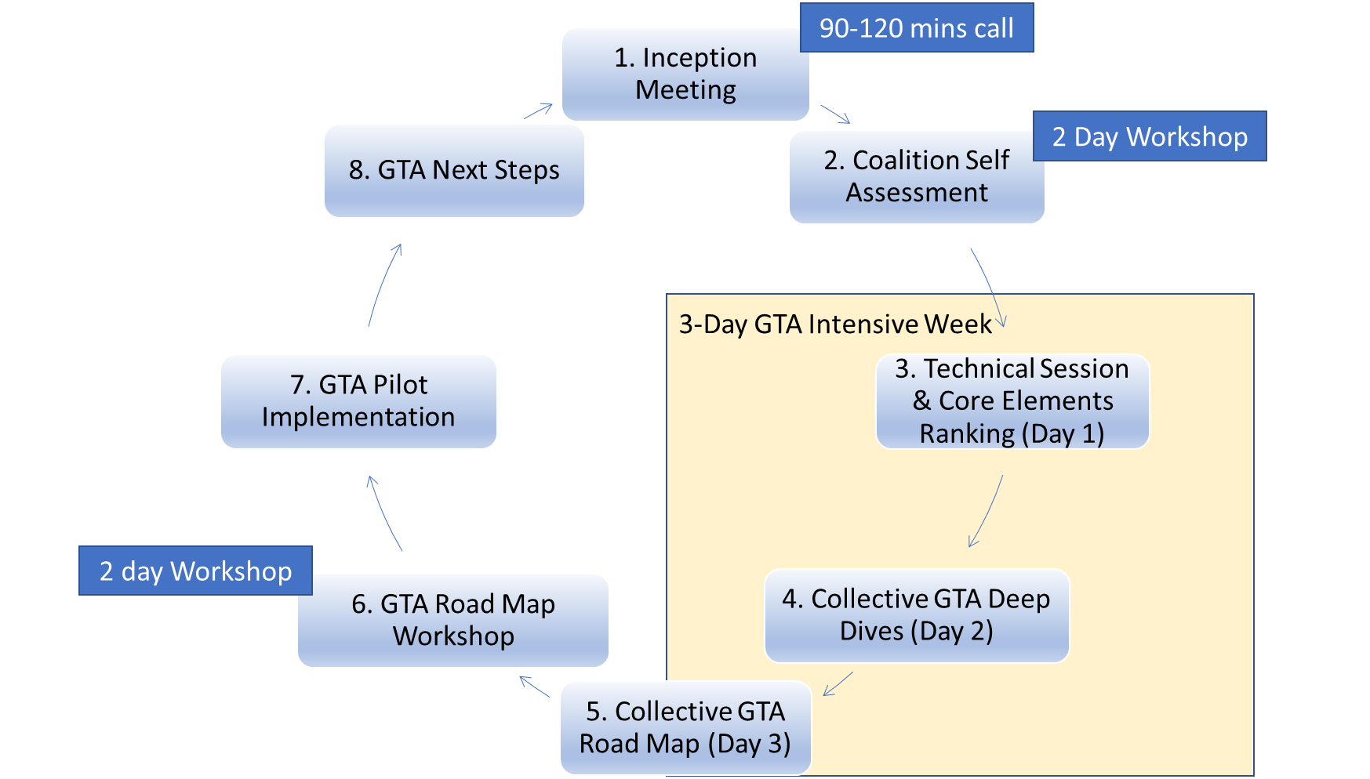
Stepping-stones in a gender-transformative journey
Notes:
Comfort
Stepping stones in a gender-transformative journey
Just to say again the tools, slides, resources, agendas, examples and steps will be made available in the CSO Facilitation Guide to be published and promoted on the GNB website, in English, Portuguese and French.
The Facilitation Guide supports workshop-based critical reflection and action planning to end child marriage as a CSO collective that is informed by external evidence and the experience and perspectives of CSO members and those most affected by child marriage
In the slide we see the 7 stepping stones that mark the gender-transformative journey over a period of 12-14 months
In brief:
Step 1: Inception Meeting, setting the compass, agreeing who does what
Step 2: Organisational self-assessment, a 1 or 2 day workshop
Steps 3,4 and 5 – The 3 days of the GTA Intensive Week of workshops with all members
Steps 6 – Finalising the GTA Road Map and GTA pilots, can be a 2 day workshop.
Step 7 – Implementation of actions and activities set out in the GTA Road Map.
Step 8 - Planning next steps in the GTA Journey, as capacity assessment/learning needs will have emerged along the way and building gender-transformative skills and leadership is a long-term process that requires long-term investment.

Slide 19
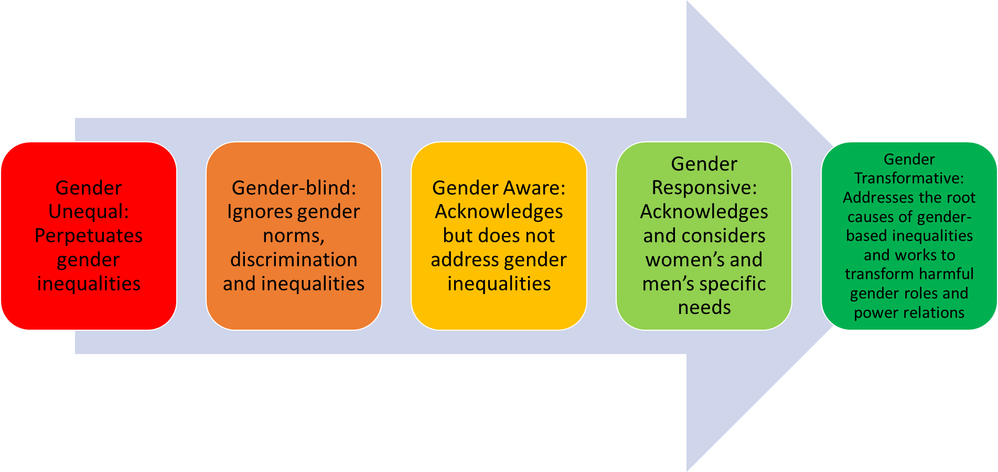
Moving across the Gender Integration Continuum to accelerate progress to end child marriage
Accelerated progress on child marriage
Notes:
Comfort
Moving across the Gender Integration Continuum to accelerate progress to end child marriage
Underpinning the gender-transformative journey is the Gender Integration – sometimes called Equity – Continuum.
This is familiar I’m sure to many of you
The process of gender integration means critically reflecting on the impact of gender norms, roles and dynamics, including unequal relationships of power, and identifying how to transform and overcome them for women, girls and gender minorities to exercise their equal rights and power, including if, when and whom to marry.
At one end (left) of the Continuum gender is not addressed, or gender norms and roles are exploited, which perpetuates gender inequality and worse can be harmful. Moving along the Continuum to the right passing through Gender-aware and Gender-responsive toward Gender-transformative shows active commitment to addressing the root causes of gender inequality which will in turn it is believed lead to change in the lives of girls.
Progress – sometimes called moving the needle – along the gender integration continuum is the only pathway to accelerate progress to end child marriage at scale, safely and sustainably

Slide 20
Summary Scores of the Girls Not Brides Self Assessment Scorecard

Slide 21
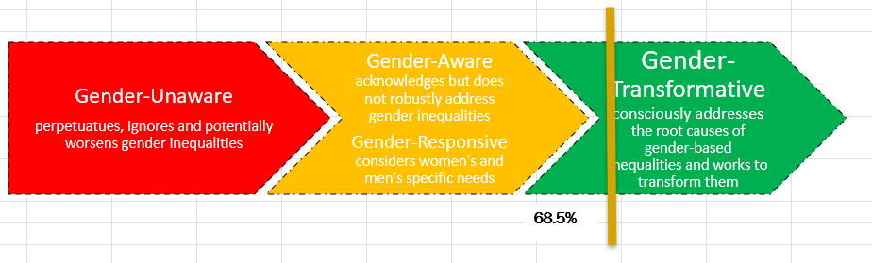
Gender Transformative Elements of the Self Assessment Scorecard.
6 Scorecard Principles that are essential for GT organisational practice
Diverse and Inclusive Membership
Leadership by and for women, youth and people from communities most affected by CM
Active Engagement with women’s collectives, youth networks, minority rights groups
Approaches that address the root causes of CM to advance girls’ rights and agency.
Advocacy to address structural drivers of CM informed by gender and power analysis
CM effectively framed and communicated as a girls’ and women’s rights priority.
Notes:
Comfort

Slide 22
Key Takeaways
There are different ways that child marriage manifests, some are more visible than others, as well as different drivers across regions.
Leveraging expertise within the coalition such as expertise on work on masculinities and working with men and boys, youth engagement and budget advocacy.
Stronger focus on quality and relevance of education, turning attention to the quality of education (not just increased access), its potential to transform discriminatory norms, provide CSE, prepare for employment .
Notes:
Comfort
Observed changes
As well as data available from participant surveys done on Day 1 and Day 3 of the GTA intensive week, included here are some of the observed or self-reported changes emerging that are suggestive of that desired progress across the gender integration continuum
(1) There are different ways that child marriage manifests, some are more visible than others.” Suggests increasing openness to address some of the most powerful and invisible drivers of child marriage, such as the link between family honour and girls’ sexuality. Engaging with complexity and with taboos is essential for gender-transformative approaches
(2) It would be good to document the different drivers across the regions: even stronger recognition of the importance of evidence-informed approaches that are context sensitive
(3) Making more of expertise within the coalition: great to see an appetite for making better use of the expertise within its own membership (this was true for work on masculinities and working with men and boys, youth engagement and also budget advocacy.)
(4) Stronger focus on quality and relevance of education. Already doing a lot to increase demand for education and support by parents and community and religious leaders for girls’ education. Turning attention to the quality of education, its potential to transform discriminatory norms, provide CSE, prepare for employment
(5) Beyond ‘engagement with’ religious and traditional leaders: echoes learning from the Global programme, of the need to do more than engage, to look at messaging, how to engage. Girls’ voice, choice and agency

Slide 23
GNB members on today’s panel
Notes:
Mercy
Introducing our CSO Panellists from Nigeria and Mozambique
It is my pleasure in a moment to hand over to our panel who have been travellers on this gender-transformative journey for most of 2022
They come from Nigeria and Mozambique
So a quick recap of the child marriage situation in their countries

Slide 24



Gender Advocate Nigeria and first responder for sexual and gender-based violence with Equitable Health Access Initiative
Peace Okeshola
Solomon Asuquo
Dorinda Odonghanro
Gender Advocate Nigeria.
A Legal officer in Lawyers Alert and a girls’ rights advocate
Senior Officer for Partnership, Monitoring, Evaluation, and Learning with African Girls Empowerment Network, a young feminist organisation (member of the Coalition)
Notes:
Comfort

Slide 25
Q & A
Notes:
Kola

Slide 26
Links to key resources
Technical Note on Gender-Transformative Approaches (2020) UNFPA/UNICEF and UN Women
Here
Gender-Transformative Accelerator (2021) UNFPA/UNICEF
Here
Gender-transformative education. Reimagining education for a more just and inclusive world (2021) Plan International
Here
Ending child, early and forced marriage is crucial to gender equality (2020) Girls Not Brides
Here
Tackling the Taboo: sexuality and gender-transformative programmes to end child, early and forced marriage and unions (2019) The Child, Early & Forced Marriage & Unions and Sexuality Working Group
Here
Transcending Norms: Gender-Transformative Approaches in Women and Girls’ Safe Spaces in Humanitarian Settings (2021) UNFPA
Here
Enhancing Social Norms Programs: An Invitation to Rethink “Scaling Up” From a Feminist Perspective (2021) CUSP
Here
Gender-Transformative Budgeting: A Guide for Pan-African Parliamentarians (2019) FEMNET
Here
Notes:
Kola

Slide 27
THANK YOU!

