Slide 1

CHILD MARRIAGE AND GIRLS’ EDUCATION
Girls not brides learning series, February 2023

Slide 2
Interpretation
ENGLISH - This session will have presentations in English and French. To access simultaneous interpretation, please click on the globe icon at the bottom bar of your screen and select your preferred language (English, Spanish, French, or no interpretation).
français - Cette session comprendra des présentations en anglais et en français. Pour accéder aux services d'interprétation simultanée, veuillez cliquer sur l'icône globe que vous trouverez dans la barre inférieure de votre écran, et sélectionnez la langue de préférence (anglais, espagnol, français, ou version originale).
Español - Esta sesión tendrá presentaciones en inglés y francés. Para acceder a los servicios de interpretación simultanea, por favor haga clic en el icono del globo que encontrará en la barra inferior de su pantalla, y seleccione su idioma de preferencia (inglés, español, francés, o versión original).
Notes:
Lara or Laia?
Please write in the chat box (preferably in Port, Fr, Sp or English!) if you are having any technical difficulties and a member of our team will be happy to support
Please also use the chat box to post Questions or experience you would like to share. And if you have a question for one of our panellists please do put their name.

Slide 3
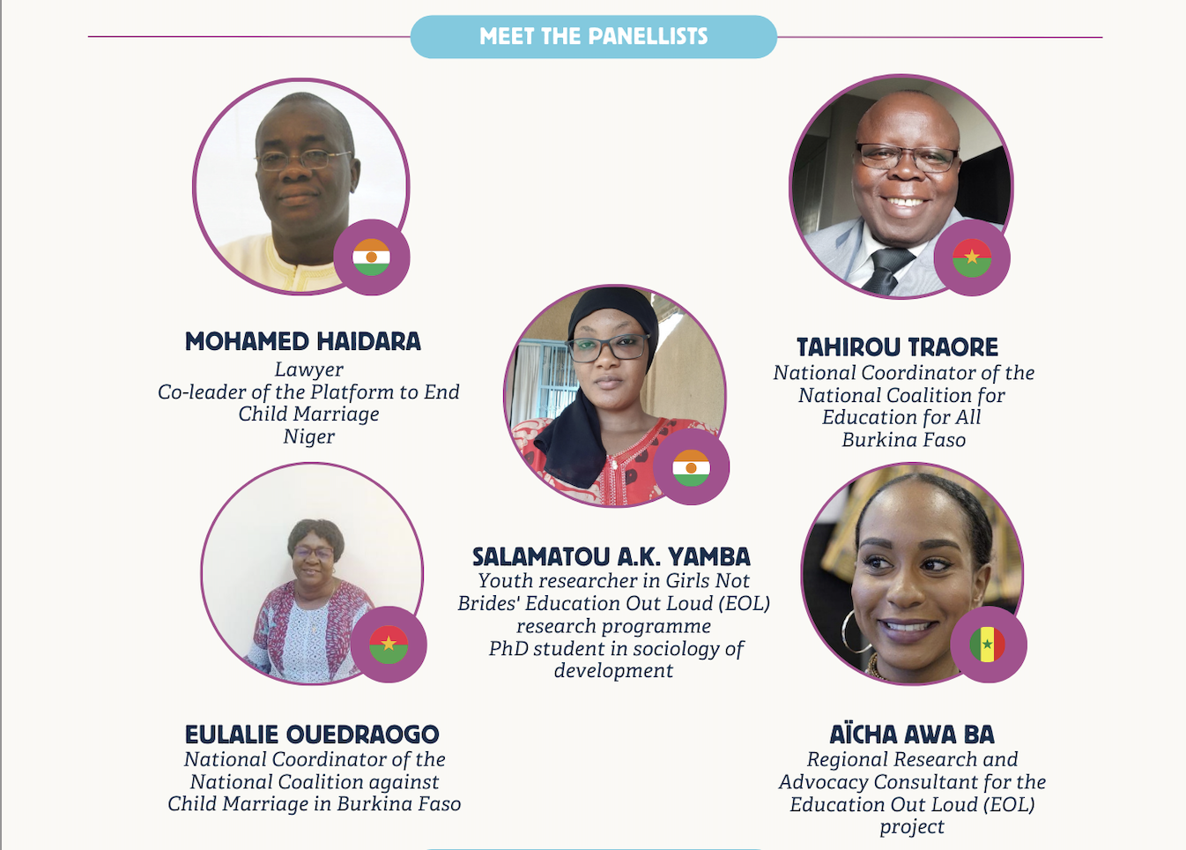

Slide 4
Introduction

Slide 5
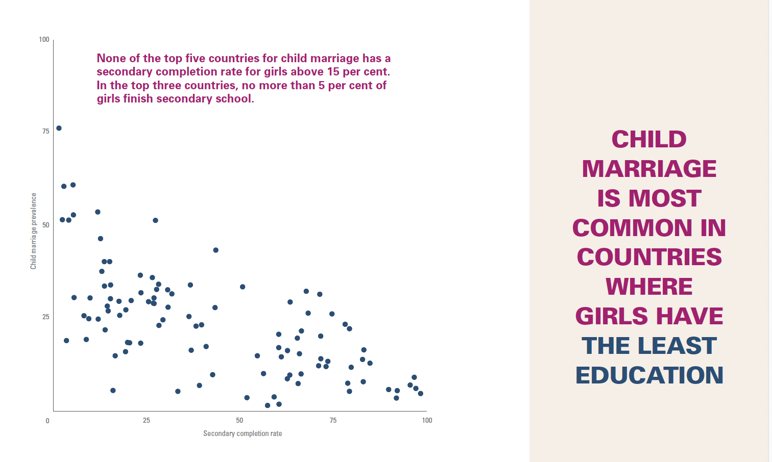
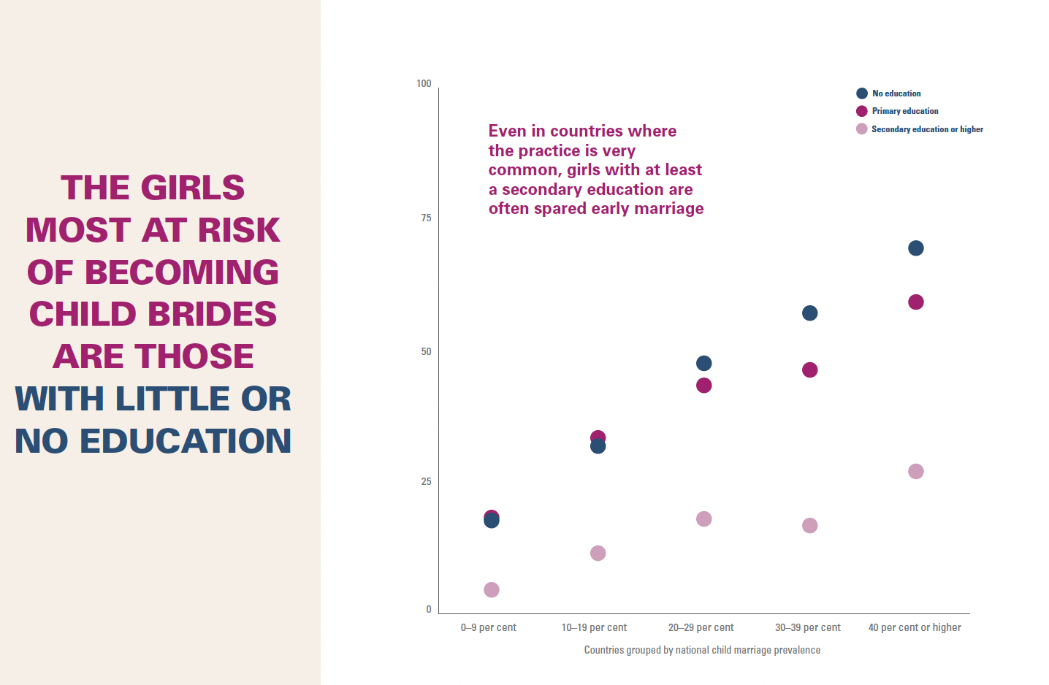
Keeping girls in school is key to preventing child marriage
1 in every 5 girls around the world marries before the age of 18
Keeping girls in school is the most powerful protective factor for delaying marriage. Every year of schooling matters but advancing through secondary school is especially protective
Child marriage is significantly more common among girls and in countries with lower levels of education.
Marriage and education are often viewed as incompatible and decisions about removing a girl from school and marrying her at a young age are often made at the same time.
These decisions are influenced by the perceived value of education. Better quality and higher education may make the returns on investment in girls more readily apparent and justifiable to both parents and society.
100
100
75
75
Child marriage in prevalence
25
75
100
0-9%
10-19%
20-29%
30-39%
40% or higher
Secondary completion rate
Countries grouped by national CM prevalence
Notes:
United Nations Children’s Fund (UNICEF), The Power of Education to End Child Marriage, UNICEF, New York, 2022

Slide 6
Pregnant girls and young mothers must not be left behind
Supporting girls who are pregnant or already mothers to continue with their education is also a key priority.
The majority of adolescent mothers around the world are married girls: 90% births to adolescent mothers take place within the context of marriage, with pregnancy both a cause and a consequence of child marriage.
Adolescent pregnancy and child marriage are both major causes of school dropout around the world: in Africa alone, an estimated 4 million girls drop out of school every year due to pregnancy.
A review of policies in Africa by Human Rights Watch found that many countries have recently taken steps to protect the right of pregnant adolescent girls and adolescent mothers to education. However, in nearly one-third of African countries girls who are pregnant continue to face significant legal and policy barriers.
Even where supportive policies exist, adolescent mothers often face practical and social challenges in returning to school.
It’s essential to create an enabling policy and social environment that allows pregnant girls and adolescent mothers to continue with their education.

Slide 7
Our project:
Strengthening collective advocacy on child marriage and girls’ education in Francophone West and Central Africa
Bringing together education and end child marriage coalitions across Francophone West and Central Africa
Supporting capacity building, shared learning and collective advocacy for the implementation of laws, policies and programmes to improve girls’ access to quality education and end child marriage.
Three levels:
  National - Burkina Faso and Niger
  Regional - Francophone West and Central Africa
  International
Notes:
Our Education Out Loud-funded project focuses on Francophone West and Central Africa, a region where around 39% of girls are married before the age of 18 and where gender inequality in education is the highest in the world. The security crisis in the Sahel, and now Covid, have further reduced girls’ chances to continue their education.
The project supports shared learning and joint advocacy on child marriage and girls’ education and works at 3 levels:
National (and local) in Burkina Faso and Niger
Regional across FWCA
International

Slide 8
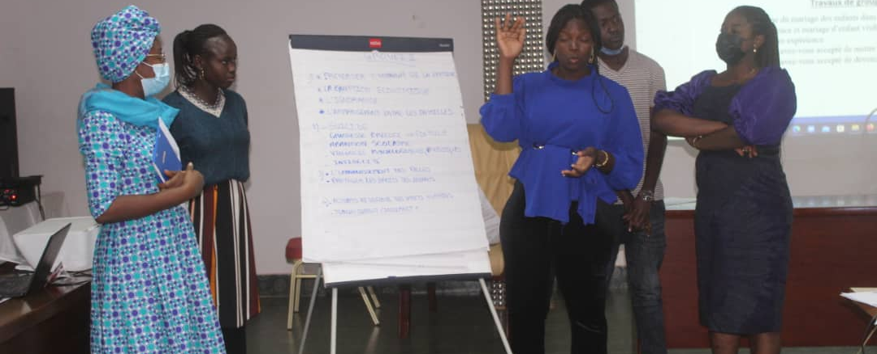
National
Participants at a youth activism workshop held by the Girls Not Brides National Partnership, CONAMEB, in Burkina Faso.
Credit: Noëlie Sinare / CONAMEB.
Burkina Faso & Niger
Strengthening governance of coalitions, supporting increased involvement and leadership of youth and women-led CSOs.
Strengthening institutional capacity in areas such as safeguarding and protection of vulnerable girls and women.
Relationship building and joint advocacy by ECM and education coalitions to support right to education of girls at risk of CM and married girls.
Youth activism training, building skills of young women leaders
Notes:
In Burkina Faso a youth activism workshop was held with a group of mainly female participants, from the end child marriage and education coalitions. The participants explored the causes and consequences of child marriage, discussed the role of an activist and set up a network that they called “JAPAME”: Young Activists for the Abandonment of Child Marriage.
According to a young female activist in Burkina Faso, the youth activism workshop provided an opportunity to access: “the tools to express myself and give young women a voice”. The workshop included training on using digital platforms for advocacy. Group members created a blog and a Facebook page to share information and build awareness on child marriage and the importance of girls’ education.
The activist emphasized the importance of reaching out to young people - “It is necessary to involve more young people who are not sufficiently engaged or informed. We should visit various elementary or high schools, work with teachers and share these experiences with them so that they position themselves and transmit the message”.

Slide 9
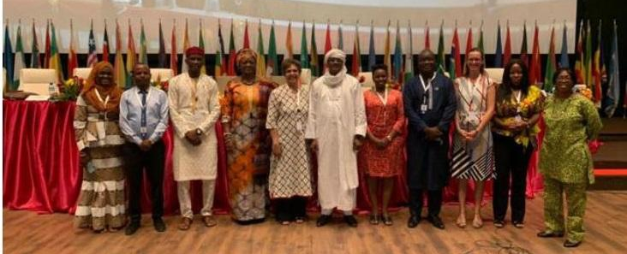
Regional and international
Panelists in the AGS session on girls’ education
Credit: AU CIEFFA
Advocacy and campaigning
Grants to CSOs and coalitions for advocacy on girls’ education and ECM
Webinars to share project learning
Participation in key regional and international events such as the African Girls’ Summit in Niger and CSW in New York.
Youth-led research on girls’ education and child marriage in crisis contexts.
Notes:
The Third African Girls’ Summit was held in November 2021 in Niger.
The Niger Platform supported the organisation of a Pre-Summit, bringing together over 300 participants from across Niger and elsewhere in Africa (Burkina Faso, Cote d’Ivoire, Ethiopia, Gambia, Nigeria, Uganda, Sierra Leone and Zimbabwe). The aim of the pre-summit was 1) to prepare youth representatives, especially girls and young women, to actively participate in the AGS as panellists, moderators, and contributors to debates; and 2) to support youth organisations active in the fight for the elimination of harmful practices, particularly child marriage and female genital mutilation, to develop their advocacy recommendations.
In collaboration with AU CIEFFA, UNAIDS, UNESCO, UNFPA, UNICEF, UN Women and the Global Partnership for Education, Girls not Brides organised a parallel session on “Harnessing Girls’ Education for the Africa We Want”, in which Girls Not Brides and UNESCO gave a joint presentation on girls’ education in West Africa. With support from the Niger Platform, Niger’s First Lady organized an AGS side event on education as an effective response to child marriage. This event aimed to draw the attention of States and donors to the importance of girls’ education, especially in emergency contexts. Around 100 participants joined the event. Outcomes included strong government commitments to keeping girls in school in emergencies and a pledge by traditional leaders to develop a ‘discourse of peace’ to reduce insecurity.
The Girls Summit provided young female activists with a strong learning and networking experience.
As stated by one participant: “We discovered many convergences between practices and experiences concerning the rights of girls (all over Africa). It’s great to have a space of dialogue between us to discuss our situations and to present our experience to decision-making bodies, and to express our needs in programmes and policies”.
However, there was also concern at the lack of integration of young women in official policy discussions: “… the girls came together and wrote a statement announcing the creation of a collective. Unfortunately, we were not granted a slot and could not read the content of this declaration. We approached the African Union organizing committee and they first accepted. They then refused to give us this space when the time came. It is as if we were being denied the right to speak.”

Slide 10
Child marriage and girls’ education in West and
Central Africa

Slide 11
Overview of the context
Child marriage and girls’ education in WCA
Multidimensional crisis in the Sahel
4 in 10 girls are married before age 18 - 60 million girls
Despite recent progress, gender inequality in education remains the highest in the world. 28 million girls don’t have access to education.
At the regional level, girls' chances of becoming literate decrease by 5.7 percentage points (World Bank) for each additional year of early marriage
Stereotypical gender roles and peer pressure limit girls’ opportunities and increase the likelihood of dropping out of school and of child marriage.
Strong correlation between household economic vulnerability, child marriage and girls’ lack of access to education.
The security crisis in the Sahel:
Led to the closure of 11,100 schools and reinforced protective attitude towards girls (UNICEF)
Dramatic increases in military and security spending have negatively impacted the financing of social services, including child protection, education and health.
Girls dropping out of school in crisis has led to increased rates of child marriage in regions affected by armed conflict
The Covid-19 pandemic:
Delay in learning for girls because of difficulties in pursuing distance learning: increasing household and care responsibilities, unequal access to ITC/radio
The same factors jeopardized girls' chances of returning to school after the pandemic.
Notes:
Nguyen, M. and Wodon, Q., 2014. Impact of child marriage on literacy and education attainment in Africa. The World Bank.
https://www.unicef.org/press-releases/11100-schools-closed-sahel-region-due-conflict

Slide 12
Advocacy challenges and opportunities
Institutional challenges faced by coalitions:
Non-domestication and lack of implementation of international legal instruments, despite widespread ratification in WCA
Many WCA countries also suffer from legal pluralism between customary, religious and civil law and insufficient popularization of the law
Decentralisation and unequal access to public services (legal, education, health) in remote areas
Inadequate budgeting of national plans strategic to end child marriage and national/local development plans
Advocacy opportunities:
Great progress achieved through advocacy to promote girls’ education for all
Increased budgeting for SRRH
Political commitment to end child marriage promotes accountability and sustain the public debate
Civil Society Organisations’ expertise in the prevention of child marriage and the promotion of girls’ education
CSOs’ expertise in community advocacy where the prevalence of child marriage is very high
Dynamic young activists

Slide 13
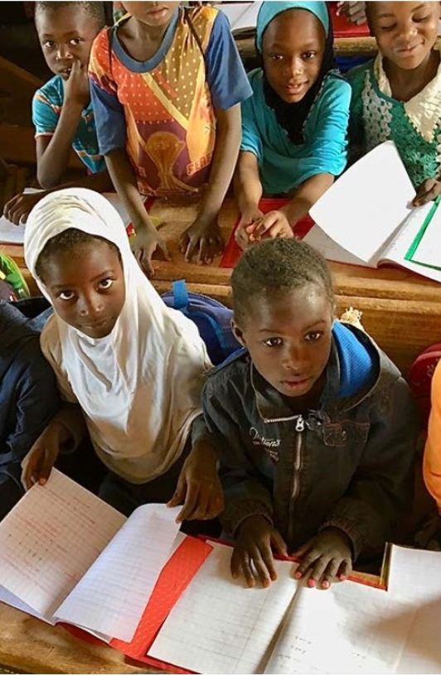
Bridging the knowledge gap
As part of our EOL project, a literature review on child marriage and girls’ education in West Africa was carried to:
Address the data needs expressed by coalitions
Provide up-to-date evidence for coalitions’ advocacy
Shed light on knowledge gaps to guide future research needs
The literature review explores:
The link between child marriage and girls' education in West Africa
Social norms, child marriage and girls' education
Specificities of advocacy approach according to contexts (humanitarian, pandemic, etc.)
Normative and legislative frameworks around child marriage and girls' education
Recommended approaches to scaling up selected interventions
Download it here.
Notes:
Photo: Burkina Faso, Human Rights Watch 2019 – les salles qui sont trop pleines – overcrowded classrooms

Slide 14
Youth-led research and advocacy
Youth-led research was initiated to position young people as agents in the process of change by:
  Empowering youth activists with sophisticated tools and skills
  Creating a culture of evidence-based advocacy to promote accountability and credibility
  Rethinking who has the power to produce and disseminate knowledge
8 young researchers were selected in Niger and Burkina Faso to conduct context-specific research case studies on child marriage and girls’ education, supported by LASDEL, a research institute based in Niamey
Each case study is developed based on a contextual approach, including – humanitarian and/or political crisis context, Covid-19, refugees and displaced persons, school closures
The research results, which will be available soon, will support CSOs and youth-led organizations in West Africa in their advocacy (institutional – budgetary, policy or legislative – and community) with national and regional institutions.

Slide 15
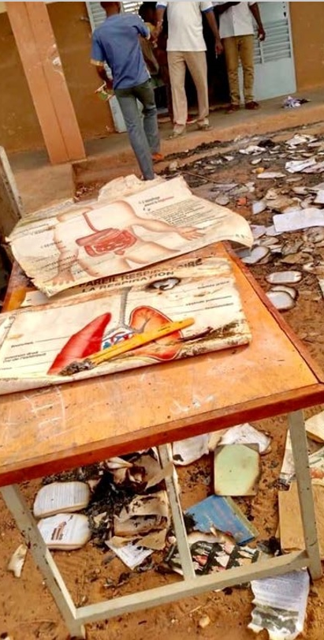
Budget advocacy
In 2022, Girls Not Brides awarded grants to 8 civil society organisations across Francophone West Africa (Burkina Faso, Côte d’Ivoire, Mali, Niger (x 2), DRC and Togo)
Three organisations were forced to interrupt project implementation or follow-up because of a political and security crisis.
As explained in the upcoming learning report on budget advocacy in the EOL project, 6 major lessons learnt were identified :
  Lesson 1: Consolidating the government’s position as a legitimate leader to end child marriage and promote girls’ education can be achieved through budget advocacy
  Lesson 2: Increasing visibility and raising the political profile of child marriage and girls' education requires leveraging CSOs’ expertise and capacity building
  Lesson 3: Fostering community participation in budget advocacy promotes ownership and sustainability of solutions
  Lesson 4: Advancing decentralised budgeting for the elimination of child marriage and the promotion of girls’ education is fundamental
  Lesson 5: Promoting evidence uptake from budget analysis is instrumental for evidence-based advocacy
  Lesson 6: The need to rethink budget advocacy to end child marriage and promote girls’ education in the WCA crisis context must be addressed
Notes:
Photo: Burkina Faso, Les droits des filles en peril – Plan International (?)

Slide 16
Expérience du Burkina Faso : Plaidoyer conjoint des coalitions CONAMEB-CN/EPT

Slide 17
The context
Burkina Faso has the 5th highest prevalence of child marriage among African countries.
Every year, thousands of women and girls are victims of early and forced marriage. According to UNICEF, 52% of girls are married before the age of 18 and 10% before the age of 15.
In Burkina Faso, girls face serious obstacles to schooling, including lack of access to school, poor quality of education, GBV, insecurity, early marriage and pregnancy. Thus, in 2021, according to the DGESS/MENAPLN, the completion rate of girls in the first cycle is 41% against 32.6% for boys. "Only 41 girls complete the first cycle. At secondary level, the completion rate is 18.4% against 21.6% for boys.
If left unchecked, the right to quality education and training will continue to be compromised for thousands of girls and women in Burkina Faso
As part of the 2030 Agenda (SDG4), the country has committed to "Ensure inclusive and equitable quality education and promote lifelong learning opportunities for all". It also pledged to combat all kinds of gender-based discrimination with the full ratification of CEDAW in 1984.
As part of the implementation of the EOL project whose objective is to "Strengthen collective action to end child marriage, prevent girls from dropping out of school and promote gender equality in West Africa", CONAMEB has established a learning partnership with CN-EPT/BF.
The two organizations have made it their mission to galvanize civil society organizations and individuals whose work focuses on education in emergencies, girls' education, education of children with disabilities and child marriage, to share knowledge and strengthen collective advocacy for the adoption of laws, policies and programmes that improve girls' access to education and retention in school and thus contribute to ending child marriage.
Notes:
https://www.education-inequalities.org/countries/burkina-faso#dimension=%7B%22id%22%3A%22sex%22%2C%22filters%22%3A%5B%5D%7D

Slide 18
CONAMEB & CN-EPT
CONAMEB
CONAMEB is an umbrella organization of national and international associations and NGOs working to end child marriage in Burkina Faso. It was created in 2013 and currently has 76 members. Its overall objective is to promote children's rights and the abandonment of child marriage in Burkina Faso. More specifically, it aims to contribute to (i) community awareness of the respect of children's rights and the elimination of child marriage, (ii) influence policies for the taking of measures in favour of the elimination of child marriage.
CN-EPT/BF
Created in October 2000, the EFA Coalition's vision is the achievement of a quality, non-discriminatory, rationally managed, transparent and participatory education system capable of generating sustainable human development. Its mission is to inform, raise awareness and mobilize civil society actors and grassroots populations to put pressure on decision-makers and civil society actors to respect the commitments they have made through the Dakar Framework for Action, the Education 2030 Framework for Action, to ensure free and quality basic education for all citizens of Burkina Faso. Its main objective is to advocate for EFA in Burkina Faso.

Slide 19
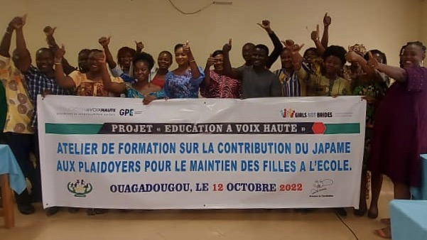
Working together
Over the past two years CONAMEB and CN-EPT/BF have been working in synergy.
CONAMEB has taken the lead in the implementation of the EOL project, involving the CN-EPT/BF in all its programming, implementation and monitoring activities.
The organizations divide the tasks according to their interests and organize quarterly meetings to ensure effective collaboration.

Slide 20
What we’ve achieved
Together we have:
Developed a strategic guidance document for joint advocacy on issues related to girls' education and child marriage
Advocated with customary and religious authorities and opinion leaders to secure their commitment to address child marriage
Held a 3-day training workshop for education stakeholders on their contribution to the effective implementation of policies and strategies (PSEF, PDSEB)
Organized advocacy with 35 customary and religious authorities for the creation of an environment conducive to keeping girls in school
Organized 5 advocacy meetings with 150 community, traditional and religious leaders to obtain their commitment to keeping girls in school post-primary, secondary and higher education and the fight against child marriage
Commemorated International Teachers' Day; Day of the Girl and Day of the Child.

Slide 21
Lessons learnt and next steps
Addressing child marriage and improving girls' completion rates in school requires the involvement and buy-in of all stakeholders: government authorities, customary and religious authorities, civil society organisations, parents' and mothers' education associations, teachers' unions and public and private media.
We will continue our awareness-raising, citizen monitoring and advocacy actions for the adoption of laws and implementation of policies to end child marriage and improve girls' success rates at all levels of the Burkinabe education system.
In a context of insecurity that leads to school closures and thousands of internally displaced people, mainly women and children, our wish is that we can accompany these children throughout their education.
The work started through the EOL project should be continued and strengthened for quality education for girls and the eventual elimination of child marriage.

Slide 22
Youth-led research – an experience in Niger

Slide 23
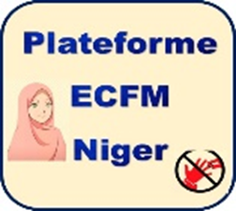
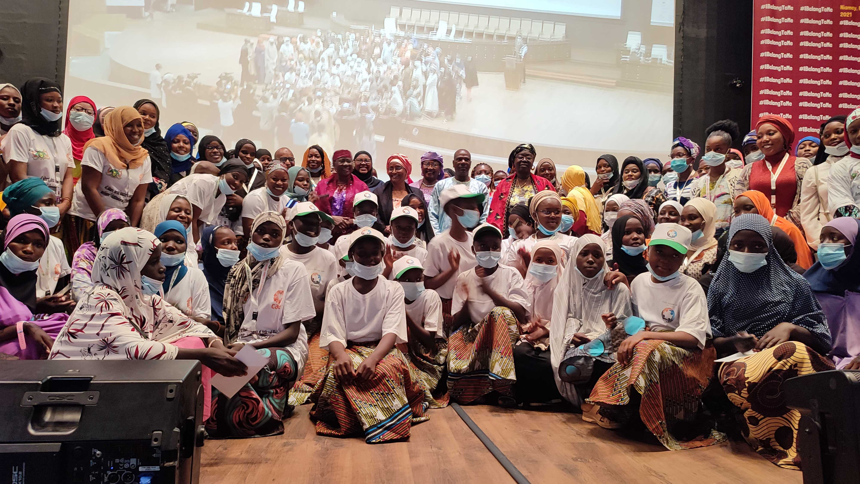
Platform to end child marriage in Niger

Slide 24
The context
Highest population growth in the world at 3.9% per year
Niger has the highest prevalence of child marriage in the world. According to UNICEF, 76% of young women were married before the age of 18. 28% were married before the age of 15. Child marriage is most prevalent in Maradi where 89% of young women married by age 18.
According to UNESCO (2012 DHS data) 54% of girls of primary school age and 76% of girls of lower secondary school age are out of school. Only 4% of girls complete lower secondary school.
Significant impact of the security situation on school attendance with 878 schools closed at the end of 2022 (affecting 73,864 students, including 35,990 girls)
Notes:
https://www.education-inequalities.org/countries/niger#dimension=%7B%22id%22%3A%22sex%22%2C%22filters%22%3A%5B%5D%7D

Slide 25
Who we are
The platform 'Towards the End of Child Marriage' is a strategic cross-partner coalition
Its aim is to coordinate advocacy efforts to end child marriage in Niger
It is composed of more than 80 members (international organizations, United Nations system and national civil society organizations)
Working with Girls Not Brides and other partners to implement the EOL project in Niger.

Slide 26
Activities
Advocacy capacity building of youth associations
Participation in the development of national GBV policies
Implementation of advocacy strategies with ASO/EFA, the national education coalition
Organization of an advocacy workshop on strategies to keep girls in school in fragile security contexts
Activism days advocacy
Youth-led research

Slide 27
Youth-led research
Youth-led research to strengthen CSO ownership of advocacy practices to end child marriage and promote girls' education
8 young researchers (5 women and 3 men)
Technical support by LASDEL
Main research themes:
  Early marriage and school drop-out
  Influence of new information and communication technologies on early school leaving
  Impact of insecurity on young people' s schooling
  Parents' responsibility to keep girls in school

Slide 28
Lessons learnt and next steps
Familiarization with qualitative studies
The importance of conducting research before implementing activities
Research helps to identify concerns that may be hidden but are important when designing interventions (for example, exploring the influence of peers in decisions around marriage)
It also provides evidence that can be used in advocacy
Willingness of young people to continue research in future actions (a new weapon for young people)

Slide 29
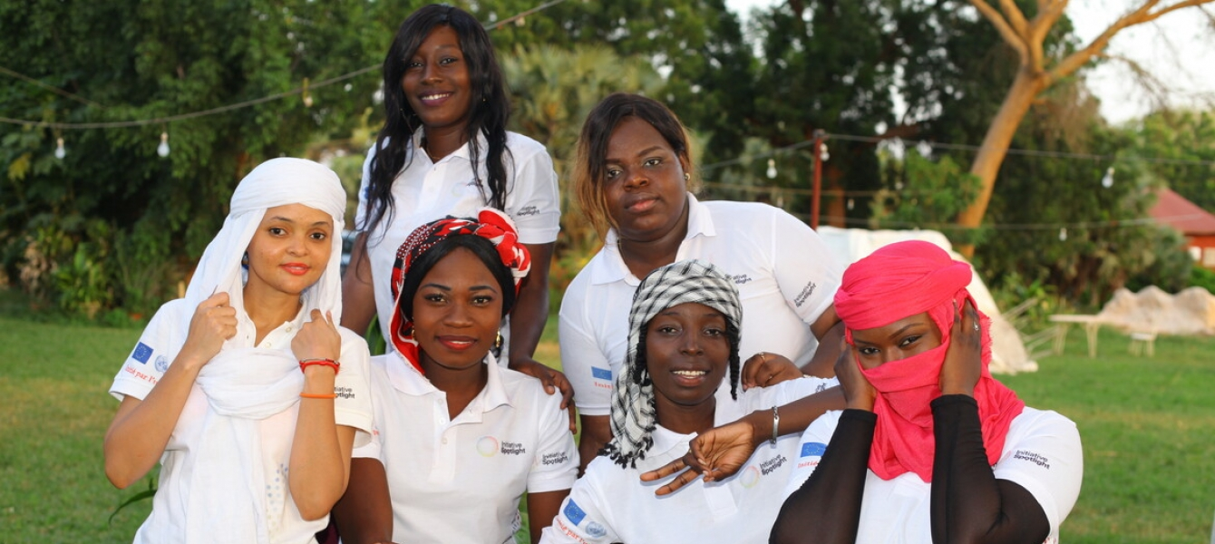
Thank you

Slide 30
Q & A
Notes:
Kola

Slide 32
Links to key resources
Girls Not Brides, Child Marriage and Girls' Education in West and Central Africa Literature Review
Girls Not Brides, Child marriage and girls’ education brief, updated September 2022
United Nations Children’s Fund, The Power of Education to End Child Marriage, UNICEF, New York, 2022
UNESCO World Inequality Database on Education (WIDE)
Human Rights Watch, A Brighter Future: Empowering Pregnant Girls and Adolescent Mothers to Stay in School

