Slide 1
latest evidence on child marriage: Trends in prevalence and burden around the world
Learning series session July 2023

Slide 2
INTERPRETATION
ENGLISH - This session will have presentations in English and Spanish. To access simultaneous interpretation, please click on the globe icon at the bottom bar of your screen and select your preferred language (English, Spanish, French, or no interpretation).
français - Cette session comprendra des présentations en anglais et en espagnol. Pour accéder aux services d'interprétation simultanée, veuillez cliquer sur l'icône globe que vous trouverez dans la barre inférieure de votre écran, et sélectionnez la langue de préférence (anglais, espagnol, français, ou version originale).
Español - Esta sesión tendrá presentaciones en inglés y español. Para acceder a los servicios de interpretación simultánea, por favor haga clic en el icono del globo que encontrará en la barra inferior de su pantalla, y seleccione su idioma de preferencia (inglés, español, francés, o versión original).
Notes:
Laia?
Please write in the chat box (preferably in Port, Fr, Sp or English!) if you are having any technical difficulties and a member of our team will be happy to support
Please also use the chat box to post Questions or experience you would like to share. And if you have a question for one of our panellists please do put their name.

Slide 3

OVERVIEW
Background
How common is child marriage (Burden and Prevalence), and where it happens around the world
Who has benefited from progress?
Key takeaways
Programmatic response

Slide 4
BACKGROUND
Sustainable Development Goal (SDG) 5: Achieve gender equality and empower all women and girls
TARGET 5.3: Eliminate all harmful practices, such as child, early and forced marriage and female genital mutilation
INDICATOR 5.3.1: Proportion of women aged 20 to 24 years who were married or in a union before age 15 and before age 18
Measures of child marriage:
        Burden, the total number of girls and women in a country/region/globally, married before 18
    Prevalence, the percentage of women aged 20 to 24 years who were first married or in union before age 18
    Source data: UNICEF global databases, 2023, based on DHS, MICS and other national surveys
Notes:
Majority from 2015-2022, but some from as par as 2011

Slide 5
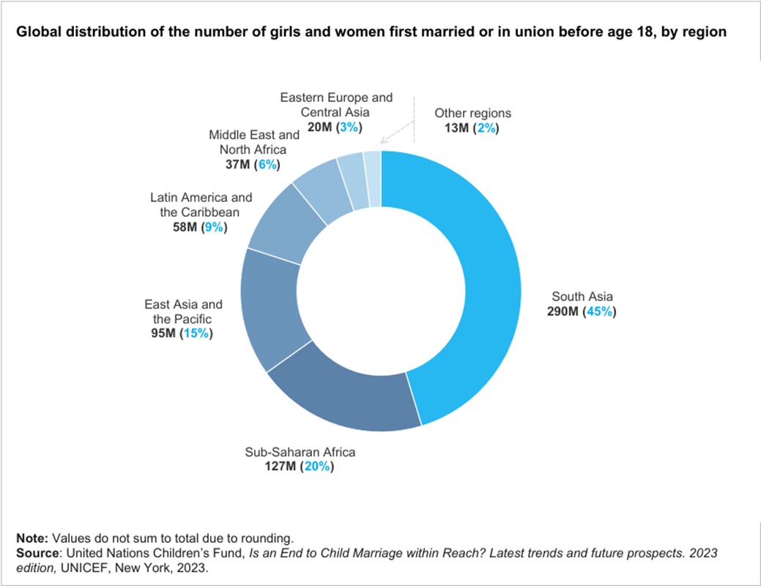
GLOBAL TRENDS
Burden of child marriage
An estimated 640 million girls/women alive today were married before 18
Nealy half (45%) of them live in South Asia
Global burden likely to shift to West, Central, East and Southern Africa

Slide 6
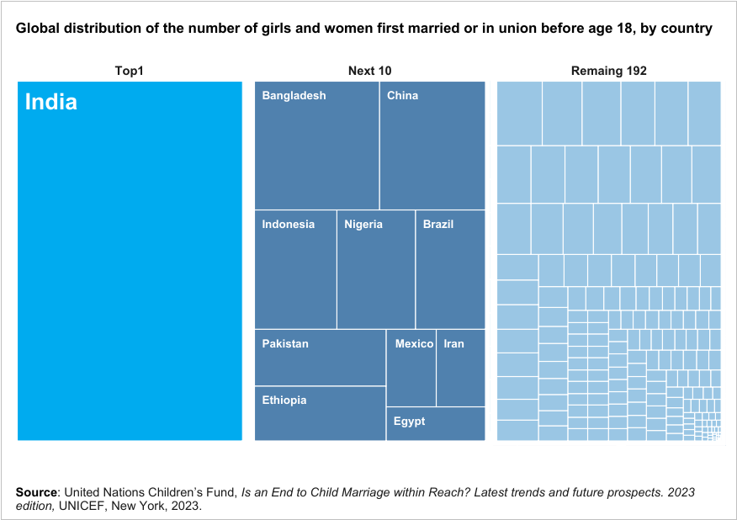
Burden (continued)
One third of girls/women married before age 18 live in India
The next 10 countries account for a further third
192 countries account for the remaining one third

Slide 7
Prevalence: How common is child marriage?
Globally, 19 % of girls and women were married before age 18
21% in Latin America and the Caribbean
16% in the Middle East and North Africa
From 32% in West, Central, East and Southern Africa
33% in West and Central Africa
37%
37% in the countries with the lowest incomes
32% in East and Southern Africa
9/10
9/10 of the countries with highest prevalence are in West, Central, East and Southern Africa
26% in South Asia
Notes:
Notes:9/10 countries with highest child marriage rates are in SSA, 7 of those in WCA, and 2 in ESA
point 1
point 2
point 3: excluding the 2 million girls added due to COVID-19.

Slide 8
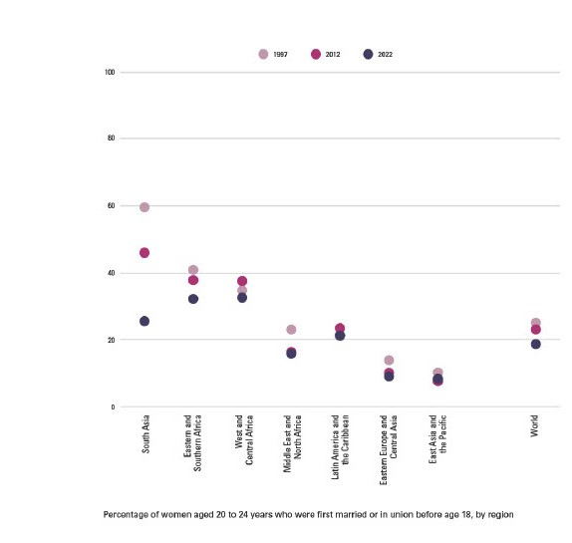
Global trends in prevalence
Global prevalence has declined from 23% to 19% in the last 10 years
Prevalence in South Asia has declined steadily in the last 10 years
But progress has been slow in some regions, like West and Central Africa, and in Latin America and the Caribbean
Source: United Nations Children’s Fund, 2023, Is an end to child marriage within reach? Latest trends, and future prospects.
Notes:
Notes:9/10 countries with highest child marriage rates are in SSA, 7 of those in WCA, and 2 in ESA
point 1
point 2
point 3: excluding the 2 million girls added due to COVID-19.

Slide 9
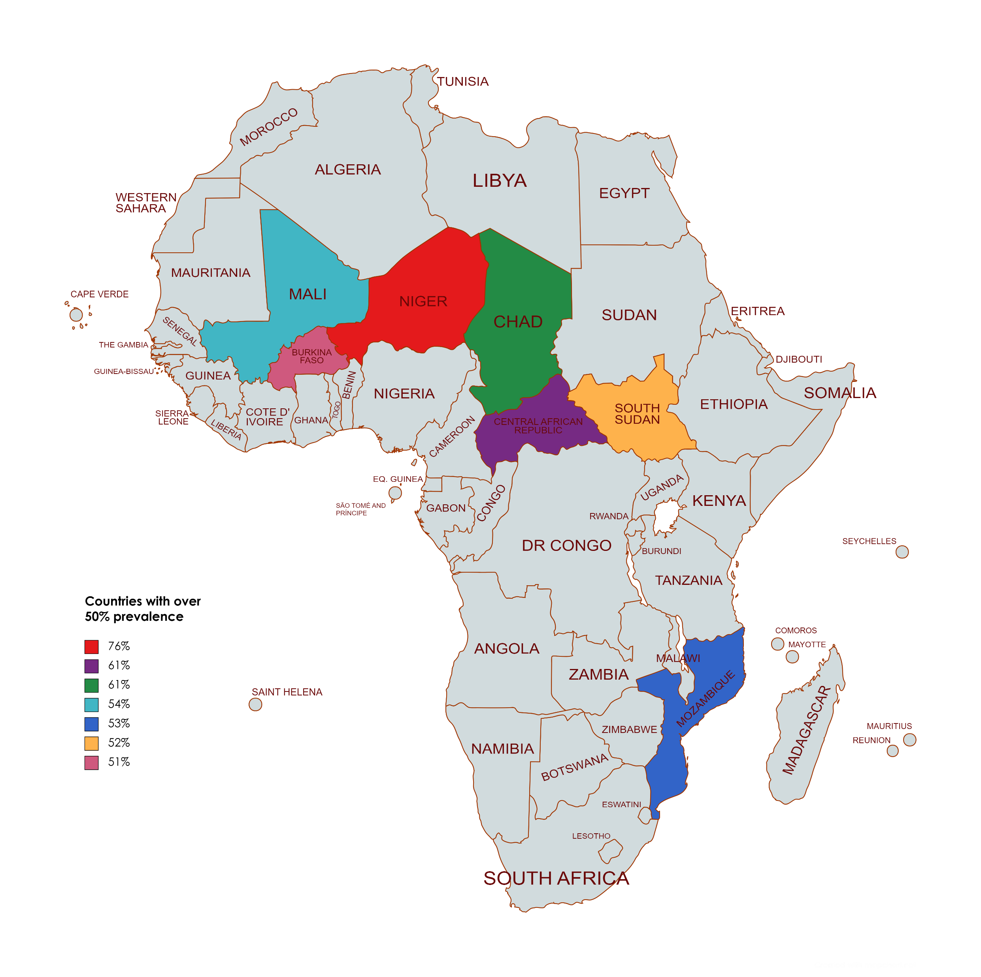
The Sahel region is characterised by high prevalence compared with regional and global figures
7 in 10 girls in central Sahel were married before age 18
6 in 10 married girls give birth before age 18, and 9 in 10 before age 20
95% of married girls in this region are out of school
17% of boys in Central African Republic married before age 18
Notes:
SSA is emerging as a region of considerable concern: Girls there now experience the highest risk of child marriage in the world, with one in three marrying before age 18. Levels vary across countries, although the practice is more concentrated in West and Central Africa, which is home to 7 of the 10 countries with the highest prevalence of child marriage in the world. CAR 17%

Slide 10


While other regions have made progress in reducing child marriage, the prevalence in Latin America and the Caribbean has remained stagnant for 25 years
More than 1 in 5 young women were married or in a union before age 18
Child marriage in Latin America and the Caribbean most often takes the form of informal unions, in which girls live with a partner, rather than a formal marriage
Most women who married or entered a union before age 18 also gave birth before their 18th birthday; 8 in 10 did so before they turned 20
Countries in Latin America and the Caribbean have some of the highest prevalence of child marriage among boys worldwide
9 of the 10 countries with available data show levels above the global average
Notes:
Global average of CM for men is 3 percent, Belize 22, Nicaragua, 19%, Suriname 20%

Slide 11
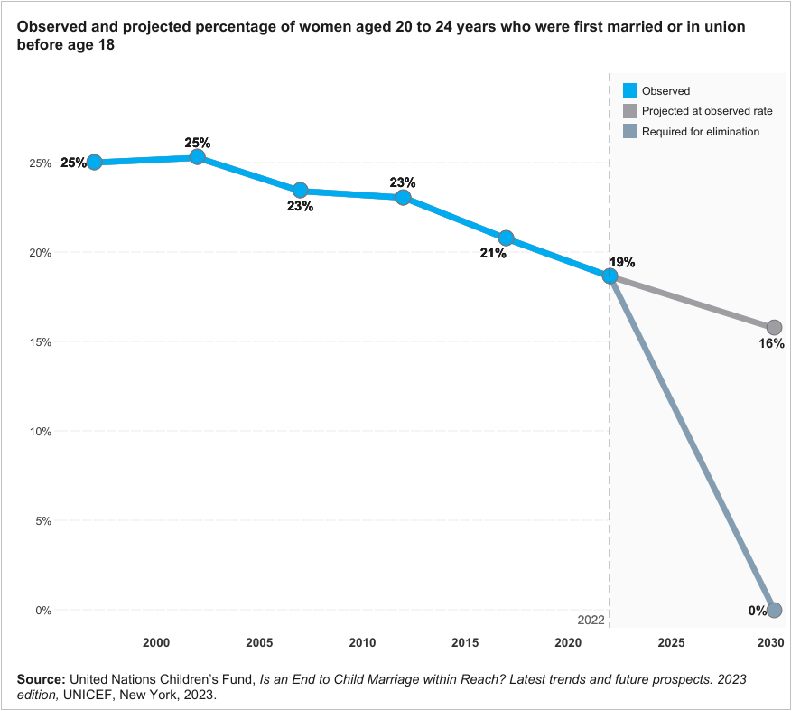
At the current pace, the world is not on track to meet the SDG Target of ending child marriage by 2030
It would take the world 300+ years to end child marriage
It would take West and Central Africa 200+ years to end child marriage
Overall, progress needs to happen nearly 20 times faster
We need to accelerate progress in all parts of the world – the global target can only be reached if we end child marriage everywhere
Notes:
5 times more that what was projected in 2018

Slide 12
In the last 25 years, 68 million child marriages have been averted
Ongoing multiple and interconnected crises – or a “polycrisis” caused by public health crises, protracted conflict and natural disasters happening at the same time – are increasing the risk of child marriage through channels of impact like interrupted education, insecurity, and income shocks.
In 2022 alone, 12 million girls are estimated to have married before age 18.
10 million additional girls expected to marry over the decade 2020-30 due to the COVID-19 pandemic
10-fold increase in conflict deaths is related to a
7% increase in child marriage
due to a heightened sense of insecurity, threats of sexual violence, infrastructure failures and other channels
10% increase in climate shocks is related to a
1% increase in child marriage due to disrupted sources of income, food insecurity, strains on communal resources, and other channels
Notes:
South Asia, is prone to Natural disaster, Natural disaster such as the drought being experienced in the Horn of Arica.

Slide 13
Who has benefited from progress?

Slide 14
To achieve the goal of ending child marriage by 2030, we need to reduce inequality and ensure all girls and women can make and act on their decisions
Economic development and poverty reduction
Increase school enrolment and completion
Legal provisions
Increase women’s participation in the labour force
Increase access to quality sexual and reproductive health and rights (SRHR) and reduction in adolescent pregnancy
Address discriminatory gender and social norms

Slide 15
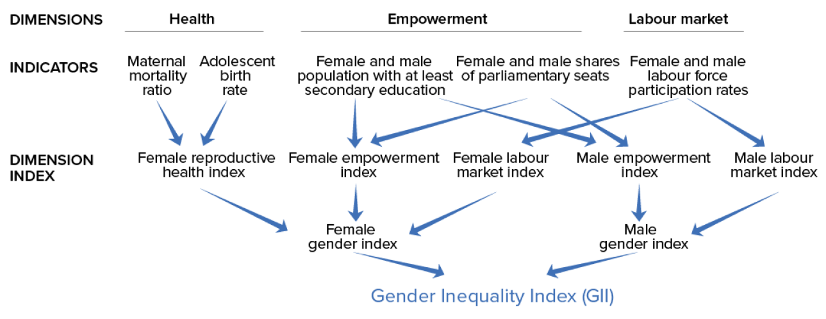
Gender Inequality Index (GII)
GII is a composite metric of gender inequality using three dimensions: reproductive health, empowerment and the labour market
A low GII value indicates low inequality between women and men, and vice-versa
Source: United Nations Development Programme
Notes:
Composite metric, is defined using other measures

Slide 16
Gender Inequality Index of Countries where Child Marriage is still common and Countries where there is notable Progress. ​
Country | Gender Inequality Index | Maternal Mortality Ratio (deaths per 100,000 live births) | Adolescent birth rate (births per 1000 women aged 15-19) | Share of seats in Parliament |  |  | Population with at least some secondary education (aged 25+) |  |  | Labour force participation rate (15+ years)
 |  |  |  | Female | Male | Dif | Female | Male | Dif | Female | Male | Dif
World | 0.465 | 225.4 | 42.5 | 25.9 | 74.1 | -48.2 | 64.2 | 70.3 | -6.14 | 46.2 | 71.7 | -24.9
Bangladesh | 0.530 | 173 | 75.5 | 20.9 | 79.1 | -58.2 | 50.6 | 58.5 | -7.9 | 34.9 | 78.8 | -43.9
India | 0.490 | 133.0 | 17.2 | 13.4 | 86.6 | -73.2 | 41.8 | 53.8 | -12 | 19.2 | 70.1 | -50.9
Maldives | 0.348 | 53 | 7.3 | 4.6 | 95.4 | -90.8 | 46.4 | 41.5 | 4.9 | 34.4 | 67.5 | - 33.2
Niger | 0.611 | 509 | 170.5 | 25.9 | 74.1 | -48.2 | 9.2 | 15.2 | -6 | 61.7 | 84.3 | -22.6
Gambia | 0.611 | 597 | 63.2 | 8.6 | 91.4 | -82.8 | 29.9 | 43.2 | -13.3 | 48.9 | 66.3 | -17.4
Rwanda | 0.388 | 248 | 32.4 | 55.7 | 44.3 | 11.4 | 11.4 | 16.3 | -4.9 | 82.5 | 82.2 | 0.3
Notes:
Rwanda top 10 Gender Gap, South Asia has had a steady decline in child marriage over the past 10 years, India alone has largely contributed to the decline witnessed globally, while Maldives is on track to end child marriage by 2030. Bangladesh has made progress but remains top in terms of prevalence in South Asia. Child marriage is still very common in Niger; it is the country with the highest prevalence globally. On the other hand, Gambia and Rwanda have shown remarkable progress.

Slide 17
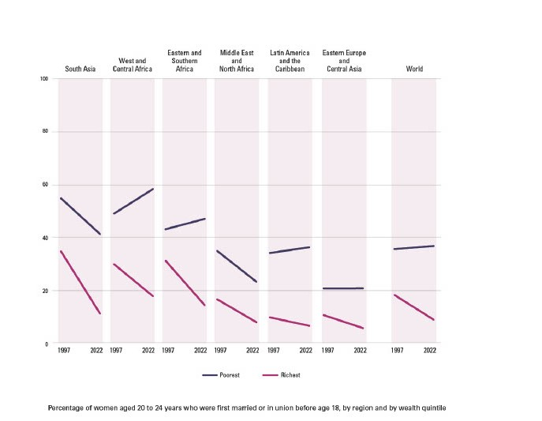
Three times as many of the averted child marriages are from the richest families as from the poorest ones
Source: United Nations Children’s Fund, 2023, Is an end to child marriage within reach? Latest trends, and future prospects.
Notes:
why wasn’t it possible to develop sampling frame?

Slide 18
KEY TAKEAWAYS
Globally, prevalence and burden are going down, but not fast enough (or equitably enough) to meet the SDG target
To accelerate progress change needs to happen 20 times faster, countries should prioritise reproductive health, empowerment and labour market participation, particularly for women
Without significant investment and a change of course, the Sahel region is likely to fall further behind and progress will continue to stagnate in LAC​
Conflict and crisis are making the SDG target more unattainable

Slide 19
PROGRAMMATIC RESPONSE
Advancing girls and women’s rights and leadership, so they can transform norms by strengthening gender-transformative action and movement building to address the drivers of gender inequality and child marriage​.
Gender-equitable services including 12 years’ quality education and stigma-free, affordable and accessible sexual and reproductive health rights and services​
Engaging families and communities, including boys and men
Strengthening and implementing laws and policies within an ecosystem that centers the human rights of all with respect for evolving capacities.
Generating and making use of data and evidence

Slide 20

KEY RESOURCES
UNICEF, 2023, Is an end to child marriage within reach? Latest trends and future prospects
UNICEF, 2023, A profile of child marriage in South Asia
UNICEF, 2023, Ending child marriage: A profile of progress in India
UNICEF, 2019, Profile of Child Marriage and Early Unions in Latin America and the Caribbean
UNICEF, 2022, Child marriage country profiles
UNDP, n.d., Gender Inequality Index
The CRANK, 2023, Research Spotlight: Addressing child marriage and supporting married girls in conflict- and crisis-affected settings, Girls Not Brides and the UNFPA-UNICEF Global Programme to End Child Marriage

