Slide 1
LESSONS LEARNED FROM BUDGET ADVOCACY PILOT PROJECTS TO END CHILD MARRIAGE AND PROMOTE GIRLS' EDUCATION in West and Central Africa
Education Out Loud Project GIRLS NOT BRIDES
Aïcha Awa Ba
Regional Research and Advocacy Consultant for the Education Out Loud project

Slide 2
Objectives of the session
Presentation of the EOL project and the context of budget advocacy Presentation of key findings of the Budget Advocacy Pilot Project Learning Report Sharing experience around budget advocacy by CSOs (End Child Marriage and Education) Open discussion Conclusion

Slide 3
The Education Out Loud Project: Strengthening collective advocacy on child marriage and girls' education in Francophone West Africa
Girls Not Brides: the global partnership of civil society organisations working together to end child marriage Bringing together education coalitions and ending child marriage in Francophone West Africa Support capacity building, shared learning and collective advocacy for the implementation of laws, policies and programmes to improve girls' access to quality education and end child marriage. Three levels: National - Burkina Faso and Niger/ Regional - Francophone West Africa/ International
In Burkina Faso & Niger
Strengthen coalition governance, with increased youth and women's leadership. Building institutional capacity Relationship building and joint advocacy between FME and education coalitions Youth activism training, youth leaders' skills building
At the regional and international levels
Advocacy and campaigns CSO and Advocacy Coalition Grants Learning Webinars Participation in key regional and international events Youth-led research on girls' education and child marriage in crisis contexts.
Notes:
Our Education Out Loud-funded project focuses on Francophone West and Central Africa, a region where around 39% of girls are married before the age of 18 and where gender inequality in education is the highest in the world. The security crisis in the Sahel, and now Covid, have further reduced girls’ chances to continue their education.
The project supports shared learning and joint advocacy on child marriage and girls’ education and works at 3 levels:
National (and local) in Burkina Faso and Niger
Regional across FWCA
International

Slide 4
Context
Child marriage and girls' education in WCA
41% of girls are married before the age of 18 in AOC (4 out of 10 girls) which represents 60 million girls. Despite recent progress, gender inequality rates in education in West and Central Africa remain the highest in the world. 28 million girls do not have access to education. Regionally, girls' chances of being literate decrease by 5.7% for each additional year of early marriage. Gender stereotypical roles and peer pressure limit girls' future prospects and impact girls' ambition to succeed in school, but also their likelihood of dropping out of school early and marrying early. Strong correlation between household economic vulnerability, child marriage and girls' lack of access to education.

Slide 5
Budget advocacy pilot projects
Budget advocacy for domestic resource mobilization emerged as one of the most advocated approaches for CSOs to foster government accountability and ownership in policy development, financing and implementation.
As part of the EOL project, Girls Not Brides selected and funded 8 CSOs/coalitions across the WCA to support them in implementing budget advocacy projects
CSOs/coalitions come from Burkina Faso, Côte d'Ivoire, Democratic Republic of Congo, Mali, Niger and Togo. In order to ensure diversity, the selection was based on the type of advocacy, targeting, location and profile – with priority given to organisations led by young people and/or women.
Girls Not Brides limited its involvement in project development and implementation and focused on technical support consisting of ongoing personalised capacity building as well as sessions on (1) introduction to budget analysis (2) exploring a case study on budget analysis/advocacy and (3) training on budget analysis methodology

Slide 6
Les projets pilotes
CS) or organisation | Country and locality | Advocacy theme of budgetary interests
AJDS – Association des Jeunes pour le Développement du Sourou | Burkina Faso – Province du Sourou | Budget advocacy project for the eradication of child marriage in Tougan commune
CCNEJ - Cadre Consultatif Nigérien des Enfants et Jeunes | Niger - Tillabéry | Contribute to the creation of a protective environment conducive to the well-being of girls through their education and retention in school
CFME – T Coalition pour la Fin du Mariage des Enfants au Togo | Togo - Communes de Lavié et Kouma | Contribute to ending child marriage in the communes of Lavié and Kouma through its inclusion in communal development plans (PDCs), communal planning and budgets
CONAMEB – Coalition Nationale contre le Mariage des Enfants au Burkina Faso | Burkina Faso - Ouagadougou | Build capacity of 25 Coalition members on budget analysis and advocacy and conduct budget advocacy at institutional level to promote ending child marriage
FEMAC – Fédération d’Exploitation Miniers Artisanaux | République démocratique du Congo (RDC) - Goma | Encourage budget decision-makers to take ownership of improving the education of vulnerable girls by increasing the budget allocated to the education sector.
GFM3 – Génération Femmes du Troisième Millénaire | Côte d’Ivoire, Région du Tonkpi | Contribute to the development of shelters for 100 girls survivors of gender-based violence (GBV) and married girls survivors of domestic violence, but also for students without guardians in the Tonkpi region through budget advocacy
JAAD – Jeunesse Africaine et Actions de Développement | Niger - Niamey | Contribute to increasing budget allocation for women and children to effectively address child marriage.
SIA Mali – Solidarité Internationale pour l’Afrique | Mali | Strengthen child protection in Mali through budget advocacy to end child marriage.

Slide 7
Lessons learned from pilot projects
Lesson 5: Promoting the use of evidence from budget analysis is key for evidence-based advocacy
Lesson 6: The need to rethink budget advocacy to end child marriage and promote girls' education in the context of the WCA crisis needs to be addressed
Lesson 1: Position government as a legitimate leader to end child marriage and promote girls' education through budget advocacy
Lesson 3: Fostering community participation in budget advocacy fosters ownership and sustainability of solutions
Lesson 4: Advancing decentralized budgeting for ending child marriage and promoting girls' education is fundamental
Lesson 2: Raising visibility and policy profile on child marriage and girls' education requires leveraging CSO expertise and capacity building

Slide 8
Lesson 1: On strengthening state leadership in financing FME policies and girls' education
Budget advocacy reaffirms the accountability of authorities to appropriately develop/strengthen and finance policy frameworks: local government leaders involved in the pilot projects unanimously recognized the need to include FME and girls' education in local development plans. In Côte d'Ivoire, the project resulted in the commitment of the Ministry of Family, Women and Children, through the Regional Directorate for the Family, Women and Children, to expand the mandate of the shelter for GBV survivors to accommodate vulnerable schoolgirls for their retention in school. In Burkina Faso, at a budget advocacy workshop organized by CONAMEB in the Eastern Region including decentralized regional authorities, the Governor's representative urged community leaders and other decentralized authorities to play their part by allocating substantial resources to create a safe environment for girls to stay in school.

Slide 9
Lesson 2: Increase visibility and raise policy profile on child marriage and girls' education by leveraging the expertise and capacity building of CSOs
The majority of subsidized CSOs have prioritized the production of tools for capacity building in budget analysis, in order to better support the government in allocating domestic resources more equitably to children's rights and gender issues.
In Niger, the NGO JAAD organised a parliamentary and government advocacy day bringing together 30 women and 10 male parliamentarians to (1) review all public policy documents that integrate FME actions and (2) provide introductory capacity building on budget advocacy to end child marriage.
In Burkina Faso, AJDS organised a specific workshop to analyse the CDP and IAP to identify gaps and opportunities to integrate sensitive budget lines to ending child marriage in Sourou. In addition, the budget advocacy pilot project enabled AJDS to raise public awareness of AJDS's complaint and reporting mechanisms.

Slide 10
Lesson 3: Fostering Community Participation in Budget Mobilization and Ownership of Solutions
CSOs have capitalized on long-standing collaboration with community leaders by:
As part of the advocacy led by the CFME-T in Togo, traditional leaders recognized the importance of being at the forefront of mobilization, as illustrated by the chief of the canton of Kouma: "... I have often participated in trainings that I have never been convinced of. But I really liked this one because your approach touched on the problems we are experiencing. It responds to the realities of our environment and commits us to seek solutions ourselves. As head of the canton, I have to awaken the notables to plan meetings with the commune on the subject. »
In Côte d'Ivoire, GFM3 budget advocacy also aimed to address the inadequacy and informality of citizen participation in budget processes.
1. Supporting the sustainable mobilisation of domestic resources to end child marriage and promote girls' education.
2. Democratizing access to citizen control over public action and the budget.
3. Immediately raise awareness of citizens' checks and balances to demand government accountability for taking action and investing in GCED and the promotion of girls' education.

Slide 11
Lesson 4: Advancing decentralized budgeting for ending child marriage and promoting girls' education
Shared observation among subsidized CSOs: communal development plans do not integrate the elimination of child marriage and remain very evasive on the promotion and retention of girls in school. The lack of precision in budget and policy documents at the decentralized level has prompted CSOs to advocate for local authorities to redirect resources towards end child marriage and girls’ education programmes and activities. In Togo, the CFME-T noted that two target communes had not specifically integrated into their communal development plans the marriage of, then implied under the cause of the "Social protection" budget line. The CFME-T has worked with the mayors of Kouma and Lavié who have strengthened their communal development plans despite difficulties related to the refusal of the Ministry of Decentralization to modify the budget nomenclature to include a budget line protecting children or supporting the fight against child marriage.

Slide 12
Lesson 5: Promoting the use of evidence from budget analysis to promote evidence-based advocacy
Greater impact of budget advocacy when combined with budget analysis and capacity building of key actors, especially local decision-makers. Persistent shortcomings: almost non-existent coordination between the sectors concerned - insufficient coordination between the education, protection and SRH sectors. Timing of advocacy is also important: In the DRC, FEMAC conducted its budget advocacy after the adoption of the 2022 finance law. They managed to secure a commitment from elected officials to include a budget line on GCED and girls' education in the 2023 budget law, however, the security crisis affecting the region could quickly reverse budget priorities in the meantime.

Slide 13
Lesson 6: On the need to rethink budget advocacy to end child marriage and promote girls' education in a crisis context
Impact of protracted humanitarian crises. Across the region, CSOs' struggle to end child marriage and promote girls' education has been seriously hampered by political upheaval, violent armed conflict, natural disasters and the Covid-19 pandemic.
Complexity of budget advocacy in crisis contexts: prioritization of security spending, aggravating budget cuts for basic social sectors (education, protection...) + opacity of budget information and government instability (turnover of ministries)
6/8 subsidized CSOs are based in countries affected by severe security crises or political instability. 3 CSOs were severely hampered by the crisis during the implementation and monitoring of the project.
Need to conduct risk assessment and develop mitigation strategies to support CSO budget advocacy work, even in times of crisis.

Slide 14
Project limitations and recommendations for scaling
Challenges
Armed conflict and political instability in West and Central Africa have severely hampered CSOs' efforts in budget advocacy. 3 CSOs interrupted the implementation or monitoring of the project due to a political and security crisis.
Burkina Faso has been in a permanent state of transition this year with two political coups in 2022 – CONAMEB had to suspend its planned activities. They were finally able to implement their budget advocacy workshop in early December 2022. In Mali, terrorist attacks that have hit the country since 2012 continue to threaten civil society activism. In the municipality of Sanando and N'Guendo, members of the SIA Mali CSO were abducted and assaulted. In DRC, FEMAC was able to carry out its pilot budget advocacy project, but the end of its project coincided with an intensification of armed conflicts and massacres in the North Kivu region..
Recommendations
Strengthen the visibility of CSOs among communities and public service actors, including health, education and social protection actors: Establish guidelines on a budget analysis methodology for countries sharing the budget configuration – and federate CSOs around regional budget advocacy (e.g. UEOMA) Budget advocacy must be carried out in a timely manner. CSOs should be well informed about the policy calendar and budget cycle in order to strategically plan their budget advocacy and the most appropriate time of year. Promote an intersectional and intergenerational approach to budget advocacy

Slide 15
Testimony of a youth-led SCO on the impact of budget advocacy
Budget advocacy capacity building helped AJDS develop strong arguments to convince community leaders and city council and created buy-in for the project. This support enabled them to head the analysis committee of Tougan's Annual Investment Plan (PAI) and Communal Development Plan (PCD) for issues related to child marriage and girls' education.
The AJDS coordinator in Burkina Faso maintains that one of the main lessons learned from the budget advocacy pilot projects is the following: "To succeed in advocacy, it is necessary to involve all actors revolving around the theme of advocacy. Thus, as part of our budget advocacy project, health, education and social protection actors, town hall actors, traditional and religious leaders, CSOs led by women and young people were involved. He adds that all of these stakeholders have been instrumental in collecting relevant data on their experiences and how advocacy could better serve them.

Slide 16
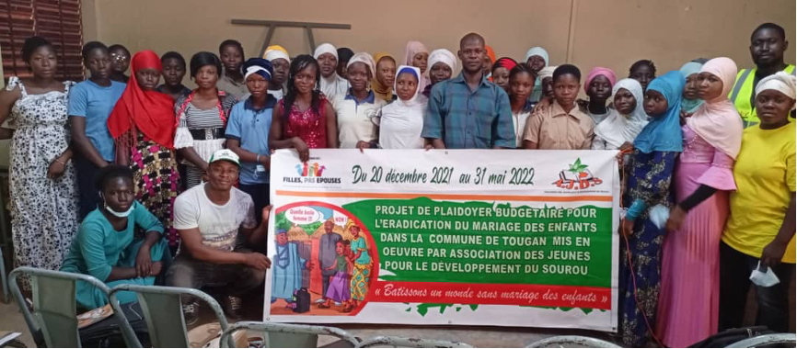
Budget advocacy in pictures
Advocacy workshop for girls' club members – AJDS in Burkina Faso

Slide 17
Intervention of Youth Association for the Development of Sourou

Slide 18
Budget Advocacy Project for the Eradication of Child Marriage in Tougan Commune – Project Impact Overview
Sharing of experiences in the majority of major meetings (provincial consultation framework, protection cluster, etc.) Financing of mass awareness activities (broadcasts of programs) during holiday periods by the Special Delegation of Tougan In terms of advocacy, AJDS is consulted by project actors and also by civil society organizations (consultations focus on the advocacy process) GBV reporting process is becoming increasingly operational The commitment of customary and religious leaders can be seen in their daily behaviour Girls' Clubs are also involved in the prevention and management of GBV cases in schools and even in their sectors. This approach creates an early warning system in case prevention and management.

Slide 19
Intervention of the National Coalition for Education for All in Burkina Faso

Slide 20
Sharing experience Advocacy for increased funding for inclusive education and education in emergencies
In 2020, 2021 and 2022, the CN-EPT/BF carried out assessments of the implementation of the National Strategy for Inclusive Education and the National Strategy for Education in Emergencies in the context of Burkina Faso's security crisis.
Challenges addressed by the budget advocacy project
The alternative reports prepared on the basis of these assessments have clearly shown that the indicators will not be achieved as the implementation of these two strategies suffers from funding shortfalls. This is because most of the actions provided for in these two strategy papers have not been implemented. It is then that the Coalition will decide to engage in advocacy actions with the Minister of Economy and Finance, the Minister of National Education and the President of the National Assembly at the national level. At the local level, with the councils of local authorities (communal and regional). It will set up advocacy groups at the national and local levels. The advocacy groups set up were grouped together and trained on advocacy, leadership and influence strategies. During this training, advocacy plans and messages were developed for the national, regional and communal levels..

Slide 21
Challenges, opportunities and impact
Challenges
In terms of challenges, it was a question of convincing the targeted decision-makers to accede to our demands for change, namely to increase the financing of inclusive education and education in emergencies. In terms of opportunity, it should be noted that the country is committed to the implementation of SDG4 through the Education and Training Sector Plan, the implementation of the Strategic Plan for the Development of Education and Training, the implementation of decentralization, Law 013, the Constitution of 2 June 1991.
Impact
The budget allocated to ESU has increased from 197 million in 2020 to 1 billion 500 million FCA in 2023. The budget allocated to girls' education from 350 million in 2020 to 400 million in 2023 The budget allocated to the education of children with disabilities from 122,750,000 FCFA in 2019-2020 to 138,850,000 in 2021/2022
Perspectives:
Continue advocacy for the increase of the education budget and the adaptation of financial procedures to the context of the emergency at national and local levels.

Slide 22
Intervention of GFM3

Slide 23
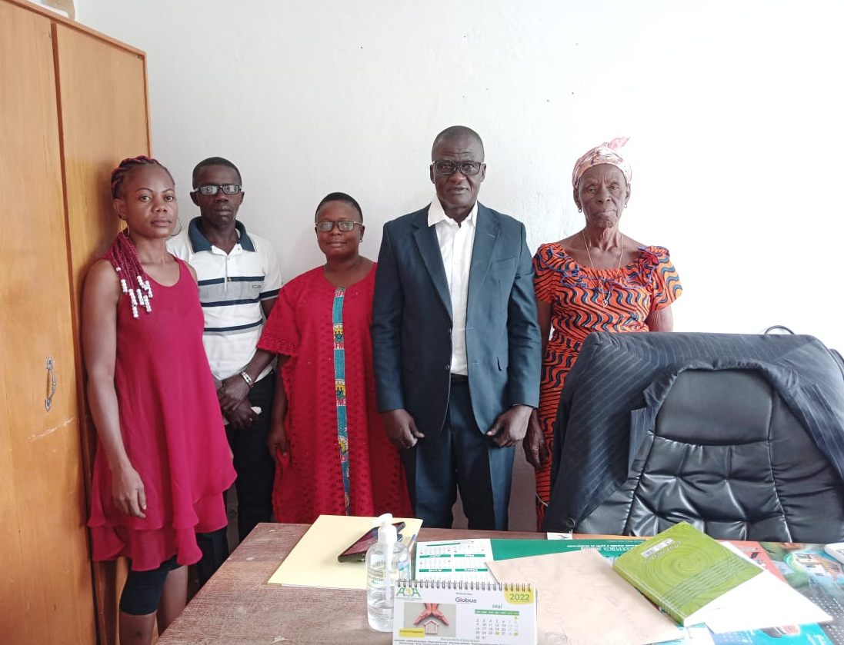
PROJECT: BUDGET ADVOCACY TO SUPPORT THE FIGHT AGAINST CHILD MARRIAGE IN THE SUB-PREFECTURE OF LOGOUALE and Danané FROM 1 FEBRUARY TO 30 May 2022*

Slide 24
1/ AN OVERVIEW OF THE GENERAL OBJECTIVES
Contribute to the development of shelters for 100 girls victims of gender-based violence (GBV) and girl wives victims of domestic violence, in the Tonkpi Region, in western Côte d'Ivoire through budget advocacy.
2 / SPECIFIC OBJECTIVES
Analyse the public budget on the financing of shelters for vulnerable girls, in the Tonkpi region, in the West of Côte d'Ivoire; Strengthen the capacity of communities in the Sub-Prefecture of Logoualé and the city of Man, in western Côte d'Ivoire, in budget analysis and advocacy and raise awareness on the consequences of child marriage; Develop budget advocacy and conduct an advocacy campaign with the competent authorities.

Slide 25
3/ EXPECTED RESULTS
A budget analysis on the financing of shelters for vulnerable girls in the Tonkpi region of western Côte d'Ivoire is made; The capacities of communities in the Sub-prefecture of Logoualé and the city of Man, in terms of budget analysis and advocacy and on the consequences of child marriage are strengthened; Budget advocacy is developed with the community and an advocacy campaign with the relevant authorities is conducted.
4/ PLANNED ACTIVITIES
Step 1: Budget analysis
Working with an expert to perform budget analysis to access budget information; Analysis of this information, explain it and draw the consequences; Using this information for budget advocacy

Slide 26
Step 2: Capacity building and awareness-raisingn
Capacity building of communities in the Sub-prefecture of Logoualé and the city of Man, in order to show them the impact of the budget on development axes and motivate them to participate in the preparation of the budget of their locality so that their needs are taken into account, particularly that of shelter. Raising awareness among the population of the Sub-prefecture of Logoualé and the city of Man on the consequences of child marriage and domestic violence.
Step 3: Development of budget advocacy and advocacy meetings
Budget advocacy will be developed taking into account budget analysis and community proposals. The project team will hold various advocacy meetings with: Regional Director of the Ministry of Women, Family and Children of Tonkpi / Regional Councillor of Tonkpi / Prefect of Man / Mayor of Man / Sub-Prefect of Logoualé / Mayor of Logoualé / Confederation of Religious Guides / Technical partners / The private sector.

Slide 27
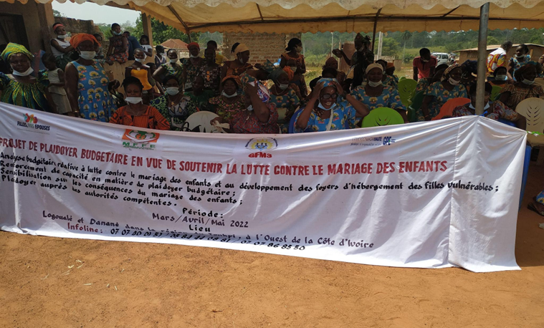
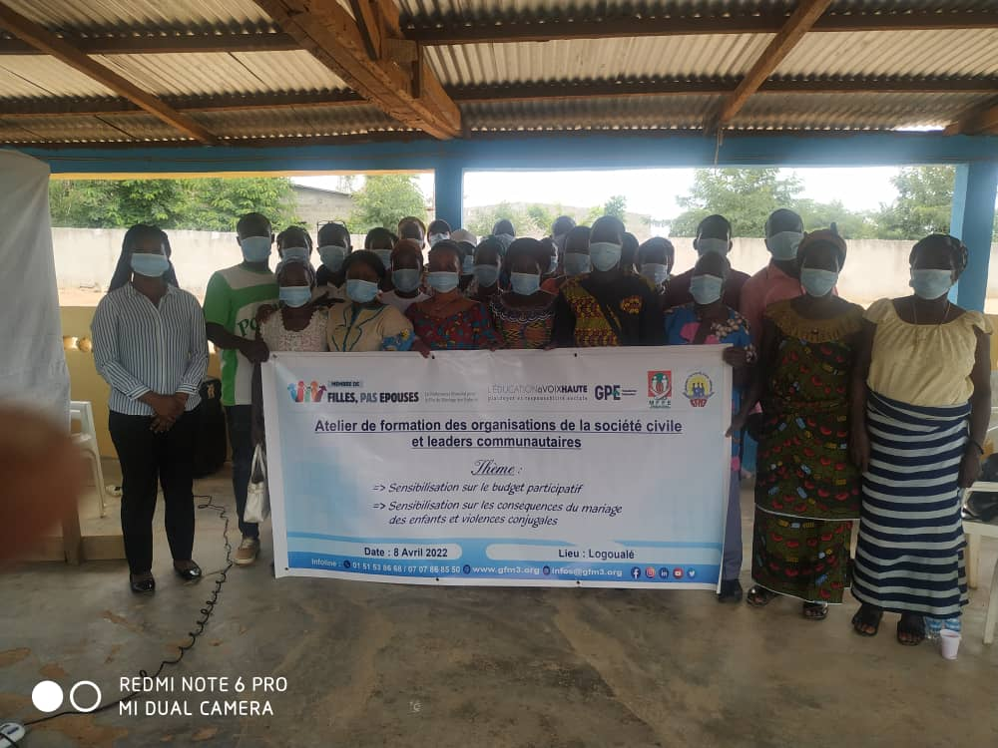

Slide 28
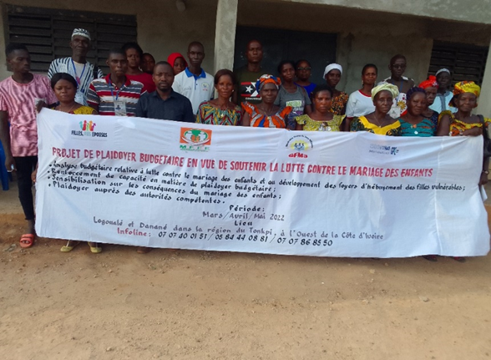
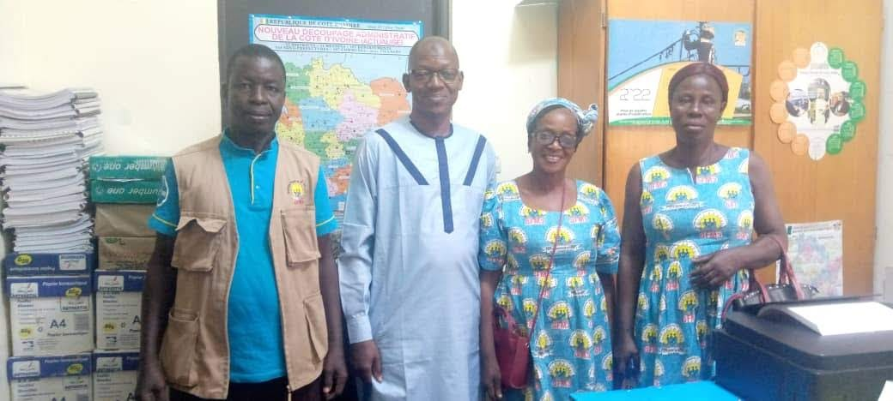

Slide 29
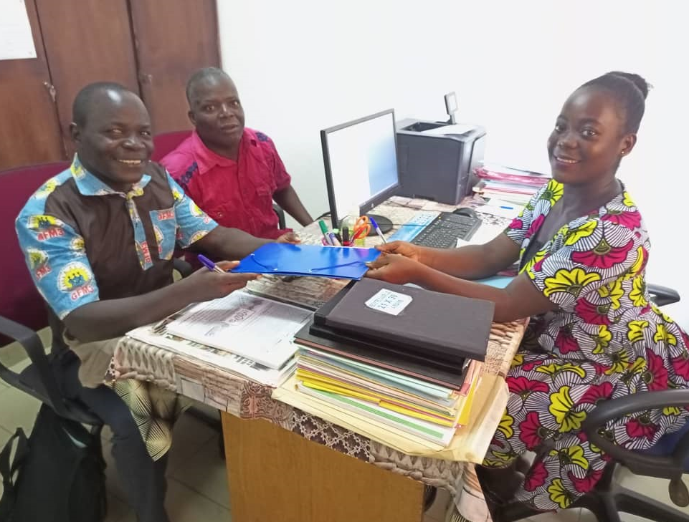
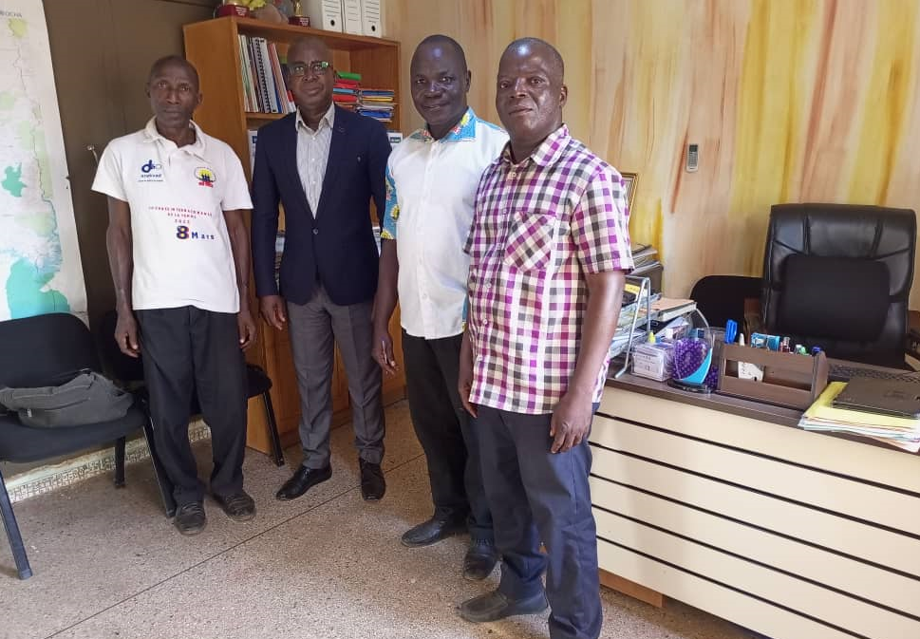

Slide 30
5/CHALLENGES AND LIMITATIONS
We had several difficulties to know:
- Refusal to share the budget of the indexed community Change of consultant due to inability to access data
We have several challenges:
Community leaders agree to take an interest in their local budget Inform communities of the possibility of accessing and influencing their local budget.

Slide 31
6/ THE RESULTS OBTAINED
The project has made it possible to acquire advances in the maintenance of the girl in school. The theme is all the more topical as it has provoked reactions from the authorities.
Danané: The mayor of the locality promised through his deputy to relay our plea for the maintenance of the girl in school. In doing so, he wished for the help of NGOs especially GFM3 which was the bearer of this message. Today it is done. GFM3, which implements a project called SWEDD EDUCATION which aims to keep the girl in school, has dropped off its suitcases in Danané within the LYCEE ZINGBE MATHIAS. This project affects nearly two cohorts of 189 girls in Danané, for a total of 378 girls in lower secondary school. It aims to help them pass the second cycle in order to become women leaders of tomorrow.

Slide 32
Logoualé:
The advocacy focused on the possibility of giving young girls the opportunity to complete their education. Indeed, it had been suggested that shelters should be built, failing which the CECAREF centre could accommodate young female students. The center could allow them to have a safe shelter and allow them to study in peace.
This school year we had two requests to accommodate the girls, which we are examining because the boarders were on vacation but with the resumption since November 17, 2022this will be examined and validated to allow young people to go to school in peace.

Slide 33
7/RECOMMANDATIONS
It is to invite the authorities to a round table to exchange with them on evidence of the budget of the municipalities or the regional council not executed / non-existent for the promotion or maintenance of the education of the girl. It is to continue the action even at the end of the project until winning the case or being heard by the authorities.

Slide 34
8/ GOOD PRACTICE AND LESSONS LEARNED
The need to strengthen community mobilization Presenting the project to the community before implementation allowed for greater commitment and involvement The involvement of community leaders in the processes of preparation and implementation of the workshops made it possible to mobilize a large number of beneficiaries (direct and indirect)

Slide 35
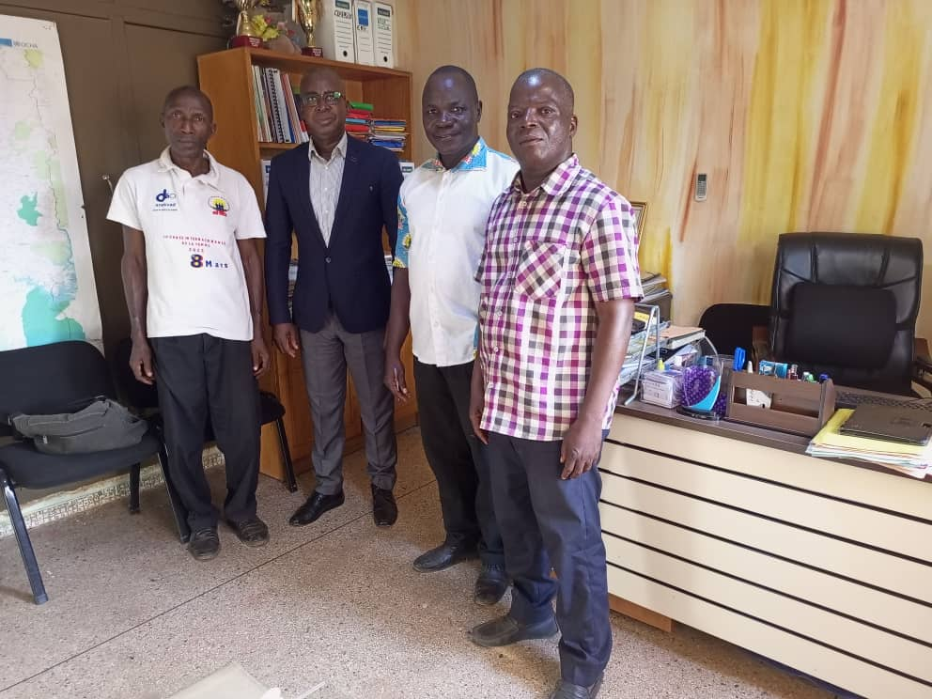
IMAGE DU DIRECTEUR REGIONAL REPRESENTANT LE MINISTERE DE LA FEMME , DE LA FAMILLE ET L’ENFANT AVEC LE FACILITATEUR ET LES CREPRESENTANTS DES COMMUNAUTES DANS LE DISTRICT DES MONTAGNES

Slide 37
Open discussion

Slide 38
Thank you

