Slide 1

CHILD MARRIAGE programming and advocacy in conflict- and crisis-affected settings.
Girls not brides learning series, AUGUST 2023

Slide 2
Interpretation
ENGLISH - This session will have presentations in English and French. To access simultaneous interpretation, please click on the globe icon at the bottom bar of your screen and select your preferred language (English, Spanish, French, or no interpretation).
français - Cette session comprendra des présentations en anglais et en français. Pour accéder aux services d'interprétation simultanée, veuillez cliquer sur l'icône globe que vous trouverez dans la barre inférieure de votre écran, et sélectionnez la langue de préférence (anglais, espagnol, français, ou version originale).
Español - Esta sesión tendrá presentaciones en inglés y francés. Para acceder a los servicios de interpretación simultánea, por favor haga clic en el icono del globo que encontrará en la barra inferior de su pantalla, y seleccione su idioma de preferencia (inglés, español, francés, o versión original).
Notes:
Lara or Laia?
Please write in the chat box (preferably in Port, Fr, Sp or English!) if you are having any technical difficulties and a member of our team will be happy to support
Please also use the chat box to post Questions or experience you would like to share. And if you have a question for one of our panellists please do put their name.

Slide 3
Overview
Introduction
Presentation on Girl Shine : Preventing and Responding to Early Marriage (Mehreen Jaswal / IRC)
Presentation on youth-led research and advocacy to address child marriage and girls’ education during crises in Burkina Faso and Niger (Aicha Ba, Flora Koné and Teoma Mamadou Ousseini / EOL)
Q&A and discussion
Closing

Slide 4
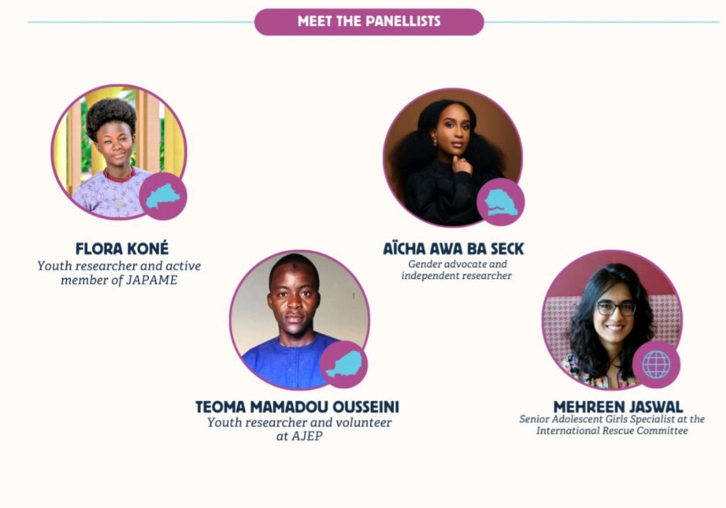

Slide 5


Girl Shine: Preventing and Responding to Early Marriage
U.S. DEPARTMENT OF STATE
BUREAU OF POPULATION, REFUGEES, AND MIGRATION (PRM)

Slide 6
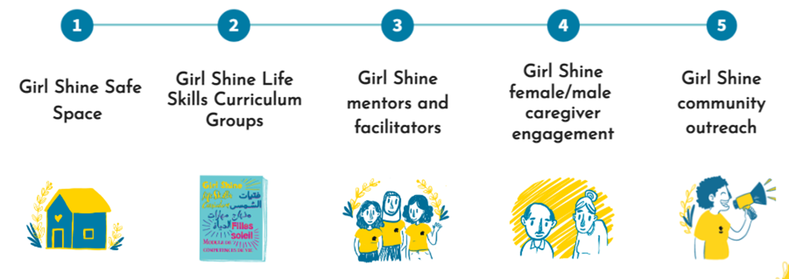
Girl Shine
Notes:
Girl Shine is a program model and resource package that seeks to support, protect, and empower adolescent girls in humanitarian settings. (Program model on the screen)
The Girl Shine program model intends to facilitate a safe space for girls to come together—a space that is conscious about patriarchal norms and actively challenges them. Girl Shine aims to cultivate (1) a space that lets girls know they are not to blame for any violence inflicted on them, (2) a space that builds on girls’ power and potential, and (3) a space that encourages girls to think about how they want to shape their own futures. The program model also intends to engage with caregivers and the broader community on the following subjects: adolescent girls’ sexual and reproductive rights, gender norms, girls’ safety, and other issues that girls have told us are important to them.
It’s implemented in over 34 countries globally through our WPE teams (plus external organisations), including in host communities, IDPs, and refugees across rural and semi-urban settings, including camp settings
Girl Shine can be considered in:
Emergency and post conflict settings
When the population has its primary needs met
Where GBV response services are fully established
When adolescent girls are stable enough to regularly attend the life skills groups
Girl Shine can be considered when:
GBV caseworkers have been trained in GBV Case Management and Caring for Child Survivors of Sexual Abuse (CCS)
Staff & young women mentors facilitating the life skills curriculum have been trained in GBV Core Concepts

Slide 7
Early Marriage Drivers
Lebanon
Uganda
Husband can provide
Belief girl is ready
Social pressure from community
Child bearing
Don’t marry early, harder time finding a husband
Expensive school fees
Idleness = trouble
Good catch
Caregivers can’t provide for girl
Girl as a source of income (dowry)
Protection
Girl’s behavior
Not doing well/out of school
Negative relationship with caregivers/family
Peer influence
Lacking information about marriage or the risks of early marriage
Girl can’t support self
Domestic work
Going to disco
Pregnancy
Sexual activity
Orphaned/no family
Notes:
A few years back, Girl Shine went through some updates to strengthen the lens on early marriage (both prevention and response)
We conducted a formative study in Uganda and Lebanon (2018) to help us shape the updates to Girl Shine. We found that some of the key drivers contributing to EM across both contexts were:
Gender inequality
Strong social norms on when a girl should marry
Breakdown in relationship between girls and caregivers
Caregivers as influential decision makers related to marriage
Economic stress and uncertainty
Cramped living conditions
GBV was also described as very common and girls’ access to services that were responsive to adolescent girls were limited.

Slide 8
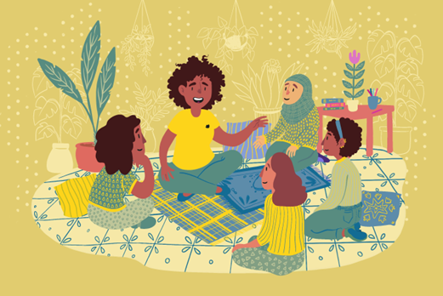
Overview of Early Marriage Tools in Girl Shine
Early Marriage Curriculum for Adolescent Girls 15-19
Early Marriage Caregiver Curriculum
Easy Read Assessment Tools and FGDs
Key Messages Guidance
Community Conversation Session Guide
Outreach Strategy
Two online trainings on Kaya:
    Training for Service Providers
    Girl Shine
Notes:
As a result of the formative study, we developed a series of new tools that are included in Girl Shine, with an emphasis on early marriage prevention and responding to the needs of married girls.
**Emphasize which tools can be used by participants who haven’t been trained on GS to help strengthen their existing work**
Part 2A: Girls Curriculum:
Two components: one for married and unmarried girls comprising of 16 sessions
We would expect that the intervention will not only contribute to a delay in marriage, but also build unmarried girls’ skills and knowledge in a number of areas, by increasing their knowledge of the risks of early marriage, providing information on sexual and reproductive health rights, supporting both girls and caregivers to find alternatives to marriage, supporting girls and caregivers to strengthen relationships with each other, and building social support and solidarity amongst girls.
In addition, for married girls, the program provides them with information about their bodies and guidance about how to influence decisions that affect their lives. It will also provide support for girls and caregivers to strengthen their relationships and encourage solidarity amongst girls so that married girls have a solid support system.
Part 3A: Caregiver Curriculum –
For female and male caregivers, comprising of 16 sessions
The aim is to support caregivers to find alternatives to marriage, and assist in strengthening relationships with each other.
We encourage the pre-marital caregivers of married girls to attend if feasible as this is a time when girls will need their support system, but we also do include mother in-laws.
Both curricula require trained Girl Shine staff. However there is a lot of other content included that could help strengthen your existing work on the topic.
Easy Read: For example, if you are conducting assessments with girls and caregivers, we have adapted all of our assessment tools into easy to read formats, making them more accessible to those with intellectual disabilities.
Key Messages Guidance: The messages have been primarily developed for women and men who are not participating in the early marriage sessions, as the content is already covered there. The messages can be adapted to the community more broadly, reaching boys, community leaders, teachers, and anyone else within the community who have influence over the lives of adolescent girls. Key messages include these such as strengthening relationships between girls/caregivers, decision making, gender equality, marginalized groups, girls with disabilities, health, violence/safety, accessing services, and early marriage. These can be weaved into existing programming.
Community Conversation Sessions Guide: These sessions have been designed to be conducted with the broader community, but each participant should commit to completing all four sessions. The sessions have been designed to help implementing organizations reach the community with messaging and information related to adolescent girls so that this information is not just limited to those people participating in the caregiver sessions. It is recommended that trained facilitators implement these, but there is flexibility to use these outside of Girl Shine programming.
Outreach Strategy: can be used by actors who want to increase their reach of diverse adolescent girls for their program activities. It can be used to find girls to participate in Girl Shine as well as other activities being offered by humanitarian actors. The strategy supports the intentional outreach of girls who could most benefit from programming e.g. diverse girls, girls most at risk of violence, girls without strong support networks, girls with disabilities and girls who are often missed by general outreach initiatives and girl with disabilities. It will also help you to tailor activities to meet the needs and interests of girls.
Kaya Training courses:
The objectives of the Service Provider training are:
•Understand what some of the barriers to care are for adolescent girls
•Strengthen communication techniques for working with girls
•Learn about adolescent girls’ right to sexual and reproductive health information and services
•Understand GBV case management approaches to working with adolescent girls, including related to early marriage.
Girl Shine Training
Understand the Girl Shine program model and theory of change
Know how to assess and design the Girl Shine intervention based on your context
Understand the Girl Shine implementation and close out process

Slide 9

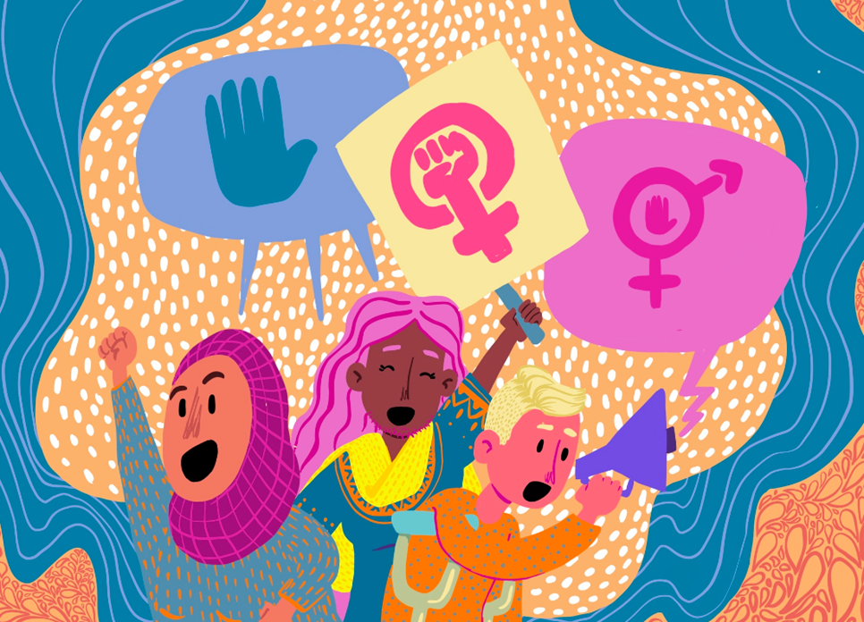
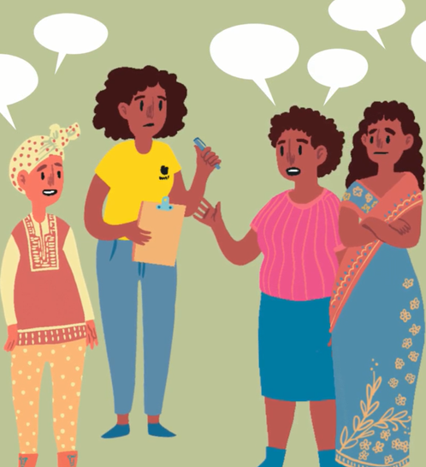


Framework for Addressing Early Marriage through Girl Shine
Empower girls with information, skills, and support networks
Mobilize families and the community to delay early marriage and support married girls
Support girls’ access to services and opportunities
Leverage
supportive laws
and policies
Notes:
How do these new tools come together to address early marriage:
As part of the updates to Girl Shine, we developed a framework for addressing early marriage:
These are the four key areas we identified as key to addressing early marriage (both preventing and responding to). The tools that have been added to Girl Shine address SOME of these areas, but it is important to advocate on the other areas which Girl Shine isn’t addressing.
Empower girls with information, skills, and support networks: Providing girls with information and skills and building their support network is key to early marriage delay and responding to the needs of married girls. Through the new Girl Shine content, we raise girls’ awareness about their right to be free from early marriage, how to seek help if they are being forced into a marriage and work with married girls to navigate relationships and SRH when married. Here - we are really talking about the life skills sessions, which work to provide girls with information, skills and develop their support networks.
Mobilising families and communities: Is critical to early marriage prevention and response. We know that families and communities are critical to addressing early marriage and are fuelling early marriage. Ignoring the families and community and only focusing on girls will cause tensions as girls don’t have decision making power in the same way, so we are in danger of creating a lot of awareness with girls about early marriage and then they cant do anything about it,. So it is critical to start addressing family and community norms. This is addressed through early marriage curriculum for caregivers, key messages and community conversations covering key topics such as Gender, relationships, power, ASRH, comprehensive outreach tool to continue engaging with supporters and leaders.
Support girls’ access to services and opportunities – advocating for girls access to services –there are things we can advocate for as humanitarian practitioners and the spaces we move in to support girl access to services GBV and other services. Providing a holistic approach is critical for addressing early marriage – and while this may not be fully covered in Girl Shine (i.e. it has a GBV focus), we do encourage advocating for girls to receive a holistic response for the intervention to be meaningful and impactful. Will be covered in the next slide
4. Leverage supportive laws and policies
When we work on early marriage it is critical we have a good understanding of the national legal framework in the country where we operate. This will help us to draw on these laws if we need to, to ensure we have a rights based approach to our work and to use during discussions with caregivers to strengthen arguments against early marriage. We can also identify where there are gaps, especially in protections for married girls or where early marriage is legal. We can coordinate across orgs and institutions to catalyse change. We will also understand if there are any requirements to report early marriage and the potential impact that could have on the program/recruiting married girls.
Understand the legal framework in the context where you work
Understand and advocate for the strengthening of birth, marriage, and divorce registration systems.
Advocate for gender-equitable laws and policies, including setting the legal age of marriage to 18

Slide 10

Advocating for a holistic approach to addressing early marriage
Provide spaces for girls to meet separately from boys
Close collaboration between CP and GBV actors on response
Health providers trained on gender equality, ASRH services.
Safe reporting and referral mechanisms in school.
Advocate for girls’ education, secondary and alternative.
Advocate for life skills in schools
Advocate for livelihoods training, income generating opportunities or apprenticeships to adolescent girls and/or their caregivers.
Notes:
For the areas not addressed in Girl Shine, we still have a strong advocacy role, some of the things we can do are:
Advocate for actors to provide spaces for girls to meet separate from boys for recreational or other activities
Use the approaches outlined in the Girl Shine outreach strategy to improve access to services to girls
Close collaboration between CP and GBV actors to ensure girls are not falling through the cracks for response services
Health providers trained on ASRH, gender equality, ASRH friendly services.
Safe reporting and referral mechanisms in school.
Advocate for girls’ education, secondary and alternative.
Advocate for life skills in schools
Advocate for livelihoods training, income generating opportunities or apprenticeships to adolescent girls and/or their caregivers.

Slide 11
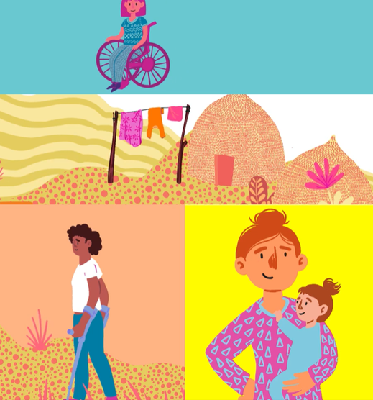
Early Marriage Programming
in Humanitarian Settings
Have established GBV services which are accessible to girls
Strong referral pathways for the whole community
Consider terminology on CEFM with communities
Invest in a comprehensive outreach strategy
Find ways to deliver adolescent sexual and reproductive health information
Make reasonable accommodations for girls with disabilities
Understand how to sensitively work with diverse girls
Notes:
Some of the things to consider when doing early marriage programming with girls that we have learnt from the implementation of this project are: (read slide)
*In situations where girls with disabilities face barriers to access, reasonable accommodations must be provided to secure participation for girls with disabilities, such as ramps, visual resources, or sign language interpretation. For more information on the process to follow to provide reasonable accommodation you can share this guidance
LBTQI girls and girls affiliated with minority ethnicities or religions will also make up the group composition. However, it is not recommended to actively seek out these girls on the basis of their sexual orientation or ethnicity, as this might put them in more danger in some contexts unless teams are already experienced in doing this safely and confidentially. Instead, teams can ensure that these girls are not further excluded from participation through discriminatory language or attitudes held by teams and that teams are equipped to respond to harmful attitudes and beliefs demonstrated by participants.

Slide 12

Working with Girls on Prevention and Response to Early Marriage
Think about group composition
Offer childcare and other resources girls needs
Do not shame, judge, or punish a girl who expresses interest in or positive feelings towards being married
Consider how the content and its delivery may impact girls’ sense of safety and empowerment
Do not ask the girls direct questions related to their personal experience.
Engage with their caregivers
Notes:
When working directly with girls, there are a few things to take into consideration (read slide)
Girls who are married still need a support network
Do not shame, judge, or punish a girl who expresses interest in or positive feelings towards being married. While the Girl Shine Life Skills Curriculum aims to prevent early marriage, it recognizes there are many complex drivers behind early marriage. Passing judgment about girls who express interest in marriage is stigmatizing and deters them from seeking the further support they require.

Slide 13
Overview of Field Testing – Adolescent Girls
Adolescent Girls | Pre-Test | Post-Test | Difference
Norms and Attitudes | 60% | 97% | 37%
Knowledge of Support/Services | 85% | 100% | 15%
Relationships | 51% | 84% | 33%
Total | 55% | 90% | 35%
Number of adolescent girls = 40
Ages 16-19 years old
Notes:
A pre and post-test was completed with the adolescent girls on the early marriage curriculum. There were 2 cycles completed with 20 adolescent girls in each cycle for a total of 40 participants. There were three key areas that the questions focused on: Norms and Attitudes, Knowledge of Support/Services, and Relationships.
Norms and Attitudes:
These questions were focused on equality, opportunities, input on marriage, and marriage roles.
Overall pre-test percentages 60% to post-test of 97% - 37% increase.
For example, one question: A girl’s role is limited to marriage, household chores, and childbearing =
Pre-test: 48% strongly agree 5% somewhat agree = 53% agree
30% strongly disagree 5% somewhat disagree = 35% disagree
12% no response
Post-test: 95% strongly disagree 5% somewhat disagree = 100% disagree
Knowledge of Support/Services
The focus was on the number of places adolescent girls could go to, to seek support if they or someone they knew experienced violence.
Pre-test: 1.775 - Average # of places reported where girls would seek support if they experienced violence
85% - % of Girls who know at least one place to go for services and support if they experienced violence
Post-test 3.375 - Average # of places reported where girls would seek support if they experienced violence
100% - % of Girls who know at least one place to go for services and support if they experienced violence
Adolescent Girls were also asked, "What type of support would you seek?" -
Some of top answers included: Advice, PSS, Counseling, Medical, Legal, and Materials
Relationships
These questions looked at relationships with friends, parents, caregivers, and in-laws. How adolescent girls are able to have decisions and opinions in these relationships. As well as if they feel valued by their family.
The pre-test percentage was 51% and the post-test percentage 84% with an increase of 33%.
Questions:
My caregiver does not feel comfortable talking to me about difficult topics.
Pre-test: 63% strongly agree
23% strongly disagree 3% somewhat disagree = 26% disagree
Post-test: 25% strongly agree 5% somewhat agree = 30% agree
58% strongly disagree 10% somewhat agree = 68% disagree
I would talk to my caregiver if I needed support.
Pre-test: 55% strongly agree 13% somewhat agree = 68% agree
15% strongly disagree 5% somewhat disagree = 20% disagree
Post-test: 88% strongly agree 10% somewhat agree = 98% agree
Overall adolescent girls surveyed averaged increased percentages went from 55% to 90% = 35% increase.
The total score was out of 28 points = 12 from the Norms and Behaviors Subscale + 16 from the Relationships Subscale

Slide 14
Overview of Field Testing – Caregivers
Caregivers | Pre-Test | Post-Test | Difference
Norms and Attitudes – Gender Roles | 67% | 88% | 21%
Norms and Attitudes – Violence Against Women and Girls | 57% | 91% | 34%
Relationships | 46% | 82% | 36%
Knowledge of Support/Services | 100% | 100% | 0%
Total | 60% | 88% | 28%
Number of caregivers = 45
Female = 25 Male = 20
Notes:
A total of 45 participants participated over 2 cycles of the caregiver’s curriculum, 25 females and 20 males. Participants included: mothers, fathers, aunts, uncles, grandmother, and others (preferred not to say). The questions focused on Norms and Attitudes – Gender Roles and Violence Against Women and Girls, Relationships, and Knowledge of Support/Services.
Norms and Attitudes – Gender Roles (scored out of 12 points – each question 3 points)
Average Pre-test percentage 67% with Post-test 88%
Questions focused on: obeying husbands; equality and investment amongst boys and girls, friendship, sexual and reproductive health, girls’ roles and responsibilities, and men’s roles in child are responsibilities.
Women should always do what their husbands tell them.
Pre-test: 74% strongly agree 15% somewhat agree = 89% agree
10% somewhat disagree = 10% disagree
Post-test: 7% strongly agree 18% somewhat agree = 25% agree
69% strongly disagree 4% somewhat disagree = 73% disagree
Breakdown of Men:
Pre-test: 72% strongly agree 28% somewhat agree = 100% agree
Post-test: 10% strongly agree
70% strongly disagree 20% somewhat agree = 90% agree
Interesting finding: Girls should be able to access sexual and reproductive health information even if they are unmarried.
Pre-test: 80% strongly agree 2% somewhat agree = 82% agree
13% strongly disagree 2% somewhat disagree = 15% disagree
2% Prefer not to answer
Post-test: 80% strongly agree 2% somewhat agree = 82% agree
11% strongly disagree 7% somewhat disagree = 18% disagree
Sex breakdown:
Females: Pre-test: 72% strongly agree 24% strongly disagree 4% no response
Post-test: 64% strongly agree 4% somewhat agree 20% strongly disagree 12% disagree
68% agree / 32% disagree The percentage went down in agreement for females
Males: Pre-test: 90% strongly agree 5% somewhat agree = 95% agree / 5% somewhat disagree
Post-test: 100% strongly agree
Norms and Attitudes – Violence against women and girls (scored out of 21 points, with each question worth 3 points).
Questions looked at: victim blaming, speaking with a trusted person, decision making on marriage, physical and emotional violence, and girls with disabilities.
Overall averages: pre-test 57% with a post-test of 91% an increase of 34%.
If an adolescent girl experiences violence, it is usually because she has made a bad decision.
Pre- test
18% strongly agree 14% somewhat agree = 32% agree
61% strongly disagree 7% somewhat disagree = 68% disagree
Post-test
7% strongly agree
84% strongly disagree 9% somewhat disagree = 93% disagree
It is possible for a couple to have a good relationship even if the husband sometimes hits his wife.
Pre-test
33% strongly agree 7% somewhat agree = 40% agree
51% strongly disagree 9% somewhat disagree = 60% disagree
Post-test
13% strongly agree
84% strongly disagree 2% somewhat disagree = 86% disagree
Relationships (subscale was scored out of 6 points, with each question worth 3 points)
This looked at the relationship between caregivers and daughters/adolescent girls.
I do not feel comfortable talking to my daughter about difficult topics.
Pre-test:
40% strongly agree 20% somewhat agree = 60% agree
38% strongly disagree
2% no response
Post-test
20% strongly agree 4% somewhat agree = 24% agree
67% strongly disagree 9% somewhat disagree = 76% disagree
Knowledge of Support/Services
Pre-test: 100% of Caregivers who know at least one place to go for services and support if their daughters experienced violence
Post-test 100% of Caregivers who know at least one place to go for services and support if their daughters experienced violence
Pre-test: 2.31 Average # of places reported from where caregivers would feel comfortable with their daughters seeking support
Post-test: 3.24 Average # of places reported from where caregivers would feel comfortable with their daughters seeking support
Some common responses on where to go included: Women's Center, Church Leaders, Health center/workers, Caregivers from these sessions
Overall, pre-test percentages 60% with a post-test of 88%, an increase of 28%
The total score was out of 48 points
21 from the Gender Roles Subscale
21 from the Violence Subcsale
6 from the Relationships Subscale)

Slide 15

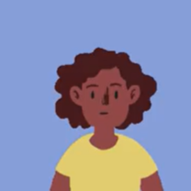
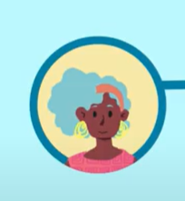
Testimonies From Participants
“I used to have a lot of problems in my marriage with my husband and my mother in law, but I could not have the courage to tell my parents because I thought marriage problems are not my parents business. I could suffer silently and when it is too much I tell my mother in law but she tells me 'this is what every woman goes through in marriage'. However, since I joined this program, I learnt that I have tell my parents what I am going through. I did that and they have supported me a lot”. Elizabeth – Married adolescent girl
“I used to restrict my daughter in law from moving outside home on the basis that she is married and has to do all the household chores. When she complains, I shout on her. But ever since I joined the early marriage program, I have learnt that she is still a girl and needs to associate with her mates”. Dedebe – Mother in-law

Slide 16

Field Testing Lessons Learned
Challenges with getting male caregivers involved initially
Importance of identifying the right caregiver for married girls
Need to engage broader community
Invest in staff and mentor training
Addressing early marriage through one programme alone will not have the desired impact
Notes:
Lessons learnt: Engaging male caregivers and the development of the community conversations
Challenges around identifying right caregiver
Cannot work with girls alone

Slide 17
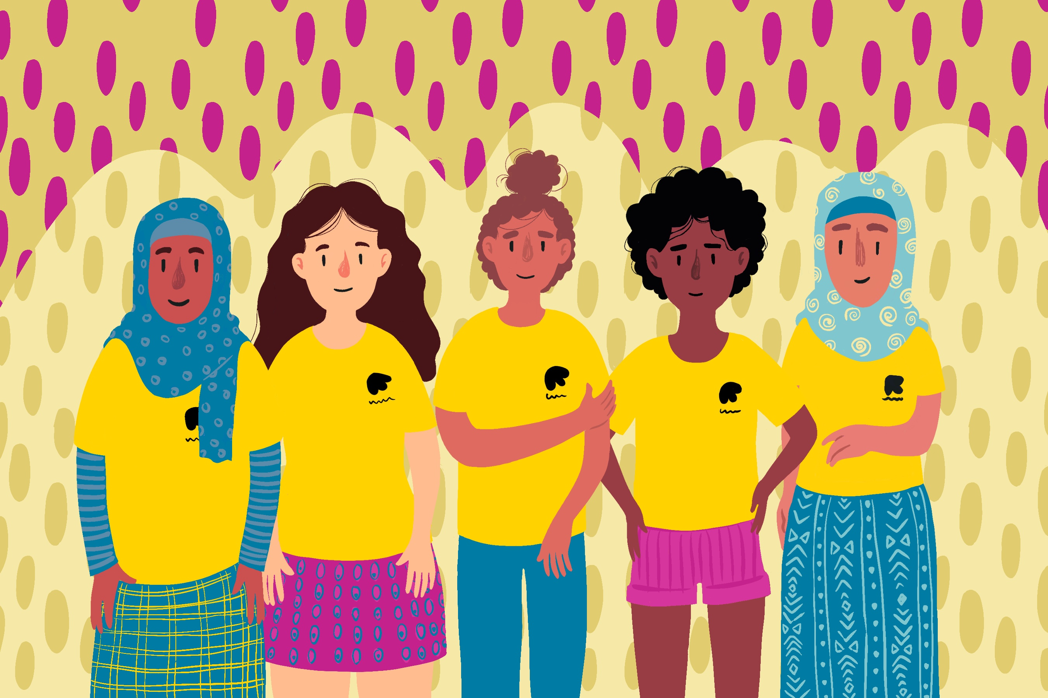

Thank you!
Girl Shine Resources: https://gbvresponders.org/adolescent-girls/girl-shine
Girl Shine online training: https://kayaconnect.org/course/info.php?id=3913

Slide 18
Résultats clés de la recherche menée par les Jeunes sur le lien entre les déplacements en contexte de Crise, le mariage d’enfants et l’éducation des filles
Webinaire cefmu:
Soutenir la programmation et le plaidoyer en faveur du mariage des enfants dans les situations de conflit et de crise
Flora koné Ousseini Teoma Mamadou Aïcha Awa BA

Slide 19
Contexte
Le projet financé par EOL mis en œuvre par Girls Not Brides
Le mariage des enfants et l’éducation des filles en Afrique de l’Ouest
Rassembler les coalitions pour l’éducation et la fin du mariage des enfants en Afrique francophone de l’Ouest et du Centre
Soutenir le renforcement des capacités, l’apprentissage partagé et le plaidoyer collectif pour la mise en œuvre de lois, de politiques et de programmes visant à améliorer l’accès des filles à une éducation de qualité et à mettre fin au mariage des enfants.
Trois niveaux: National - Régional - International
7 des 10 pays où la prévalence du mariage des enfants est la plus élevée se trouvent en Afrique de l’Ouest. 4 filles sur 10 sont mariées avant l’âge de 18 ans - 60 millions de filles
28 millions de filles n’ont pas accès à l’éducation.
Corrélation entre l’éducation et le mariage des enfants: Au niveau régional, les chances des filles de devenir alphabétisées diminuent de 5,7% (Banque mondiale) pour chaque année supplémentaire de mariage précoce

Slide 20
Polycrise au Sahel
La crise sécuritaire au Sahel :
La Fermeture de 11 100 écoles et renforcé l’attitude protectrice envers les filles
L’augmentation spectaculaire des dépenses militaires et de sécurité a eu un impact négatif sur le financement des secteurs sociaux de base, notamment la protection de l’enfance, l’education d’urgence et la santé.
L’abandon scolaire des filles en situation de crise a entraîné une augmentation des taux de mariage d’enfants dans les régions touchées par les conflits armés
Déterioration de la crise sécuritaire Burkina Faso avec la multiplication des groupes armés qui contrôlent jusqu’à 40% du pays – provoquant le déplacement interne de plus de 1,9 million de personnes particulièrement des les zones rurales. Les conflits et le changement climatique ont rendu les services essentiels plus difficiles d'accès.
Au Niger, les conflits armés et la crise humanitaire prolongé complexe a provoqué le déplacement de près de 377 000 PDI. Les catastrophes naturelles s'intensifient et se diversifient, mettant en péril des vies et les moyens de subsistance. À ces crises complexe s’ajoutent le recent coup d’état politique de juillet 2023 avec le renversement du president élu du Niger par les forces de sécurité.

Slide 21
La recherche menée par les jeunes
Des recherches menées par des jeunes ont été lancées pour positionner les jeunes en tant qu’agents dans le processus de changement en :
  Donner aux jeunes militants les moyens d’agir et de posséder des compétences sophistiquées
  Créer une culture de plaidoyer fondée sur des données probantes pour promouvoir la responsabilisation et la crédibilité
  Repenser qui a le pouvoir de produire et de diffuser des connaissances
9 jeunes chercheur.ses (6 femmes et 3 hommes) ont été sélectionnés au Niger et au Burkina Faso pour mener des études de cas contextuelles sur le mariage des enfants et l’éducation des filles, avec le soutien de LASDEL, un institut de recherche basé à Niamey
Flora Koné est une jeune diplomate etchercheuse qui a mené des recherches sur l’impact de la crise sécuritaire sur la scolarisation des filles Pazani, en particulier sur le cas des filles déplacées internes au Burkina Faso.
Ousseini Teoma Mamadou est un doctorant et jeune chercheur qui a exploré le déplacement forcé et l’expérience des filles non scolarisées à Torodi, au Niger.
Notes:
Lire bio des jeunes chercheur.ses

Slide 22
Crise sécuritaire, Mariage des Enfants et Éducation des filles
Déplacements, fermeture d’écoles et éducation des filles
Les déplacements et les fermetures d’écoles ont eu lieu au milieu de l’année scolaire et les déplacements forcés avec la fermeture des écoles ont conduit ces dernières années à un abandon massif des jeunes filles
Les effets immédiats des conflits armés observés sont l’afflux massif de déplacés internes et la fermeture d’écoles dans le département
Les différentes stratégies visant à permettre aux enfants de poursuivre leurs études – à savoir la stratégie de famille d’accueil et de regroupement familial – dans le contexte du déplacement ne sont pas toujours perçues comme appropriées ou sûres pour les filles selon les parents.
Violence des conflits: La gravité du traumatisme psychologique résultant du conflit et amplifié par les déplacements forcés et le degré extrême de privation qui s’ensuit.
L’absence de programme de suivi psychologique pour les filles déplacées ou de formation pour les enseignants pour apprehender les traumatismes psychologiques ne permet pas de fournir un soutien adéquat aux filles lorsqu’elles retournent à l’école.

Slide 23
L’insécurité exacerbe les comportements surprotecteurs envers les filles et incite les parents à être sélectifs dans les décisions concernant l’éducation des enfants
Absence d’alternative pour la prise en charge des filles PDI: les parents ne font pas confiance aux familles d’accueil, en particulier pendant la puberté des filles.
Perception que la fille ne doit pas souffrir d'aucun besoin matériel pour qu'elle puisse continuer ses études, mais en raison de la crise, la plupart des parents n'ont plus d'activités génératrices de revenus.
Renforcement de la norme sociale qui donne la priorité à l’éducation des garçons par rapport à l’éducation des filles en contexte de crise. Dans un contexte de fermeture des écoles, de saturation des capacités scolaires et de manque de moyens financiers, les jeunes filles sont les premières à abandonner l’école. D’autre part, les parents ont tendance à croire que les garçons peuvent se débrouiller et survivre même s’ils sont loin de leurs parents.

Slide 24
Pratiques prometteuses et lacunes dans les réponses des gouvernements à la crise de l’éducation pour les PDI et impact sur les perspectives d’éducation des filles
Les bonnes pratiques des gouvernements telles que la création de centres de regroupement scolaires et plus tard d’écoles d’accueil au Niger, les taux de scolarisation ont augmenté. Ils ont toutefois chuté faute d’accompagnement holistique (ex: prise en charge des frais collatéraux – alimentation ou fourniture scolaire).
Les filles déplacées et réinscrites à l’école sont confrontées à d’importants problèmes de baisse des résultats scolaires
L’aide matérielle reste insuffisante, mal distribuée et limitée aux écoles primaires.
Au Burkina, le fait que gouvernment ne prenne pas en considération les sites non officiels d’accueil des personnes déplacées a un impact très négatif sur la capacité des filles à poursuivre leurs études.
  Soutien limité de l’État et non application de la politique éducative d’urgence : la plupart des actions du gouvernement se limitent aux dons de nourriture. Les subventions scolaires sont limitées/rares dans la plupart des sites d’accueil officiels et quasi-inexistantes dans les sites non officiels de PDI.
La réflexion sur la durabilité du financement d’urgence de l’éducation est en jeu, car la majeure partie du soutien est fournie par des ONG et des organisations caritatives

Slide 25
Sur l’expérience des filles déplacées à l’intérieur de leur propre pays qui se réinscrivent à l’école et des filles non scolarisées
Les traumatismes psychologiques, le sentiment d’insécurité et de liberté restreinte, la séparation des familles et les préoccupations de ne pas pouvoir satisfaire les besoins fondamentaux entraînent souvent un manque de concentration et de motivation pour les filles retournées à l’école.
Frustration autour de la privation qui a conduit certaines filles déplacées à adopter d’autres stratégies pour accéder aux ressources financières au détriment de leur éducation
Les filles peuvent également avoir à subvenir aux besoins de leurs familles en s’engageant dans des activités génératrices de revenus telles que le travail domestique rémunéré ou le sexe transactionnel, ce qui implique souvent l’incapacité de rester à l’école.
La crise sécuritaire a considérablement accru la vulnérabilité des filles aux risques de mariages forcés et précoces et de violences sexuelles

Slide 26
Recommandations
Renforcer les mécanismes de prise en charge des PDI en assurant l’enregistrement des déplacés internes vivant sur des sites officiels ou officieux
Renforcer la mise en oeuvre et le financement des politiques d’éducation d’urgence avec un emphase sur une approche intégrée/trans-formatrice de genre en faveur des filles déplacées internes
VEILLER À UNE PRISE EN COMPTE RIGOUREUSE SYSTÉMATIQUE DES VOIX DES FILLES PDI DANS LES POLITIQUES ET PROGRAMMES
Renforcer l'appui aux acteurs du secteur de l'éducation pour une meilleure prise en charge des filles PDI
Intégrer la question de la santé mentale dans la réinsertion scolaire des enfants PDI

Slide 27
Conclusion
Des efforts qui doivent s’aligner sur l’ampleur des défis
Le plaidoyer doit survivre aux crises
Augmentation spectaculaire du budget dédié à l’éducation d’urgence au Burkina Faso – les montants alloués demeurent insuffisants pour relever les défis et l’exécution des budget est lacunaire.
Nécessité d’engager une refléxion sur comment améliorer la quantité mais surtout la qualité des politiques et budgets en faveur de l’éducation d’urgence et en particulier la résiliences des filles PDI
L’actuelle crise politique au Niger menace de remettre en questions les efforts institutionnels et des OSC en faveur pour améliorer l’éducation des filles
Les OSC doivent maintenir les efforts de plaidoyer pour exiger la redevabilité des instances de gouvernances – intérimaires ou non – dans la protection des droits des filles à une éducation de qualité, en particulier en temps de crise.

Slide 28
Merci

Slide 29
Q & A
Notes:
Kola

Slide 30
Links to key resources
Girl Shine:
Girl Shine Resources: https://gbvresponders.org/adolescent-girls/girl-shine
Girl Shine online training: https://kayaconnect.org/course/info.php?id=3913
Adolescent girl training for service providers https://kayaconnect.org/course/info.php?id=3958
GNB:
Girls Not Brides Brief Conflict-related-sexual-violence-child-marriage 2023
The Crank-research-spotlight-child-marriage-conflict-crisis-settings 2023
The Crank-research-spotlight-reach-the-most-marginalised-girls 2023
The Crank-evidence-review-child-marriage-interventions-and-research-from-2020-to-2022/
Girls Not Brides Brief Child-marriage-in-humanitarian-contexts 2021
Link to Resource Centre: https://www.girlsnotbrides.org/learning-resources/resource-centre/

Slide 31
Next webinar
28 September
SDGs and Child marriage

