Slide 1
The Child Marriage Research to Action Network (The CRANK)
This session will have presentations in English. To access simultaneous interpretation, please click on the globe icon at the bottom bar of your screen and select your preferred language (English, Spanish, French, or no interpretation).
Esta sesión tendrá presentaciones en inglés. Para acceder a los servicios de interpretación simultanea, por favor haga clic en el icono del globo que encontrará en la barra inferior de su pantalla, y seleccione su idioma de preferencia (inglés, español, francés o version original).
Cette session comprendra des présentations en anglais. Pour accéder aux services d'interprétation simultanée, veuillez cliquer sur l'icône globe que vous trouverez dans la barre inférieure de votre écran, et sélectionnez votre langue préférée (anglais, espagnol, français ou version originale).
Notes:
Nankali - translation slide:
Translations are available in English, French and Spanish – please chose the channel of your choice clicking on the globe icon at the bottom of the screen.
This session will be recorded and recordings will be shared along with key notes from the session in the follow up resources communication

Slide 2
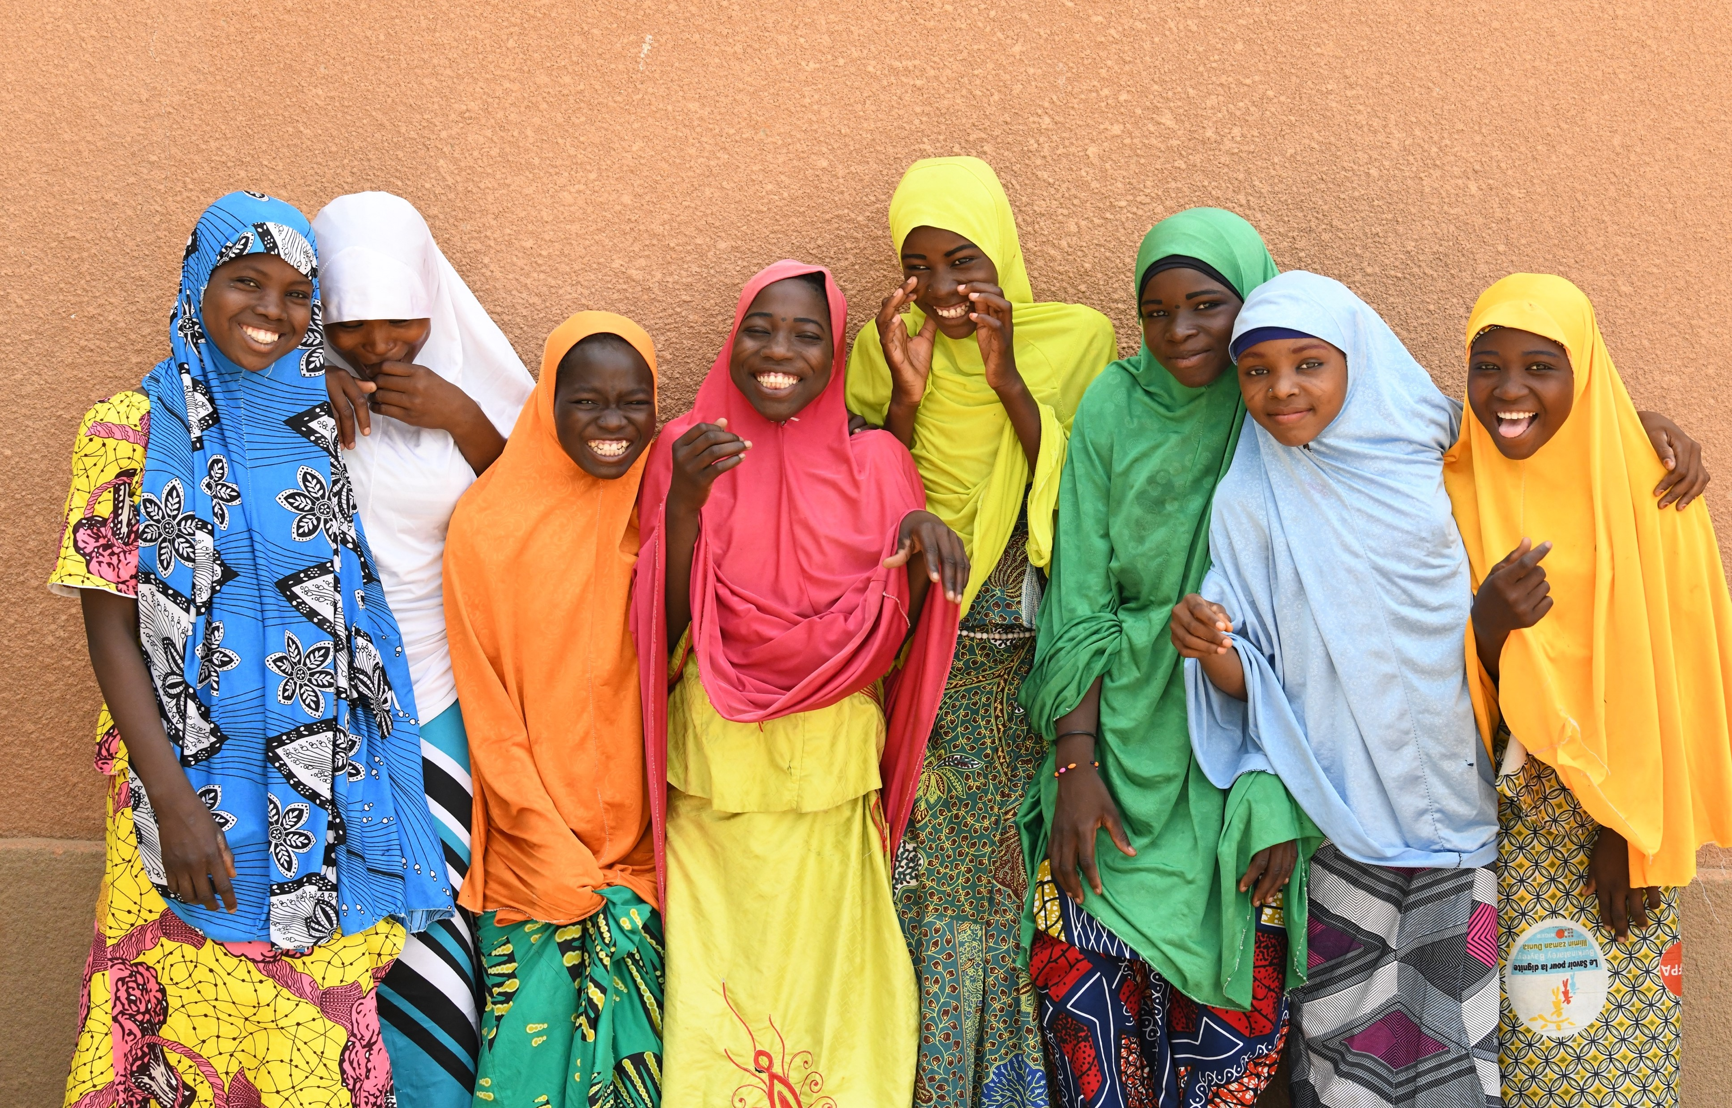
Learning from this year’s evidence reviews: Progress, gaps, and priorities on child marriage
The Child Marriage Research to Action Network (The CRANK)
29 November 2023
Notes:
Welcome from Nankali: XXXX
CRANK platform - if you want to refer to any of these points Nankali, but please feel free to take your own approach:
The CRANK - provides a platform for a better coordinated and harmonised global research on child marriage responding to priority needs and gaps of policy makers and practitioners
Promotes Reserach to Action: - encourages uptake of latestest evidence on priority topics by policy makers and practitioners though our quarterly research meetings and resource pages
It is also a knowledge management mechanism - synthesising the latest evidence with key takeaways in our biannual Research Spotlights and through the CRANK Research Tracker facilitating member coordination on research and avoiding duplication of research efforts.
Importance of this topic:- need to accelerate prevention of child marraige at scale if we are to meet our targets etc. You can draw from some of this text if helpful:
Evidence tells us that accelerating progress to end child marriage is possible under the right conditions. Focusing on effective interventions with potential for scale is critical to accelerating large-scale change to end child marriage.
In today’s session we will discuss the evidence from two large scale interventions that have contributed to the prevention of child marriage, in two differing contexts. We will present the success and learnings from two case studies - one from Ethiopia, and the second from the state of West Bengal in India drawing from UNICEF’s recent report Leveraging large scale sectoral programmes to prevent child marriage
Please post your questions and comments in the chat and we will ensure these get picked up for the discussion. A gentle reminder to please use language that is respectful and inclusive.

Slide 3
Agenda
Time (UK) | Discussion
13:00 - 13:08 | Welcome Opening welcome: Nankali Maksud, Coordinator of the UNFPA-UNICEF Global Programme to End Child Marriage. Moderator: Venkatram Chandra-Mouli.
13:08 - 13:15 | Setting the scene: Venkatram Chandra-Mouli
13:15 – 14:05 | Progress across the evidence base – learning from the latest evidence on what works: Sajeda Amin, Population Council Manahil Siddiqi, UNICEF Innocenti Margaret Greene, GreeneWorks
14:05 - 14:15 | Q&A and discussion – Venkatram Chandra-Mouli
14:15 - 14:45 | The so what and the how?: Open conversation between moderator, speakers, and participants
14:45 - 14:55 | Bringing it all together - Venkatram Chandra-Mouli
14.55 – 15.00 | Feedback poll and close – Jean Casey, Girls Not Brides
Notes:
The agenda will be presented on slide for people to refer to but no need to talk through it, has been sent out in advance.
Welcome Rachel Yates and short intro– bio pending, hand over to Rachel for her 5 minutes on importance of scale.

Slide 4
Progress and Unfinished business in Adolescent Sexual and Reproductive Health (ASRH)
Drs. Elsie Akwara & Venkatraman Chandra-Mouli

Slide 5
1/3 Child Marriage
Globally child marriage has declined over the last decade from approximately 25% in 2010 to 19% in 2020 (a 6pp decrease).
Progress has been most marked in South Asia and to a lesser extent in Sub-Saharan Africa, Middle East & Northern Africa, & Eastern Europe & Central Asia.
Illustrative example: In Bangladesh, nearly 2 in 3 girls were married/in union before the age of 18 years in 2011, whereas in 2019 about 1 in 2 girls were married/in union before the age of 18 years
There has been a decline in females married/in union before the age of 18 across all wealth quintiles & education levels between 2011 & 2019. What this means is that in addition to declines in child marriage overall in the countries, there have been across richer & poorer segments of society and the gap between declines in those with different educational levels has progressively decreased.

Slide 6
2/3 Child Marriage
The mid-term progress report towards the Sustainable Development Goals confirms continued progress on adolescent sexual and reproductive health, and dismisses worst-case scenario predictions made during the early phase of the COVID-19 pandemic.
Women aged 20-24 years married before the ages of 15 and 18: In 2017, the child marriage rate for girls globally was under 15 was 5.5% and for girls under 18 was 20.8%. The corresponding figures for 2022 were 4.2% for girls under 15 and 18.7% for girls under 18.
Notwithstanding the challenges posed by the COVID-19 pandemic, political instability, civil unrest, cross-border conflicts, and climate-related crises, there remains observable advancement in the field of ASRH on a global scale.
United Nations. Progress towards the SDG. Report of the Secretary-General. Supplementary Information, 2023.

Slide 7
Unfinished Business in child marriage
3/3 Child Marriage
No region is on track to meet the SDG target of eliminating child marriage by 2030.
West & Central Africa will require the most acceleration to eliminate this harmful practice within the next 10 years.
Levels of child marriage remain high in Sub-Saharan Africa (34%) & South Asia (28%), progress has stagnated in Latin America & the Caribbean and stalled in East Asia & the Pacific (as of 2021).
In Latin America & the Caribbean, where there has been no progress in the past decade, the stagnation must be overcome to bring the region on track towards elimination.

Slide 8
Tangible progress has been made in improving ASRH outcomes, although progress has been slow & uneven.
Conclusions 1/2
Compared to their peers, ten years ago:
Girls are less likely to become mothers before 18
They are more likely to use modern contraceptive methods
They are less likely to be married before 18, and even before 15
Both girls & boys are less likely to be infected with HIV, and to die of HIV-related causes
They are more likely to use condoms for sex with a non-married partner
Those who have HIV are more likely to be on anti-retroviral medication
They are less likely to experience female genital mutilation
They are more likely to receive Human Papilloma Virus vaccination & so less likely to develop cervical cancer in the years ahead.
While it is true that progress is slow & uneven, it is happening. That is undeniable.

Slide 9
There are sound reasons for sharing data on trends in progress.
Conclusions 2/2
It communicates to all those working in & supporting ASRH programmes that progress has been made with investment & effort, & that further progress can be made.
It points to which geographic areas & population groups of adolescents have benefited from this progress & which ones have been left behind. It also begins to answer the why this has happened, which can inform further action.
It points to the expertise that has been built up in the ASRH field over 25+ years that be put to good use e.g., using expertise in contraceptive counselling to provide mental health detection, diagnosis & care.

Slide 10
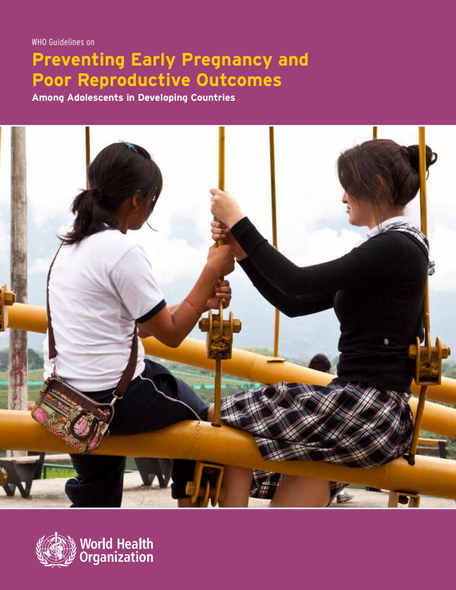
The current WHO guidelines
In 2011, WHO published guidelines on preventing early pregnancy and poor reproductive outcomes among adolescents in developing countries.
The guidelines provide recommendations for action and research on:
prevention of adolescent pregnancy
preventing child marriage
providing sexuality education
providing contraceptives
preventing coerced sex
prevention of poor reproductive outcomes
preventing unsafe abortion and its consequences
improving care before, during and after childbirth
Since their publication, the guidelines have been translated, widely dissemination and applied.

Slide 11
Rationale for updating the guidelines
In the 12 years since then:
Considerably more research evidence and programmatic experience has been generated, including in areas for which the guidelines note that there was limited/no evidence eligible for grading
The field has transitioned from a focus of addressing the needs of all adolescents to addressing the needs of groups of adolescents based on their particular needs and circumstances
Stakeholders within and outside the United Nations System have called for the guidelines to be updated

Slide 12
Rationale for the selective update
The WHO guidelines on preventing early pregnancy and poor reproductive outlines among adolescents in developing countries contain recommendations for action and research on:
prevention of adolescent pregnancy
preventing child marriage
providing sexuality education: Guidance developed
providing contraceptives
preventing coerced sex: Guidelines developed
prevention of poor reproductive outcomes
preventing unsafe abortion and its consequences: Guidelines developed
improving care before, during and after childbirth: Guidelines developed
A number of guidelines have been developed on the issues highlighted in green:
(I) On preventing adolescent pregnancy
Providing sexuality education:
Revised edition: International technical guidance on sexuality education- an evidence-informed approach (UNESCO, 2018).
International Technical and Programmatic Guidance on out of school comprehensive sexuality education. (UNFPA, 2020)
preventing coerced sex:
WHO guidelines for the health sector response to child maltreatment (2019).
RESPECT women: preventing violence against women, framework and implementation package (2019).
(II) On preventing poor reproductive outcomes
preventing unsafe abortion and its consequences: Guidelines developed
Abortion care guideline (2022).
improving care before, during and after childbirth: Guidelines developed
WHO recommendations for intrapartum care for a positive childbirth experience (2018).
Companion of choice during labour and childbirth for improved quality of care: evidence-to-action brief (WHO, 2016 – updated version dated 2020).

Slide 13
WHO guideline’s development process
1
Start with clearly defined questions:
Identify critical and important outcomes, both beneficial and harmful
Develop questions using PICO (population, intervention, comparison, outcomes) framework
2
Perform systematic reviews
3
Rate the quality (certainty) of evidence and summarize the evidence in a strength of evidence table
4
Use the summarized evidence to develop recommendations
Based on assessment of balance of benefits to harms, quality of the evidence, values & preferences regarding outcomes, equity, acceptability & feasibility

Slide 14
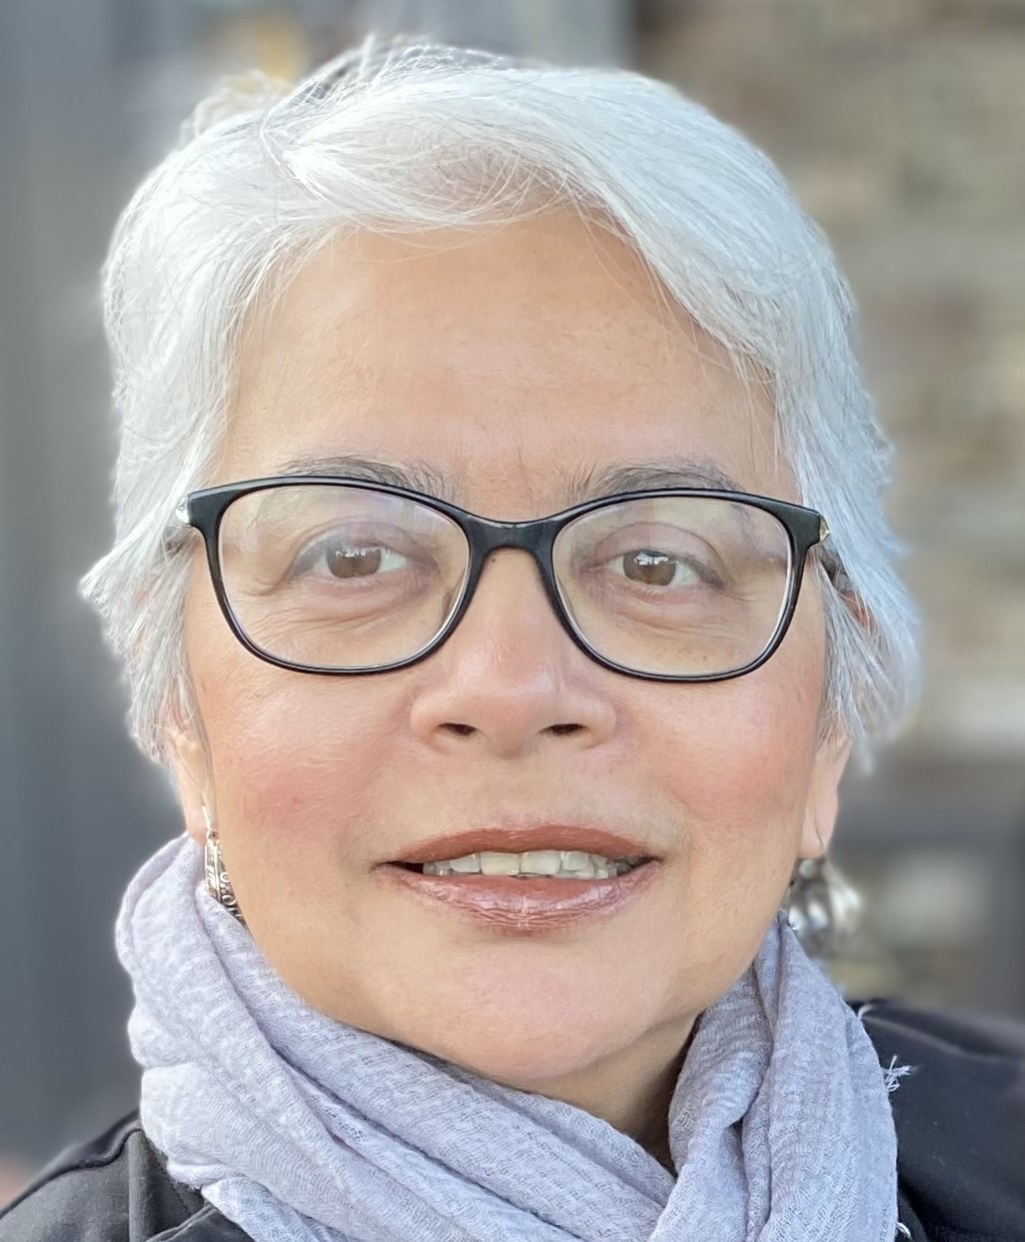
Speakers
Venkatraman Chandra-Mouli. Chandra, recently retired from the WHO after 30 years in the organization, has led the work on adolescent sexual and reproductive health in the Department of Sexual and Reproductive Health and Research. Currently Chandra continues to work on adolescent sexual and reproductive health with various organisations.
Sajeda Amin. Sajeda leads the Population Council’s work on livelihoods for adolescent girls and women where she is a Senior Associate and Girl Center affiliate. Her research focuses on learning about structures and processes that empower girls and women living in the most disadvantaged communities.
Manahil Siddiqi: Manahil specializes in the generation and use of rigorous evidence to end harmful practices at UNICEF Innocenti - Global Office of Research and Foresight. She currently leads technical support and coordination for the Strategic Technical Assistance for Research (STAR) Initiative to end FGM and Child Marriage, working directly with UNICEF and UNFPA country offices around the world to strengthen the impact and reach of programmes and policies for women and girls.
Margaret Greene: Meg has over 30 years of experience as a researcher and advocate in the fields of gender equality, sexual and reproductive health and rights, adolescent development, and positive masculinities. She is an internationally recognized expert on child marriage, and the definitive database of child marriage research she has developed with GreeneWorks colleagues has become a global resource for researchers and practitioners.

Slide 15
Systematic Review Results on Child Marriage
Responding to PICO Questions posed by WHO Guidelines Development Group to inform revised guidelines
Sajeda Amin
Senior Associate
Population Council
CRANK research meeting: Progress, gaps and priorities on child marriage
November 29, 2023

Slide 16
METHODS AND SUMMARY OF EVIDENCE
2011 WHO Guidelines were informed by 21 studies
Present evidence review includes 55 studies:
RCT/CRCT​ (N=23) | Quasi-Experimental Study​ (N=12) | Observational Study/ Natural Experiment (N=20)

Slide 17
GEOGRAPHIC BREAKDOWN OF INCLUDED STUDIES
Region | Number of intervention studies included in GRADE assessment​
Sub-Saharan Africa | N=22
South Asia | N=21
Middle East and North Africa (MENA) | N=3
Latin America & the Caribbean (LAC) | N=2
East Asia and the Pacific | N=1
Multi-Country Studies | N=6

Slide 18
STUDY IDENTIFICATION
Studies that evaluate interventions that specify CM as an outcome→ Appraisal of studies included in five most recent systematic reviews on child marriage interventions evidence (2021 Malhotra & Elnakib; 2017 Chae & Ngo, 2016 Kalamar et al., 2012 Lee-Rife et al., 2011 Malhotra et al.)
Interventions focused primarily on education, but which also include child marriage as an outcome measure→ Appraisal of studies included in recent systematic review of interventions focused on eliminated gender-based barriers to education (Psaki et al, 2022)
Interventions for married girls, which present rigorous results and disaggregate by marital status→ Appraisal of additional studies identified by Shatha and colleagues’ scoping of interventions targeting married girls
Natural experiments that consider impact of policy reform and legal interventions on CM prevalence and additional observational studies that consider macro-level drivers of child marriage→ Expert identified

Slide 19
STEP-BY-STEP METHODOLOGY
Systematic reviews (5 child marriage focused, 1 education focused);
Conduct search for more recent publications focused on same interventions for which studies included in previous reviews did not present final results→ replace such studies with updated publications;
Consult experts about recent observational studies which might be considered for inclusion, particularly for PICO 6 (Education), 8 (Child Marriage Laws)
Search for additional publications on interventions for married girls identified by Elnakib & colleagues’ in their scoping of married adolescent girls’ programs; identify publications with PICO7 alignment, rigorous design, and results presented for married girls specifically;
Screen, abstract, and review full text of relevant articles, excluding studies based on non-alignment with PICO questions, concerns related to study design, and/or concerns related to analysis methods;
Synthesize and GRADE the evidence

Slide 20
NUMBER OF STUDIES
Studies identified from existing systematic reviews (N=122)
Duplicates removed
(N=53)
Studies eliminated for poor alignment with PICO questions and/or methodological reasons (N=39)
Studies included in GRADE analysis (N=30)
Studies identified from existing education intervention review, which (N=16)
Duplicates (also included in CM intervention reviews) removed
(N=6)
Additional studies included in GRADE analysis
(N=10)
Total studies included in GRADE analysis (N=55)
Expert identified articles identified (N=16)
Studies eliminated for poor alignment with PICO questions and/or methodological reasons (N= 6)
Additional studies included in GRADE analysis (N=10)
Interventions for married adolescents (N=33)
Duplicate interventions removed (N=7); Interventions eliminated for poor alignment with PICO questions and/or methodological reasons (N=21)
Additional studies included in GRADE analysis (N=5)

Slide 21
INCLUDED STUDIES BY PICO QUESTION
PICO Question # | PICO domain | Number of intervention studies included in GRADE assessment
1 | Girl-centered approach (asset/skill-building programs, mentorship, non-formal education, CSE) | N=17
2 | Attitudes, norms, and behavior change approaches engaging men and boys, parents/guardians, others community members | N=8
3 | Mobilizing leadership for social norms change | N=4​
4 | Financial or in-kind incentives to families of adolescent girls | N=14​
5 | Improved educational environment/school-based approaches | N=17
6 | Approaches focused on girls' economic empowerment | N=11​
7 | Interventions for married girls | N=6​
8 | Existence of child marriage prevention laws | N=3​
9 | Meaningful engagement of young people in design, implementation, and/or monitoring of programmes | N=4​

Slide 22
OVERALL SUMMARY OF EVIDENCE
Fairly large number of studies but low quality of evidence for PICO 1 (Girls’ empowerment; N=18) and PICO 2 (Community engagement; N=8)
Fairly large number of studies and moderate quality evidence for PICO 4 (Incentives; N=14), PICO 5 (Educational opportunities; N=12), PICO 6 (Economic empowerment; N=11)
Very few studies and very low quality of evidence for PICO 3 (Leadership; N=4), PICO 7 (Married girls; N=6); PICO 8 (Laws; N=3), and PICO 9 (Youth engagement; N=4)

Slide 23
PICO QUESTION 4
Intervention (I) | Comparator (C) | Outcome (O) | Population (P)
Do the following types of incentives : conditional financial incentives unconditional financial incentives (labeled or otherwise) non-financial incentives (e.g. recognition, penalties, livestock and other items that they value) | No intervention Intervention without incentives Interventions with incentives and another type of activity (i.e. “cash PLUS”) | Reduce child marriage Increase school enrollment, attendance, and/or completion Delay first pregnancy and/or birth Lead to harms and/or unintended consequences | Households with a daughter under age 18 years² Female caregiver of a daughter under age 18 years² Girl under age 18 years² Others involved in the approval or processing of marriages²

Slide 24
PICO 4: KEY FINDINGS
Evidence most strongly supports cash transfers conditional on schooling
Some studies involve cash transfers as a component of a social protection strategy (not explicitly tied to delayed marriage or school enrollment)
Cash transfers may be a key strategy for addressing poverty as a driver of child marriage

Slide 25
PICO 4: RECOMMENDATIONS FROM THE 2011 GUIDELINES
Question 1.4
Is there evidence that economic incentives for families are effective in delaying the marriage of girls under age 18?
Recommendation for action
No specific intervention is recommended. Please refer to the recommendation for research related to this question.
Recommendation for research Undertake research to determine the feasibility, effectiveness and long-term impact of economic incentives on adolescent girls and their families as a means of delaying the age of marriage until girls are 18 years of age.
Possible considerations in light of new evidence:
Significantly more evidence available on this topic since 2011
Consider emphasizing importance of targeting high-risk segments of the population in particular?

Slide 26
PICO QUESTION 5
Intervention (I) | Comparator (C) | Outcome (O) | Population (P)
Do interventions to improve the availability and/or quality of educational opportunities for girls and young women | No intervention | Reduce child marriage Increase school enrollment, attendance, and/or completion Increase self-efficacy and autonomy Cause harms/consequences | All girls Married girls

Slide 27
PICO 5: KEY FINDINGS
Observational studies suggest that policies to improve access or remove barriers to schooling have broad impact in both schooling and child marriage outcomes
Several studies demonstrate the importance of investing in improving access to secondary school or programs that address the transition to secondary school
Evidence supports targeting most vulnerable population segments to close opportunity gaps in access to education (Duflo, Dake, Handa)

Slide 28
PICO 5: RECOMMENDATIONS FROM THE 2011 GUIDELINES
Question 1.6
Is there evidence that efforts to expand the availability of education for girls are effective in delaying marriage among girls under age 18?
Recommendation for action – Strong recommendation
1. Increase educational opportunities for girls through formal and non-formal channels to delay marriage until 18 years of age.
Recommendation for research
Undertake research to assess the impact of improved educational availability and school enrolment on the age of marriage.
Possible considerations in light of new evidence:
Consider emphasizing importance of investing in strategies that focus on increasing girls' access to secondary school in particular and in strategies focusing on supporting girls' transition to secondary school?
Consider 'access for all' approach versus targeting approaches to achieve educational equity

Slide 29
PICO QUESTION 6
Intervention (I)​ | Comparator (C)​ | Outcome (O)​ | Population (P)​
Do interventions to improve the economic empowerment of girls through: ​ Savings​ Bundled services​ Demand-driven job services​ Childcare​ Rural electrification​ Land rights​ Microcredit​ Business management training​ Networks and mentors​ Integrated services for farming​ | No intervention​ Interventions for girls without an economic empowerment component​ | Reduce child marriage​ Increase initiation and/or continuation of gainful employment (including self-employment)​ Increase girls’ access to income and assets​ Increase girls’ control of and benefit from economic gains​ Influence social and gender norms and attitudes about the potential for girls to contribute financially to the household through the attainment of education and employment​ Increase autonomy of girls, e.g. their influence on the timing of their marriage, their choice of partner, their economic autonomy, financial decision-making, etc.​ Cause harms/consequences​ | All girls​ Married girls​

Slide 30
PICO 6: KEY FINDINGS
Strongest quality evidence demonstrates that strategies emphasizing livelihoods skills (including financial literacy) impact child marriage and girls' employment, access to/control over resources, and/or economic autonomy

Slide 31
PICO 6: RECOMMENDATIONS FROM THE 2011 GUIDELINES
Question 1.7
Is there evidence that expanding the availability of livelihood opportunities for girls is effective in delaying marriage among girls under age 18?
Recommendation for action:
No specific intervention is recommended. Please refer to the recommendation for research related to this question.
Recommendation for research: Undertake research on the feasibility of interventions to improve the livelihoods of adolescent girls as well as their impact on delaying their age of marriage.
Possible considerations in light of new evidence:
Significantly more evidence available on this topic since 2011
Consider emphasizing importance of investing in strategies that increase livelihoods skills including financial literacy?

Slide 32
CHILD MARRIAGE INTERVENTION STRATEGIES
Interventions to prevent child marriage:
Girls' empowerment: exposure to information, skills, social networks, safe spaces, etc
Social norm change: communication or mobilization to change family and community attitudes towards marriage
Structural shifts: Increase girls' human capital or opportunities through schooling, employment
Interventions to support married girls:
Health: supporting access to and use of health services
Social: facilitating connections to community networks and resources and access to education and social services

Slide 33
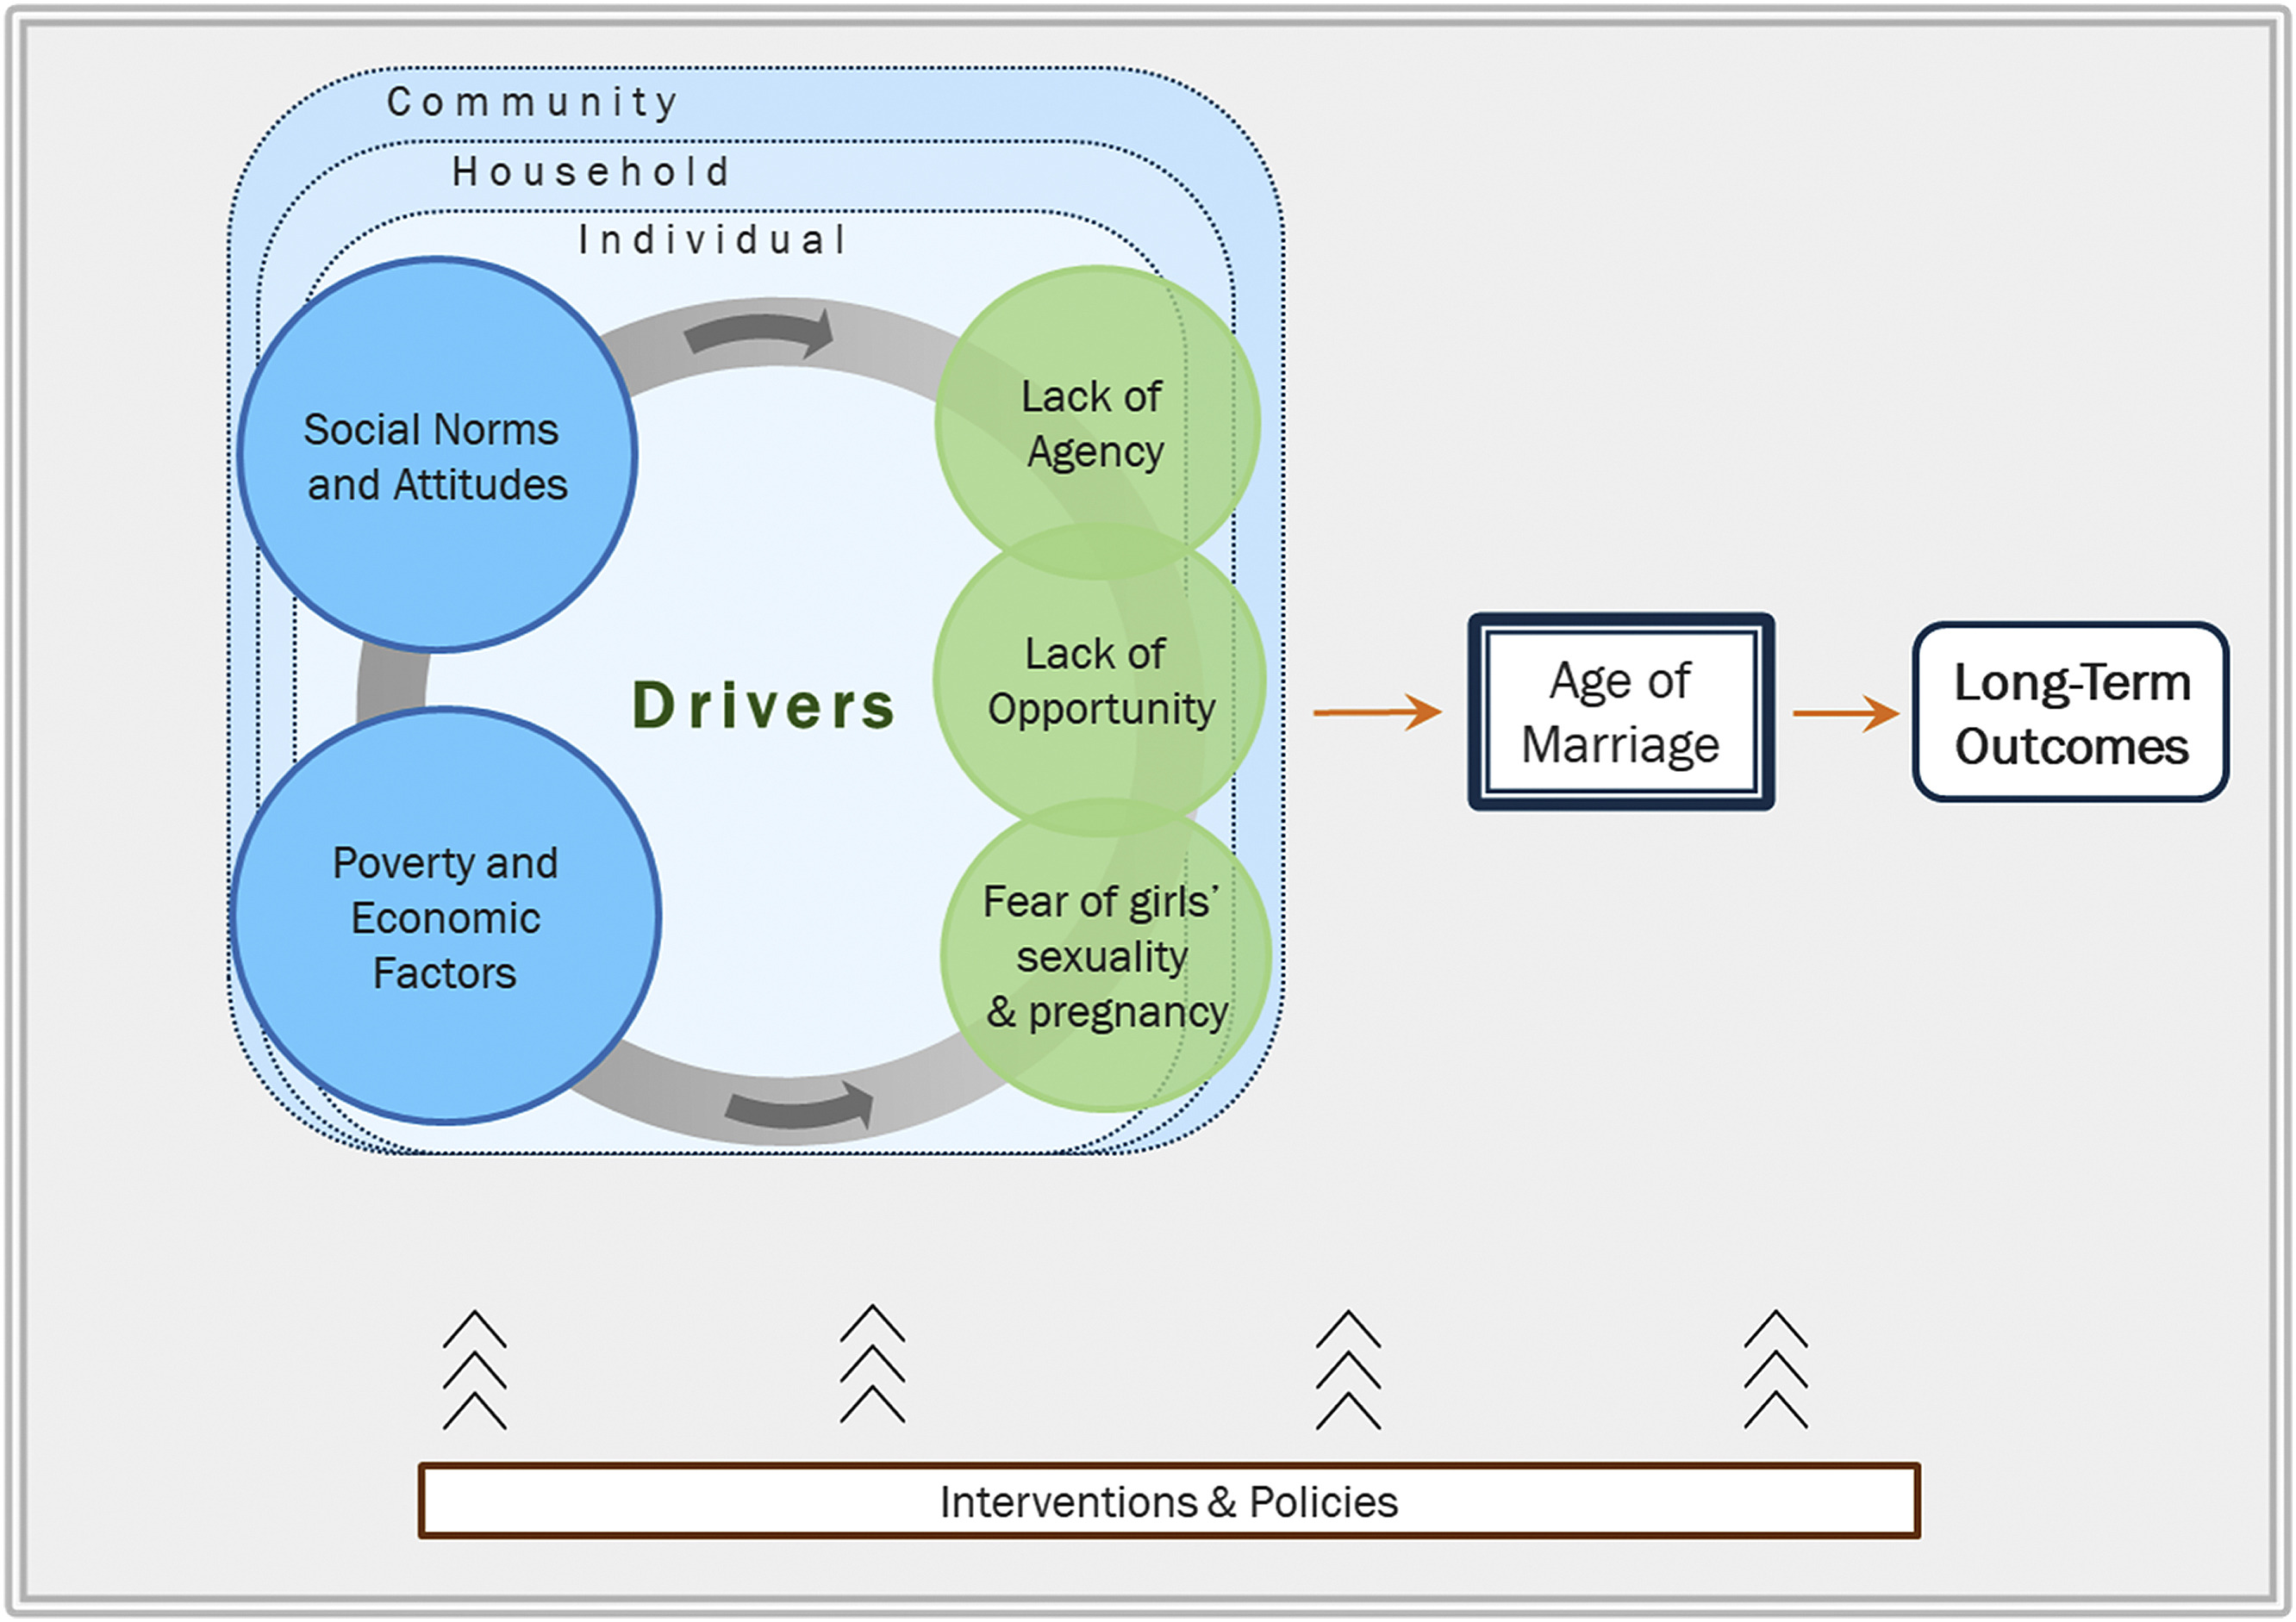
DRIVERS OF CHILD MARRIAGE
(Psaki et al., 2021)

Slide 34
Research recommendations
Projects to generate evidence should consider add-on rather than single component interventions to recognize the importance of multi-component interventions
Evidence generation should recognize ecological and multi-level effects and attempt to capture community as well as individual level effects and the potential power of diffusion
Place greater emphasis on natural experiments and observational studies
Incorporate mixed method approaches
Increase investments in geographically diverse drivers such as premarital sex and pregancy and their implications for child marriage programs

Slide 35
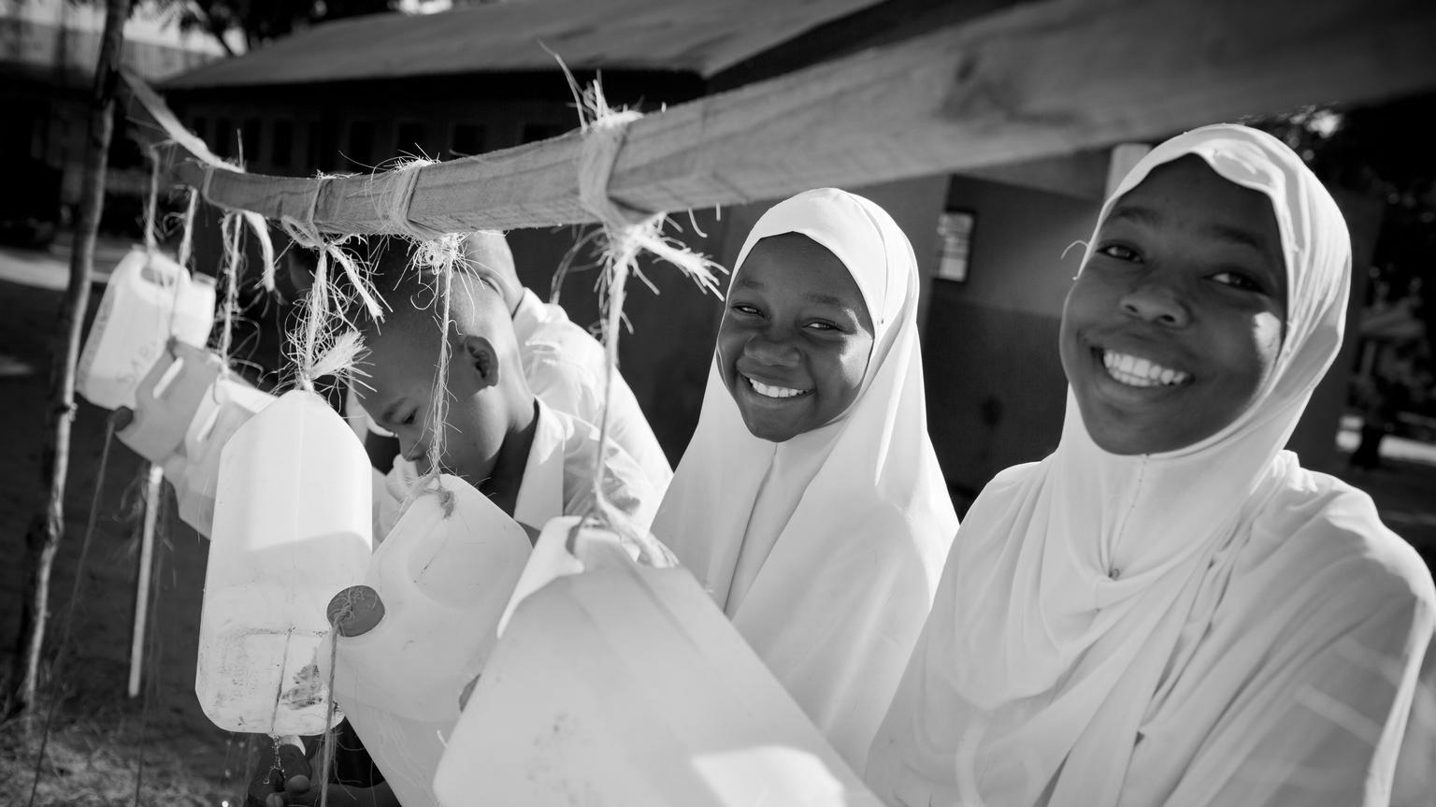
Towards a world with no child marriage:
5 Key Messages to strengthen evidence-based action
Manahil Siddiqi, MPH
Technical Coordinator, Strategic Technical Assistance for Research (STAR) Initiative to end Harmful Practices
UNICEF Innocenti, Global Office of Research and Foresight

Slide 36
ADAPT TO POLYCRISES AND MEGATRENDS
1
Off track on delivering on gender equality targets
Climate change
Inflation
Threats to democratic rights
and freedom of expression
Increasing factionalism issue for multilateralism
2015-2030 Sustainable Development Goals and the UN reform agenda
Underinvestment in child marriage
Increasing food insecurity
2022-2025 UNFPA and UNICEF Strategic Plans
Energy crisis
The lingering effects of COVID-19
Internet fragmentation
Fragile and humanitarian situations
Pushback on gender and sexual and reproductive health and rights

Slide 37
2
APPLY, SUSTAIN, AND SCALE-UP WHAT WORKS
Income and economic strengthening
Positive and consistent results
when well-designed and executed
Education and life skills
Select ASRHR interventions
Notes:
1. So first, what works?
2. A variety of approaches to prevent child marriage have been employed over the past few decades.
3. Interventions that show strong evidence of effective can be grouped into the following three approaches:
a. Income and economic strengthening;
b. Education; and
c. Adolescent sexual and reproductive health

Slide 38
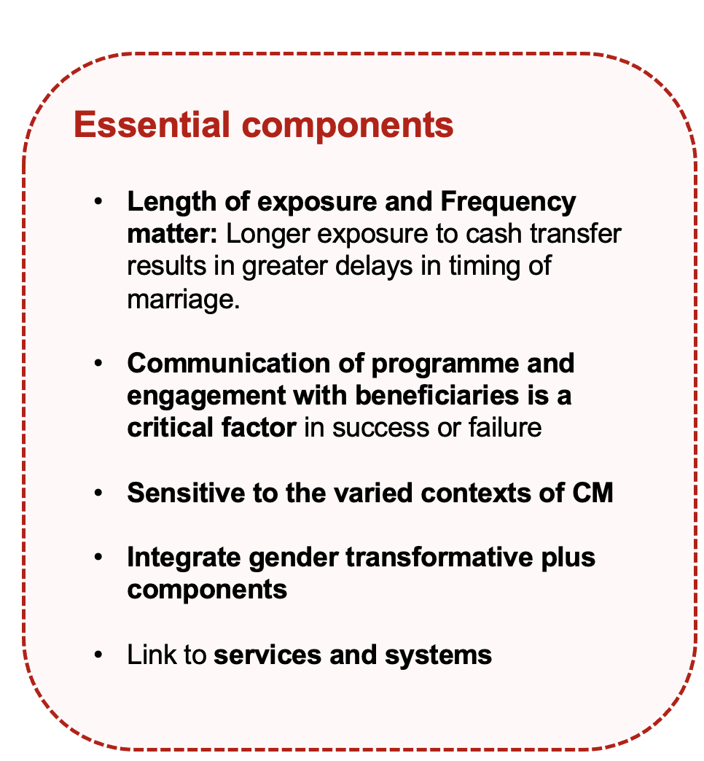
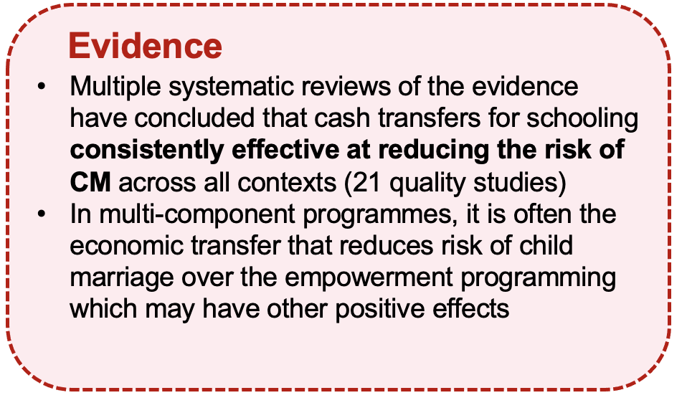
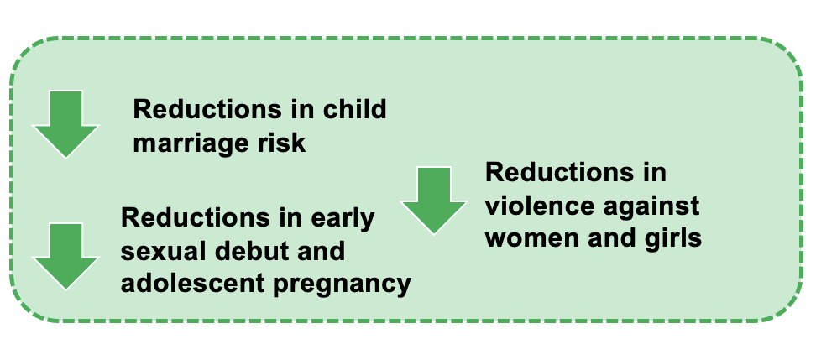
CASH TRANSFERS TO PREVENT CHILD MARRIAGE
Notes:
Interventions that support girls schooling through cash or in-kind transfers based on coverage ranging from covering 800 girls to 8 million, reveals positive effects on multiple outcomes:
a. Reduces the risk of child marriage – Multiple high quality intervention studies, at scale, were found to be effective in delaying marriage
b. Delays girls’ sexual debut and delays pregnancy c. Protects against high-risk sex
d. Robust evidence base showing that cash transfer programmes are effective in reducing violence against women.
Also note that cash PLUS interventions are important. Cash transfers alone will not change social norms related to girl and women’s work, marriage and sexuality in the short term. However, when combined with other policies, especially education, they can equip girls to resist unequal and harmful social practices. ‘Plus’ interventions are seen as critical to address deeper gender dynamics Include norm change/awareness-raising activities to account for gender norms mediating the effects of cash transfers.
Access to transfer - Adopt targeting and enrolment strategies that ensure the most at risk girls have access to the cash transfers.
b. Where conditions are used, they should not be punitive of non-compliance and should be as broad-based as possible - For example, cash transfers for education should include non-formal and vocational education
c. Size and duration of transfer matters - When cash is enough to cover increasing living costs it can prevent families resorting to negative coping mechanisms. Households that receive transfers for longer periods found longer-term positive outcomes, such as women choosing to withdraw from hazardous jobs to prioritize childcare.
d. Deliver at scale and link with systems - State run cash transfers that are part of social protection systems offer the greatest potential for addressing key drivers of child marriage sustainably and at scale.This is particularly important for “plus” components which are cross-sectoral and need to

Slide 39
Latest research from Bangladesh: “A relatively small transfer not only significantly delays marriage for participating families but also delays marriage for women who live nearby but were ineligible for the transfer.”

Slide 40
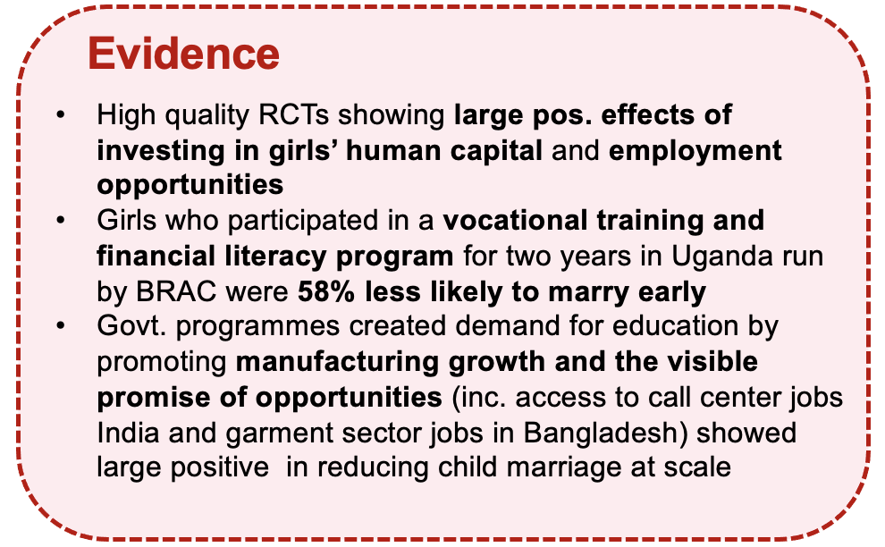
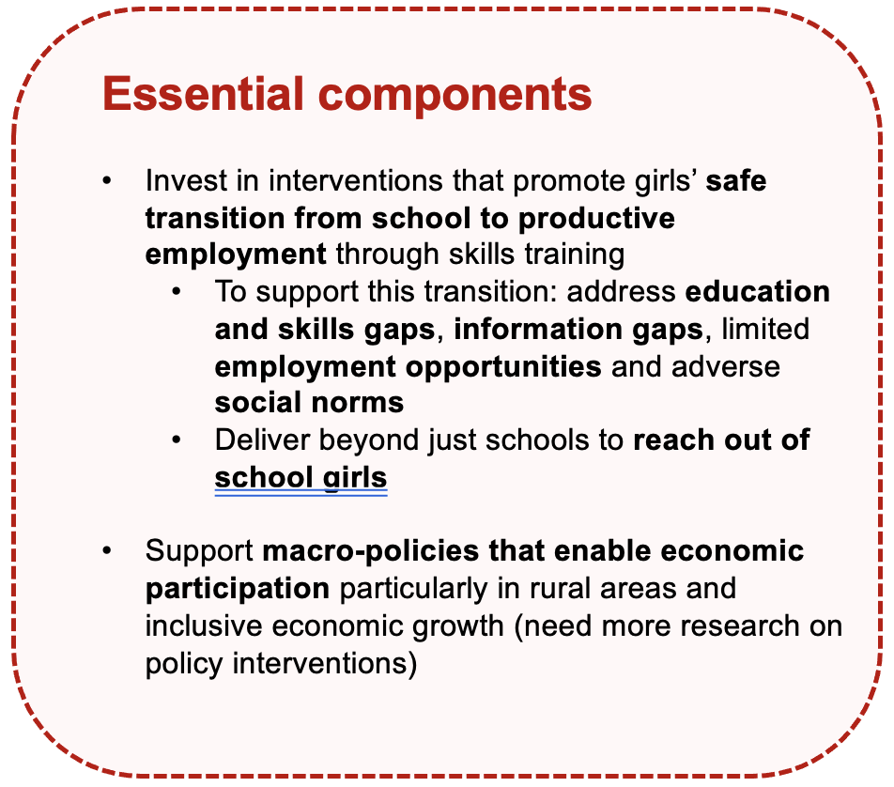
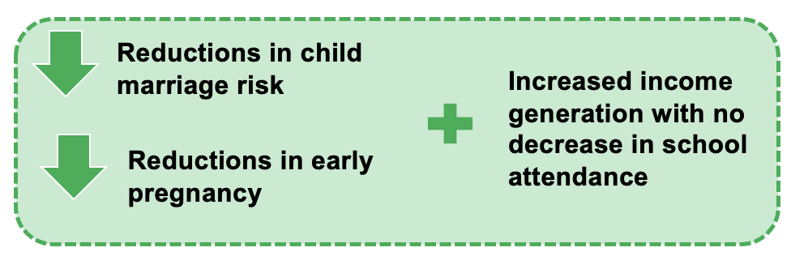
VOCATIONAL SKILLS AND TRAINING FOR INCOME
GENERATION AND FAVOURABLE JOB MARKETS
Notes:
Now moving to vocational skills and training and favourable job markets.
Vocational training interventions are those that are designed to equip individuals with the skills and knowledge required to perform a specific job or occupation. Most evidence comes largely from RCTs in Bangladesh and Uganda. Interventions worked by simultaneously providing girls with two types of human capital: vocational skills to enable them to start small-scale income generating activities and life skills to help them to make informed choices about sex, reproduction and marriage.For example, girls who participated in vocational training and financial literacy program for two years in Uganda run by BRAC were 58% less likely to marry early.
With regard to implementation, consider delivery beyond just schools to reach out of schoolgirls.
Evidence on favourable job markets is promising from South Asia. The very large positive effects in two studies on favorable job markets for women in India and Bangladesh provide some indication that not just investment in, but the visible promise of economic opportunities for girls in early adulthood, is important in delaying marriage. A study from Bangladesh shows that by the authors’ estimates, the impact of the presence of garment factories in Bangladesh is many times larger in delaying marriage than even the massive government-supported female secondary school stipend program. Similarly, macro policies supporting female employment in the garment industry in Bangladesh or the outsourcing boom in India also affected girls and young women in very large numbers. From the available evidence, these two approaches demonstrate a combination of success, as well as scale and sustainability, more extensively than any other category of interventions.

Slide 41
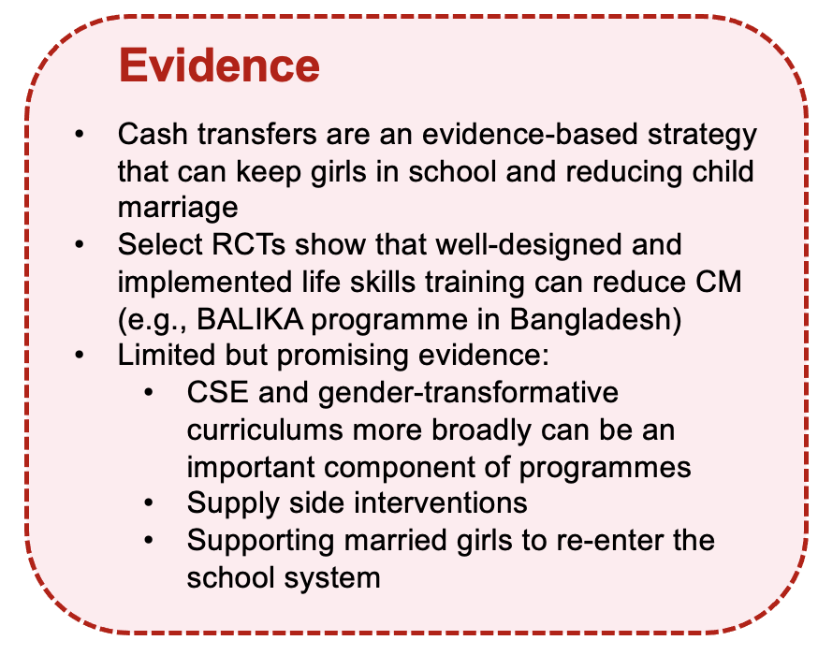
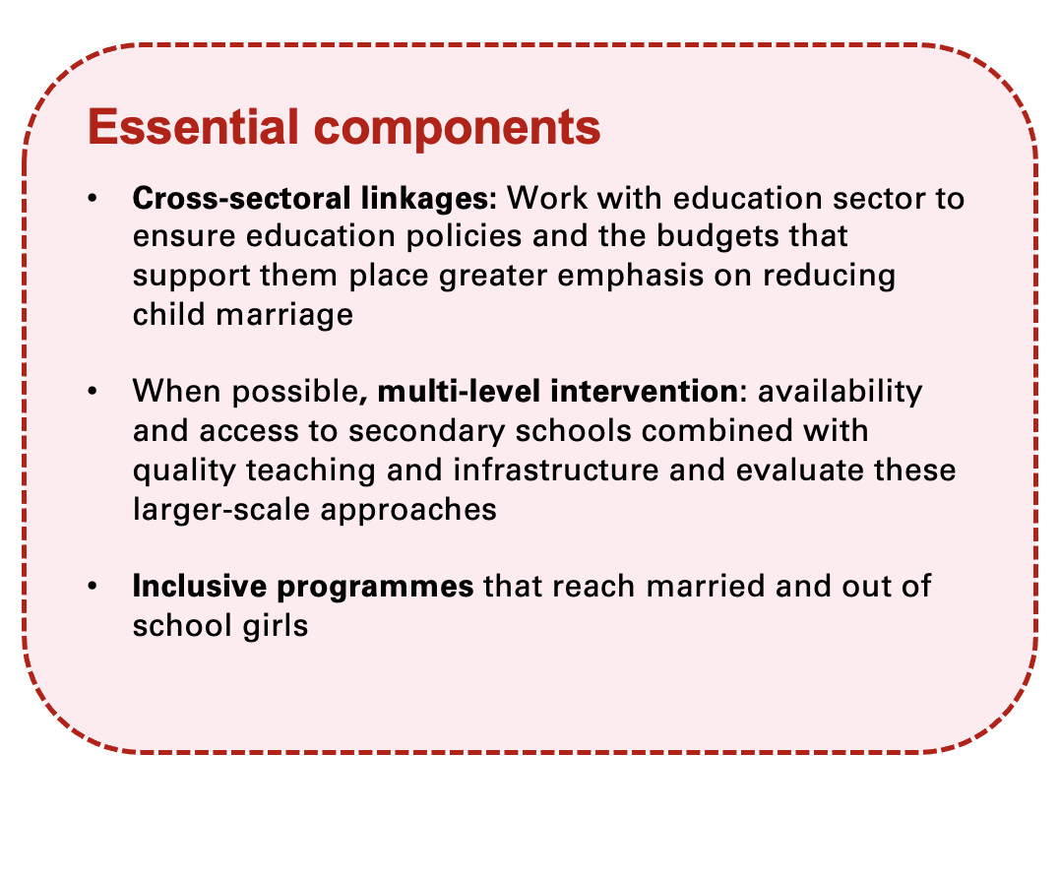
EDUCATION INTERVENTIONS
Notes:
Education and life skills interventions are those that are designed to increase access and/or quality and perceived value of schooling and training for girls, such as cash and in-kind transfers targeted life skills and capacity-development of teachers. Keeping girls in school, particularly at the secondary level, has demonstrated significant and lasting positive effects for adolescent girls including delaying marriage, delaying sexual debut and pregnancy; improved health behaviours, and an improved sense of self-efficacy and agency.
Evidence on supply-side education interventions (such as more secondary schools or female teachers, better curricula and skills, or more accessible transportation) is extremely limited – currently no evaluations examine the impact on child marriage of these supply-side interventions to promote girls' schooling outcomes. This is an important gap to address. While education sector is certainly implementing these types of interventions, evidence of effectiveness is important to establish.
Research i. Conduct rigorous evalautions of large-scale education initiatives and measure their impact on child marriage. ii. Need implementation research to understand how exactly sexuality education is designed and implemented to be effective, including the effective delivery methods, critical factors affecting delivery (school environment, teacher preparedness,), effective strategies for delivering CSE to learners with disabilities, refugee or fragile settings etc.

Slide 42
3
INVESTIGATE PROMISING APPROACHES
Gender and/or social norms change
Promising findings
but requires further rigorous evalaution
Systems-strengthening and multi-sectoral and multi-level approaches
Response and support services for married girls
Notes:
To help you seIect and integrate strategies, approaches and programmes to address child marriage in your setting. I will present each approach with a key objective, its rationale, its potential effects, and specific intervention types and the evidence supporting these appraoches

Slide 43
4
ADOPT GENDER-TRANSFORMATIVE RESEARCH PRINCIPLES
Meaningfully include and empower women and girls
Understand diversity and context of lived experiences
Challenge power and promote equality
Design and use research for purposeful action
Value expertise of women, girls, and other marginalized groups
Ensure ownership over research process and findings
Privilege voices of groups that have traditionally been silenced or underrepresented
Understand that there are intersecting systems of oppression based on gender, class, race, etc.
Recognise how gender roles and identities change over time and differ by context
Challenge traditional power dynamics between researchers and research subjects
Use the research process and findings to catalyse change in the lives and work of participants
Produce research in alignment with a larger social change agenda
Share knowledge gains with research participants and community
Build networks, alliances, and collective action to put research to use
Adapted from AJWS and IDRC, “Using research for gender-transformative change” and
UNFPA-UNICEF Global Programme Gender Transformative Change Technical Guidance
Notes:
To help you seIect and integrate strategies, approaches and programmes to address child marriage in your setting. I will present each approach with a key objective, its rationale, its potential effects, and specific intervention types and the evidence supporting these appraoches

Slide 44
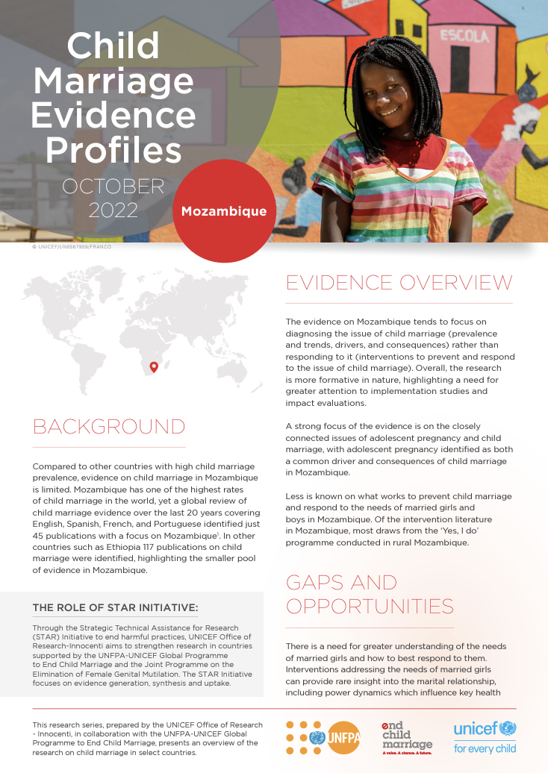
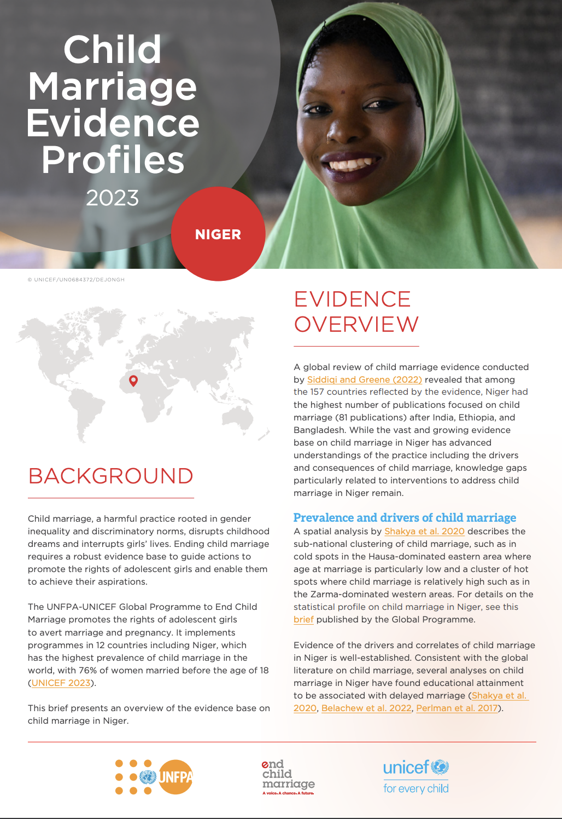
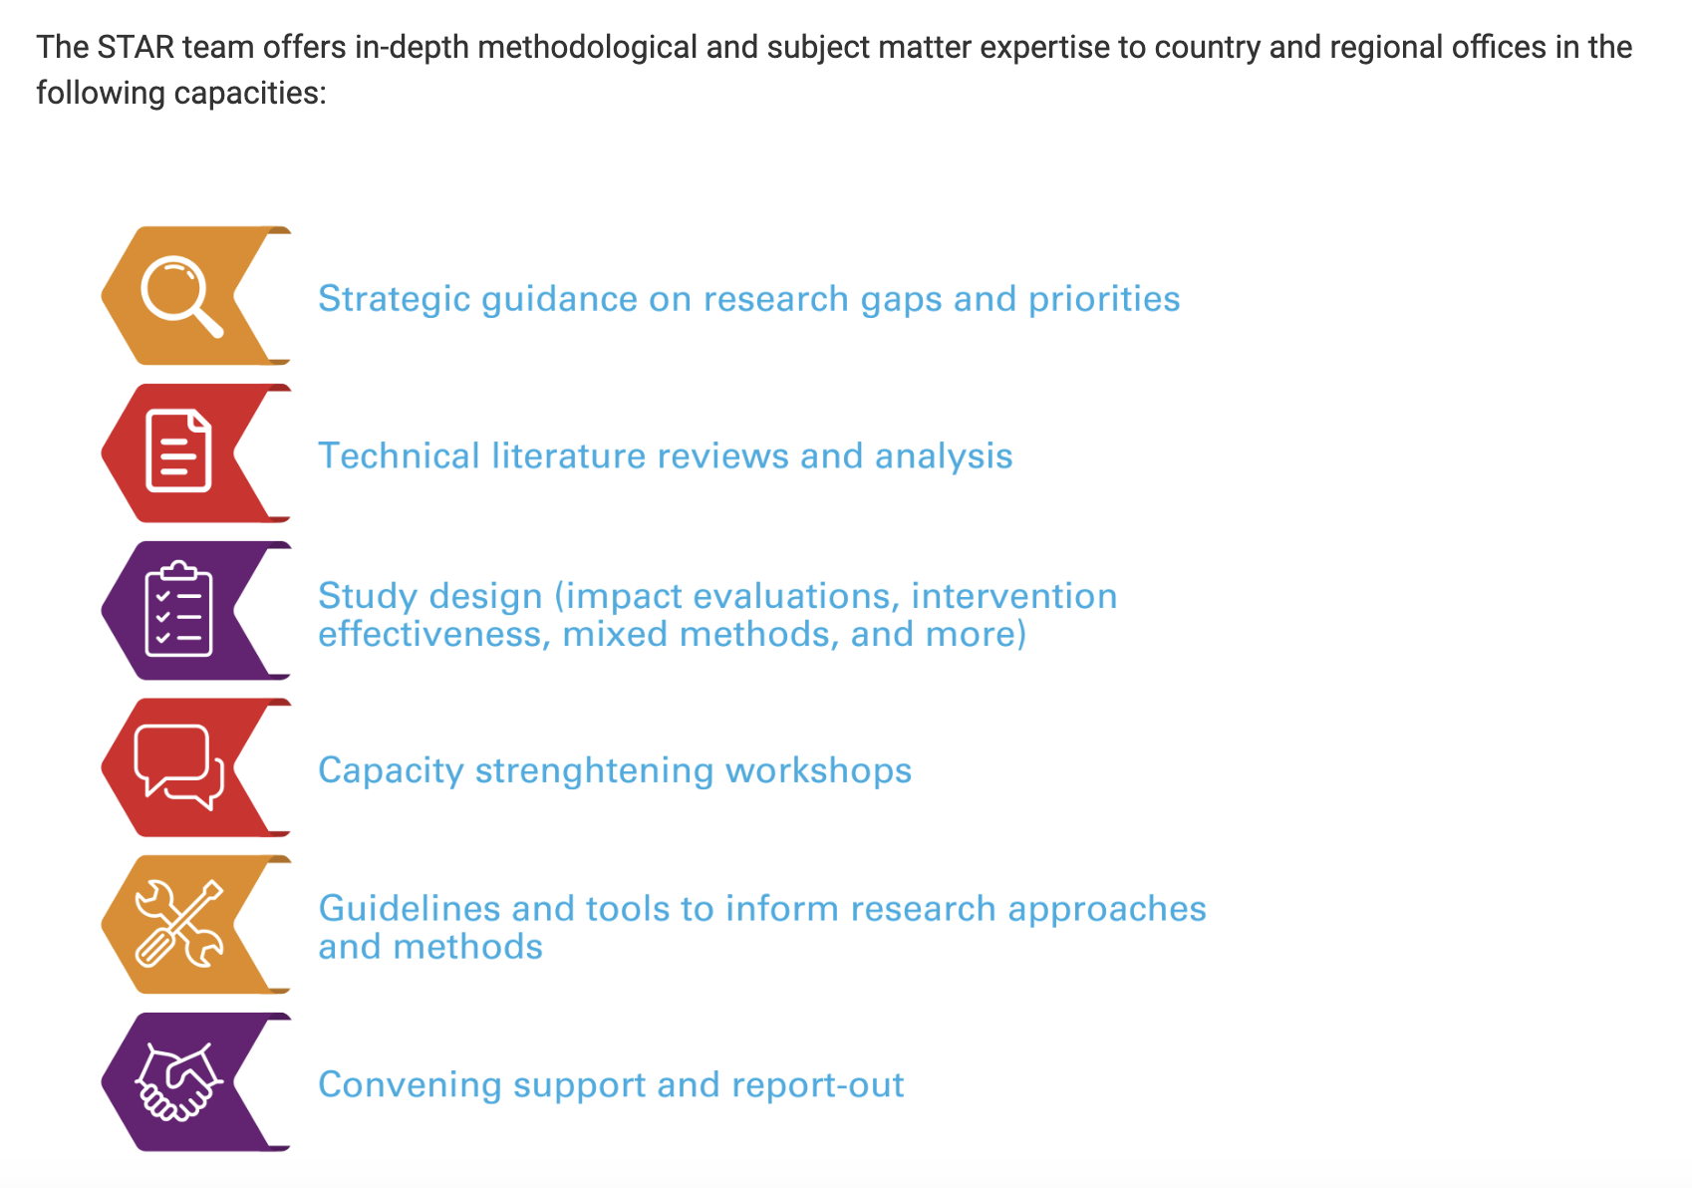
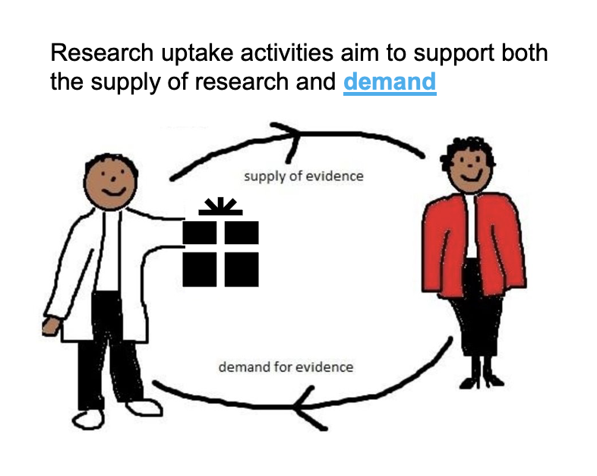
5
ACHIEVE THE 3 R’s FOR EVIDENCE IMPACT
EVIDENCE RESPONSIVENESS
EVIDENCE
RIGOUR
EVIDENCE
REACH
Notes:
To help you seIect and integrate strategies, approaches and programmes to address child marriage in your setting. I will present each approach with a key objective, its rationale, its potential effects, and specific intervention types and the evidence supporting these appraoches

Slide 45
Research is the foundation for change
Strategic Technical Assistance for Research (STAR) Initiative to end Harmful Practices
EVIDENCE GENERATION
RESEARCH PRIORITISATION
KNOWLEDGE TRANSLATION
Robust evidence produced
Research evidence synthesized
Research agenda is set, shaped, and promoted.
Evidence translated for action and uptake through international partnerships and networks
CAPACITY-BUILDING
Enhanced national capacity to generate and use evidence
MORE EFFECTIVE OUTCOMES ACHIEVED
by UNFPA-UNICEF Global and Joint Programmes to end Child Marriage and FGM
Notes:
Ramya

Slide 46
For reflection...
What are your reactions to the evidence on what works to address child marriage?
How have you integrated evidence related to child marriage into your decision-making processes? What barriers have you faced?
How has the polycrisis influenced your work?

Slide 47
For every child.
Answers.
Contact: msiddiqi@unicef.org
rsubrahmanian@unicef.org
THANK YOU.
Notes:
Every girl has the right to fulfill their FULL potential. Thank you.

Slide 48
Gaps and priorities in
the evidence on what works
Margaret E. Greene
mgreene@greeneworks.com

Slide 49
Highlighting two kinds of gaps
Geographic
Analyses of the distribution of the evidence in Africa and in LAC
Programmatic approaches
In-depth analysis of interventions in Africa

Slide 50
Our database of CEFMU publications
Result of five years of systematic searches of the literature 2000-2023
Global (South and North) in English, Spanish, French and Portuguese
Nearly 1700 publications
Academic and grey literature: 19 academic databases, 15 websites of key institutional actors and the reference lists of the publications we identified
Broad range of datapoints extracted from each publication
Notes:
4 French, 4 Spanish, 4 Portuguese, 7 English

Slide 51
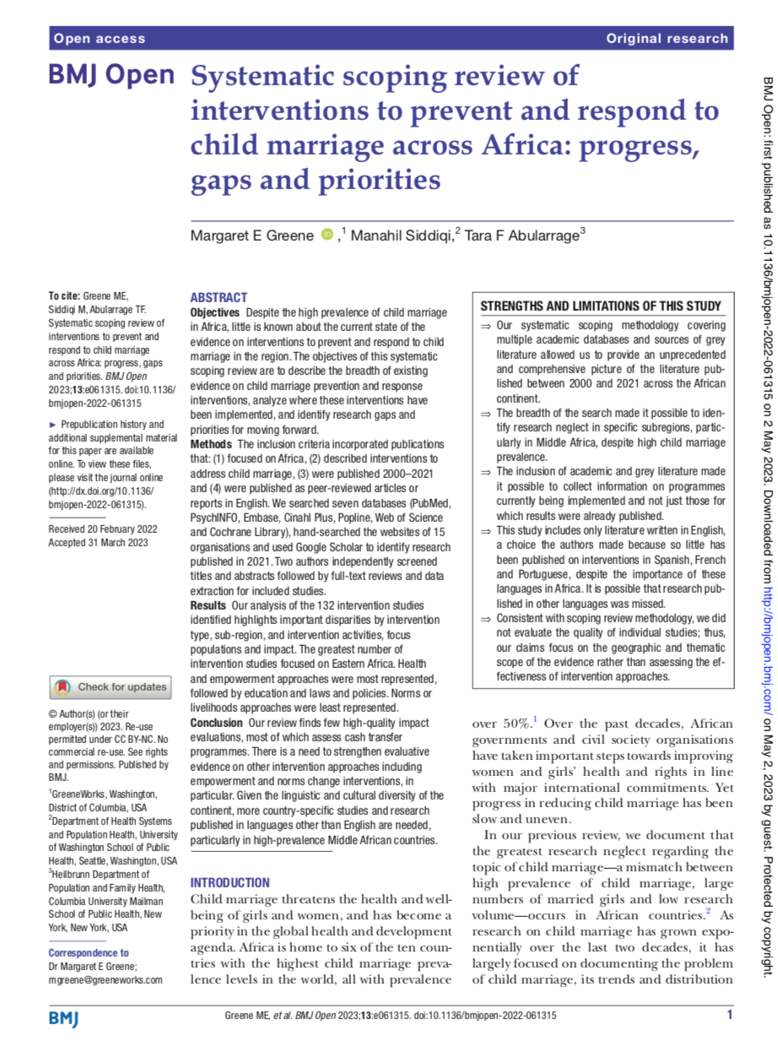
Headlines from Africa scoping review
132 intervention studies
Highly concentrated in Eastern Africa
Emphasis on laws and policies
Norms and livelihoods approaches least represented
Few high-quality impact evaluations, most of which assess cash transfer programmes

Slide 52
Gaps in distribution by country and intervention approach
Table 1. Child Marriage Intervention Approach by Sub-Region
Region (No. countries) | Laws & Policies | Education | Livelihoods | Health | Norms | Empowerment | Other | Total pubs (Avg pubs per country)
All Continental Africa (54) | 36 | 38 | 22 | 55 | 25 | 51 | 7 | 131 (2.43)
Northern Africa (7) | 6 | 5 | 1 | 4 | 2 | 8 | 3 | 14 (2.00)
Western Africa (17) | 12 | 8 | 4 | 14 | 11 | 13 | 4 | 40 (2.35)
Eastern Africa (18) | 24 | 33 | 21 | 40 | 16 | 34 | 3 | 90 (5.00)
Southern Africa (5) | 6 | 2 | 1 | 2 | 1 | 4 | 1 | 9 (1.80)
Middle Africa (8) | 5 | 2 | 0 | 5 | 1 | 3 | 1 | 10 (1.25)
Exceeds expected value by more than 1 |  |  |  |  | Reflects 2-3 below where expected
Within 1 (above or below) of expected value |  |  |  |  | More than 3 below expected
Notes:
Note: Based on the average number of publications in each approach per country on the African continent, expected values were calculated for the number of publications in each approach per sub-region. These expected values were compared to the actual number of publications found in order to highlight scarcities of interventions by approach in each sub-region.

Slide 53
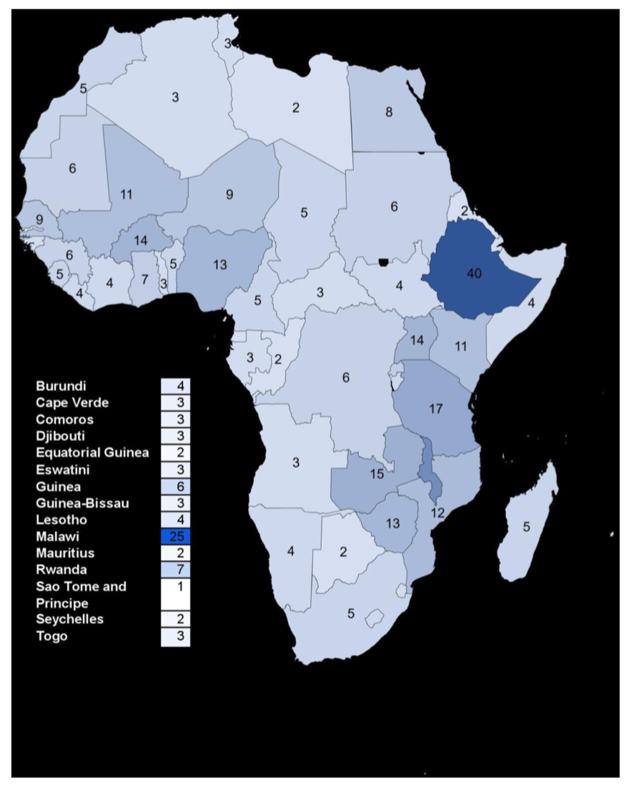
Total child marriage intervention publications by country, 2000-2021

Slide 54
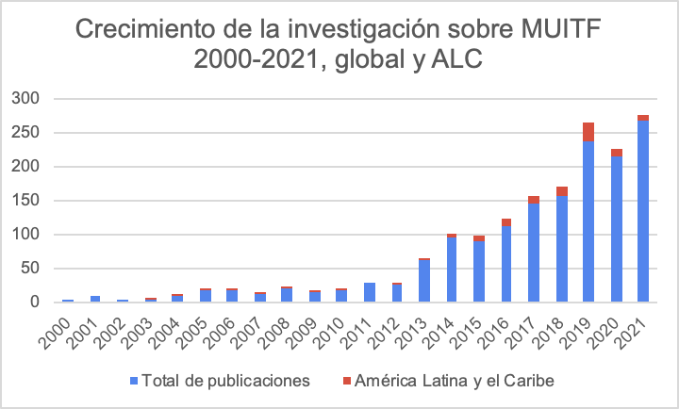
The evidence is expanding exponentially… but not in LAC
Growth in research on CEFMU 2000-2021, global and LAC
LAC
Notes:
La región es subrepresentada - solo 108 publicaciones en 21 años, pero según la proporcion de mujeres casadas o en uniones antes de 18 anos, en la region, deberiamos haber encontrado a 141. Subrepresentada por un factor de 77%. Brasil y Mexico 84%.

Slide 55
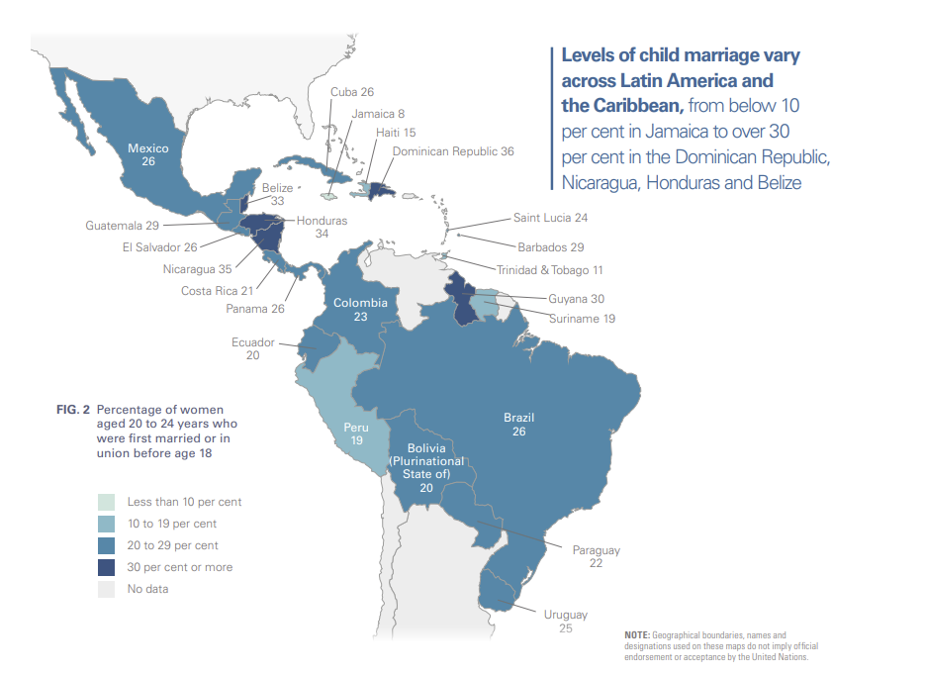
Notes:
Brazil 5to en el mundo 2,3 millones
Mexico 8vo en el mundo 1.4 millones
Fuente: UNICEF https://www.unicef.org/lac/media/8256/file/Profile%20of%20Child%20Marriage%20in%20LAC.pdf

Slide 56
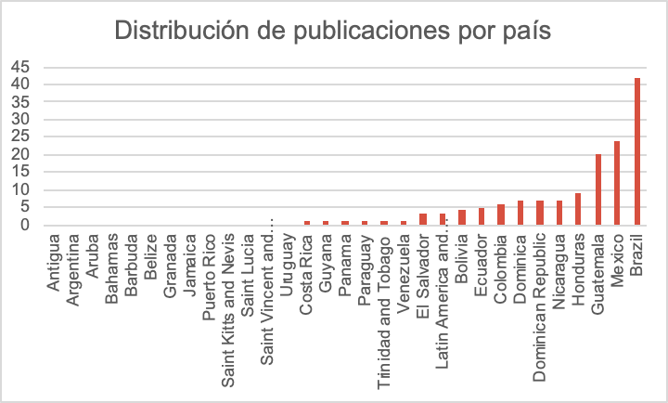
The evidence is very concentrated in certain countries and skips others completely
Distribution of publications by country
Notes:
13 studies in the region drop out when we exclude multi-country studies with more than 10 countries included
23/77 “missing”
This brings the LAC share of total publications from 121 to 108, or 8% to 7% of the total.
In 13 countries, nothing has been published - almost nothing in the english-speaking Caribbean

Slide 57
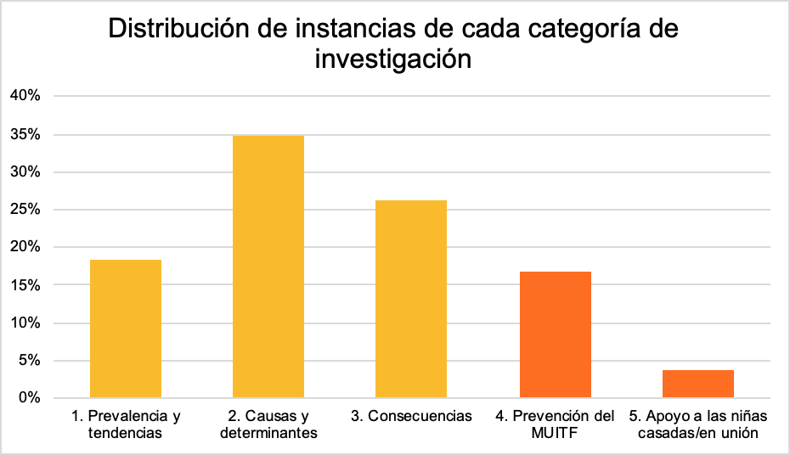
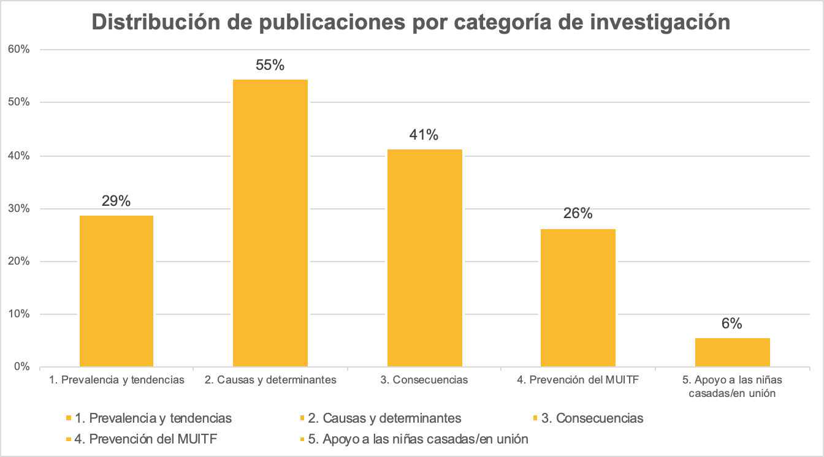
Evidence in the region is focused on documenting CEFMU and less on responding to it.
Distribution of incidence of each research category
79% = diagnoses
21% = solutions
Notes:
Reference how LAC makes up about 8-10% of the global total across all categories… except for efforts to serve the needs of married girls, where it makes up only 4% of the global total, 7 publications.

Slide 58
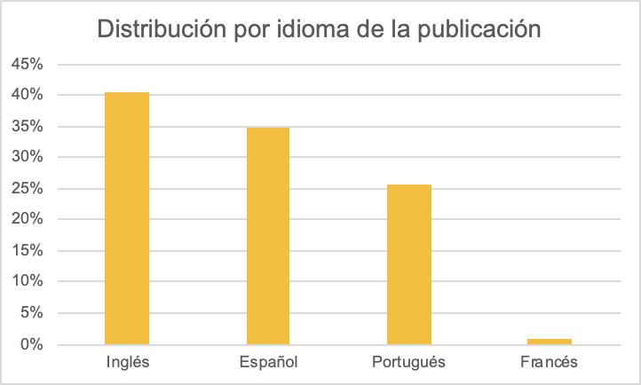
The high prevalence of publications in English shows that many studies are being conducted by researchers outside the LAC region.
Distribution by language of publication
Notes:
Con poca evidencia del Caribe, se ve que el interés en el asunto de MUITF es fuerte
Notice - many publications in English so done by people outside the region
Or: of the 60 publications on LAC, 35% were written by people based in other regions/global north

Slide 59
Bonus
material!
In some countries, CEFMU prevalence has not declined following enactment of laws
Enactment of laws can inadvertently lead to:
Fewer social protections for AGYW (and more informal unions)
AGYW being punished for their sexual and marital decisions
Conflation of age at marriage and age at sexual consent and barriers in accessing health services
Inaccessibility of the law to AGYW
Notes:
https://www.sexualityworkinggroup.org/resource/are-existing-laws-on-child%2C-early-and-forced-marriages-and-unions-working-for-adolescent-girls-and-young-women%3F

Slide 60
Key takeaways and research priorities
Geographical distribution of the research does not correspond with need, as measured by prevalence of child marriage.
Language of publications is often not that of high prevalence settings, reducing access to the research.
Program approaches in existing intervention research are narrow and don’t fully reflect the challenges we know girls face.
The quality of evaluation of norms-related and empowerment interventions is weak and inconsistent, a problem given the emphasis placed on these approaches.
Interventions involving the passage of laws are coming under scrutiny and also require careful evaluation of impact.

Slide 61
What do we know at the end of the year that we did not know at the start of the year?
What should the child marriage field do differently with this new knowledge ?

Slide 62
What could we do to make sure that decision makers at the global, regional and country level have access to this new information and can apply it in their work ?

Slide 63
What is the one area that we need to focus on, in terms of research in 2024-25 ?
What is the one area in which we do not need more research ?

Slide 64
As you reflect on the year that is coming to a close, what is the one thing that makes you happy and the one thing that makes you sad ?

