Slide 1
The Child Marriage Research to Action Network (The CRANK)
This session will have presentations in English. To access simultaneous interpretation, please click on the globe icon at the bottom bar of your screen and select your preferred language (English, Spanish, French, or no interpretation).
Esta sesión tendrá presentaciones en inglés. Para acceder a los servicios de interpretación simultanea, por favor haga clic en el icono del globo que encontrará en la barra inferior de su pantalla, y seleccione su idioma de preferencia (inglés, español, francés o version original).
Cette session comprendra des présentations en anglais. Pour accéder aux services d'interprétation simultanée, veuillez cliquer sur l'icône globe que vous trouverez dans la barre inférieure de votre écran, et sélectionnez votre langue préférée (anglais, espagnol, français ou version originale).
Notes:
Translations are available in English, French and Spanish – please chose the channel of your choice clicking on the globe icon at the bottom of the screen.
This session will be recorded and recordings will be shared along with key notes from the session in the follow up resources communication

Slide 2
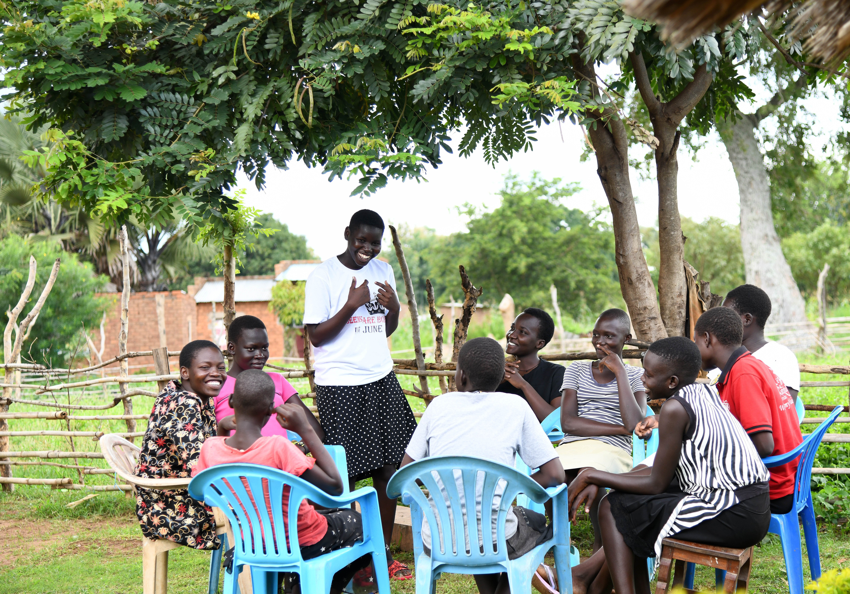
Child marriage prevention laws and their implications: Considering, context, challenges and opportunities
The Child Marriage Research to Action Network (The CRANK)
18 June 2024

Slide 3
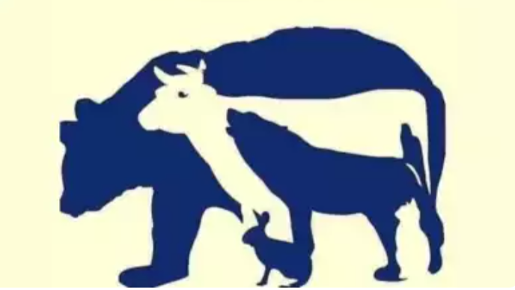

Slide 4
Agenda
Time (UK) | Discussion
14:00 - 14:05 | Welcome Opening welcome: Jose Roberto Luna, Lead on adolescent girls and ending child marriage, UNFPA-UNICEF Global Programme to End Child Marriage. Moderator: Sara Martínez.
14:05 - 14:10 | Setting the scene: Sara Martínez
14:10 – 14:35 | Learning from the latest evidence – implications for research, practice and policy: Sajeda Amin, Drawing on the global evidence review for WHO guidelines Kat Watson, Impact of minimum age (and sexual consent laws) on child marriage and girls’ rights
14:35 - 14:45 | Q&A and discussion – Sara Martínez
14:45 - 15:05 | Contextual considerations: strengthening practice and policy response: Sally Ncube, Equality Now; Challenges in implementation of Domestic Laws & SADC Model Law on Ending Child marriage Rachel Kidman, Stony Brook University; What policies matter in reducing child marriage?
15:05 - 15:25 | Q&A and discussion – Sara Martínez
15.25 – 15.35 | Research updates – Jean Casey: Evita Mouawad, RAF Coordinator; Introduction to the MENA RAF CRANK Team, CRANK research tracker – refresh!
15:35 - 15:40 | Bringing it all together– Sara Martínez
15.40 – 15.45 | Close – Jose Roberto Luna, UNFPA-UNICEF Global Programme to End Child Marriage

Slide 5
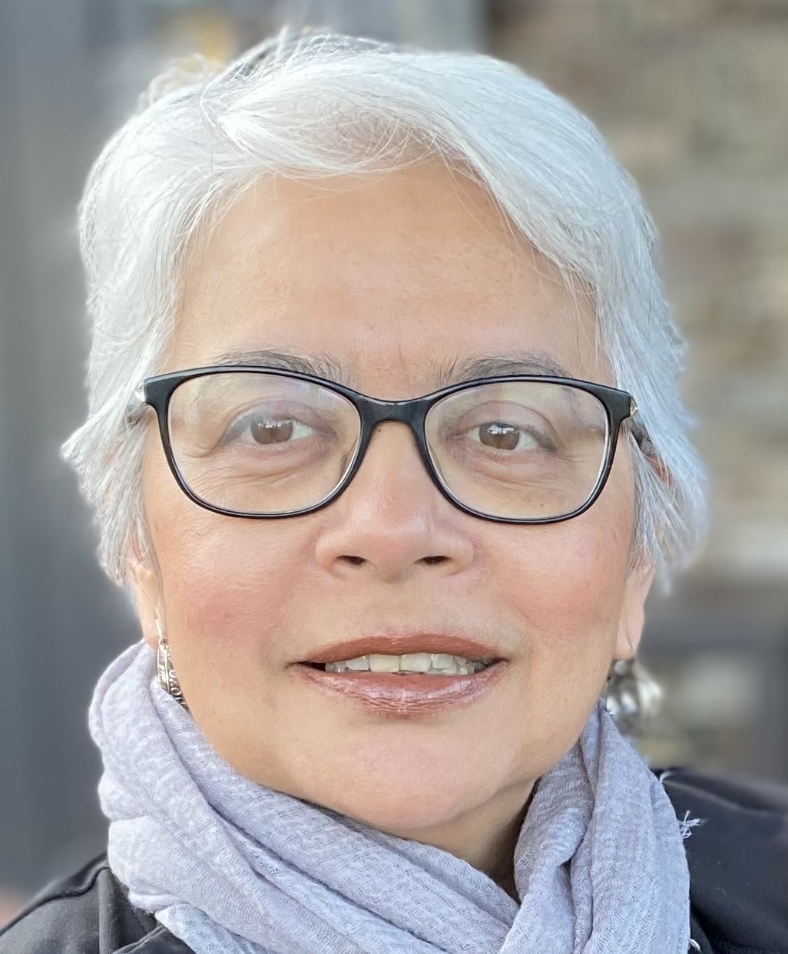
Speakers
Sajeda Amin formerly senior associate at the Population Council leading their work on livelihoods for adolescent girls and women where she is a Senior Associate and Girl Center affiliate. Her research focuses on learning about structures and processes that empower girls and women living in the most disadvantaged communities.
Katherine (Kat) Watson is a qualified lawyer and experienced mixed-methods researcher that has focused her career on the rights of adolescents. She has been a freelance consultant since 2014; before this, she worked for the Central Office of the International Planned Parenthood Federation for 6 years as part of the Gender, Youth and Rights team. She recently started her PhD journey at Leiden University studying the way that the law constructs adolescence and adolescent sexuality.

Slide 6
Formulating Guidelines on Minimum Age at Marriage Laws
Sajeda Amin
Independent Consultant
June 18th, 2024

Slide 7
RECOMMENDATIONS FROM THE 2011 GUIDELINES
Question 1.1
Is there evidence that efforts directed at political leaders/planners, including those leaders at the community level, have resulted in formulation of laws and policies to make marriage for girls before age 18 illegal?
Question 1.2
Is there evidence that efforts directed at political leaders/planners, including those leaders at the community level, are effective in enforcing laws prohibiting marriage for girls before age 18?
Recommendation for action
(in relation to Q 1.1 and 1.2) – Strong recommendation 1. Encourage political leaders, planners and community leaders to formulate and enforce laws and policies to prohibit the marriage of girls before 18 years of age.
Recommendation for research
Undertake research to identify effective interventions that result in the formulation, enforcement and monitoring of laws and policies, including unintended harmful consequences.

Slide 8
PICO QUESTION 8
Intervention (I) | Comparator (C) | Outcome (O) | Population (P)
Does the existence of child marriage prevention laws in line with those recommended by international treaty bodies, such as CRC and CEDAW | No existing laws on child marriage prevention Laws that are not in line with those recommended by international treaty bodies | Reduce child marriage Increase awareness and/or support for child marriage prevention laws | All girls²

Slide 9
STEP-BY-STEP METHODOLOGY
Develop search strategies to identify relevant articles
Review all papers from 5 previous relevant systematic reviews
Update list with more recent publications including additional observational studies for inclusion (8 on Child Marriage Laws)
Screen and review full text of relevant articles
excluding studies based on non-alignment with PICO questions,
concerns related to study design
concerns related to analysis methods;
Synthesize and GRADE the evidence

Slide 10
PICO 8: Included Studies (N=3)
Observational Study/ Natural Experiment (N=3)
Author(s), Year | Title | Country | Intervention
1. Batyra, Ewa; Pesando, Luca Maria, 2021 (N=10,803 women) | Trends in child marriage and new evidence on the selective impact of changes in age-at-marriage laws on early marriage | Benin, Bhutan, Kazakhstan, Mauritania, Nepal, Tajikistan | Observational/ Natural experiment (regression discontinuity design)
2.McGavock, Tamara, 2021 (N=15,683 women) | Here waits the bride? The effect of Ethiopia's child marriage law | Ethiopia | Observational/ Natural experiment (DID analysis)
3.Wilson, Nicholas, 2022 (N=250,000 women) | Child Marriage Bans and Female Schooling and Labor Market Outcomes: Evidence from Natural Experiments in 17 Low- and Middle-Income Countries | Albania, Benin, Dem. Republic of Congo, Egypt, Ethiopia, Guinea, Jordan, Kazakhstan, Liberia, Madagascar, Maldives, Namibia, Nepal, Nigeria, Peru, Sierra Leone, Togo | Observational/ Natural experiment

Slide 11
GRADE RESULTS
Study 1. No decline in CM 4 countries; decline in CM in 2 countries immediately following introduction of child marriage laws, but not in later cohorts;
minimum-age-at-marriage laws were not effective in curbing early marriage in Benin, Mauritania, Kazakhstan, and Bhutan
In Tajikistan and Nepal CM fell immediately after law change but did not sustain for later cohorts
Study 2 Significant reduction in child marriage following introduction of marriage age law, but only in younger subset of the population (marriage under age 16)
Marriages of girls under 16 delayed by about 17 percent (6.8 percentage points) following implementation of minimum age at marriage law in areas where early marriage was more common prior to the reform.
effect of the reform not statistically significant in ethnic groups highest child marriage.
Study 3. No impact of introduction of age at marriage laws on child marriage prevalence found in the overall sample, but significant declines in urban areas following the introduction of the law,
Impact highest in areas where the mean age at marriage is lot lower than the age limit specified in the new law,
Bans more effective in urban areas (likely because of stronger enforcement)

Slide 12
PICO 8: KEY FINDINGS
Evidence suggests that introduction/ change in child marriage laws do not consistently work to reduce child marriage and that where they do appear to work, statistically significant results hold only for a subset of the population
Evidence suggests that the introduction of age at marriage laws may initially lead to a decline in child marriage, but that this impact may not be sustained over time
Overall, the evidence was graded and assessed to be of low certainty.

Slide 13
PICO 8: EVIDENCE-TO-DECISION TABLE
Factor | Judgment
Certainty of evidence | Low
Balance of benefits vs. harms | Uncertain
Values and preferences | Benefits and harms too uncertain to determine sensitivity to preferences
Costs requirements/ effectiveness | Uncertain
Equity and human rights | Uncertain
Acceptability | Uncertain
Feasibility | Uncertain

Slide 14
On Child Marriage Laws…
Why is the evidence of low certainty?
Research on the law is difficult to conduct explaining the weak evidence base
Laws are not easy to manipulate and implement for experimentation
In most high child marriage settings there is a plurality of practices and associate laws (civil, religious, ethnic practices)
Religious laws and cultural practices are difficult to change and manipulate without resistance
Criminal sanctions can drive the practice underground
Changes in law may be difficult to implement
Communication about changes in laws complex and difficult to communicate

Slide 15
The Problem of communication…
Bangladesh: The Child Marriage Restraint Act of 2017 (CMRA 2017) Before 2017, the Child Marriage Restraint Act of 1929 modified in the 1980s set the legal minimum age of marriage at 18 for women and 21 for men. specified that taking part in or facilitating a child marriage was a punishable offense, but the punishment itself was relatively mild – imprisonment up to one month or a fine of 1000 taka (USD 12.50). The Child Marriage Restraint Act of 2017 instituted a more severe punishment of 2 years’ imprisonment, a fine of 1,000,000 taka (USD 1,250) or both for any adult who marries an under-aged person. The underage boy or girl also faces punishment of 1 month’s imprisonment, a fine of 50,000 taka (USD 625) or both. However, an “exception clause” was also introduced that enabled parents or guardians to marry off boys and girls before they reached the legal minimum age if a court rules that this is “in the best interest of the child,” with no age limit specified for the exception clause (Amirapu et al., 2020). Experimented with communicating these laws and found that the exception provision led people to conclude it was more acceptable to marry girls at younger ages and several other studies found that underage marriage registration declined.

Slide 16
What Next on Legal Approaches
Laws are necessary but not sufficient
Important to address Structural Drivers
For example, addressing alternatives such as work and education opportunities
Premarital sex and pregnancy as drivers of child marriage
Unintended Consequences
Need better communication: Bangladesh legal exception confusion
Do we need more/different laws?
Context matters (plurality of laws and practices)
Ability to implement laws
Child Marriage bans and informal unions

Slide 17
Speakers
Sajeda Amin formerly senior associate at the Population Council leading their work on livelihoods for adolescent girls and women where she is a Senior Associate and Girl Center affiliate. Her research focuses on learning about structures and processes that empower girls and women living in the most disadvantaged communities.
Katherine (Kat) Watson is a qualified lawyer and experienced mixed-methods researcher that has focused her career on the rights of adolescents. She has been a freelance consultant since 2014; before this, she worked for the Central Office of the International Planned Parenthood Federation for 6 years as part of the Gender, Youth and Rights team. She recently started her PhD journey at Leiden University studying the way that the law constructs adolescence and adolescent sexuality.

Slide 18
Recent evidence on the impact and implications of child marriage and sexual consent laws
A global synthesis
Presented by: Katherine (Kat) Watson

Slide 19
Primary research question
What are the impacts of child marriage and sexual consent laws on:
Child marriage prevalence
Girls’ rights & agency

Slide 20
Evidence of impact on CEFMU prevalence
Heavy emphasis on content of the law – alignment with HR law
Most studies do not measure the “before and after” effect of a new law/reform OR analyse how a law is implemented
Laws have had a limited impact on child marriage prevalence but have contributed to raising the age of marriage in some contexts
Laws have contributed to changing dynamics around marriage and union (e.g. Mexico, India)

Slide 21
Construction of adolescence in the law + concept of ‘evolving capacities’
“Adolescence” is a relatively new legal category that challenges the historical binary
International human rights concept of ‘evolving capacities’ rarely applied in formulation or interpretation of national law
Minimum age laws still dominant approach
Default to potectionist approaches
Judges can apply evolving capacities in their interpretations of individual cases
UK Gillick competency (1986)
India case law affording self-determination to girls

Slide 22
Understanding the impact of punitive approaches - criminalization, stigmatization
Criminalising adolescent sexuality and/or raising the age of sexual consent does not reflect reality of adolescents
(Self) stigmatization of adolescents; in El Salvador, study showed that people believe sexual consent laws exist to deter young people from being sexually active
Laws have been shown to restrict access to SRH information and services
Kenya: contradictions between the age of sexual consent and the right to access SRH services in health policy
Various: providers refuse to offer SRH services to adolescents for fear of legal repercussions

Slide 23
Understanding the impact of punitive approaches - lack of access to support, further rights violations
In Ethiopia, Malawi and Egypt – punitive legal approaches drive child marriage underground, where girls cannot access services, social support or justice
In Mexico – the criminal law could exacerbate existing marginalizations due to greater penalties when cases involve people of Indigenous or Afro-Mexican descent
Girls can face harassment or emotional abuse by law enforcement officials when they make a complaint
Legal enforcement often replaces efforts to enhance the welfare of girls and their communities

Slide 24
Who and what is protected by the law?
On the one hand, laws used to punish adolescents who express self-determination in relation to sex or marriage
In India and Nepal – parents are using the law to break up marriages or unions of which they disapprove, including where they are inter-caste
On the other hand, legal redress not accessible for girls who are in need of its protection
In India – the law is rarely used to support girls who have experienced forced marriage
Notes:
Add references here

Slide 25
Challenges within the legal system
Lack of anonymity in reporting cases of child marriage to the police
Uncertainty due to conflicting laws or discrepancies between formal and informal law
State birth and marriage registration systems are often under-resourced and staff are unprepared
Lack of awareness in communities about laws and policies
Girls cannot access legal systems without a legal adult
Financial barriers due to cost of legal representation

Slide 26
Implications

Slide 27
We need more research and greater understanding of what works for girls
1
What does this look like?
More research to understand the specificities of how laws impact the whole population, and girls in all their diversity → we need to ask them!
Legal advocacy informed by deep understandings of evolving capacities in each context and how/if this can be promoted in tandem with a minimum legal age approach
Understanding how (criminal) laws shape and respond to the prevalence of different types of marriage and unions and the interplay between marriage and sexual consent laws
Notes:
And adolescents’ realities, desires and rights

Slide 28
We need to make sure that the legal system works for those who need it
2
What does this look like?
Legal literacy campaigns for girls and their communities to increase awareness of the law and the rights and protections it offers for girls
Working with girls to understand their needs and advocating with them for changes to address them
Ensuring support services and legal aid are available to girls who have been forced into marriage
Notes:
Without the requirement for parental involvement

Slide 29
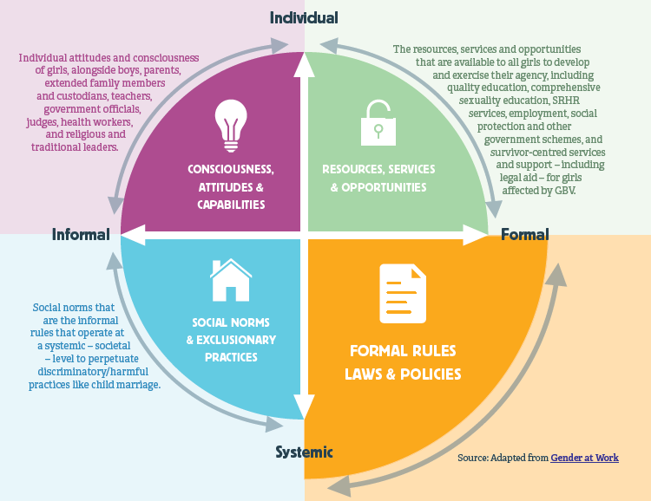
We need to understand the role of the law in the context of a more comprehensive approach to girls’ rights and agency
3

Slide 30
Discussion questions
How should adolescents' evolving capacities be integrated into international and national law on marriage and sexuality?
Is age a sufficient indicator of their capacity to make such decisions?
If not, then what could replace it in law?
How, if at all, should the criminal law be used in relation to marriage and sexuality during adolescence?

Slide 31
Speakers
Sally Ncube is the Southern Africa Regional Representative at Equality Now, working for the protection and promotion of the rights of women and girls worldwide. She cultivates partnerships at all levels and supports civil society movement-building for advocacy, including Equality Now’s SADC End Child marriage campaign.
Dr. Rachel Kidman is an Associate Professor at Stony Brook University and teaches in their Program in Public Health. She is a social epidemiologist with twenty years of research experience focused on vulnerable children and adolescents in sub-Saharan Africa. She currently leads NIH-funded projects focused on childhood adversity, gender-based violence, and HIV.

Slide 32
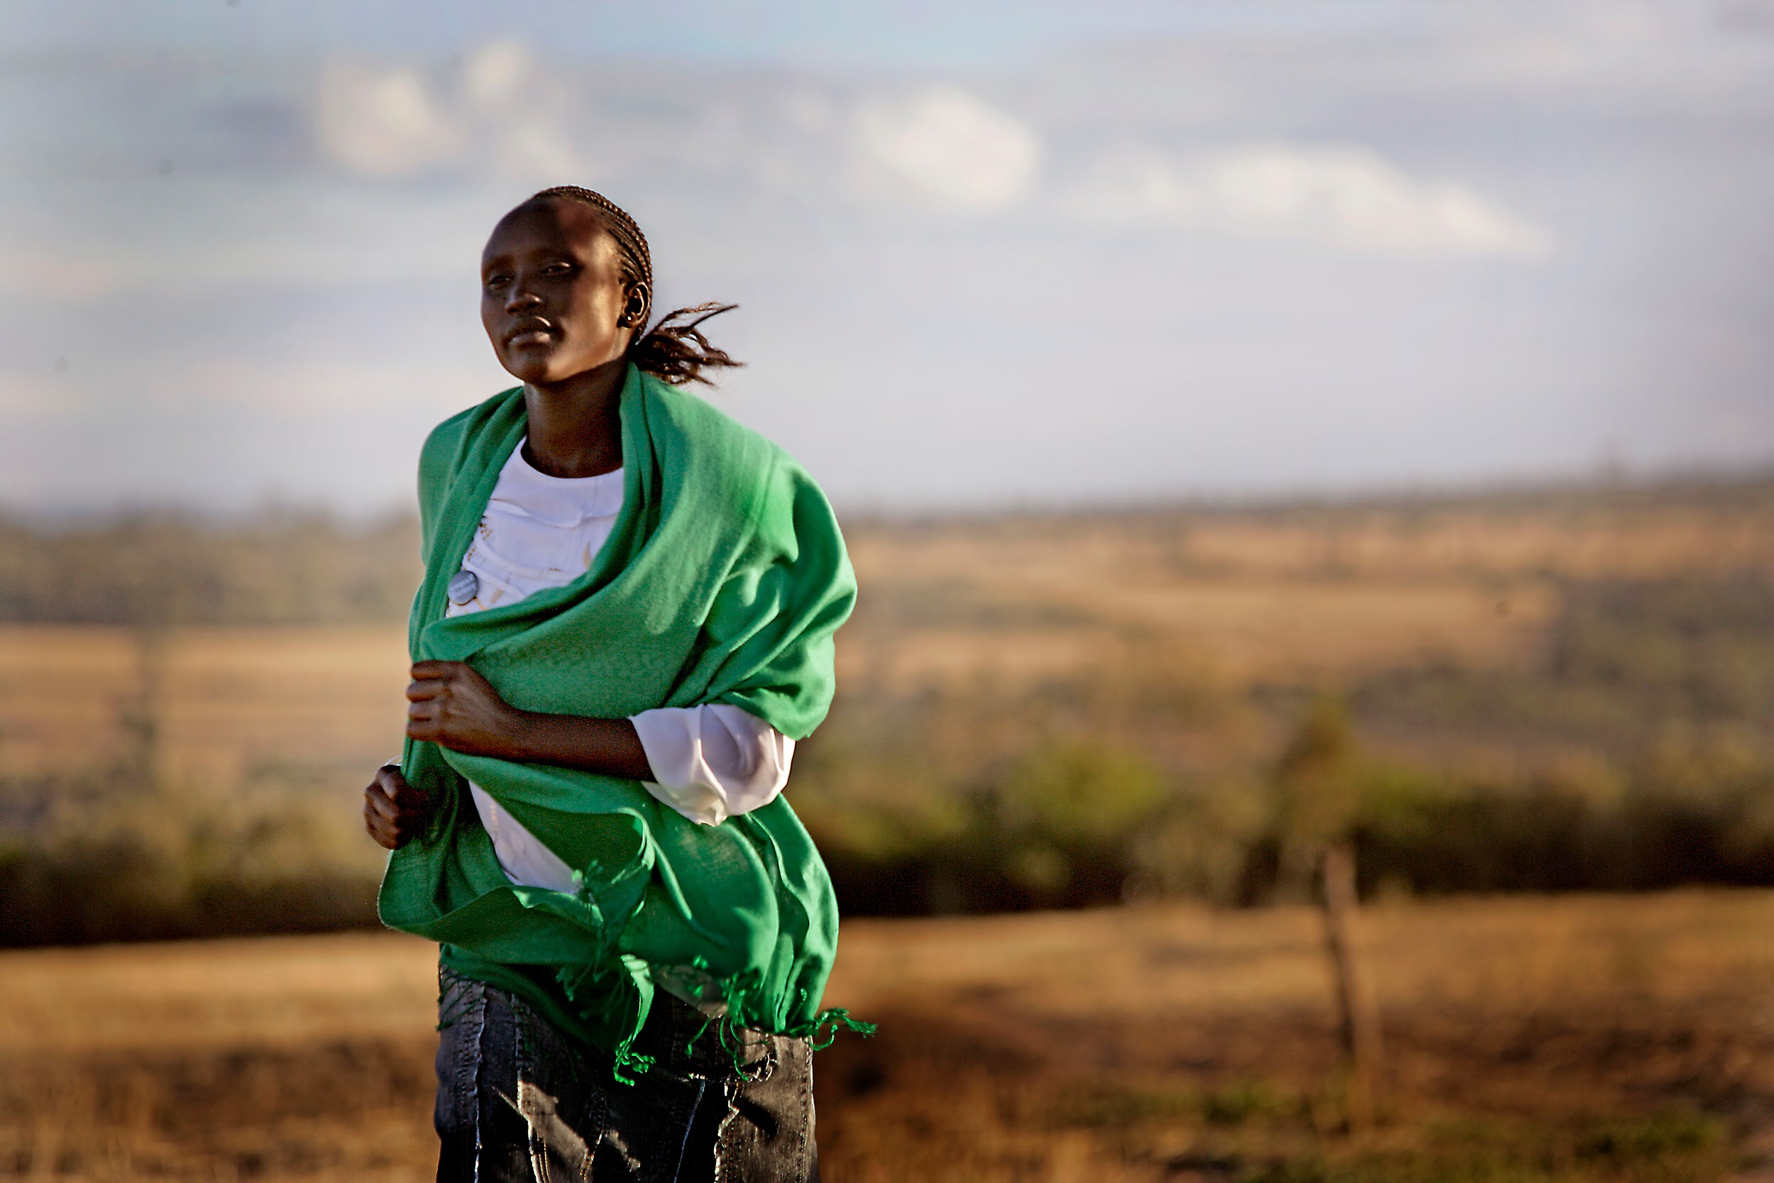
Ending Child Marriage in Eastern & Southern Africa
Challenges in implementation of Domestic Laws & SADC Model Law on Ending Child marriage,Best practices & Recommendations

Slide 33
Introduction
The Eastern and Southern African region has some of the highest rates of child marriage in the world, with an estimated 31% of young women and children being married before the age of 18.
Equality Now, in partnership with UNFPA, implemented a Regional and National Advocacy campaign to Accelerate Ending Child Marriage in Eastern and Southern Africa and have governments in East and Southern Africa fulfil their obligations to eliminate child marriage, including through domestication and implementation of the International human rights law, SADC Model Law on Child Marriage and implementation of their national laws.
As part of the campaign, Equality Now, UNFPA, and the SADC Parliamentary Forum developed policy briefs on Challenges in Implementing Domestic Laws and the SADC Model Law on Child Marriage, which highlighted the challenges in implementation, best practices, and recommendations to improve implementation, with a specific focus on Zambia, Uganda, and Malawi and Ending Child Marriages in Eastern and Southern Africa: A Multi-Sectoral Approach which define the multi-sectoral approach in the context of child marriage, highlights best practices and provides recommendations on making the approach more effective.
While the SADC Model Law on Ending CM is primarily applicable to countries in the SADC region, many East African countries have also incorporated international and regional human rights standards in their legislative frameworks to work towards ending child marriages.
This presentation focuses on the implementation of the Model Law in the SADC region by assessing Malawi and Zambia, as well as the implementation of laws on child marriage in East Africa using Uganda as a case studies highlightging the challenges in implementation, best practices and recommendations on how implementation can be improved within the East and Southern Africa region.

Slide 34
SADC Model Law on Ending Child marriage
The SADC Model Law on Eradicating Child Marriage objective is to provide model provisions to assist Member States enact laws on the eradication of child marriage,protection of children already in marriage, and domesticate international and regional human rights instruments dealing with, or impacting on, child marriage.
SADC Model Law is comprehensive legislation that goes beyond only prescribing the minimum age of marriage.SADC Model Law on Child Marriage is a good example of a comprehensive legislation. In addition to prescribing 18 as the minimum age of marriage and prohibiting child marriage and child betrothals, the Model Law
contains provisions regarding the need for equal distribution of property and inheritance for children leaving marriages
highlights the need for appropriate custody, access and maintenance provisions to protect children who are parents themselves
Includes a host of prevention measures, such as need for SRHR education, advocacy and awareness, supporting girls and their families economically to address root causes of poverty and the like
Section on mitigation measures to protect children already in marriage

Slide 41
Multisectoral Approach & Pillars
The underpinning principle of a multisectoral approach is an intentional, coordinated collaboration between relevant partners and sectors to plan and deliver commitments to women’s rights. It demonstrates a unified national commitment and ensures that all relevant expertise is utilized in a coordinated manner, without duplication or working in silos. Some of the relevant stakeholders in a multisectoral approach to eliminate women’s rights violations include government ministries, international agencies, donors, civil society organizations, religious institutions, community leaders and gatekeepers. Below is an outline of Pillars of MSA:
Pillar 1: Child Marriage as a national priority .
Pillar 2: Defining the organ and department of the government’s responsibility and role in the elimination of child marriage e.g. education, finance, health, justice, social welfare etc.
Pillar 3: Ensuring a coordinated response amongst the government sectors, departments, and organs in a coherent strategy with a clear allocation of resources. The convenor of the multisectoral plan must have the requisite gender and human rights expertise and enough power within the government.
Pillar 4: Drawing together state and non-state actors in coordinated partnerships and consolidated expertise Relevant stakeholders in the fight against child marriage include civil society organizations (CSOs), development partners, faith-based/religious organizations, and donors.
Pillar 5 - Consolidating State and non state Technical Expertise To ensure that the maximum output is achieved in tackling child marriages,

Slide 42
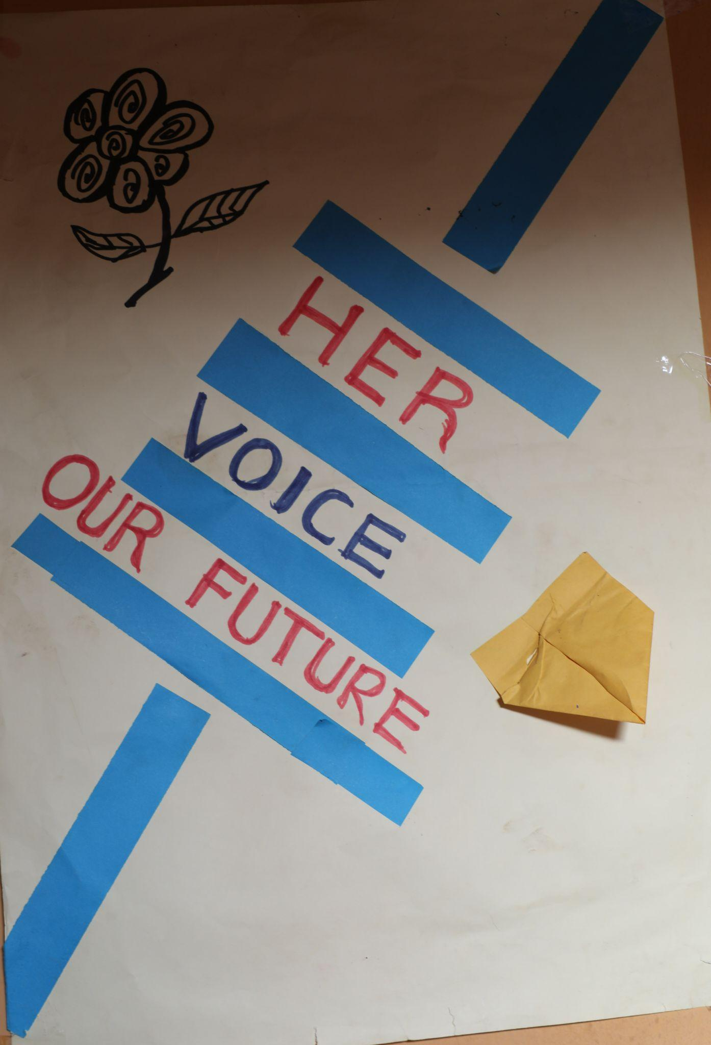
Challenges
While best practices on multisectoral programming to end child marriage have been highlighted, there are still some challenges in getting the programs to work efficiently since the rate of child marriage in the sub-regions has yet to drop to acceptable levels. Some of the challenges include:
Funding challenges
De-prioritization of child marriage
Lack of political will and capacity to implement the multi-sectoral approach
Poverty and natural disasters:
Inadequate implementation, monitoring, and learning
Community resistance

Slide 43
Recommendations for Parliamentarians
Parliament should prioritize ensuring that laws on child marriage are in line with international and regional human rights obligations, including those in the African Charter on the Rights and Welfare of the Child (ACRWC), the Protocol to the African Charter on Human and Peoples’ Rights on the Rights of Women in Africa (Maputo Protocol), and the SADC Model Law on Child Marriage.
Laws relating to child marriage, including statutory, religious, and customary laws, need to be harmonized to remove ambiguities and conflicting provisions.
Parliament should increase its knowledge base by engaging with experts in the field of child marriage (including some members of CSOs) so that they can competently carry out their oversight role over government actions to end child marriage.
Parliamentarians should make full use of their monitoring and oversight roles to monitor the effective implementation and enforcement of laws and policies to end child marriage.
Parliaments should consider creating permanent sub-committees on child marriage (or on harmful practices, sexual and reproductive rights, and health or gender-based violence). These could be offshoots of the gender committee with a small group focused on ending child marriages. This could assist in keeping child marriages on the agenda of parliament and increasing the political will of parliament and the government

Slide 44
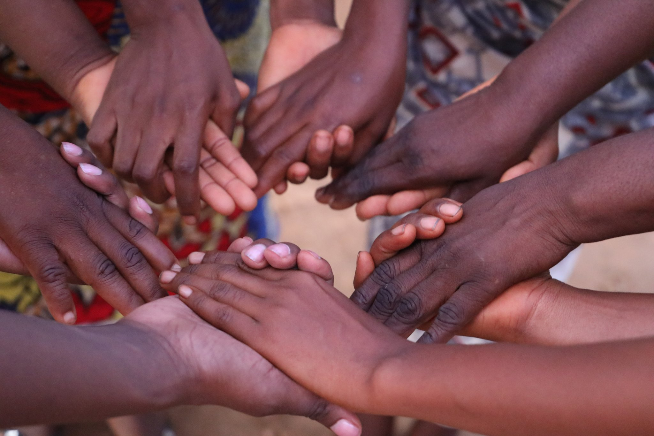
Recommendations for CSOs
CSOs should strengthen local and regional coordination amongst themselves, as well as map and identify the strengths of different CSOs that may specialize in specific aspects, to prevent duplication of work and siloed working. Existing networks to address child marriage need to be transparent and accountable to increase trust in the network. The functioning of these networks will be enhanced by monitoring and evaluation; and the creation of a database of resources and documentation to promote best practices and knowledge sharing.
The work plans of CSOs and other stakeholders towards addressing child marriage align with national action plans to end child marriage.
Young people and survivors should be meaningfully engaged in advocacy and programming by both parliament and CSOs to design programs that best serve their interests.
CSOs should prioritize advocacy to promote the domestication of international and regional human rights instruments and to promote effective enforcement and implementation of laws and policies on child marriage

Slide 46
Speakers
Sally Ncube is the Southern Africa Regional Representative at Equality Now, working for the protection and promotion of the rights of women and girls worldwide. She cultivates partnerships at all levels and supports civil society movement-building for advocacy, including Equality Now’s SADC End Child marriage campaign.
Dr. Rachel Kidman is an Associate Professor at Stony Brook University and teaches in their Program in Public Health. She is a social epidemiologist with twenty years of research experience focused on vulnerable children and adolescents in sub-Saharan Africa. She currently leads NIH-funded projects focused on childhood adversity, gender-based violence, and HIV.

Slide 47
Exploring policy synergies: Do we need both protective marriage & education policies to impact child marriage?
Rachel Kidman, Stony Brook University
Research conducted with Amy Raub, Alfredo Martin, Pragya Bhuwania,
Bijetri Bose, & Jody Heymann, Work Policy Analysis Center, UCLA
This work was supported by the Hilton Foundation (grant 26870).

Slide 48
Child Marriage Laws + Education
Existing evidence is mixed for whether child marriage laws work¹, but growing evidence on role of education in delaying marriage.²
Minimum age
at marriage
Tuition-free
secondary education
1- McGavock, 2021; Garcia-Hombrados, 2022; Bellés-Obrero & Lombardi, 2023; Maswikwa et al., 2015; Wilson, 2022; Batyra & Pesando, 2021; Collin & Talbot, 2023.
2- Bhuwania et al, 2023.

Slide 49
Research Question
Does a combination policy approach (free secondary and minimum marriage age laws) reduce child marriage & early childbearing MORE than each policy individually?

Slide 50
Conducting a rigorous natural experiment
Policy data from WORLD Policy Analysis Center
Legal minimum age of marriage for girls from 1995 to 2019
Year that tuition was abolished for lower secondary school from 1990 to 2019

Slide 51
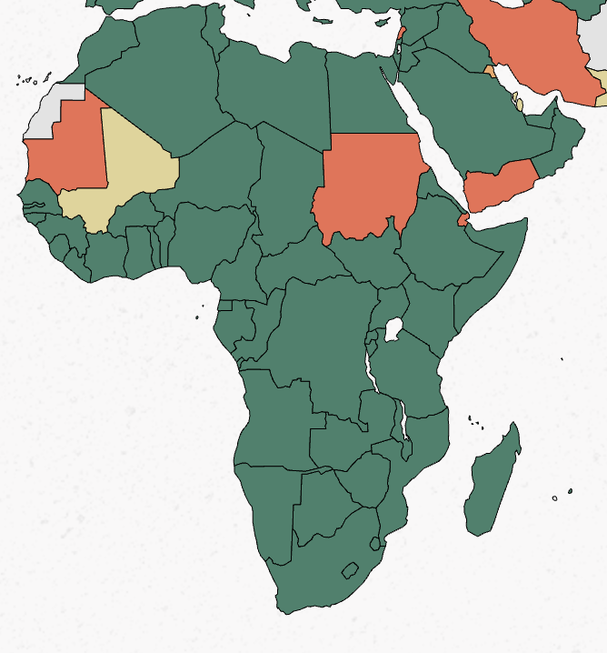
What is the minimum age of marriage for girls?
Source: WORLD Policy Analyses Center; https://www.worldpolicycenter.org/

Slide 52
What is the minimum age of marriage for girls with parental consent?
Source: WORLD Policy Analyses Center; https://www.worldpolicycenter.org/

Slide 53
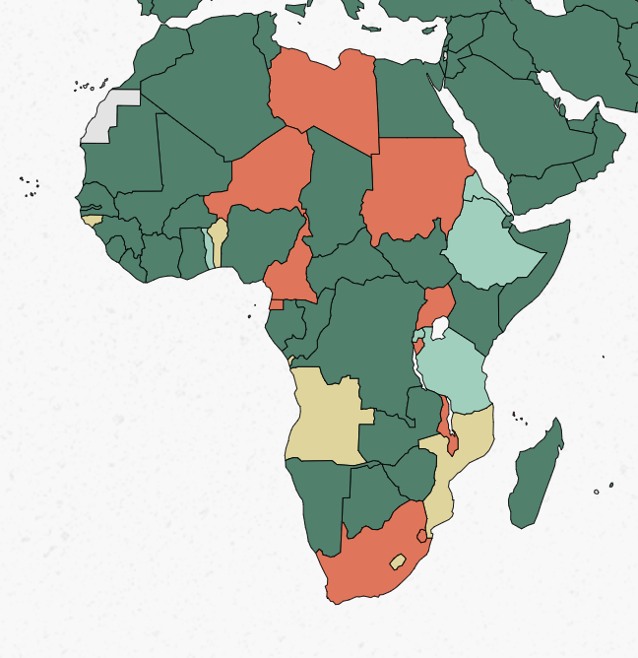
Is beginning secondary school free?
Source: WORLD Policy Analyses Center; https://www.worldpolicycenter.org/

Slide 54
Conducting a rigorous natural experiment
Policy data from WORLD Policy Analysis Center
Legal minimum age of marriage for girls from 1995 to 2019
Year that tuition was abolished for lower secondary school from 1990 to 2019
Harmonized DHS from 2003-2021 from 16 countries in sub-Saharan Africa, including 238,665 women aged 15 to 26 years old
Individual-level outcomes on large global populations
Surveys allow for studies in change over time
Two-way fixed effects (TWFE) models to evaluate the relationship between policy change and child marriage among women aged 15-26

Slide 55
What are the impacts of introducing protective policies?
Neither policy alone had a significant impact.
Introducing both protective child marriage laws and tuition-free lower secondary education
Reduced the odds of early marriage
55% reduction before age 15
Reduced the odds of early fertility
37% reduction before age 15
Impacts were smaller but still significant at age 18.
Source: Kidman, R., Raub, A, Martin, A, Bhuwania, P, Bose, B, Heymann, J. Reducing child marriage in sub-Saharan Africa: evaluating the joint potential of protective marriage and education policies. Under Review.

Slide 56
Final Thoughts
This study can only show the impact of having a policy on the books; we don’t measure how well it has been implemented
It is possible that the potential of child marriage policies can only be realized when girls are given a viable alternative such as access to secondary education
What is the broader suite of social policies that are necessary to have a meaningful impact on child marriage?

Slide 57
EVITA MOUAWAD – RAF coordinator
Regional Action Forum (RAF) to End Child Marriage - Middle East & North Africa and Arab States coordination platform.
CRANK TEAM
CRANK research tracker – refresh!

Slide 58
Regional Action Forum to End Child Marriage
In Arab States/MENA
(RAF)

Slide 59
About the RAF
Founded as a result of the 2017 multi-country study on child marriage (CM) in MENA
Co-chaired by UNICEF MENARO and UNFPA ASRO
Includes more than 40 UN agency, INGO, NGO, CSOs and WROs and Academic members committed to ending CM in the region

Slide 60
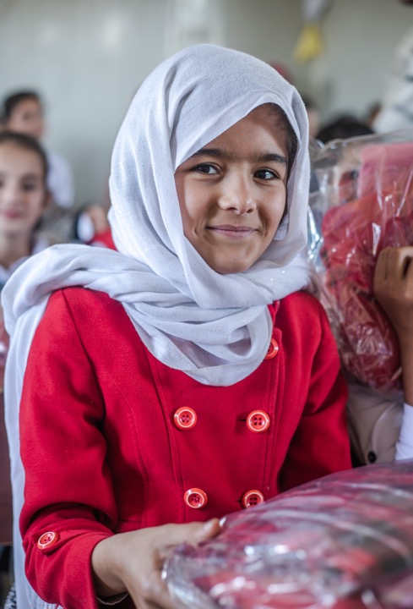
Progress since 2018
During its first phase (2018-2021), the RAF succeeded to bring together different organizations in the region and globally with a common agenda to address child marriage.
Building on this momentum, RAF continued its journey into the second phase from 2022-2024 (RAF 2.0) – with specific attention to increase participation of CSOs and WROs.
Our priority is to respond to emerging issues linked to social and economic crises, protracted conflict and instabilities in the region, and their impact on child marriage through a number of relevant coordination, research and advocacy initiatives.

Slide 61
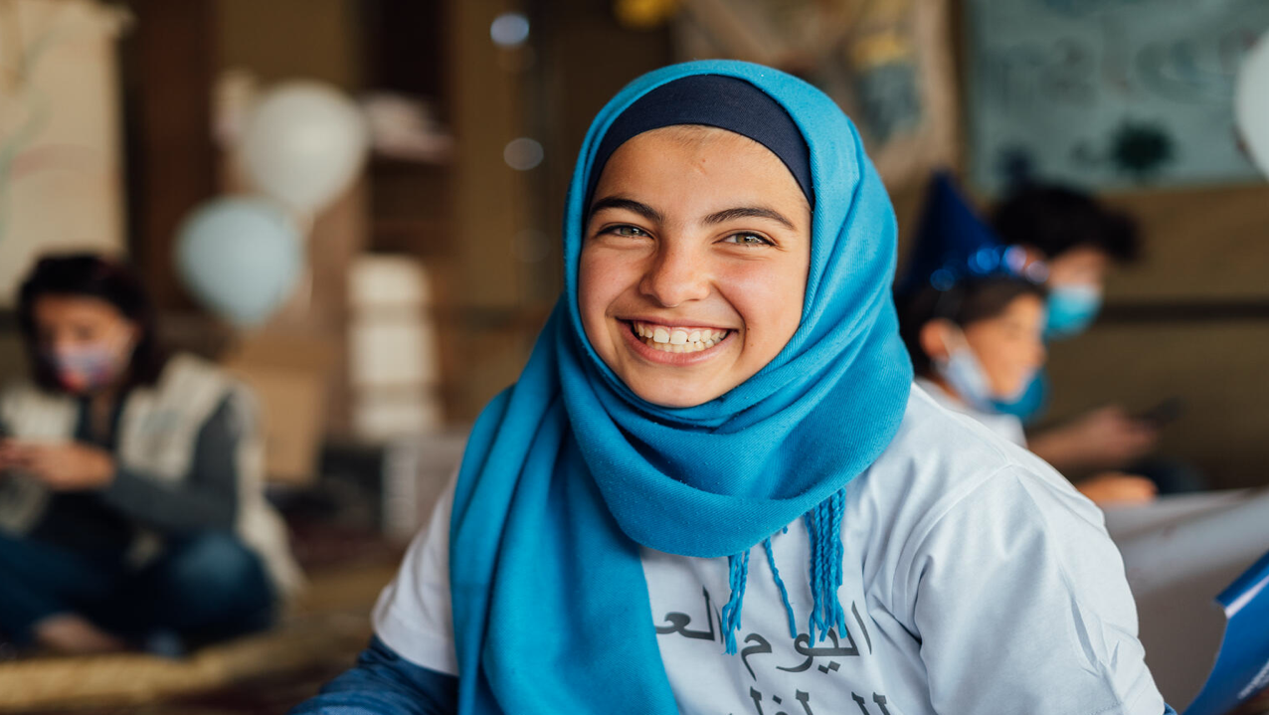
RAF activities include:
Thematic webinars: - Cash assistance for CM prevention - CM prevention in conflict and crisis
Joint advocacy events: - IDGC - Arab Girls Summit
Research initiatives: - Desk review on impact of CM on girls living with disabilities in MENA - CM Costing study with ESCWA
Close coordination with key members and coordination mechanism working on CM: - Girls Not Brides / CRANK - Website plans
RAF is a platform that brings together actors working on CM prevention
to share knowledge and best practices
while advocating for lasting change for women and girls in the MENA region.

Slide 62
Email: emouawad@unicef.org if interested to become a member!

